Slide 1
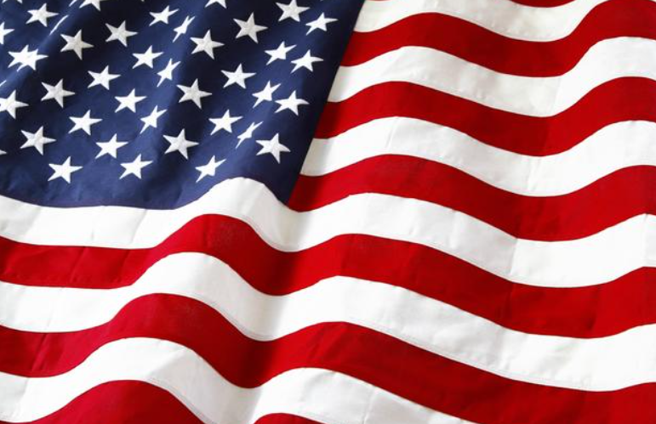



Veterans Day
2020

Slide 2
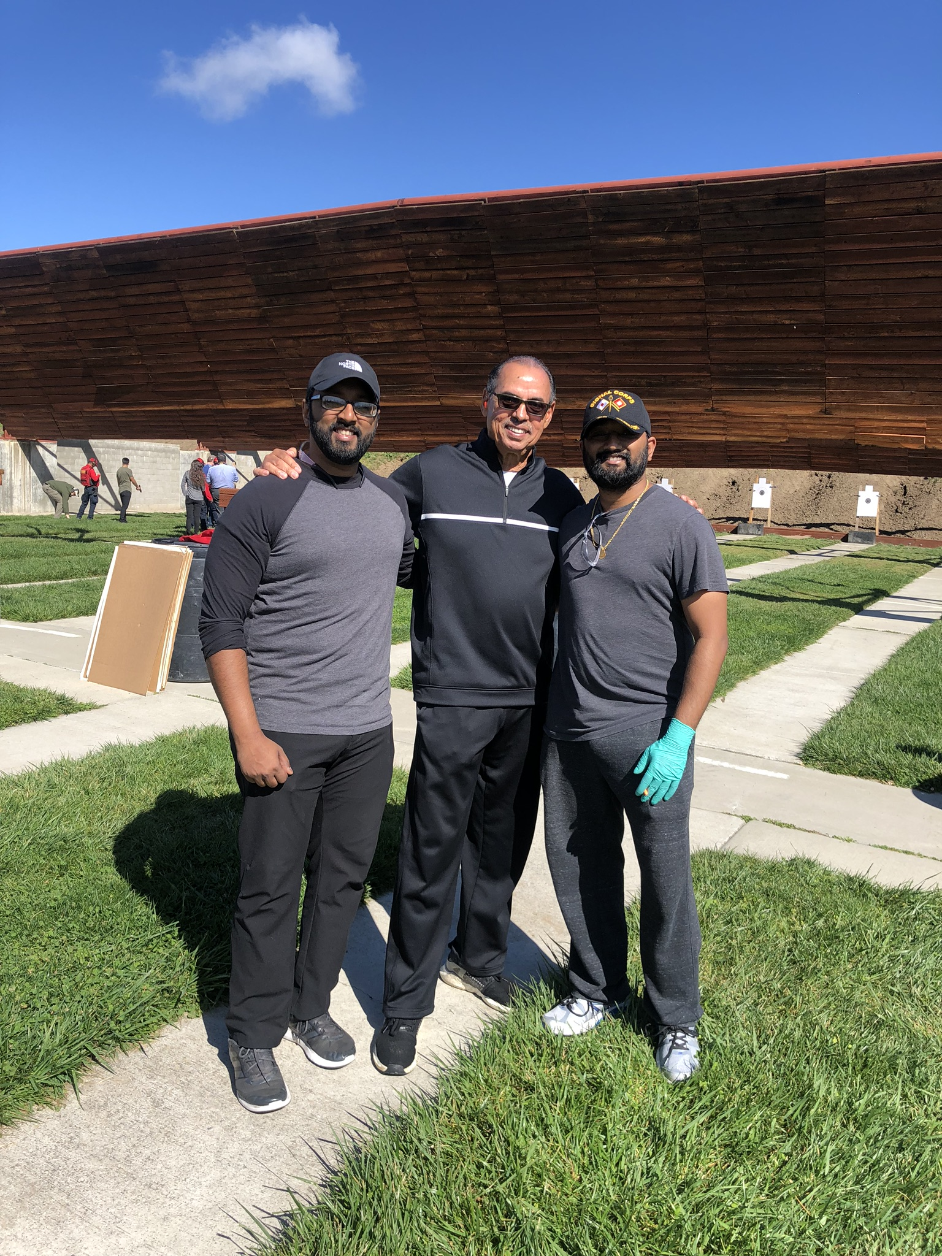

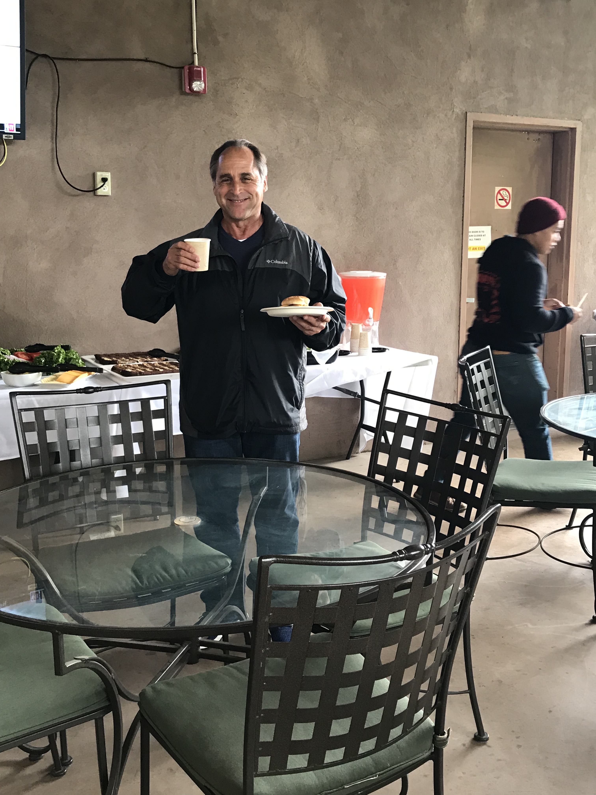
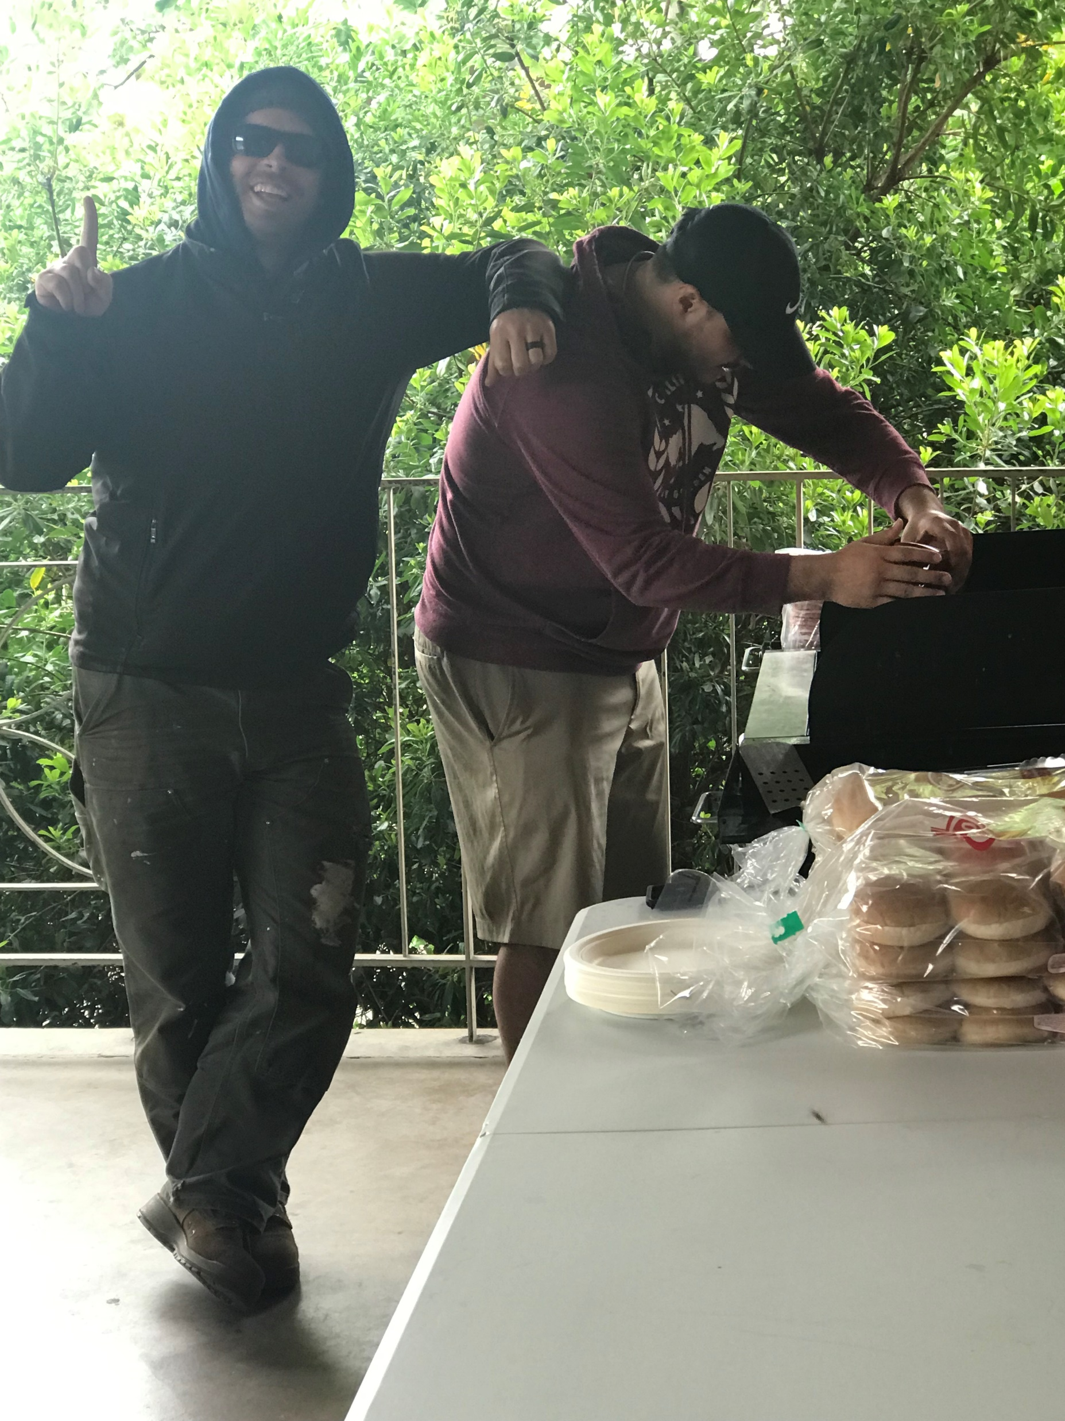
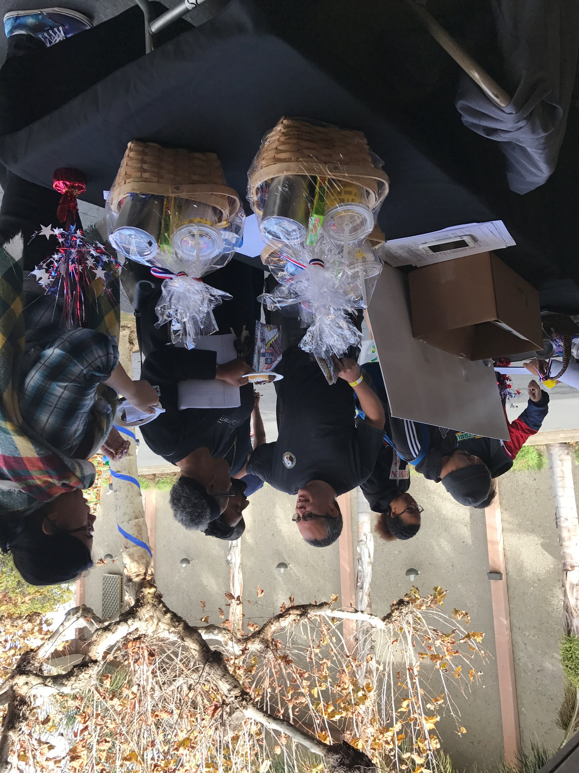
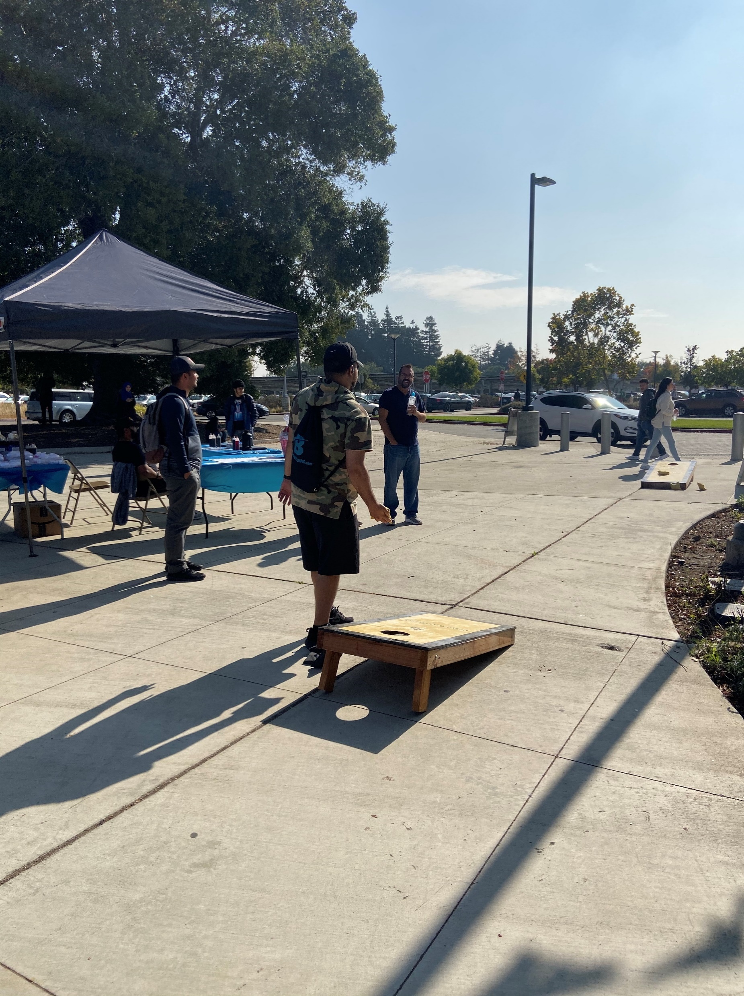
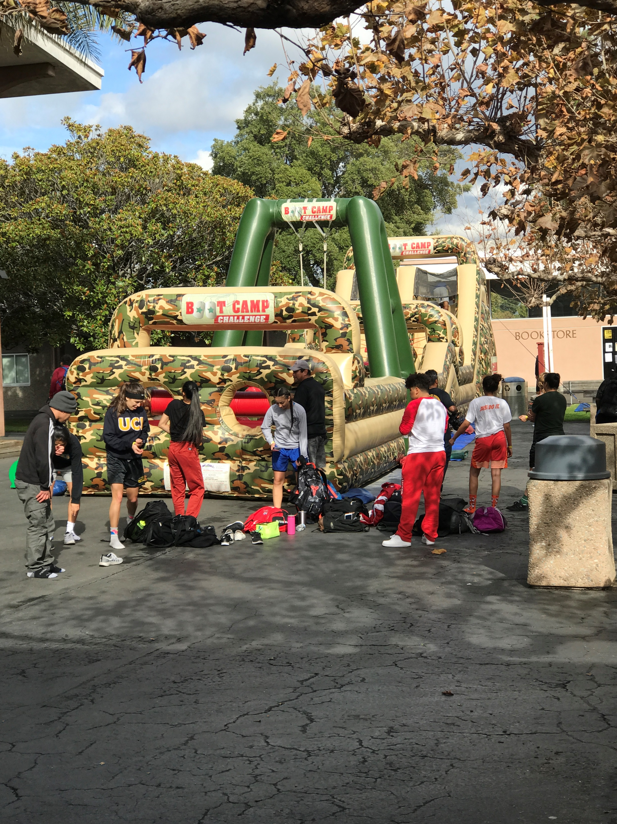
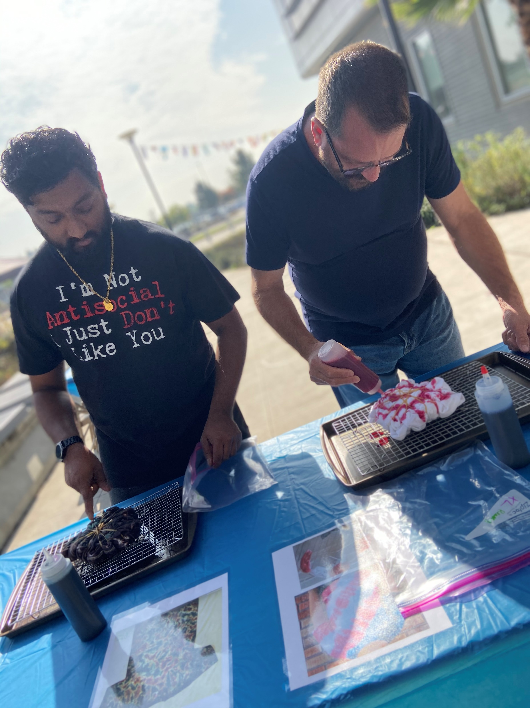
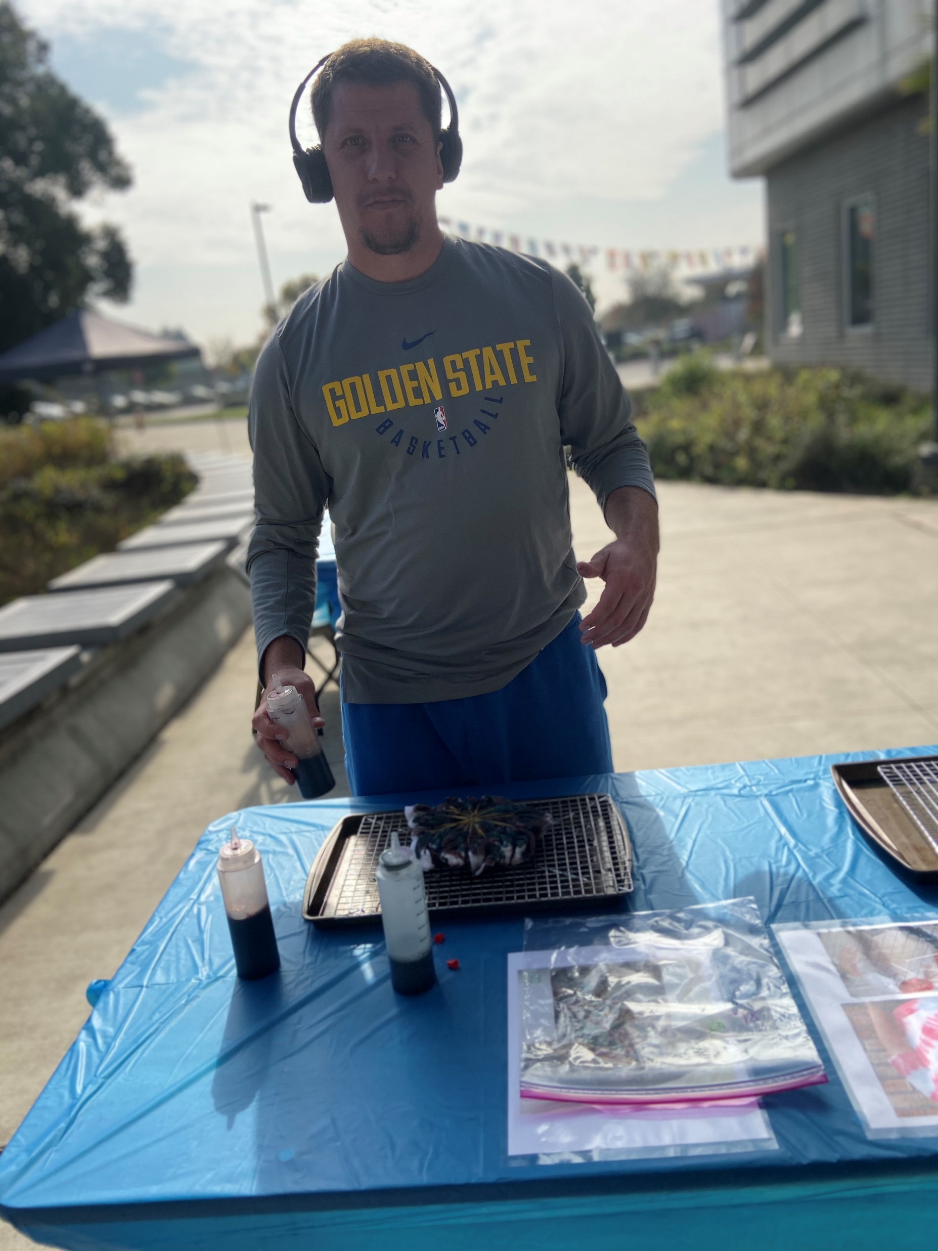
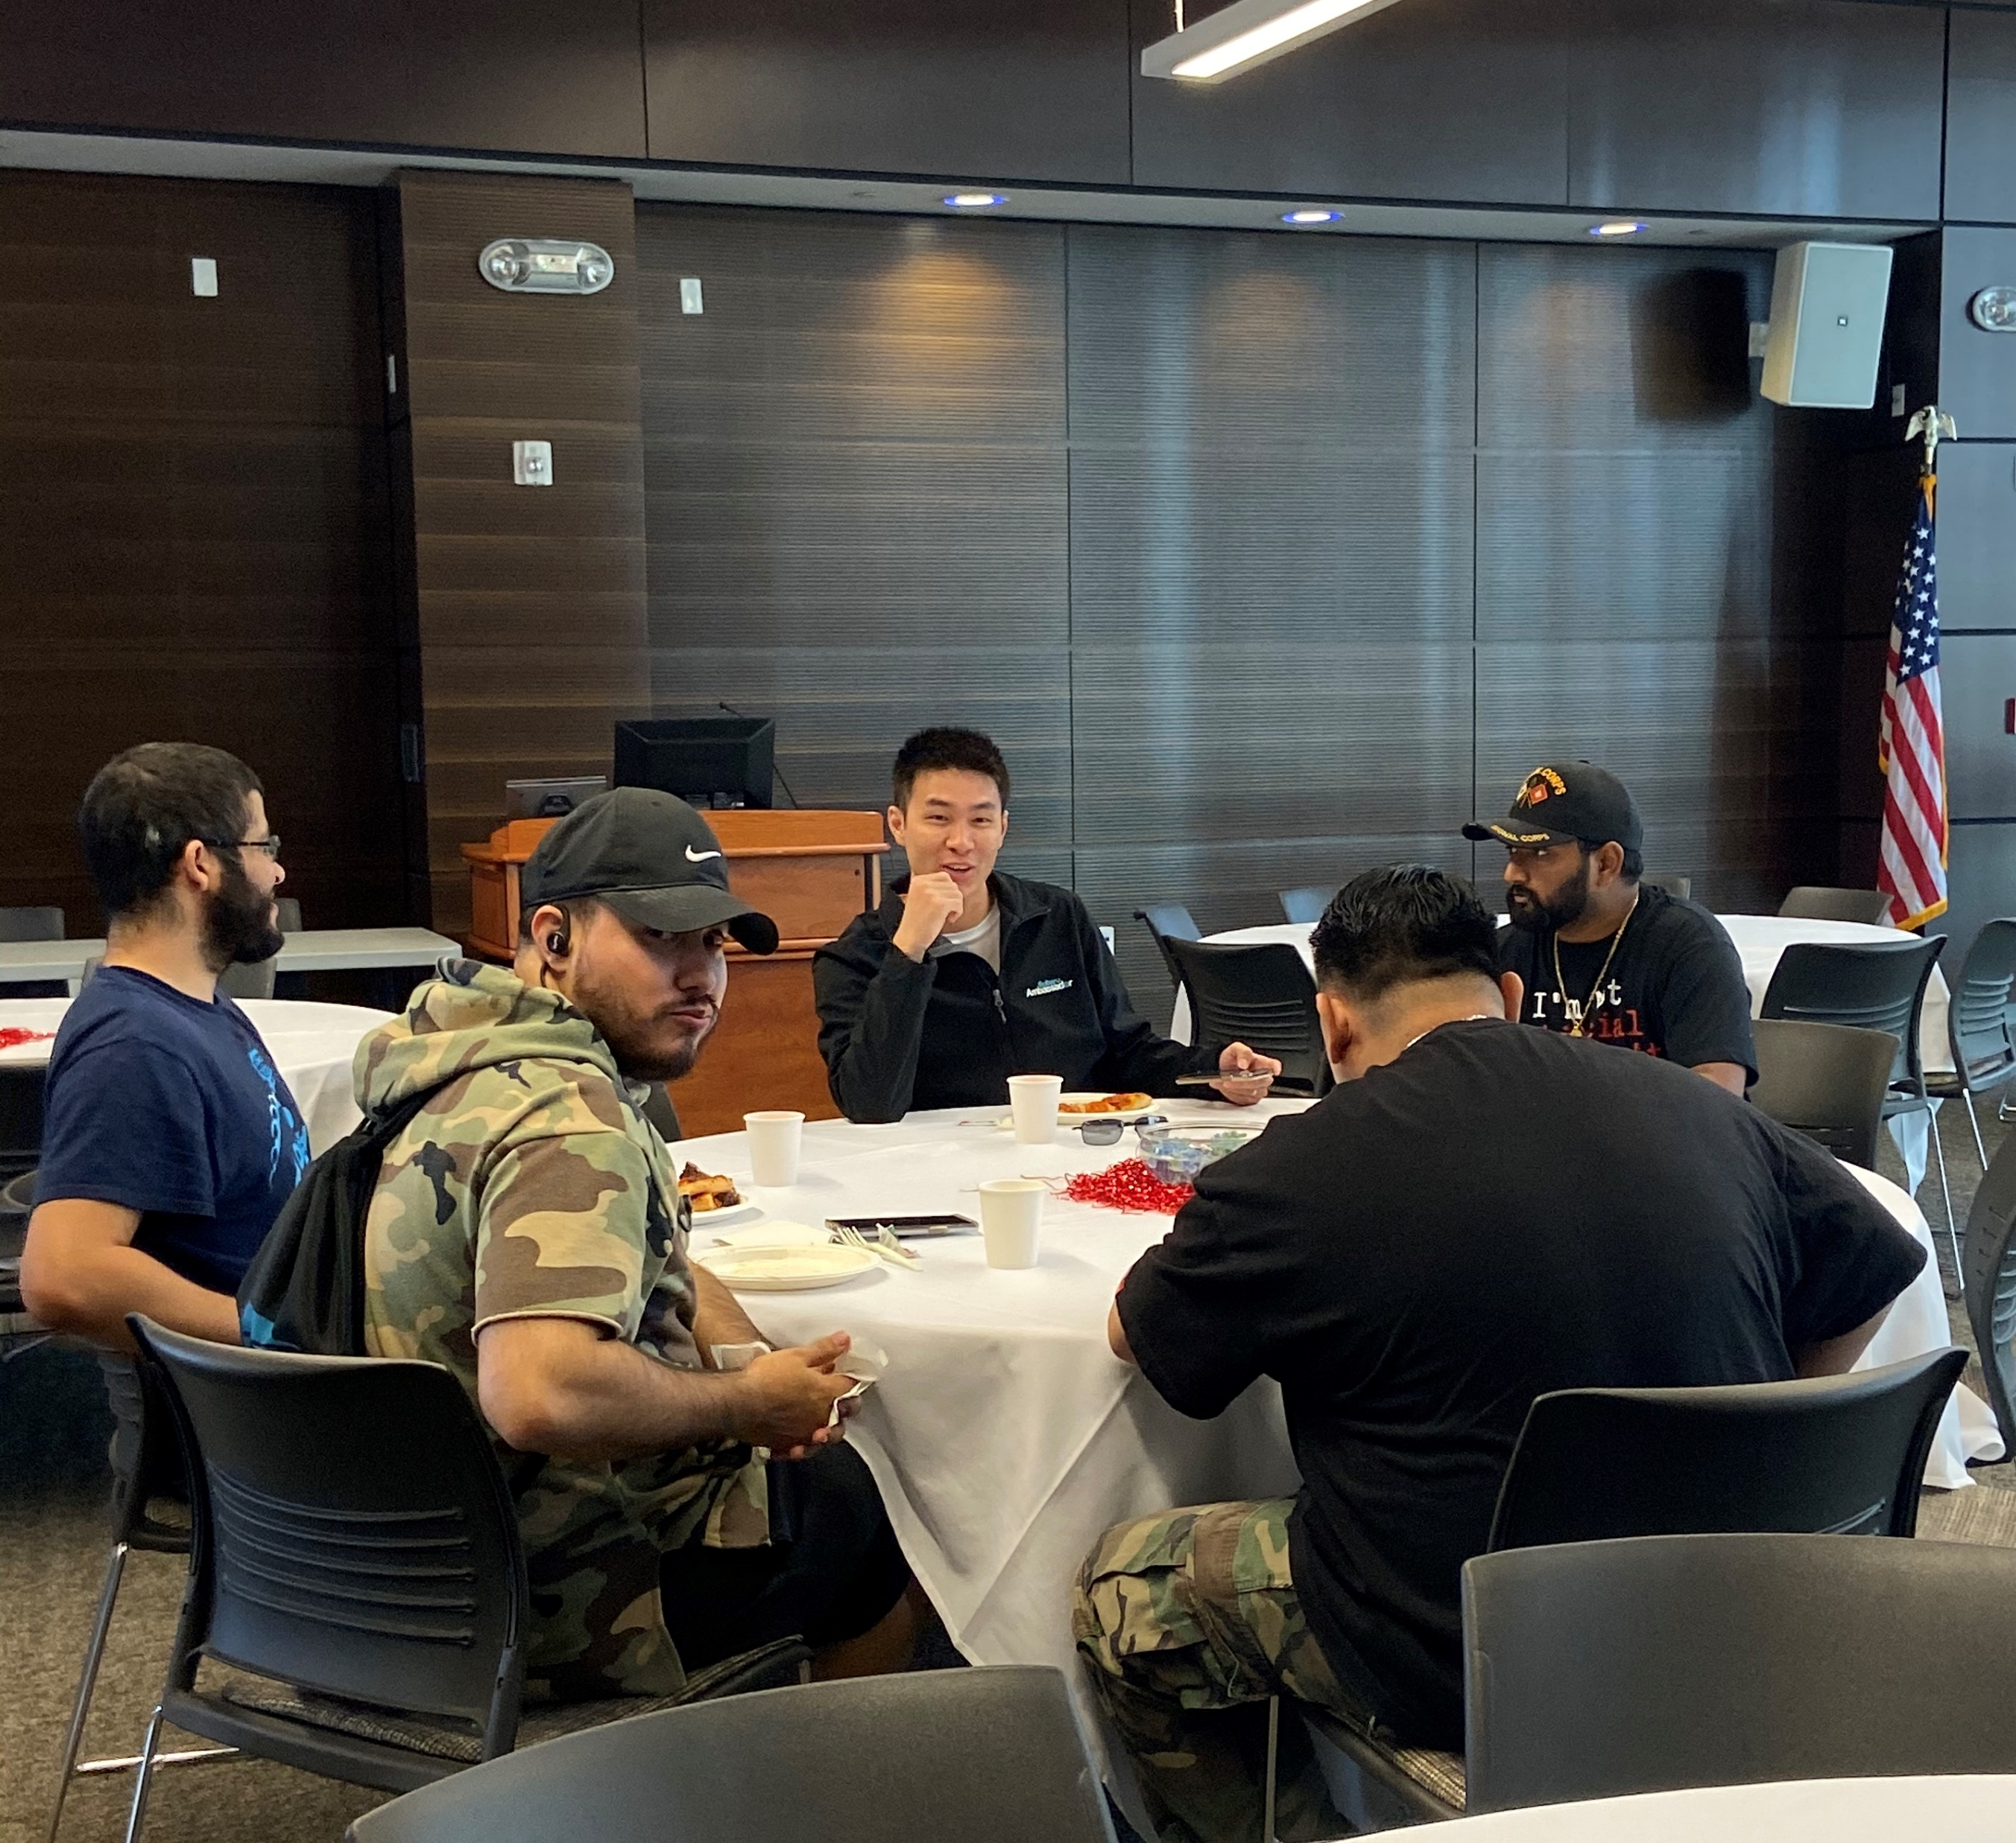
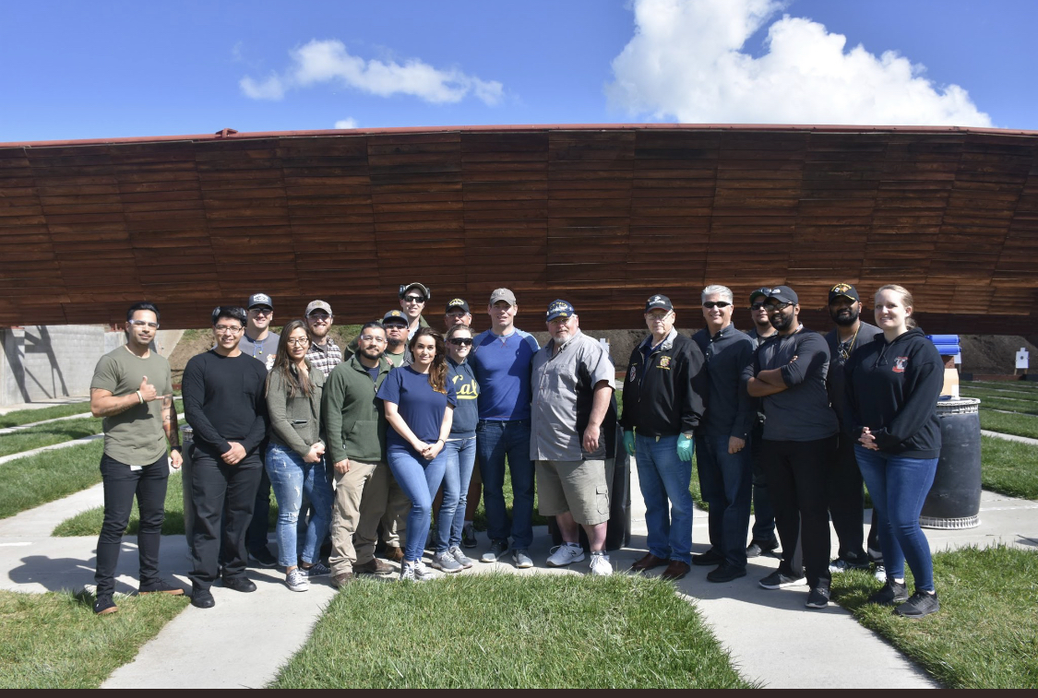
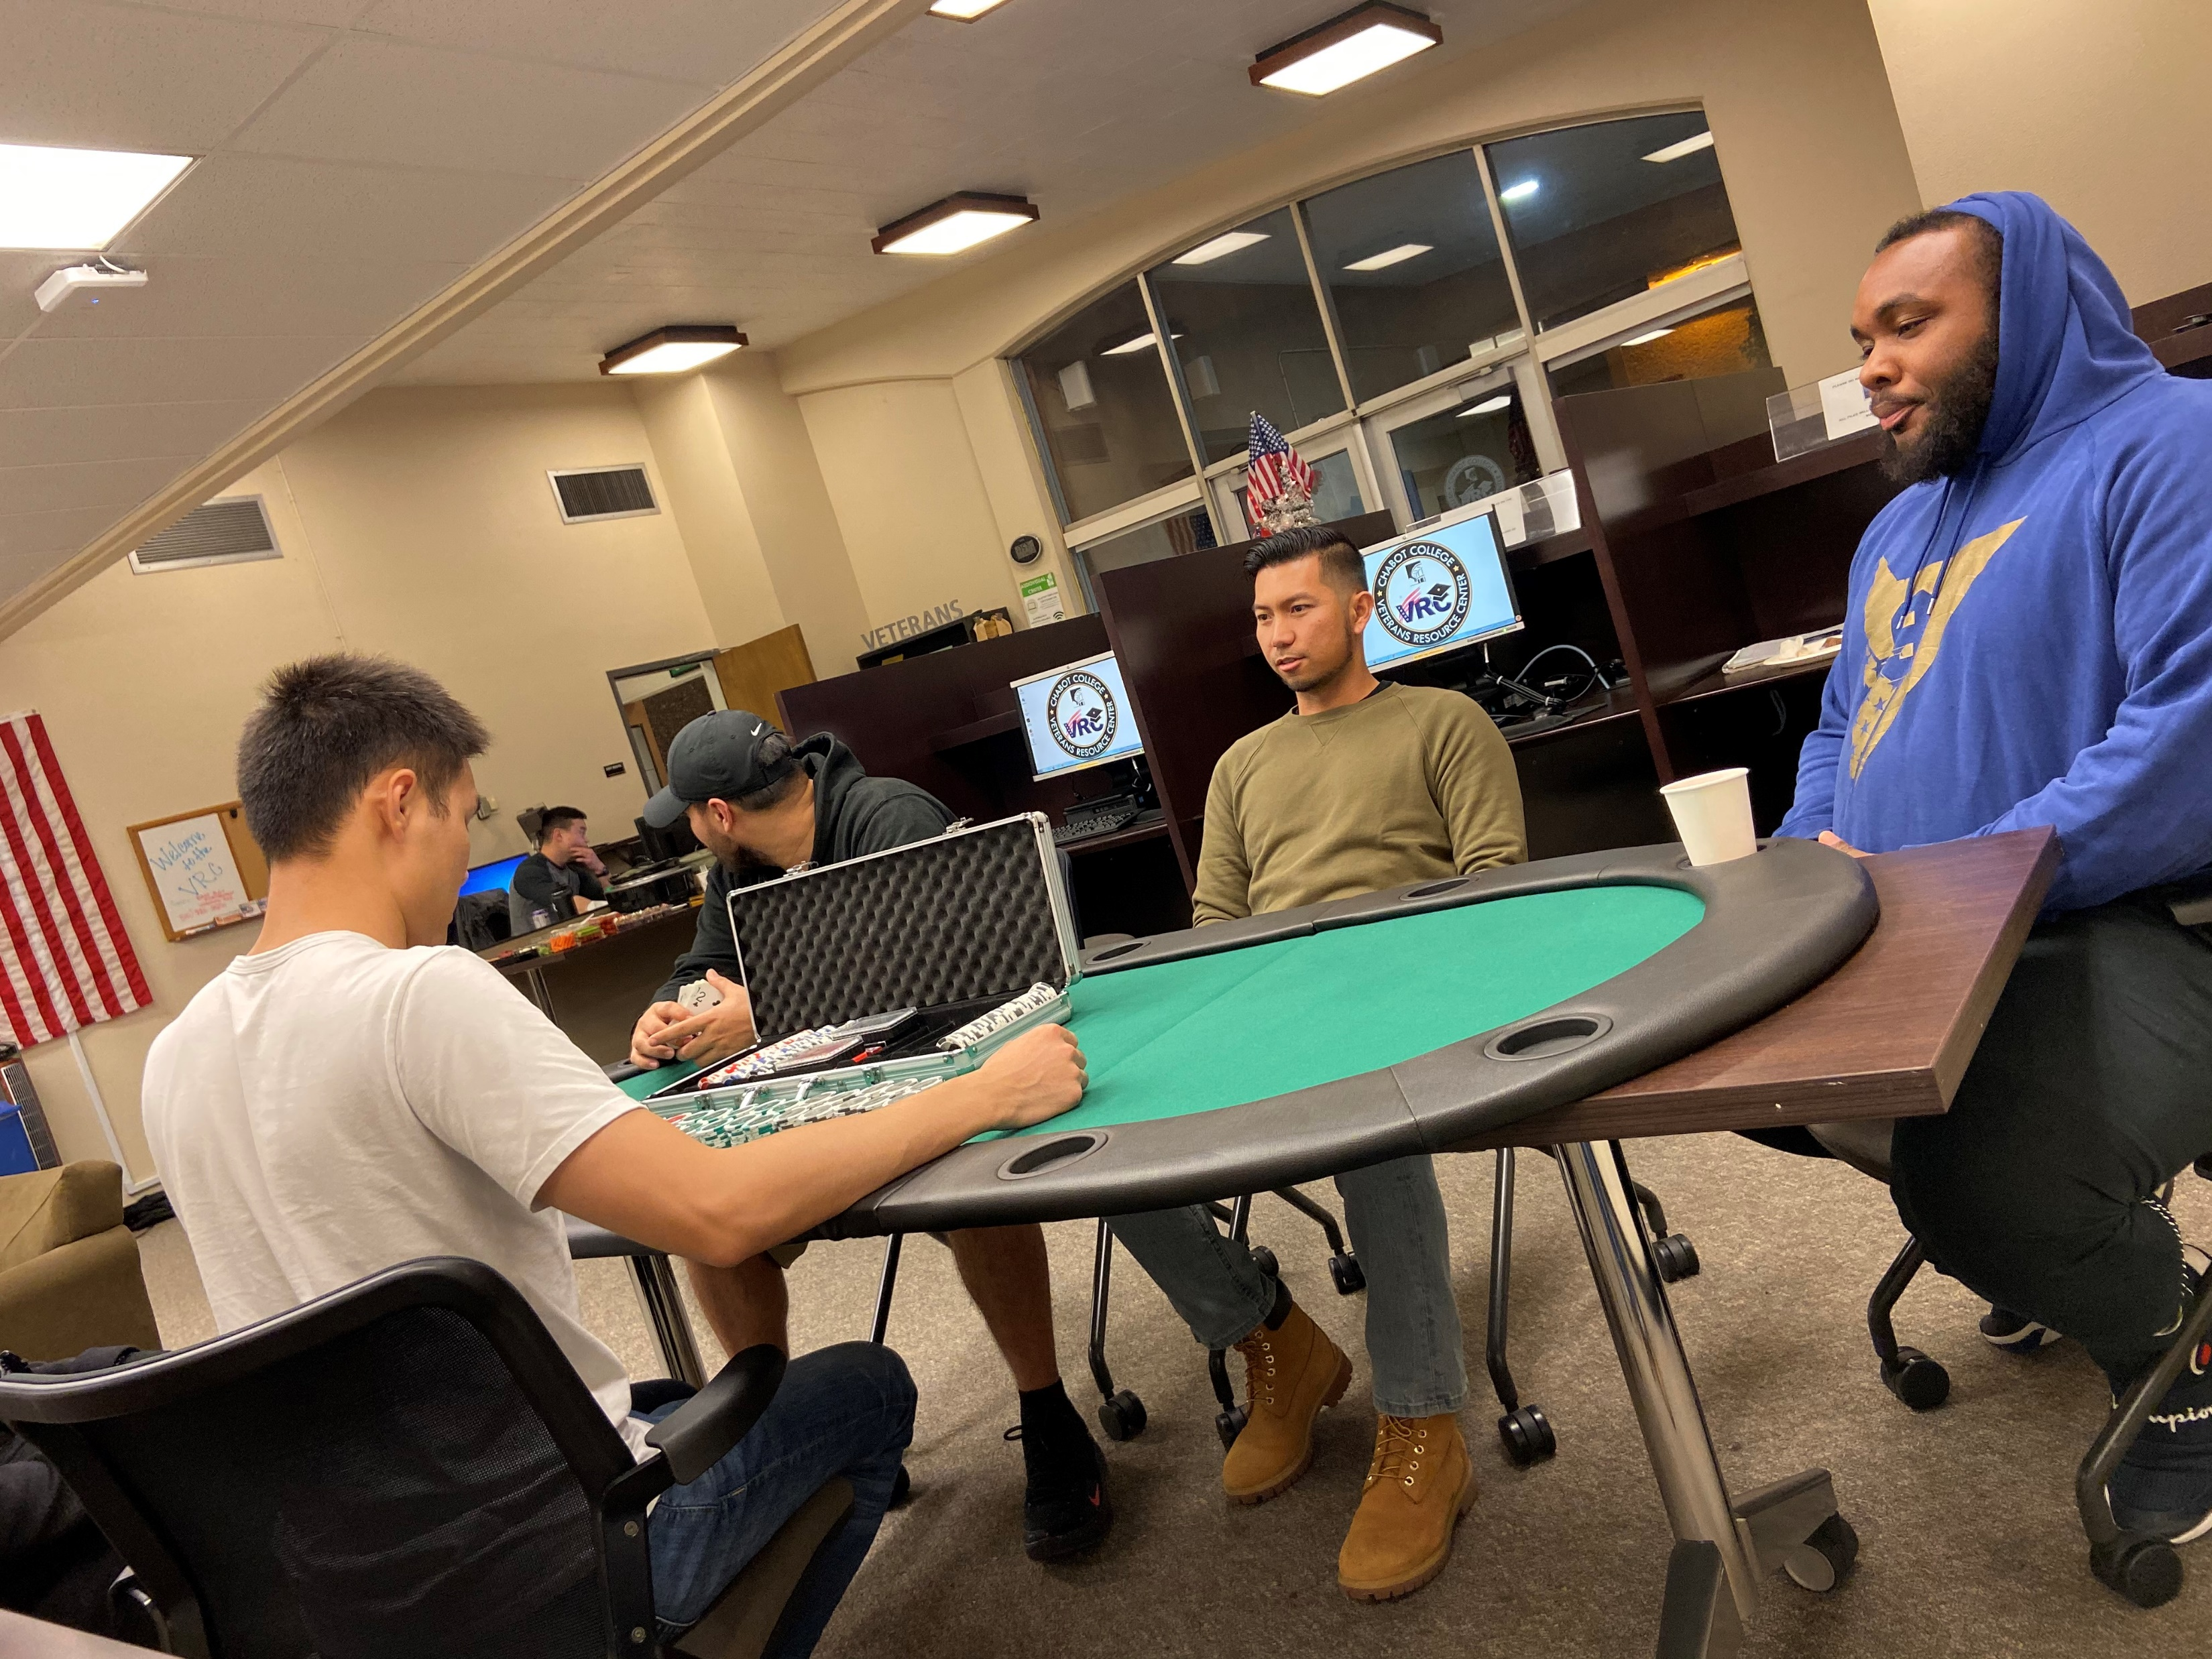
Chabot College Student Veterans

Slide 3
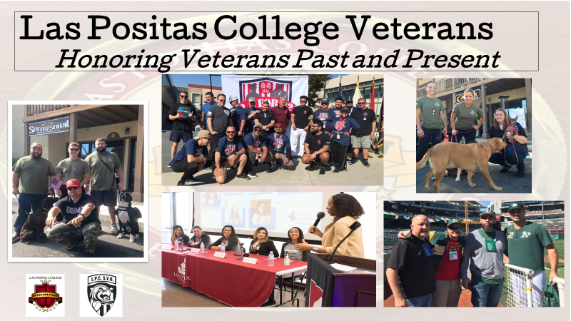

Slide 4
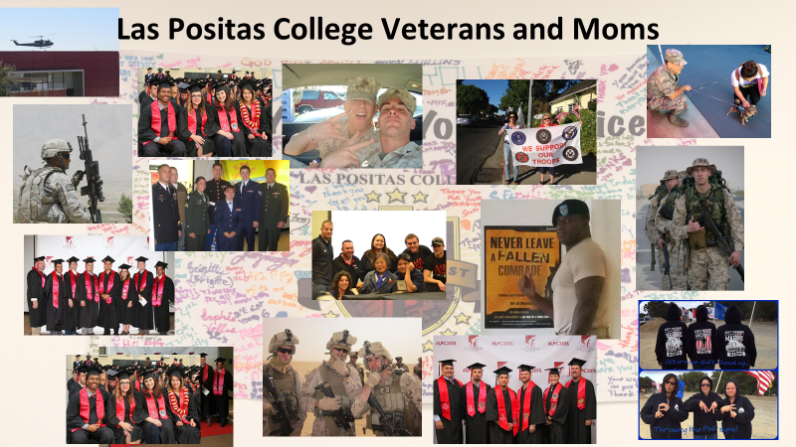

Slide 5
Always Remembered Never forgotten

Slide 6
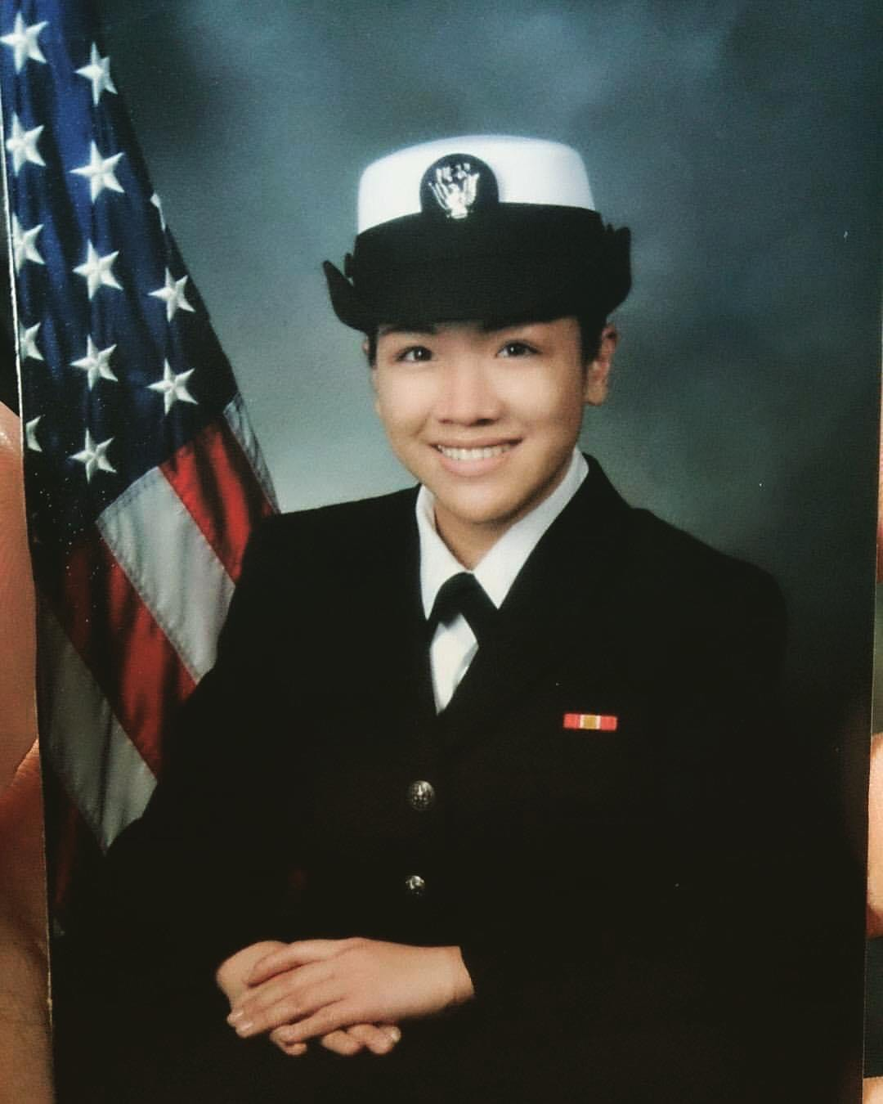
Melody Ann Igualdo
US Navy
5 Years 2015-2020
“Sky is your only limit”
- Thank you, Master Chief Castillo

Slide 7
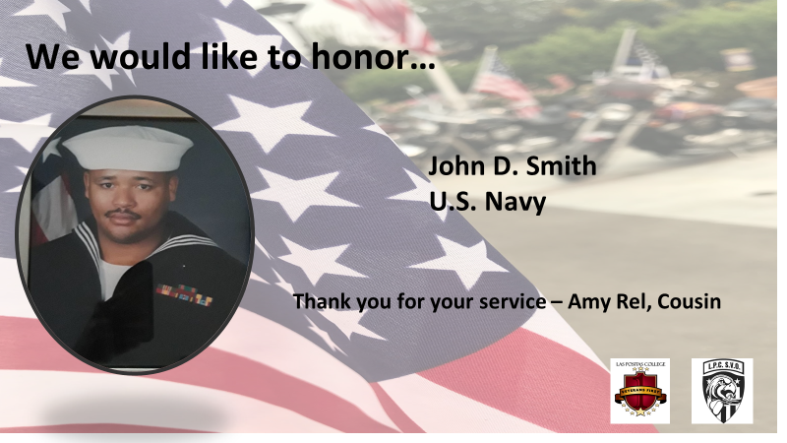

Slide 8
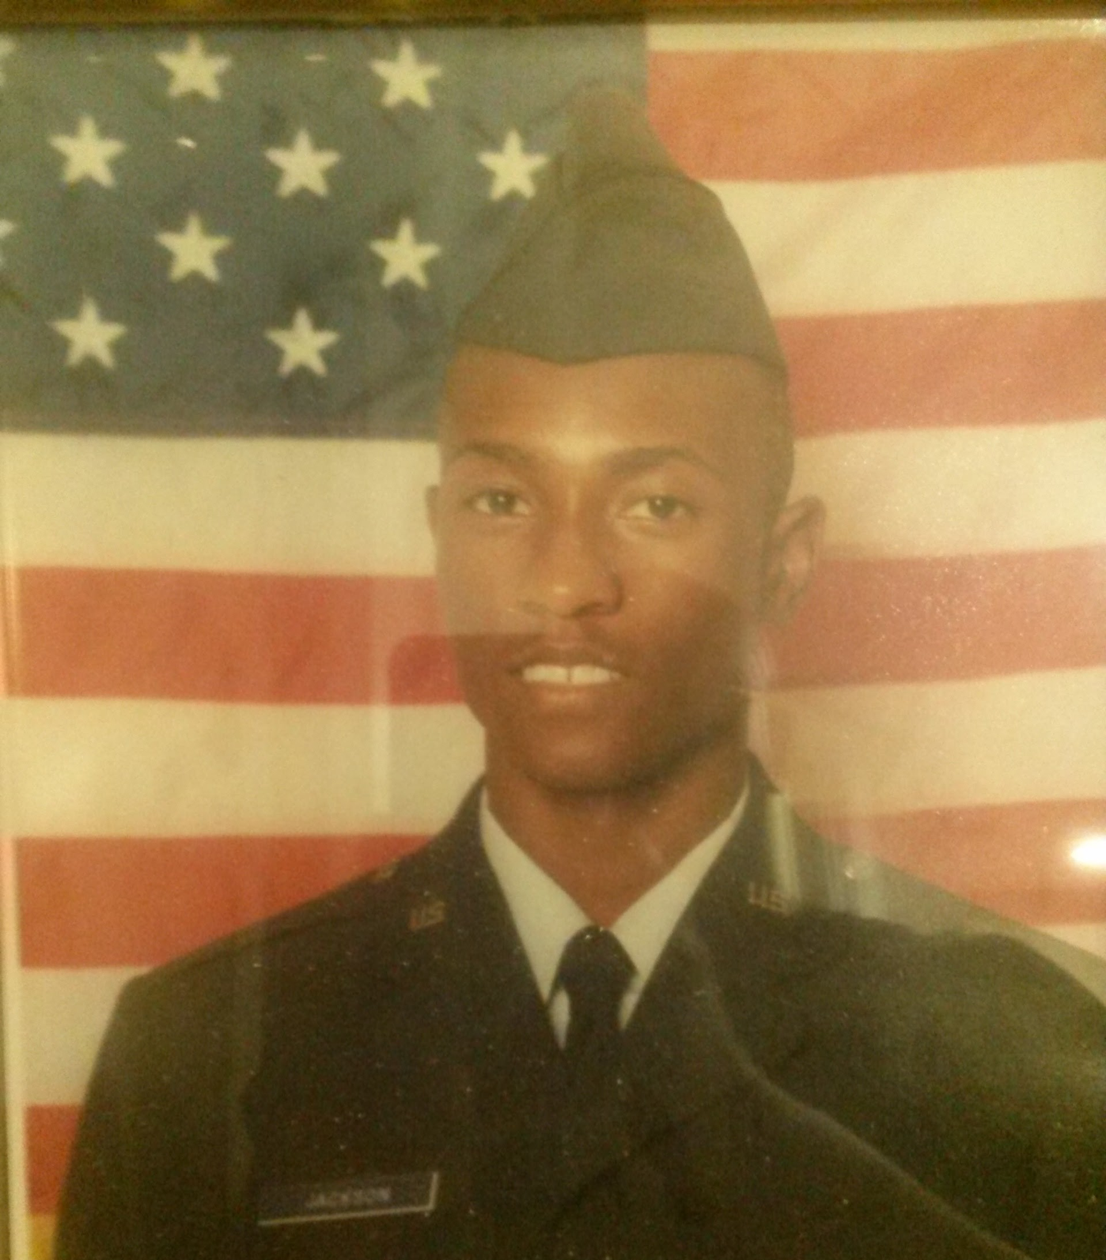
Ryan Jackson
United States Air Force
12 years of service
It was an honor to serve our great nation and be a valuable asset to the world's most powerful Air Force. I joined to follow in my father's footsteps. He was a Marine and served in the Vietnam War.

Slide 9
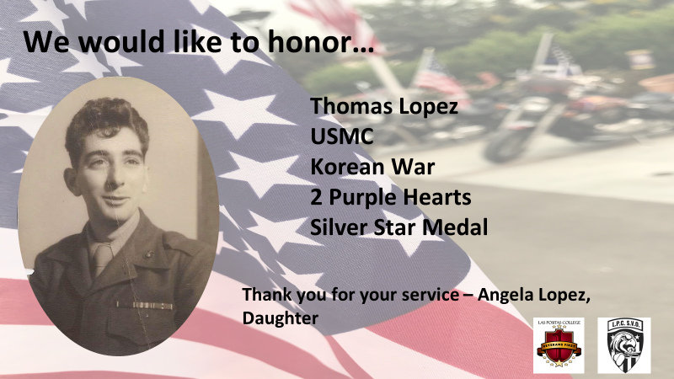

Slide 10
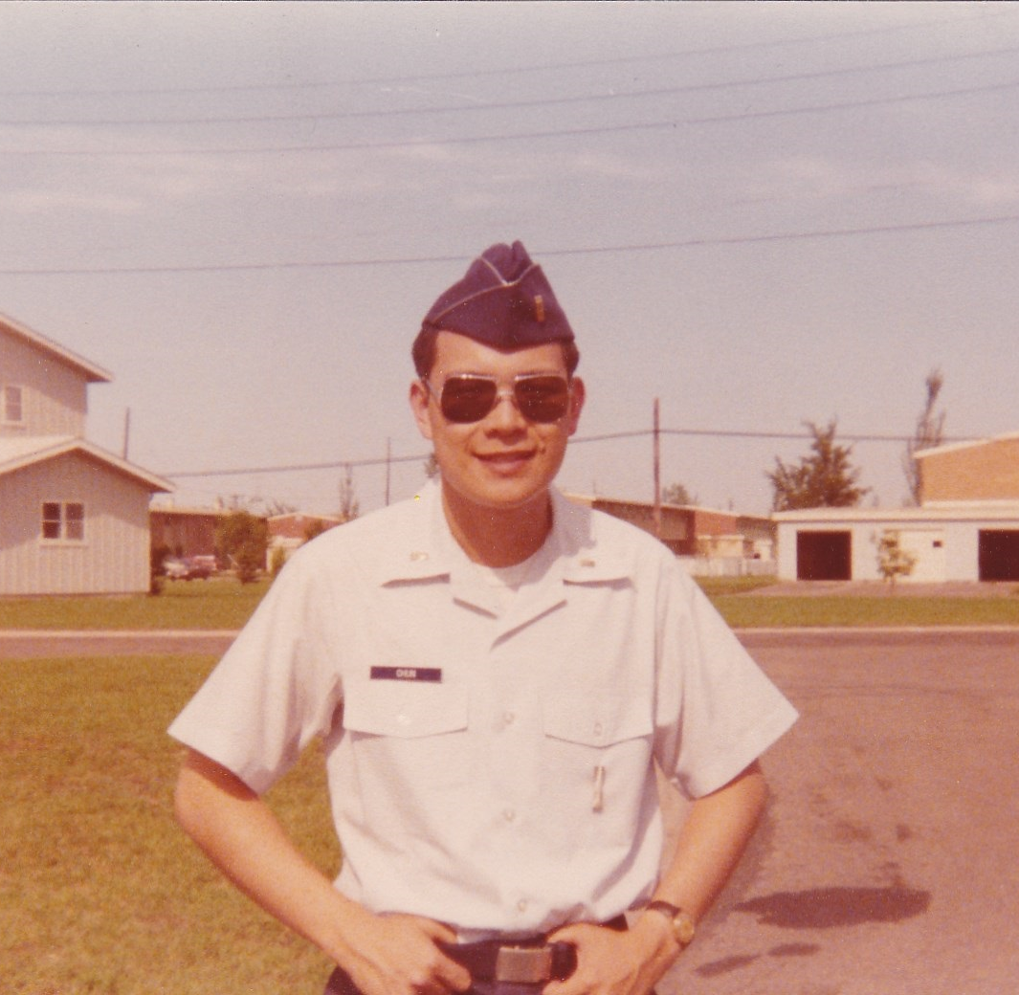
Desmond K.H. Chun
United States Air Force
3 Years 1976 -1979
Missile Launch Officer - 'Last of the Cold War Warriors' with his hands on the 'launch keys' to 10 Minuteman II Intercontinental Ballistic Missiles each carrying three nuclear Multiple Independent Reentry Vehicle warheads...We kept the country Free....

Slide 11
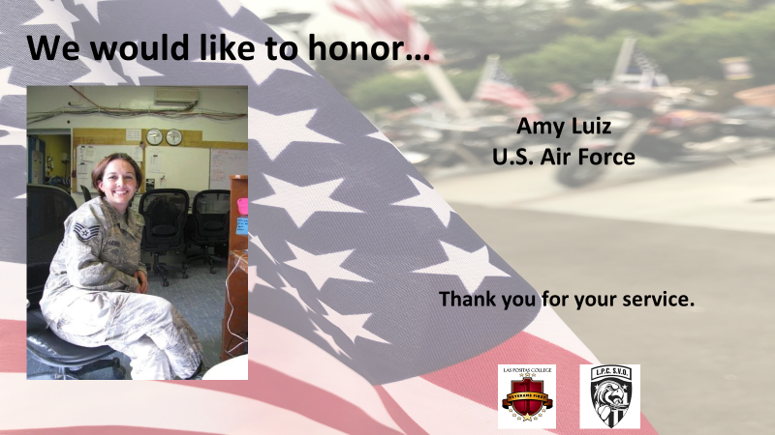

Slide 12
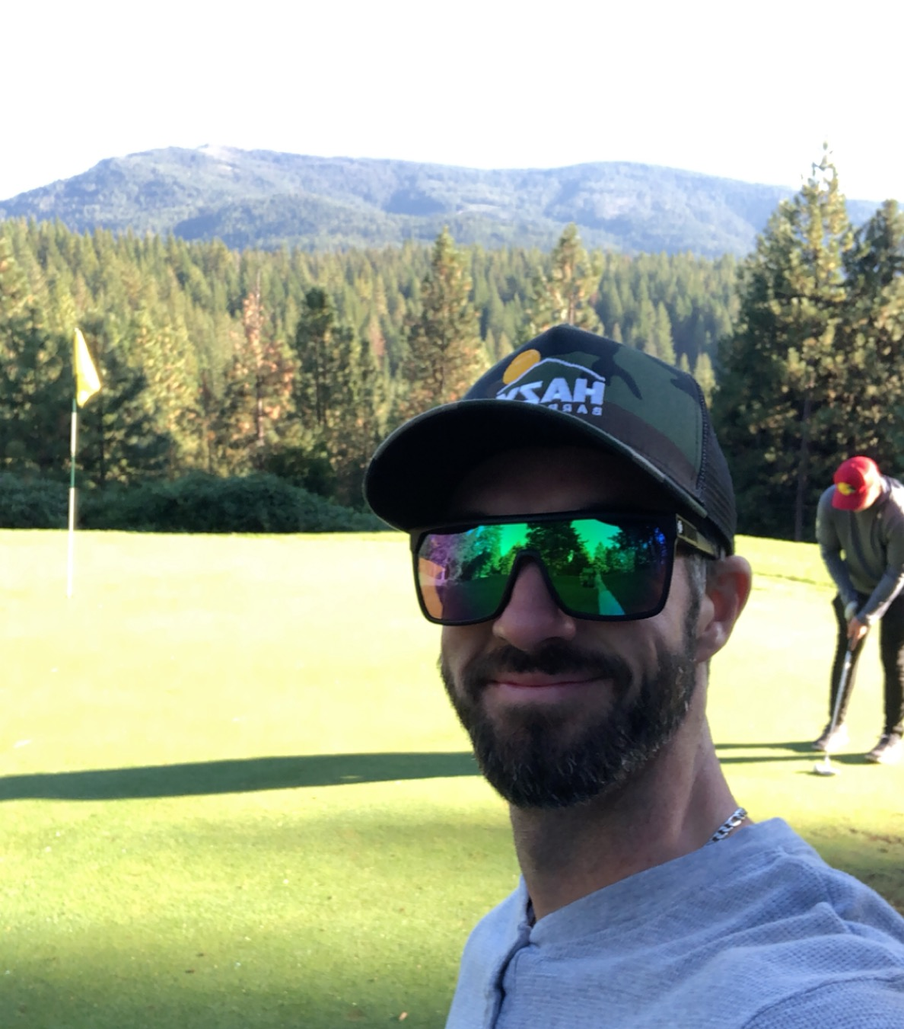
Chandler N. Kelley
Army
4 years-Active
Serving our great country was one of the best experiences of my life and it has truly set me up for a life full of success!
“What we think, we become.” Buddha

Slide 13
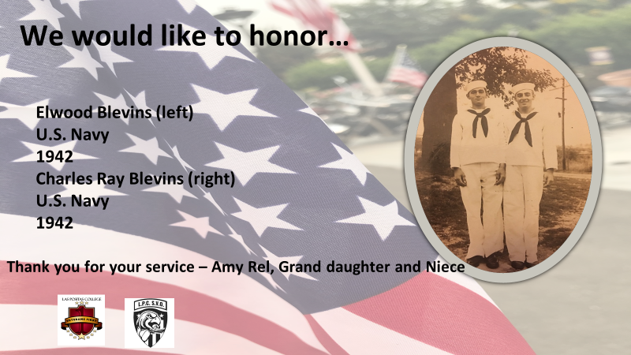

Slide 14
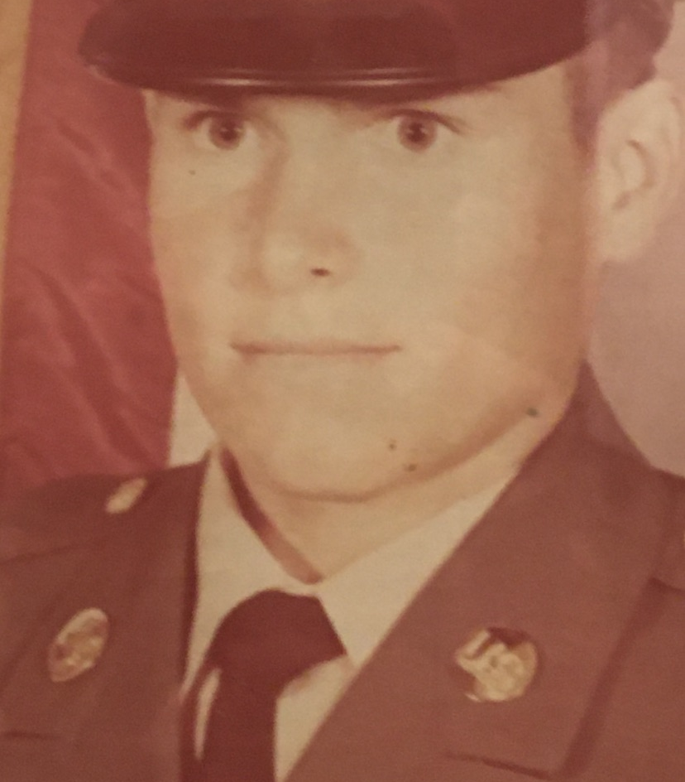
Grady Ray High
Unites States Army
2 Years of Service
Grady is very proud to be an American and took great pride in serving his country in the United States Army. Grady truly loves and respects his country, and it shows by the man he is today. With his impeccable work ethic, and the respectful words he speaks to his fellow Americans. I am so very proud of Grady for his dedication, smart mind, strong hands, and a very warm heart.
I love you, Linda

Slide 15
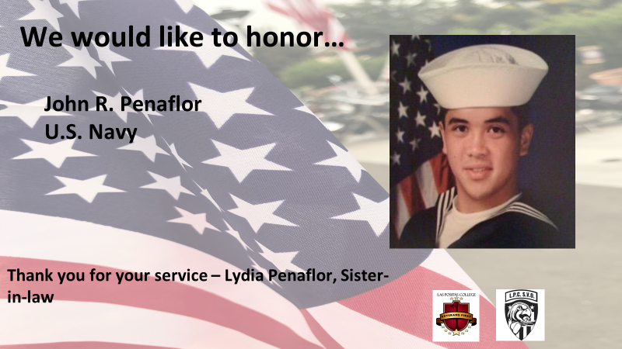

Slide 16
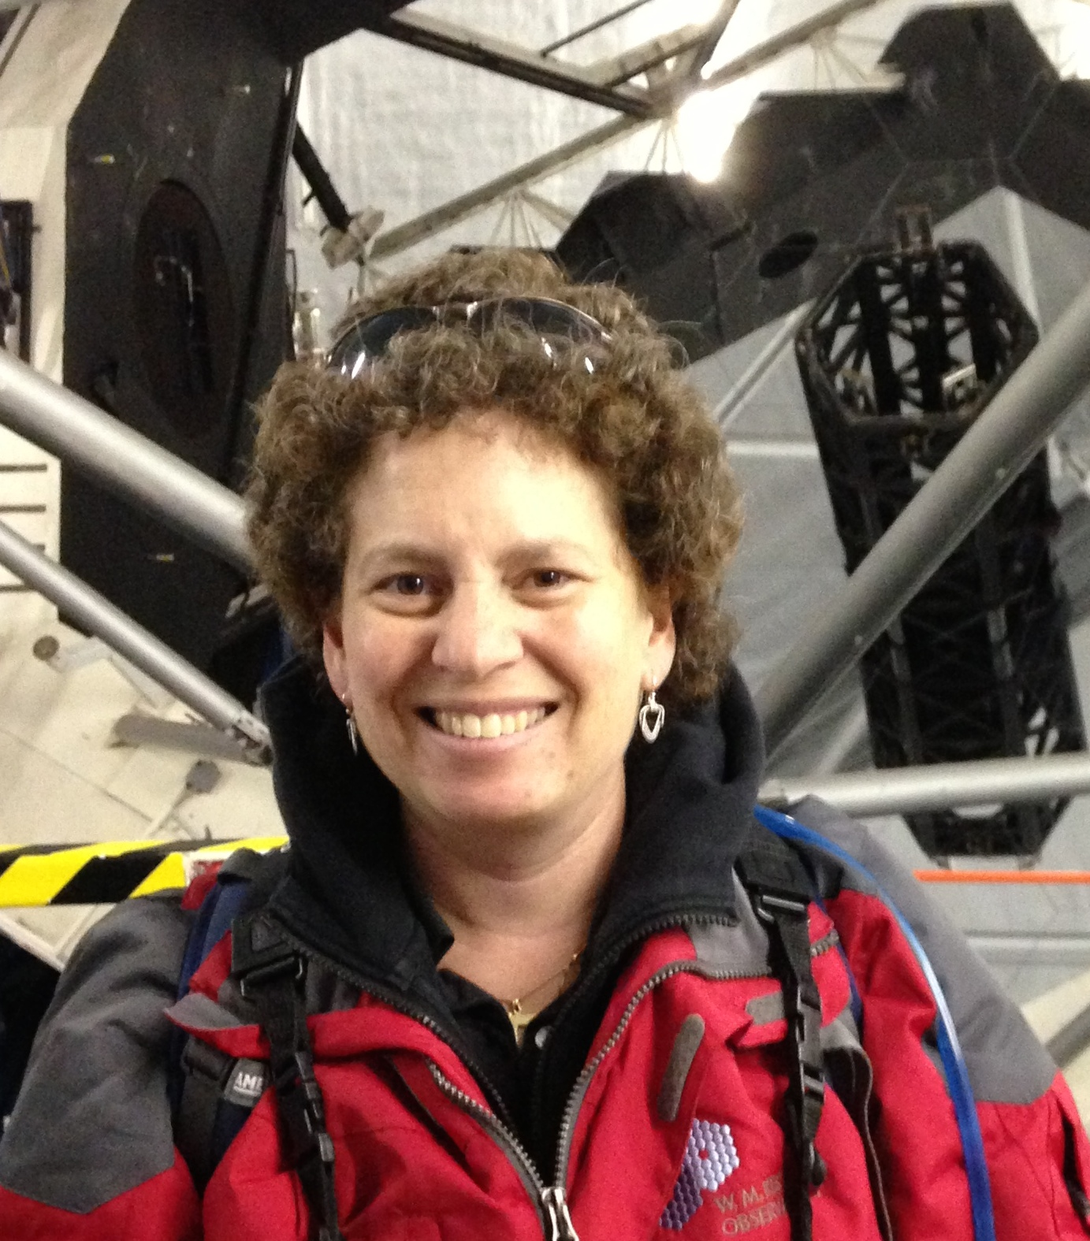
Katie Berryhill
USAF/USAFR
11 Years 1990-2001

Slide 17
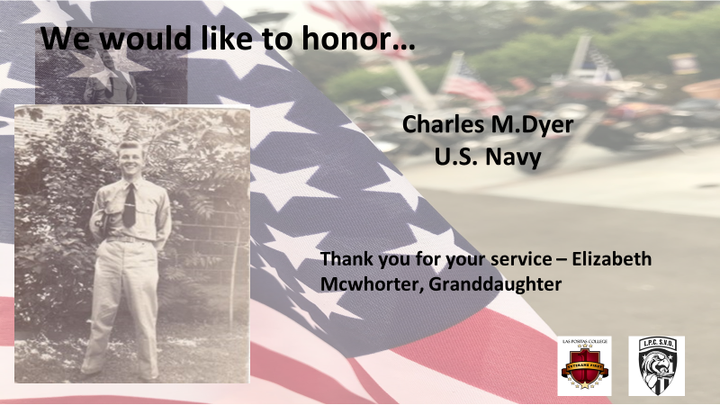

Slide 18
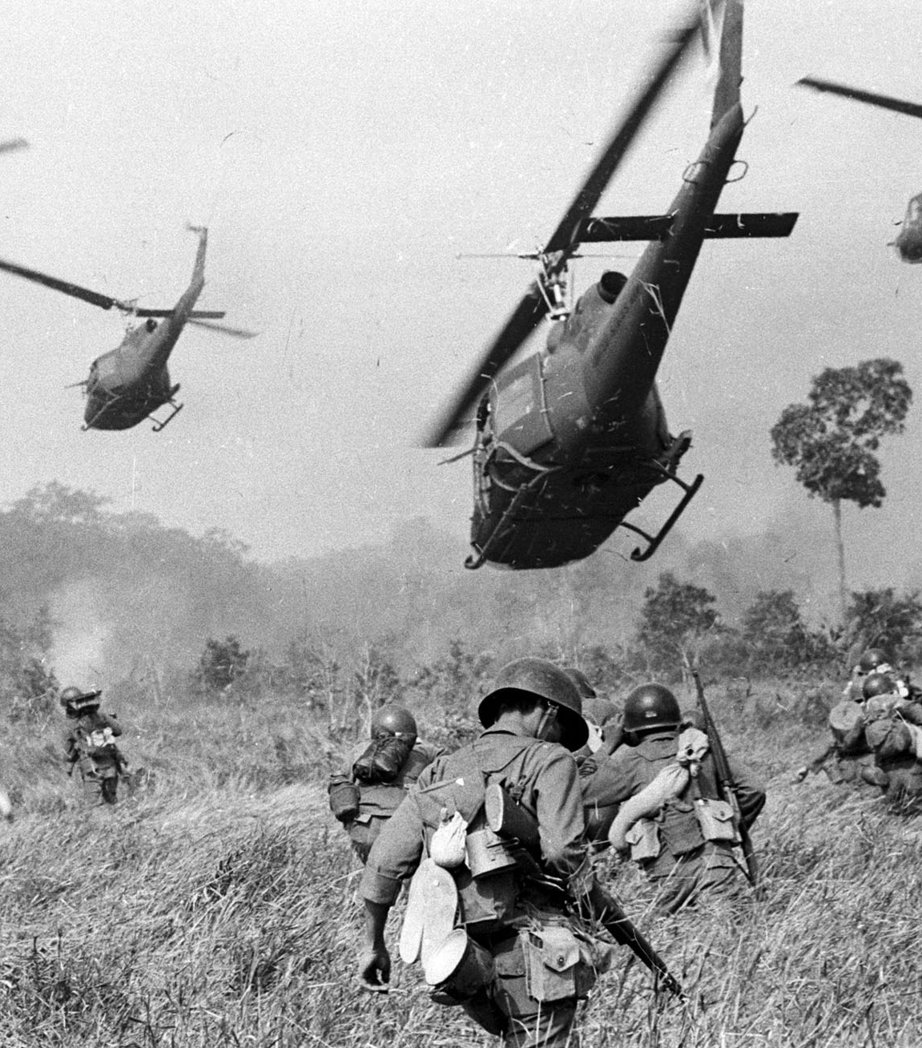
Ret. Lt. Colonel William F. Huggins
29 Years of Service
United States Air Force
4 isolated tours, 2yrs each, in foreign countries. Korea, Turkey, Vietnam and Guam.
“It’s hard to beat a person who never gives up.”
― Babe Ruth

Slide 19
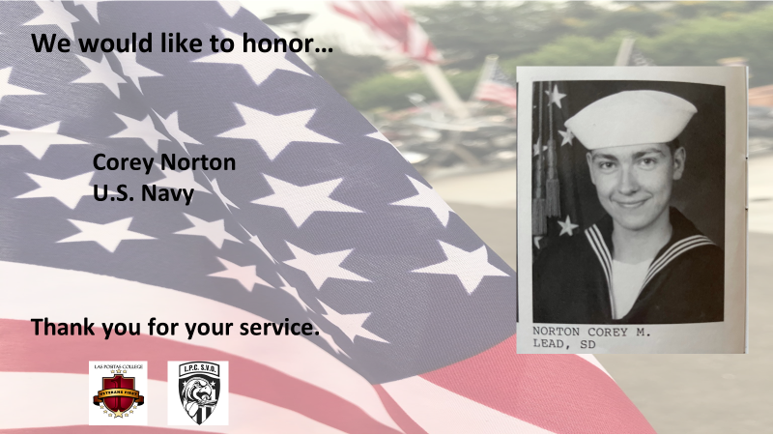

Slide 20
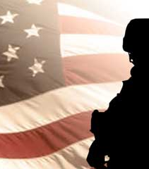
Patrick E. Larkin
40 Years of Service
Navy
“I can imagine no more rewarding a career. And any man who may be asked in this century what he did to make his life worthwhile, I think can respond with a good deal of pride and satisfaction: ‘I served in the United States Navy.”- John F. Kennedy

Slide 21
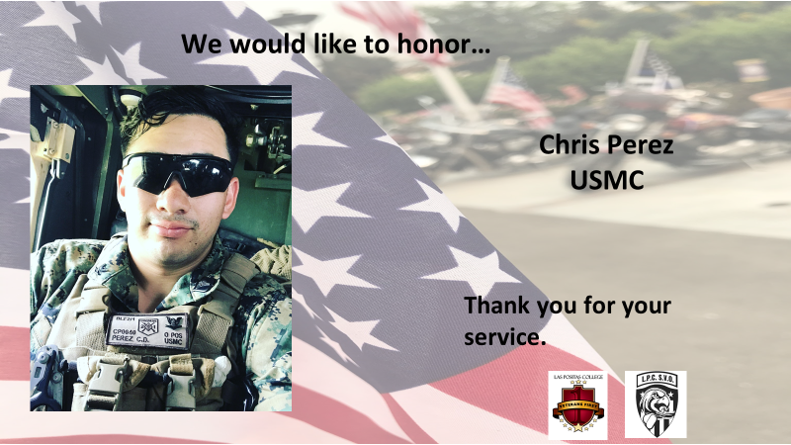

Slide 22
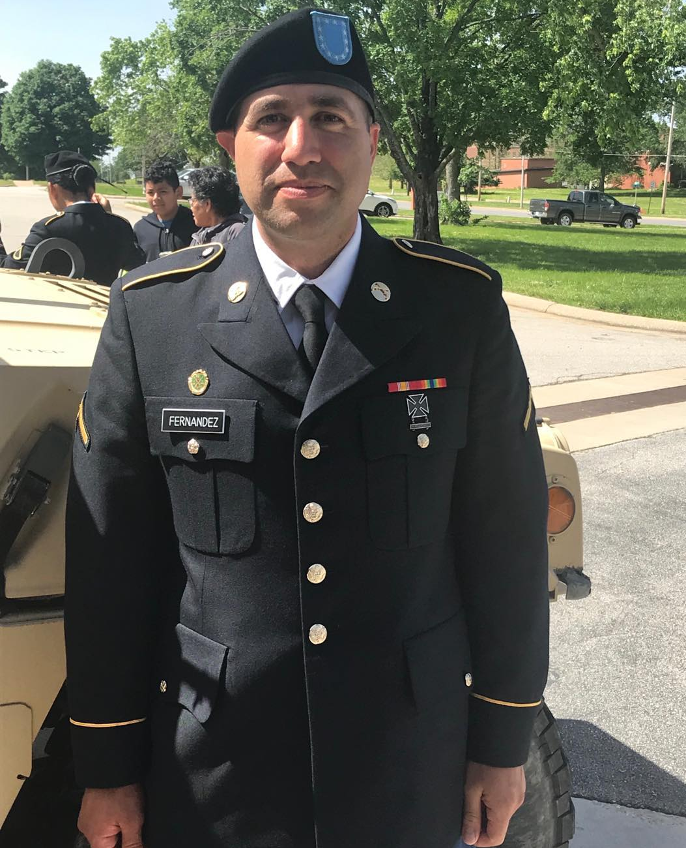
Victor Antonio Fernandez
2018-Present
Army Reserve
Thank you for risking your life to serve this country during the COVID-19 crisis
-Alise Smith

Slide 23
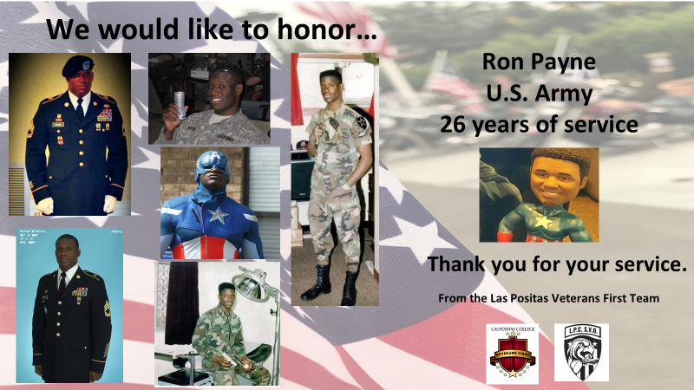

Slide 24
Major Charles Hopson
28 Years of Service
1 Year in Vietnam
United States Air Force
"Thanks for all you did to protect our freedoms, Dad. I have always been so proud of you! Miss you so much, your loving daughter"

Slide 25
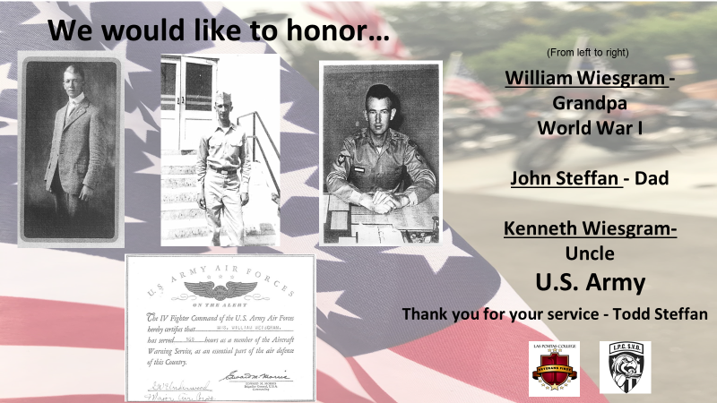

Slide 26
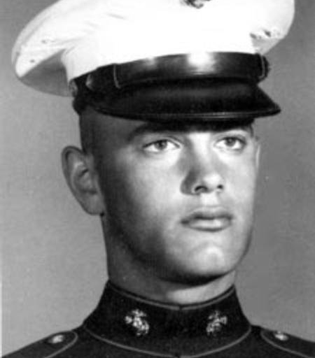
Paul George Telles
Killed in action 1/31/1969
Vietnam
Marine Corps
"The uncle I was never able to meet. A son, brother and Marine who gave the ultimate sacrifice."

Slide 27
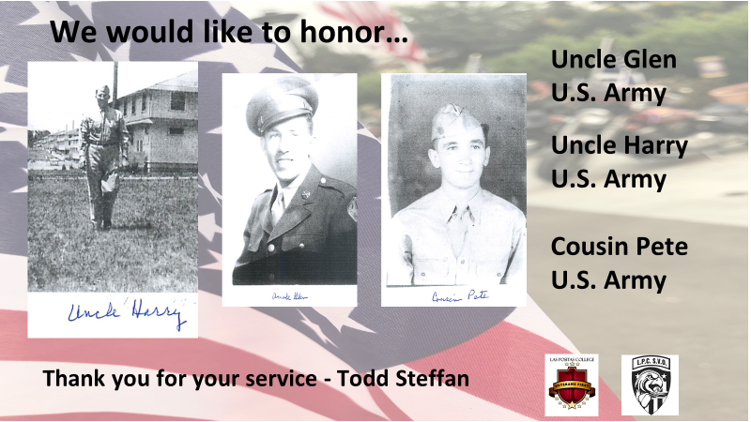

Slide 28
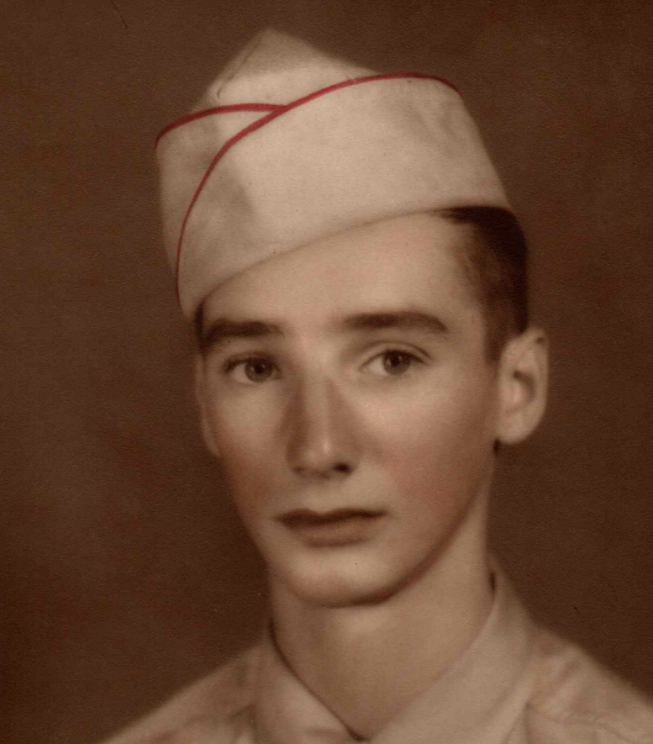
Wallace J. Schissler
United States Army
“I guess missing you is just my hearts way of reminding me how much I love you.”

Slide 29
A Special Thank You!!

Slide 30
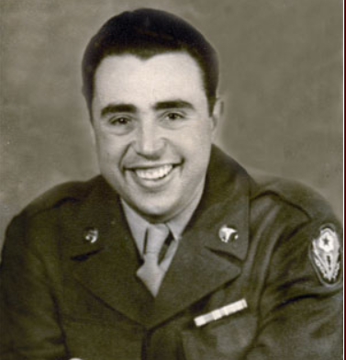
Peter Sategna Educational Foundation
Peter Sategna was a combat military veteran of World War II. Near the end of his life, Peter asked his family to help him start a foundation that would give others the same kind of opportunity to either start or finish their education or learn a trade. Peter passed away in 2007 and in 2008 the Peter Satagna Education Foundation was created. Over the years, the foundation has been busy living up to the request of Peter and providing scholarships to our local youth and combat military veterans to help in their quest to change their lives.
Chabot College and the Veterans Resource Center would like to thank the Sategna family for the ongoing support they have shown, Peter’s wishes have helped so many of our veterans in need and we are so thankful!!!

Slide 31
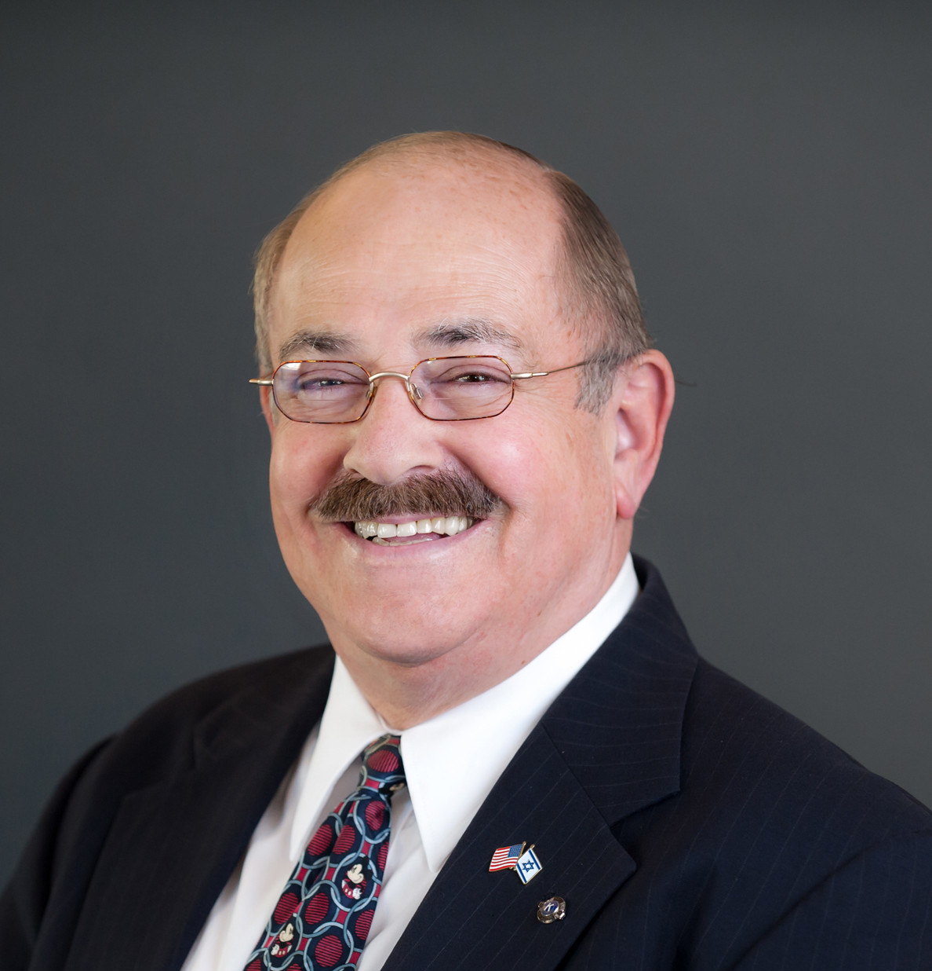
Dr. Marshall Mitzman
Dr. Marshall Mitzman's dedication to his community was evident through his service leadership through board memberships and key board roles in organizations such as Alameda County School Board Association, Alameda County Salvation Army, Hayward Education Foundation, Friends of Chabot College Foundation, Hayward Chamber of Commerce and many more.
Chabot College and Las Positas, will always remember the support, excitement and passion you shared with us, our student veterans and our community. Thank you for all you did to support our veterans and you will always be remembered.

Slide 32
Today is about remembering and honoring all the men and women who have sacrificed more than we will ever know for the freedoms we all enjoy.
Thank you!!!

