Slide 1

Las Positas College
English Pathways
Trivia Challenge

Slide 2
How to play the game
This is a trivia game like “Jeopardy” or some shows you may have seen on TV in your country.
There will be many questions that will help you learn a little about Las Positas College and the ESL Program here.
For each question, you will be given the answer and must choose the correct question that goes with the answer.
Discuss with your group and when you think you have the correct answer, raise your hand.
Now, let’s try a practice...

Slide 3
(Practice) The answer is “all over the world.” What is the question?
Where did Julia go this summer?
What is the name of the new Taylor Swift cd?
Where are LPC students from?
Answer: C.

Slide 4
Answer 1: It is one of the most important questions you have as an International Student.
A. What is “How can I find a native-speaker boyfriend/girlfriend?
B. What is “How much do I have to look at Donald Trump?”
C. What is “Which English pathway is best for me?”
Answer: C

Slide 5
Answer 2: Because they have very different ways of learning.
A. Why do Alexis and Cindy sometimes fight?
B. Why can’t American politicians agree?
C. Why do we have separate programs for native and non-native English speakers?
Answer: C

Slide 6
Answer 3: Reading and Writing
What are Cindy’s favorite hobbies?
What skills does Julia need to practice?
What skills do most of our ESL classes emphasize?
Answer: C. We also offer Oral Communication and Pronunciation at the Beginning and Intermediate levels, but since our goal is to prepare you for college, our program focuses mostly on developing your reading and writing.

Slide 7
Answer 4: 6
How many goals will the U.S. score in the next World Cup final?
How many levels are there in the ESL Program?
How many students are in each class?
Answer: B

Slide 8
The ESL Curriculum
ESL 131A, 130A 133 or 136
ESL 131B, 130B 133 or 136
ESL 121A, 120A 123 or 126
ESL 121B, 120B 123 or 126
ESL 24, 23 or 26
ESL 25, 23 or 26
**After ESL 25, students go to English 1A

Slide 9
Answer 5: 2
A. How many gifts should each student give to his/her instructor to get an “A”?
B. How many levels in the native-speaker English program prepare students for college-level English?
C. How many cups of coffee will you need to survive your 8:00 am class?
Answer B

Slide 10
The English (native speaker) Curriculum
English 100A
English 104
**After English 104, students go to English 1A

Slide 11
Answer 6: Take as many units as you can and try to finish your classes (especially ESL classes) as quickly as possible.
What is the best way to do well in college?
What is the best way to do poorly in college?
What is the best way to make your parents happy?
Answer: B. Take your time, enjoy your education, and build a solid foundation in English!

Slide 12
Answer 7: Save you money and speed up your education.
What will a part-time job do?
How will finding an American boyfriend/girlfriend help you?
How will the advanced level ESL courses help you?
Answer: C. All ESL Advanced level courses (23,24,25,26) can transfer to California State and UC schools.

Slide 13
Answer 8 : 2
How many countries has Julia visited?
How many hours of homework will I have for each hour of class?
How many U.S. politicians have a brain?
Answer: B. Let’s do the math...

Slide 14
Answer 9: The Integrated Learning Center, the ESL website, Instructor’s Office Hours, the Tutorial Center, the Reading and Writing Center, the LPC Library.
Where can I eat my lunch?
Where can I get help with my classes?
Where is the best place to find a new boyfriend or girlfriend?
Answer: B

Slide 15
Answer 10: Daytime and Evening
When should I brush my teeth?
When should students bring coffee to their teachers?
When does LPC offer ESL/English courses?
Answer: C. We offer both daytime and evening choices for most of our classes. Evening classes can be an excellent choice for International students!

Slide 16
Answer 11: It is the most important thing you’ll need to succeed as a student at a U.S. college.
What is “a lot of money?”
What is English?
What is a good sense of humor?
Answer: B.

Slide 17
Answer 12: 60-82%
What are the chances of Donald Trump lasting four years?
How much will your brain grow while you are in the U.S?
How many native-speaker students pass English 1A?
Answer: C.

Slide 18
Answer 13: 96-100%
What are the chances that living in the U.S. will change your view of the world?
How much weight will you gain in the U.S?
How many ESL students pass English 1A?
Answer: C. When you complete the ESL program, you are very well prepared to be successful at any American university!

Slide 19
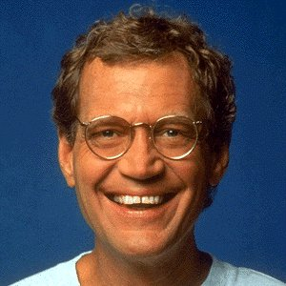
The Top Ten
Reasons Non-Native English Speaker Students Benefit from the ESL Program
19

Slide 20
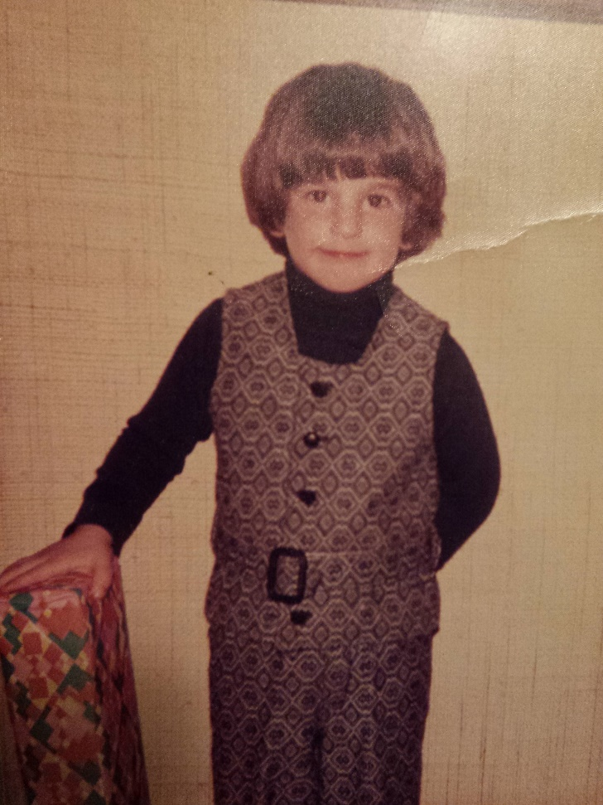
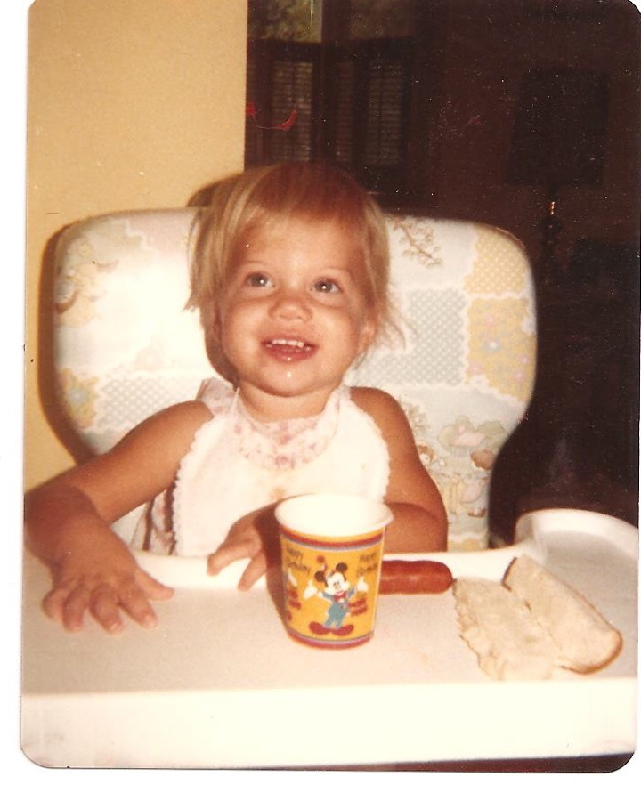
Number 10: US!
20

Slide 21
Number 9: ESL classes help students adjust to living in the U.S.

Slide 22
Number 8: The non-threatening environment of our classes.
“I feel comfortable and not nervous in my ESL classes. I feel that I can participate.”
-Cecila
22

Slide 23
Number 7: Transfer credit for ESL 23, 24, 25, 26.
23

Slide 24
Number 6: ESL classes function like a Learning Community.
Through these communities, ESL students meet other students with similar experiences, learn about the U.S. and the world, become more engaged with Las Positas, develop support networks, and, ultimately, are more likely to succeed.
  “When we have the same classes, we get to know other students more and more and share our experiences. Also, we learn that we can help each other and learn from each other.” -Hector
24

Slide 25
Number 5: English classes are full.
25

Slide 26
Number 4: ESL students desperately need to improve their vocabularies
20,000-35,000 words
  Average adult native English speaker vocabulary
5,000-10,000 words
  Average adult non-native speaker vocabulary. (they will only reach 10,000 after living in an English speaking country)
10,000 words
  Average vocabulary of a native English speaker at age eight
26

Slide 27
Number 3: The language that ESL students need to learn is completely different than what native speakers need to learn
I have finished my homework yesterday.
I finished to do my homework yesterday.
This are the books interestings that I bought them at the bookstore.
I put the book in the table.
Student in chair solving problem.
27

Slide 28
Number 2: ESL teachers are trained to teach ESL students
Would you choose to take a chemistry class taught by a biology instructor?…
28

Slide 29
The Number 1 Reason Non-native English Speaker Students Benefit from the ESL Program:
Students completing ESL 25 have the highest success rates (96-100%) in English 1A of any group of students.
29

Slide 30
Thank you for choosing to come to Las Positas College to study! We hope that you enjoy your time here and learn many new things...
We look forward to getting to know you!

