Slide 1
Las Positas College ESL Program
Trivia Challenge

Slide 3
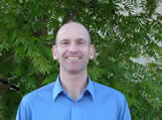
ESL Program
Jonathan Brickman
ESL Coordinator/ Instructor
Office: Building #2400
Room: 2411N
Phone: 925-424-1216
E-mail: jbrickman@laspostiascollege.edu

Slide 4
How to play the game
This is a trivia game like some games you may have seen on TV in your country.
There will be many questions that will help you learn a little about Las Positas College and the ESL Program here.
For each question, you will be given the answer and must choose the correct question that goes with the answer.
Discuss with your group and when you think you have the correct answer, raise your hand.
Now, let’s try a practice...

Slide 5
(Practice) The answer is “all over the world.” What is the question?
Where did Sean go this during his summer vacation?
What is the name of the new Lady Gaga CD?
Where are LPC students from?
Answer: C.

Slide 6
The answer is: September 3, 2013. What is the question?
When is American Independence Day?
When do LPC ESL classes begin?
When will the next Star Wars movie come out?
Answer: B: ESL Classes begin the first class meeting after September 3 (This is a Tuesday). Please note that this is two weeks after most other LPC classes begin. Check the Class Schedule!

Slide 7
Answer 2: December 20, 2013
What day do Americans celebrate Teachers’ Day (the most important holiday on the calendar)?
When is Cindy’s birthday?
When does the Fall 2013 semester end?
Answer: C. The Fall 2013 semester ends on December 20, 2013...sorry, no early holidays...

Slide 8
Answer 3: Reading and Writing
What are Barak Obama’s greatest strengths?
What skills does Cindy have most trouble with in Korean?
What skills do most of our ESL classes emphasize?
Answer: C. We also offer Oral Communication at the Beginning (ESL 133) and Intermediate (ESL 123) levels.

Slide 9
Answer 4: 6
How many children does Sean have?
How many levels are there in the ESL Program?
How many burritos does Rachel eat per week?
Answer: B. There are six levels to our core reading/writing classes: 131A, 131B, 121A, 121B, 24, 25.

Slide 10
ESL Assessment Scores
CELSA Score | Writing Score | ESL Level
20-34 | 1 | 1A
35-48 | 2 | 1B
49-55 | 3 | 2A
56-64 | 4 | 2B
65-69 | 5 | 3A
70-75 | 6 | 3B
Students who assess below 131A are encouraged to study English at an Intensive English language program until they reach the beginning level at LPC.
1A=131A,130A,133 2A=121A,120A,123,126 3A=24, 23 or 26
1B=131B,130B,133 2B=121B,120B,123,126 3B=25, 23 or 26

Slide 11
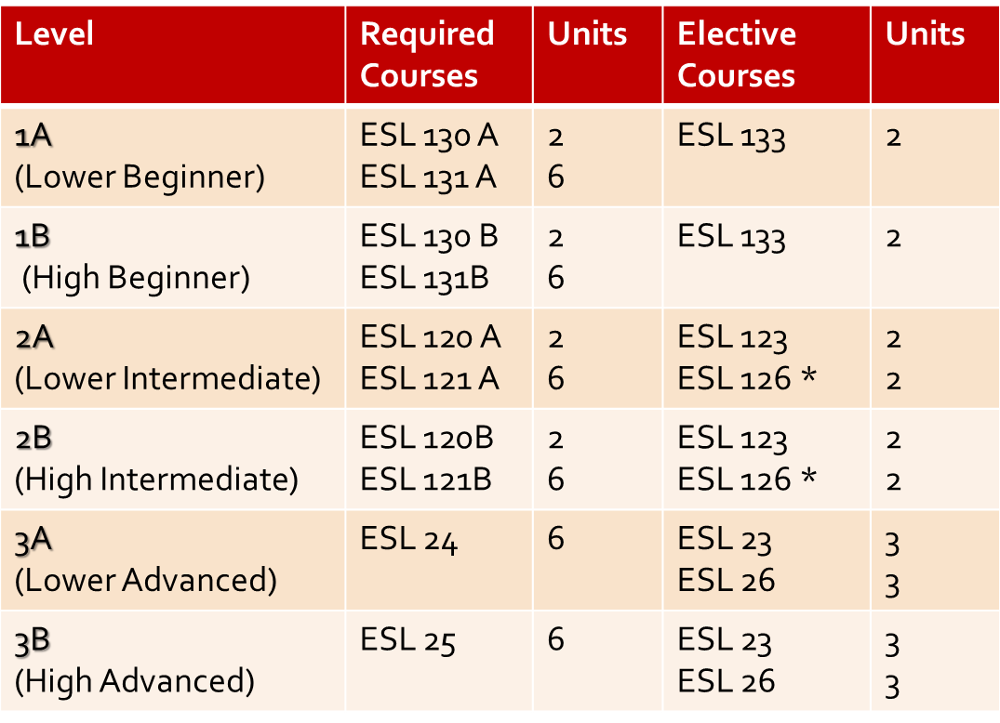
ESL Program

Slide 12
The ESL Curriculum
ESL 131A, 130A 133
ESL 131B, 130B 133
ESL 121A, 120A 123
ESL 121B, 120B 123
ESL 24, 23 or 26
ESL 25, 23 or 26

Slide 13
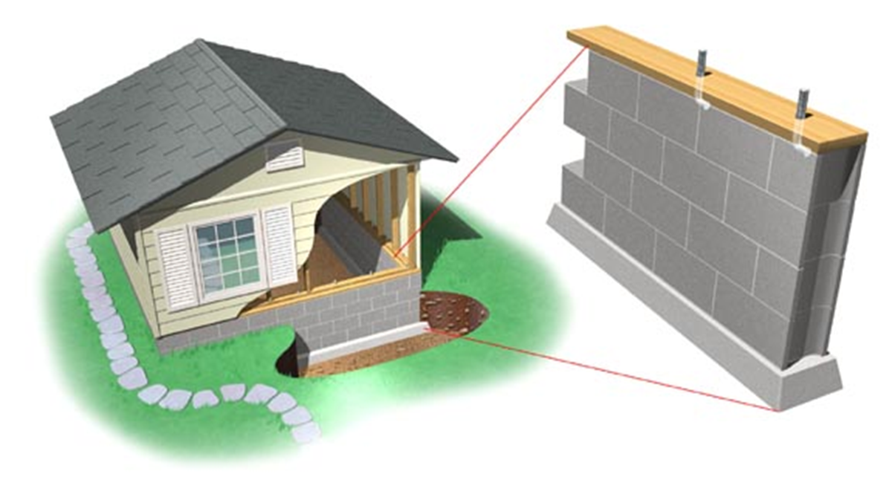
What is this called?

Slide 14
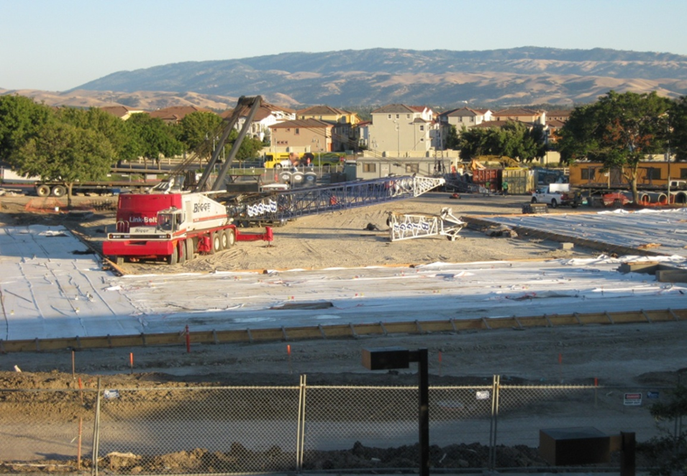
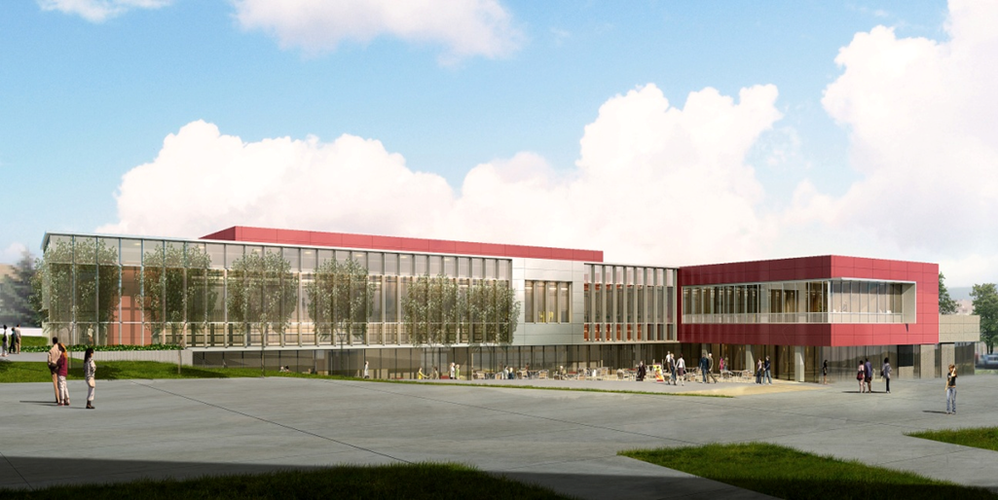
The key to success is a strong foundation!

Slide 15
Answer 6: 2
How many gifts should each student give his/her teacher to be sure to get a good grade?
How many hours of homework will students have for each hour of class?
How many U.S. politicians have a brain?
Answer: B. Let’s do the math...

Slide 16
Answer 7: The Integrated Learning Center, Self-Access Learning Materials, Instructor’s Office Hours, the Tutoring Center, the Writing Center, the LPC Library.
Where can I eat my lunch?
Where can I get help with my classes?
Where is the best place to find a new boyfriend or girlfriend?
Answer: B

Slide 17
Answer 8: Daytime and Evening
When should I brush my teeth?
When should students bring coffee to their teachers?
When does LPC offer ESL courses?
Answer: C. We offer both daytime and evening choices for most of our classes. Evening classes can be an excellent choice for International students!

Slide 18
Answer 9: International Students Club
What is the name of the international organization dedicated to creating dance parties for world peace?
What is the name of the international restaurant on Dublin Boulevard specializing in dolsot bibimbap?
What is the name of the most fun student club on campus?
Answer: C. Get Involved! It’s fun, it’s a great way to meet people, and it looks great on your transfer application!

Slide 19
Answer 10: Stupid and Mean
What are the names of Sean’s brothers?
Who are the two Republican candidates running for president?
What are 2 qualities that you will never find in LPC ESL teachers?
Answer: C. Please get to know your teachers! They really want to get to know you!

Slide 20
Answer 11: It is the most important thing you’ll need to succeed as a student at a U.S. college.
What is “a lot of money?”
What is a good sense of humor?
What is English?
Answer: C

Slide 21
Answer 12: Take as many units as you can and try to finish your classes (especially ESL classes) as quickly as possible.
What is the best way to do well in college?
What is the best way to do poorly in college?
What is the best way to save lots of money?
Answer: B. Take your time, enjoy your education, and build a solid foundation in English!

Slide 22
ESL Advice
Work Hard
Be Patient
Get to know your class-mates – Speak English
Get to know your instructors
Have fun!

Slide 23
Remedial English
Non-native English speaking International students are strongly advised NOT to take remedial English classes (English 100A or 104)
Designed for native English speakers who did not learn appropriate skills for College level English
ESL is much better preparation for non-native English speakers to be eligible for and SUCCEED in English 1A (Critical Reading and Composition)!

Slide 24
LPC English Language Proficiency Policy
Students can enroll in Academic Classes when they:
Provide English language proficiency by:
TOEFL (iBT) score of 45
IELTS score of 4.5
ITEP with Level 4
STEP Eiken with Grade 2A OR
Reach ESL 2B (High Intermediate) level (strongly recommended to take ESL classes along with Academic classes) OR
Lower ESL level with Counselor approval

Slide 25
Thank you for choosing to come to Las Positas College to study! We hope that you have fun and learn many new things...
We look forward to getting to know you!

Slide 26
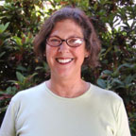
ESL Program
Marilyn Marquis
ESL Instructor
Office: Building #2400
Room: 2411P
Phone: 925-424-1209
E-mail: mmarquis@laspostiascollege.edu

