Slide 1
Working Together
FLEX Day – February 16, 2016
11 AM – 11:50 AM (with Brown Bag lunch at 12) Room 2206
Organized by Howard Blumenfeld, Steve Chiolis, Brittany Miller, and Marsha Vernoga
Powered and developed by YOU!!!!

Slide 2
Follow us in the Cloud
You can follow along with the contents of this PowerPoint presentation in the cloud by visiting the following link:
http://1drv.ms/1PoYvBS

Slide 4
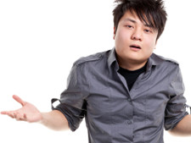
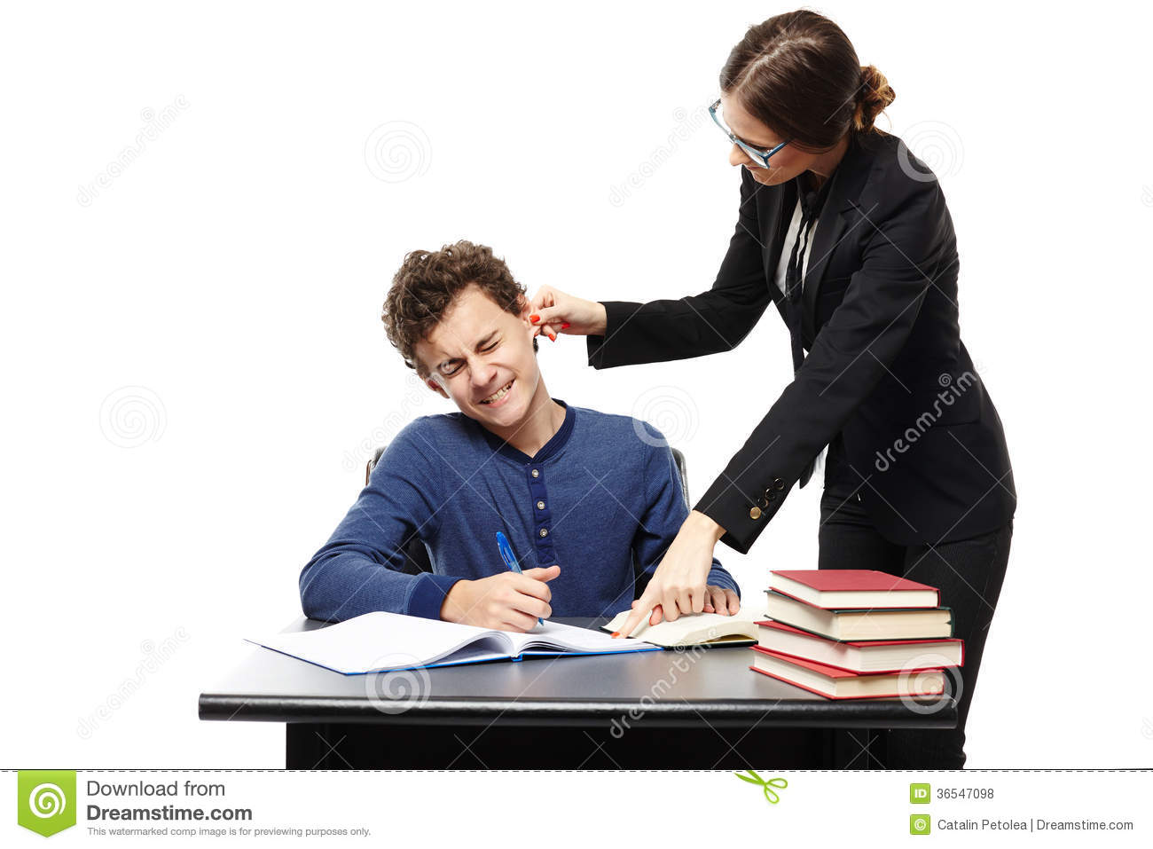
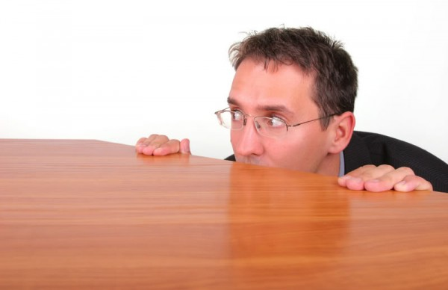
Tales of Vulnerability
Notes:
This is where each of us will tell our 3-4 minute anecdote. If you wish to include additional slides with your anecdote, you may do so here, or you can just send them to me and I will insert them into the presentation.

Slide 5
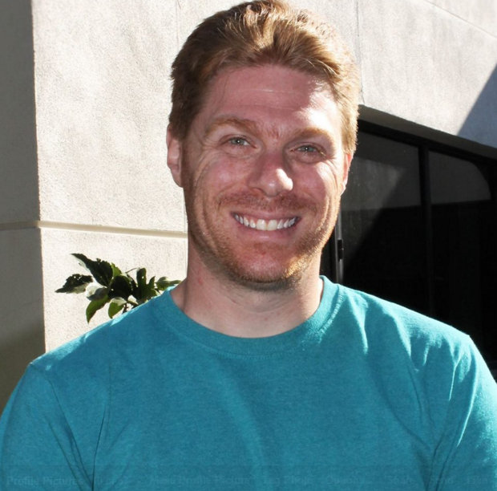
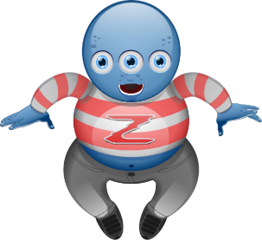
Aliens, Racism, and a Repugnant Student (Howard Blumenfeld)
Awkward conversations before class
Fear of the unknown and retaliation
An unsteady relief

Slide 6
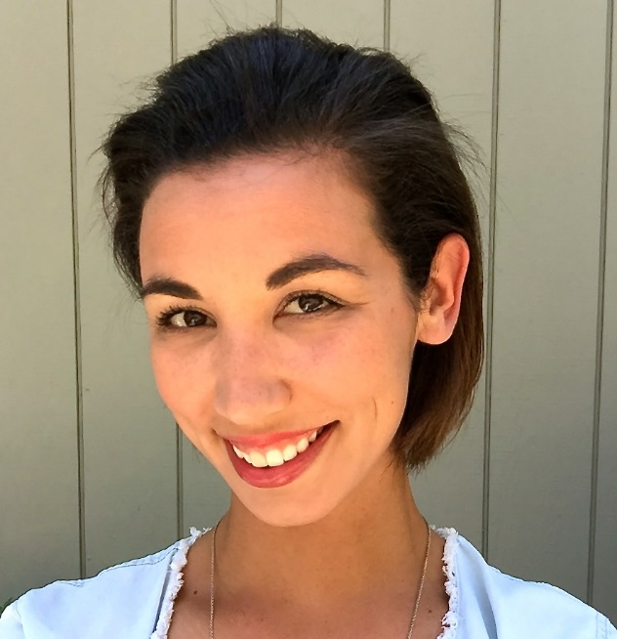
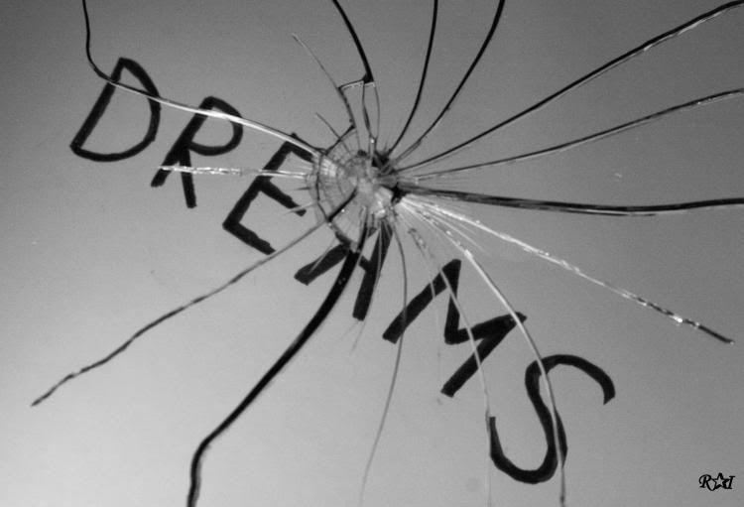
I’m disappointed. (Brittany Miller)
American Dream (Academy Edition)
Dream Deferred
What now?

Slide 7
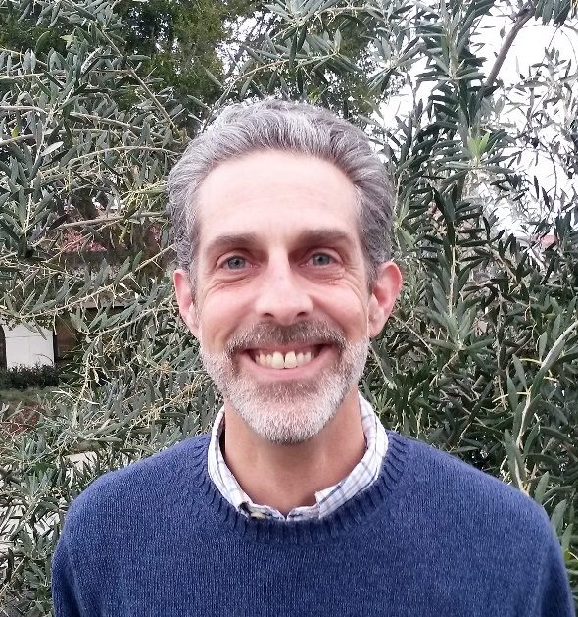
Sometimes it can’t wait. (Steve Chiolis)
Instant Active Listening
When the rules don’t seem to apply
Did I handle this correctly?

Slide 8
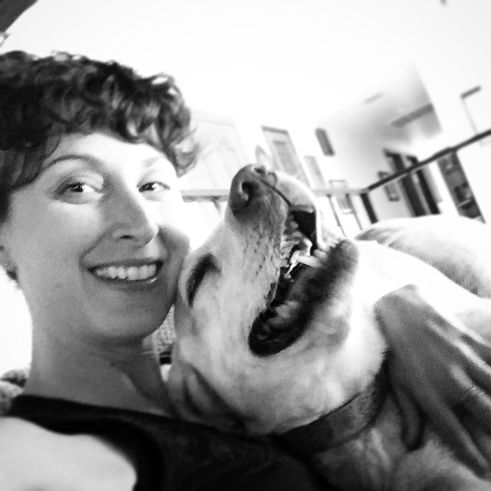
Did they not have a lot of applicants? (Marsha Vernoga)
What have I gotten myself into?
A veiled insult
College Day

Slide 9
Our idea
Goal: regular meetings; small groups
Each group determines meeting frequency
Your input needed:
how can we best use our time to form engaging and effective communities together?

Slide 10
Availability
Group breakout session facilitators:
Brittany Miller
Marsha Vernoga
Howard Blumenfeld
Steve Chiolis

Slide 11
Questions to answer in groups
Think of a time in your teaching (working with others) when you felt exposed, didn’t know what to do. How did you react?
Have you ever felt absolutely foolish in the classroom? Tell us about it.
How do we support each other during moments of vulnerability?
Notes:
When we break up into groups, each of us will have a marker and a few pieces of large post-it notes to write on. We should split up into the four different corners of the room. Groups should ideally be split up by our designated time slots.

Slide 12
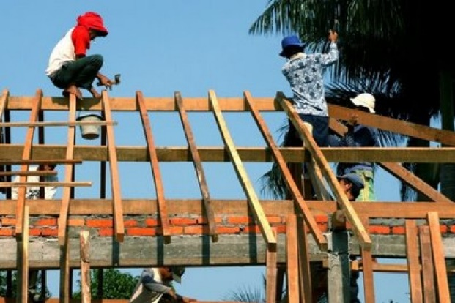
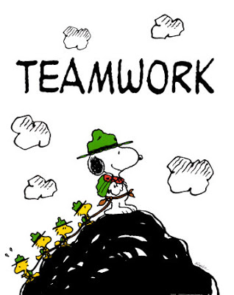
Working Together
Brown Bag Lunch Session – Video showcasing Vulnerability by Brene Brown (12 – 12:20 PM) followed by informal discussion.
If you are interested in continuing these conversations and would like to be a part of a small group, please fill out the following form online:
http://goo.gl/forms/rWR7Tb2obl

Slide 13
Vulnerability Brown Bag Lunch Session

Slide 14
Thank you!
We hope you enjoyed our FLEX day activity and look forward to seeing you again soon!
Feel free to contact any one of us in person or by email if you have any questions, comments, or feedback.
The form to fill out if you are interested in being a part of future meetings is http://goo.gl/forms/rWR7Tb2obl

