Slide 1
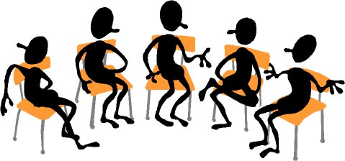

Working Together: Grading Theories and Practices
FLEX Day – October 24, 2017
1:00 PM – 2:50 PM
Room 2470
Organized by Howard Blumenfeld, Steve Chiolis,
Marty Nash, and Marsha Vernoga with special guests Elena Cole and Frances Hui

Slide 2
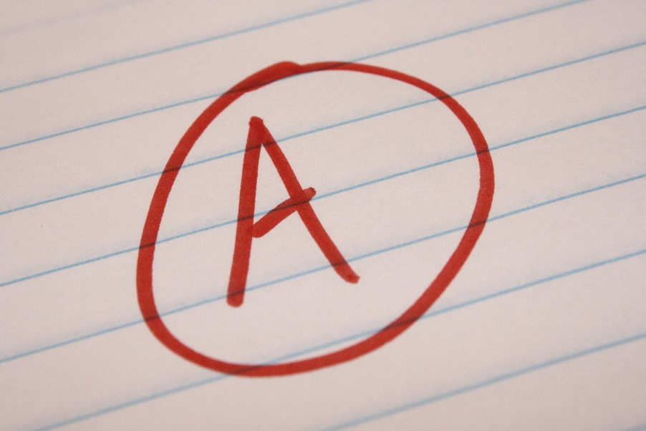




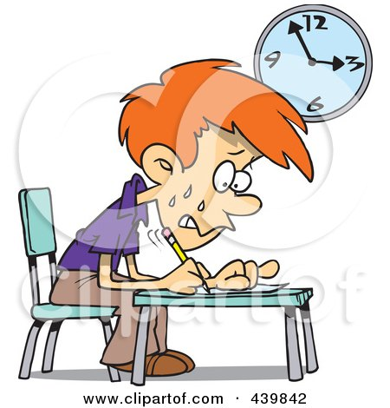

Slide 3
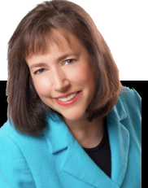
De-Grading Education
Elizabeth Wissner-Gross is an author and educational strategist based in New York. She has helped many high school and college students to discover their passions and get into the right college or university to further their studies.

Slide 4
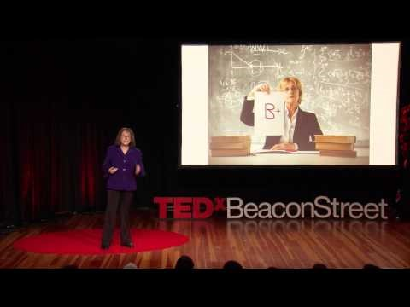
De-Grading Education

Slide 5
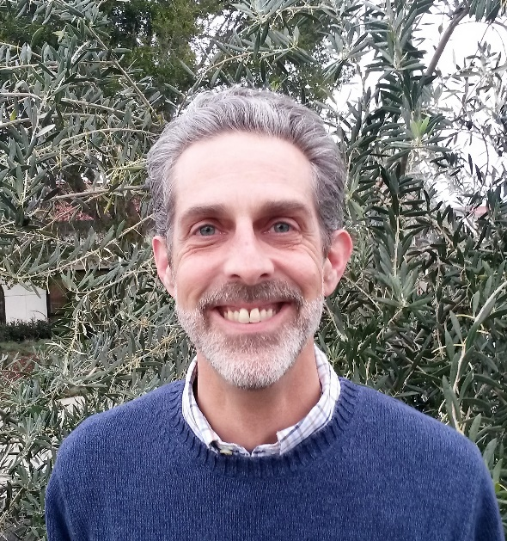

A Brief History of Grading (Steve Chiolis)
Bullet Points about the evolution of modern grading as an educational norm in the classroom, including what methods of evaluation preceded modern grading practices.

Slide 6
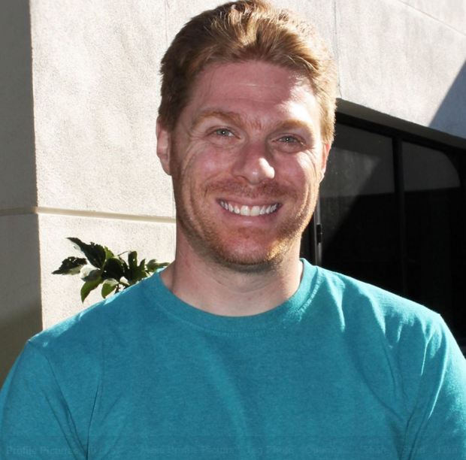
To Grade or not to Grade? That is the Question (Howard Blumenfeld)
Bullet Points about deciding whether or not to grade certain assignments, quizzes, etc. Can we motivate students to learn without using the fear of grades? What about dropped assignments, leniency, and extra credit?

Slide 7
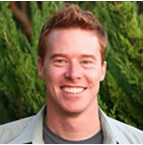
Honoring the Teaching Process (Marty Nash)
Bullet Points discussing the difference between teaching as a process and a product.

Slide 8
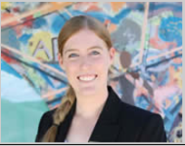
The Purpose of Feedback (Elizabeth Owens)
Is feedback defending the grade you’ve given or is it really for the student?

Slide 9
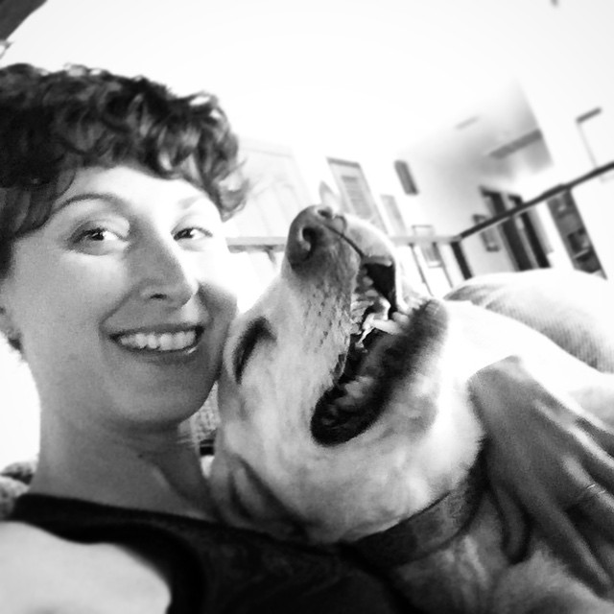
Can Students Grade Themselves and Each Other? (Marsha Vernoga)
Bullet Points for self-generated rubrics and answer keys.

Slide 10
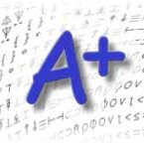
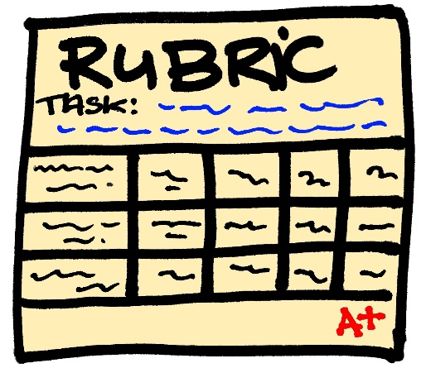
Small Group Breakout Sessions
Group breakout session facilitators:
  Marty Nash & Steve Chiolis
  Marsha Vernoga & Elizabeth Owens
  Howard Blumenfeld

Slide 11

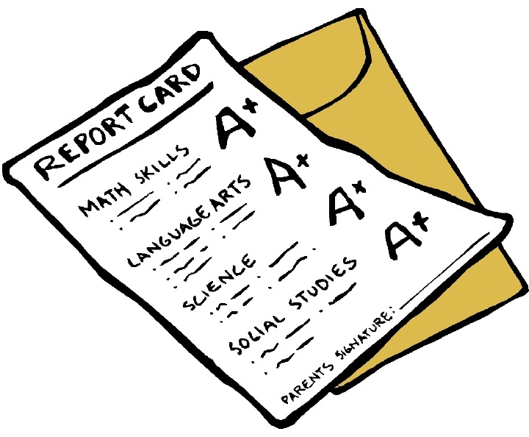
Questions to answer in groups
  Question #1
  Question #2
  Question #3

Slide 12


Reflections
  Briefly summarize highlights of small group discussions.

Slide 13

Where do we go from here?
Changed format of “Working Together” Small Group Conversations
The Teaching Institute
Other Workshops
Hand out surveys

