Slide 1


Fostering a Sense of Belonging
Caring Campus at LPC
New Faculty Meeting
December 10, 2025

Slide 2
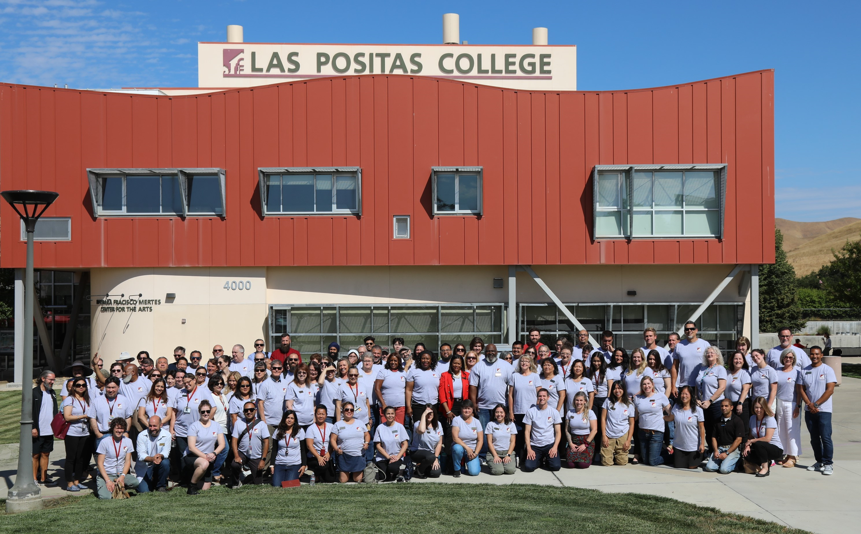
What is Caring Campus?
Caring Campus is a program that encourages connection with students by faculty, classified professionals, and administrators
Studies show that when students feel a sense of belonging, they persist at higher rates. For this reason, LPC has adopted three behavior commitments.

Slide 3

Behavioral Committments
03.

Slide 4
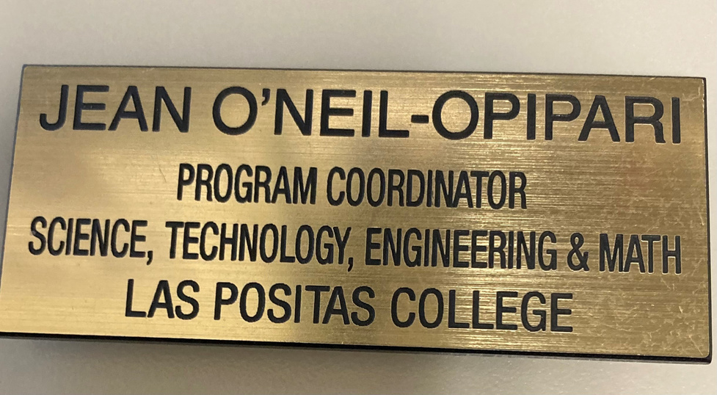


LPC’s Behaviorial Commitments
Wear a nametag
Warm Handoff
Cross Departmental Awaremess

Slide 5


Additional ways to support students

Slide 6


LPC Basic Needs

Slide 7

Resources at LPC
Assessment Center (1642)
Basic Needs Center (Welcome Center, 1600)
Black Cultural Resource Center (1726)
Career & Transfer Center (1604)
Computer Center (21206)
Cultural Community Center (2401)
Disability Resource Center (DSPS) (1615)
English Center (1st floor 2100 Bl)
EOPS / CalWORKs / CARE / NextUp (1668)
Health and Wellness Center (1710)
Veterans First Program (1310)
Tutorial Center (21215)
Reading & Writing Center (RAW) (Tutorial Center)
Registration Support Center (1672)
Student Life Office (1643)
Las Positas College Student Government (LPCSG) (1643)
Student Clubs (1643)

Slide 8

Caring Campus Office
Jean O’Neil-Opipari
925-424-1306
joneilopipari@laspositascollege.edu
Building 2100, Room 21128

