Slide 1
Student Learning Outcomes
Ann Hight
Chair, SLO Committee

Slide 2
Outcomes for this presentation
Upon completion of this session, new faculty will be able to
  Explain a student learning process to reach an outcome.
  Design assessments to produce a high-stakes judgement about student knowledge and skills at the conclusion of a learning process.

Slide 3
Grades
Learning Outcomes

Slide 4
What are outcomes and why do we use them?
Notes:
Accreditation, improving instructional effectiveness, improve student learning, allocating resources

Slide 5
Student Learning Outcomes
Describe the types of knowledge, skills, and abilities students can demonstrate at the end of your class.

Slide 6
Assessment Data
Productive use of assessment data
  internally to inform and strengthen undergraduate education
  And externally to inform policy makers and other stakeholders

Slide 7
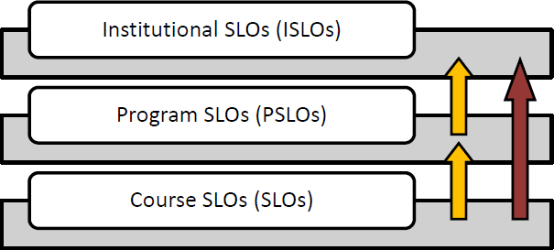
Student Learning Outcomes
Notes:
eLumen Curriculum map for Bio AA
https://laspositas.elumenapp.com/elumen/Controller?actionClass=vieworg&processType=navigate&toTabItem=CurriculumMap

Slide 8
SLO-centric
Course Design
Requires “reverse engineering”
Guides the development of
  Course content/objectives
  Pedagogical methods
  Opportunities for feedback
    Rubrics
Developing assessment(s) linked to the outcomes
Early Attempts
Developing Competences
End-of Process Achievement

Slide 9
Practice makes progress,
Not perfect
Early Attempts
Developing Competences
End-of Process Achievement
For instructors, practice guiding and coaching instead of the “traditional method” of presenting and grading

Slide 10
Practice makes progress,
Not perfect
Develop opportunities for practice
Low-stakes
Practice allows for learning competencies
Early Attempts
Developing Competences
End-of Process Achievement
Ideas?

Slide 11
SLO-centric
Course Design
Developing meaningful assessments linked to a student outcome
Designing projects, examinations, performances, writing prompts, and other tasks that allow students to demonstrate what they know and can do is one of a faculty member’s most consequential roles.
Early Attempts
Developing Competences
End-of Process Achievement
Types of Assessments?

Slide 12
Guiding Students

Slide 13
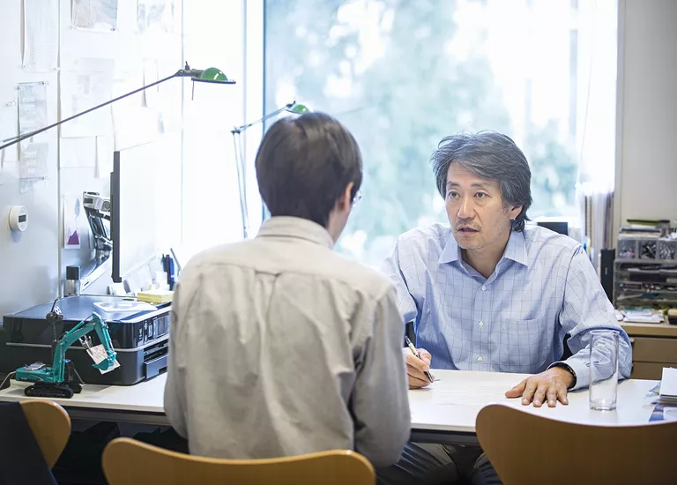
A student focusing on getting a good grade…
I messed up on the midterm, can I still get an “A”?
I need to get an “A”
???
Is there extra credit?
Hisayoshi Osawa/Getty Images

Slide 14
Shifting the focus to task-oriented goals instead of grades
Instead of grades, students should focus on the opportunities for PRACTICE.
For example:
  Committing to doing homework
  Dedicating a set time for exam preparation
  Reviewing the previous lecture before attending class again
  Etc.
https://www.insidehighered.com/news/2017/08/01/research-suggests-students-may-make-more-academic-progress-focusing-task-oriented
Ideas?
Notes:
Focusing on the practice instead of the assessment.

Slide 15
Shifting the focus to task-oriented goals instead of grades
Traditional practice = “get the right” answers
Develop challenges to push students to use what they’ve practiced to do the best they can.
Ideas?

Slide 16
eLumen
LPC’s tool to document, use, and report evidence of student accomplishment.

Slide 17
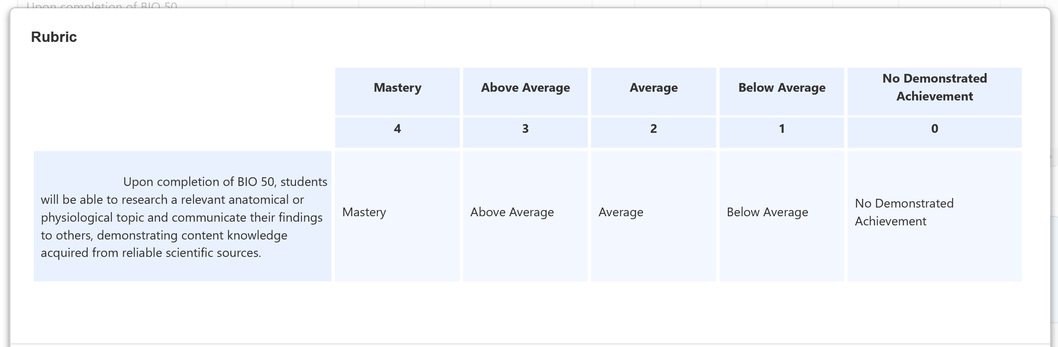
Default Rubric

Slide 18
eLumen
Enter assessment data
Answer reflection questions of assessments
Then submit

Slide 19
After eLumen
“Closing the Loop”
Using assessments to refine pedagogy
For yourself, with other faculty, within the department
Role of program review

