Slide 1

Payroll-BENEFITs road show
Presented by:
Lori Benetti
and
Deborah Dobbins

Slide 2

Overview
Types of Pay/Earnings
Payroll Deductions
Medical and Other Leaves
Retiree Pension and Health Benefits
Employee Health Benefits
Work Related Injuries & Illnesses

Slide 3
Types of Full-Time Pay
FT Faculty paid by the day
  Column 2/Step 4 = $66,547 yr.
  $66,547/175 days = $380.26 a day
  175 days is min. requirement for a full year of service credit with STRS
  Overload is paid in equal installments based on number of months worked
  Office Hours on Overload – paid in equal payments excluding August
  Alternate Duty/F-Hour Assignments – paid by timesheet with H.R. approval
  Evaluations – paid by timesheet

Slide 4
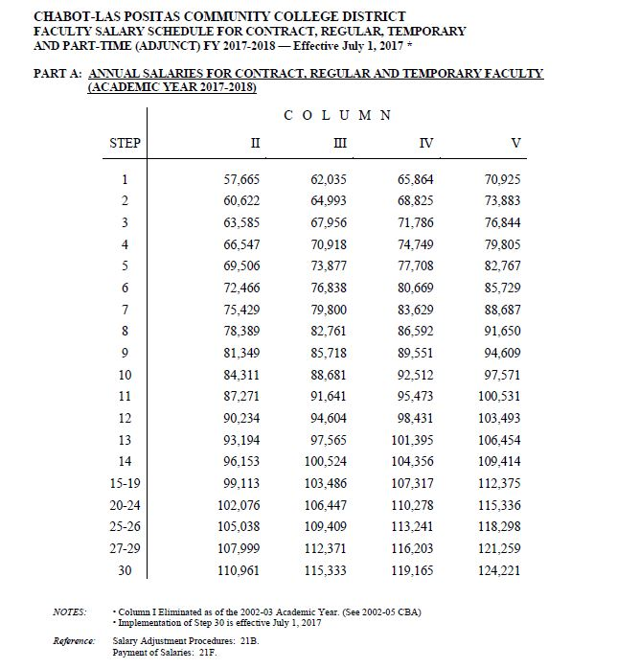

Full-time salary schedule

Slide 5
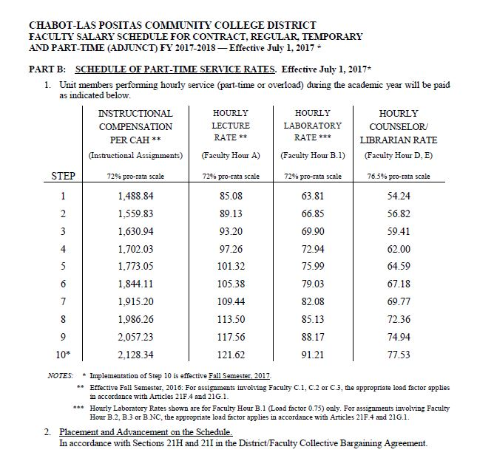
CAH Overload Schedule
Paid by load, not by hourly rate (exception counselors & librarians)
CAH is a Faculty Hour A, B, & C

Slide 6

Payroll Deductions
STRS
  Reported as earned not as paid
  12 month employee will have 10 deductions
  Excess refund
Union Dues
  .60% of all earnings
FACCC Dues
  $18.90 per month for 10 months
SDI
  Not covered
Social Security
  Not covered with STRS
Health Benefits
  Paid in advance over 10 months
  In Lieu benefits $400
Flexible Spending
  Medical $2,600
  Dependent Care $5,000
  Over 10 months
I50 – Taxable gross inc.
Voluntary Life Ins.
  Age based on employee
  $500,00 maximum $10,000 children
Voluntary American Fidelity Ins. Products
  Cancer, Life, Long Term Care, Accidental Death

Slide 7

CalPERS Contributions
Connect with CalPERS
Directly
1-888-225-7377
www.
CalPERS.
ca.gov
Hire dates and plans |  | 2016-17 | 2017-18
Before 1/1/13 | Classic | 7.00% | 7.00%
On or After 1/1/13 | PEPRA | 6.00% | 6.50%
All Dates | Employer | 14.165% | 15.531%

Slide 8

CalSTRS Contributions
Connect with CalSTRS
Directly
1-800-228-5453
STRS Rates |  | 2016-17 | 2017-18
Hired before 01/01/2013 | Classic | 10.250% | 10.250%
 | DBS | 9.205% | 9.205%
Hired after 01/01/2013 | PEPRA | 9.205% | 9.205%
 | DBS | 9.205% | 9.205%
All Dates | Employer | 12.580% | 14.430%
www.
CalSTRS. com

Slide 9
Medical or Pregnancy Leave
The Benefits Office requires a note for any illness lasting 1 week or longer.
Each department may request/require notes for their records based on departmental policy.
Sick, Pregnancy, Bonding, Parental Leaves, FMLA/CFRA
  Absence: Leave of Absence (LOA) Request
  Request 30 days in advance or as soon as possible
  Include note from your physician
  Leave to care for a family member – special form to be completed by family member’s physician

Slide 10
Paid/unpaid Leaves
Payroll
Sick Leave Reporting
Sick leave loaded in advance
  10 days 8 hrs. per day
Personal Day(s)
Sick Leave donations
Extended sick leave Differential pay*up to 100 days per year
100 days w/o pay
18 Month Re-employment list
*Differential pay will effect future STRS benefits.
A full sick day is 8 hrs. no matter class time scheduled
A partial day is percentage of scheduled hours missed. (3/6 = 50%)
Faculty minimum obligation is 175 days per year
During extended illness unscheduled days are deducted from sick leave (Fridays)

Slide 11
Other leaves
Sabbatical Leave
Reduced Work Load
Full Academic Year will be 75% of annual salary
1 Semester will be 90% of annual salary
Library & Special Assignments Faculty will be 95% of annual salary for the semester
Workload banking may be used to augment salary
STRS credit may be purchased after completion of Sabbatical leave
Must have reached age 55 prior to reduced work load
Must have been employed full time at CLPCCD with at least 10 years of creditable service
Please see contract for further restrictions and requirements
STRS requires at least 50% FTE

Slide 12


Personal Necessity and Bereavement
Bereavement for “Family”
Mother, Father
Brother, Sister
Grandparents and grandchildren
In-laws – parents,
son, daughter
Spouse, Significant Other, Domestic Partner, Relative in household or by Chancellor approval
Personal Necessity
Maximum of 56 hours per fiscal year
Must be handled during business hours
Full dock for overuse of personal necessity*
Personal Day
1 day per academic yr.
*Dock pay may effect future service credit with CalSTRS
Bereavement Leave
3 Working Days
5 Days if traveling out of state or 350 air miles is required

Slide 13
Planning for Retirement?
Benefits Received
Retirement Age
Years of Employment
Highest Salary
403(b) & 457 Plans
District Health Benefits
Social Security & Medicare
CalPERS CalSTRS Pension

Slide 14
CalPErs Pension estimates
**estimate only**
Charlie Brown DOB 07/01/1962 Current Service Credit = 20 yrs. |  |  | Planned Retirement Date: 07/01/2019 Final Compensation: $4,735 Sick: 50 Hours
 | At Age 57 | At Age 58 | At Age 59 | At Age 60 | At Age 61
Scenario 1 | $2,253 | $2,419 | $2,591 | $2,771 | $2,955
Charlie Brown DOB 07/01/1962 Current Service Credit = 20 yrs. |  |  | Planned Retirement Date: 07/01/2023 Final Compensation: $4,735 Sick: 434 Hours
 | At Age 61 | At Age 62 | At Age 63 | At Age 64 | At Age 65
Scenario 2* | $3,322 | $3,534 | $3,752 | $3,880 | $4,009
*Assumes 6% wage increase over 4 years, 5% longevity & 4 yrs. Sick leave accrual.

Slide 15
Calstrs Pension estimates
**estimate only**
Information Provided for Estimates:
Retirement date: | 10/12/2037 | 10/12/2040 | 10/12/1943
Your age at retirement | 60 | 63 | 66
Years of service credit (incl. sick leave) | 25 | 28.714 | 31.714
Sick leave included | ( 0 ) | ( 125 Days) | ( 125 Days)
Age factor based on DOB 10/12/1977 | 0.02 | 0.024 | 0.024
Average monthly salary over 3 year period (Final compensation) | $9,117.42 | $9,364.25 | $9,611.08
Member-Only Benefit | $4,558.71 | $6,453.24 | $7,315.34
Service Credit X Age Factor X Final Compensation = Member-Only Benefit

Slide 16
Windfall Elimination provision
May apply if you receive a STRS pension and you qualify for Social Security Retirement
Reached 62 or became disabled after 1985
First became eligible for a STRS pension after 1985
If you have more than 20 or less than 30 years of Social Security reported earnings your Social Security Pension will be decreased.

Slide 17
Voluntary Tax deferred savings
403(b) and 457 Plans using Pre-tax money reduces your annual taxable income.
$50 month, net cost $32 after 20 yrs. $25,520 cost $12,000*
$100 month, net cost $63 after 20 yrs. $51,041 cost $24,000*
*Assumption of annual growth rate of 7%
*Assumption of marginal tax rate of 37% combined

Slide 18
Retiree Health Benefits
MidAmerica/American United Life Insurance Co. HRA Plan
Contribution of $200 per month for Regular FT and prorated for less than FT
Quarterly Statements
HRA Plan after 5 year vesting period
Available after separation
Reimbursement for
  Insurance premiums for Medicare B & D and Long Term Care
  Retirement Home (medical) Fees
  Automobile Modifications

Slide 19

Changing your Benefits
When to make changes
With proof of Life Event - 30 days to make changes
Marriage or Divorce
FTE Change
Loss of coverage
Birth or Death
Notes:
If forms rcvd be sure both rcvd and completed.
If knowledge of Life Change refer EE to us.

Slide 20
Employee Benefits
Dental Plans
  Standard $2,000 max.
  Enhanced $4,000 max.
Vision Plan
Life Insurance
  Benefit based on age
Supplemental Life Insurance
  Self, spouse/partner and children
Medical Plans
  Kaiser Permanente
    $5 or $20 Copayment
  Anthem Blue Cross
    HMO $15 or $30 Co-pay
Flexible Spending
  Medical Expense Reimbursement $2,600
  Dependent Care $5,000
  Transit Program
EAP Programs

Slide 21
Flexible Spending
$$
$$
What is it all about?
Sample Expenses
Can’t write off medical expenses from taxes?? Flex reduces taxable income.
Kids need Orthodontics?
Dental Ins. only pays part of cost
What about Chiropractic services?
Anybody…. Seriously, anybody??
Carry over of up to $500 into the next plan year!
Glasses/contacts
Dental expenses
Medical and Rx co-payments
Acupuncture
Medical travel/ mileage costs
Must Enroll Every Year

Slide 22
Flexible Spending
$$
$$
Dependent Care
Transit Expenses for work commute only
Set aside up to $5,000 pre-tax to pay for daycare costs.
Licensed care providers
BART/bus tickets
BART Parking
Van pools
Flexible spending contribution of $232 per month reduces taxes by $76.31 per month.*
*Assumption of marginal tax rate of 27% combined.

Slide 23

Employee assistance program
Work/Life Services:
Parenting & Childcare Resources
Summer care, New baby kits, Children with special needs
Legal & Financial Consultations
Estate planning, Probate, Marital,
Consumer, Business, Real Estate,
Taxes, Child Custody and Support
Eldercare Resources
Home Health Care, Assisted Living,
Transportation Services, Nutrition
Call 1-800-344-4222 or www.concern-eap.com

Slide 24
Work related injuries & illnesses
Always report incident to manager or Dean immediately or ASAP
If you need medical attention go to Stanford/Valley Care or any Kaiser Occupational Medicine
If coworker is unable to drive themselves – call an ambulance!

Slide 25
Payroll-BENEFITs road show

