Slide 1

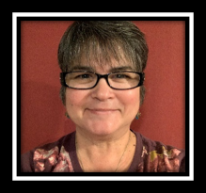
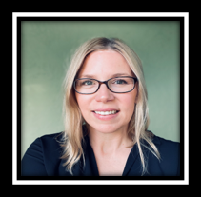

Meet ComplyBot:
Your Accessibility + Course Design Assistant
Wanda Butterly
Instructional Technology Specialist
wbutterly@laspositascollege.edu
Kat King
Instructional Technology Coordinator
kmking@laspositascollege.edu

Slide 2

Workshop Description
Are your course materials accessible to all your students? We’ll show you how to quickly check and introduce you to a new tool that can dramatically improve your students’ experience. Come learn how to:
Quickly identify accessibility errors on Canvas.
Leverage ComplyBot to dramatically reduce the time and effort required to make your course materials accessible.
Quickly create ADA-compliant design features (like buttons and accordions) that can improve your students’ experience in your courses.
Meet the April 2026 deadline for colleges to ensure everything online - including in Canvas - meets accessibility standards.
We’ll start the workshop with demos and then shift to hands-on time for you to work on your course materials

Slide 3
What's new with accessibility?
ESS 26-17: Accessibility Standards and Revised ADA Title II Regulations - Memo from the CCCCO that clarifies our responsibilities and implementation expectations
Essentially – anything online must meet web accessibility standards (WCAG 2.1 Level AA). This includes all content in Canvas, whether your course is on campus or online.

Slide 4
What are web accessibility standards?
Perceivable
Formatting that ensures equal access to online materials. Some examples include:
Using "Headings"
Creating descriptive hyperlinks
Considering color contrast
Tagging images with alternative text
Captioning videos
And more...
Operable
Understandable
Robust
Learn more: WCAG 2.1 Level AA

Slide 5
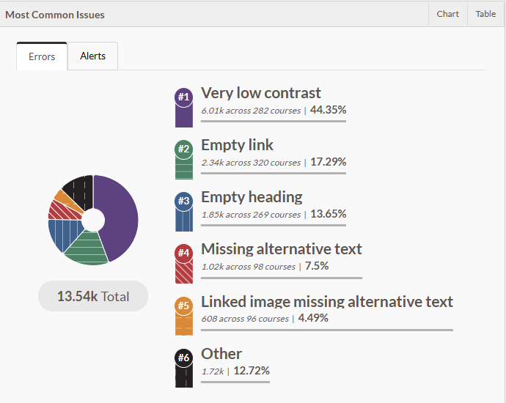
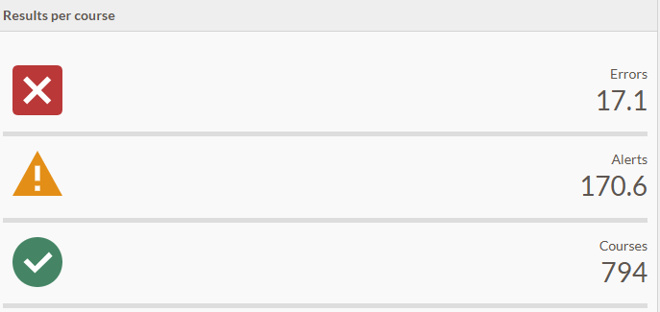

Common Canvas Accessibility Errors

Slide 6
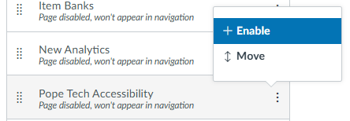

Checking Accessibility in Canvas
If you don't see "Pope Tech" in Canvas:
Open your course.
Click "Settings" in your course navigation menu.
Click the "Navigation" tab.
Scroll until you see Pope Tech Accessibility.
Click the 3 vertical dots and select "+ Enable."
Scroll to the bottom and click "Save."
Canvas Guide: Manage Course Navigation Links

Slide 7
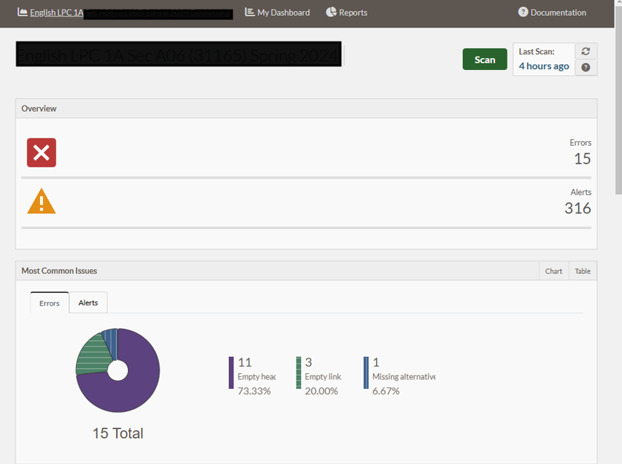
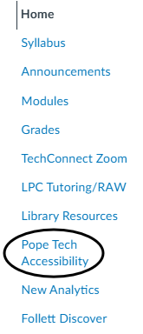
Pope Tech Dashboard
Click Pope Tech in your course navigation menu to scan your entire course. You'll get a list of all the content that needs to be fixed + tutorials!
Instructor Guide: Canvas Pope Tech Dashboard Tutorials

Slide 8
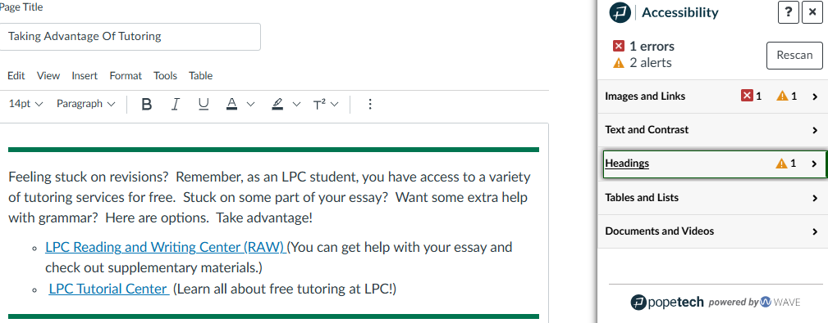

Pope Tech Accessibility Guide
Click the "P" to open the Accessibility Guide when building/editing content on Canvas. Click through to fix any errors and check alerts.
Instructor Guide: Canvas Pope Tech Accessibility Guide Tutorials

Slide 9

Lots of errors? Meet "ComplyBot"
The amazing Wanda Butterly created an accessibility assistant for all of you!
It's been trained on accessibility and UDL standards and can help you make quick fixes to documents and Canvas content.
Try ComplyBot
Always check the results! Ask ComplyBot to make edits or make them yourself.

Slide 10
ComplyBot Testimonials
"I can't even put it in words HOW GOOD the transformation from before and after is in my Canvas course! You must try it." -Drew Patterson, BUS
"ComplyBot has been a game-changer for my Canvas courses. I simply copy and paste HTML code, and it instantly transforms plain pages into stunning, eye-catching content using colorful fonts, borders, and call out boxes. It’s incredibly easy to use, and I really appreciate learning about this tool." -Karen Oeh, ANTH
"I just love how focused and organized your classes are, from what I've learned in just the first week it's like the most organized classes I have ever had. I can tell that you really care about your students and want us to succeed." -LPC Student to Meghan Swanson, ENG

Slide 11
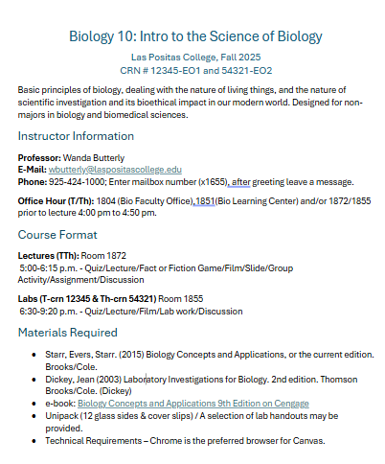
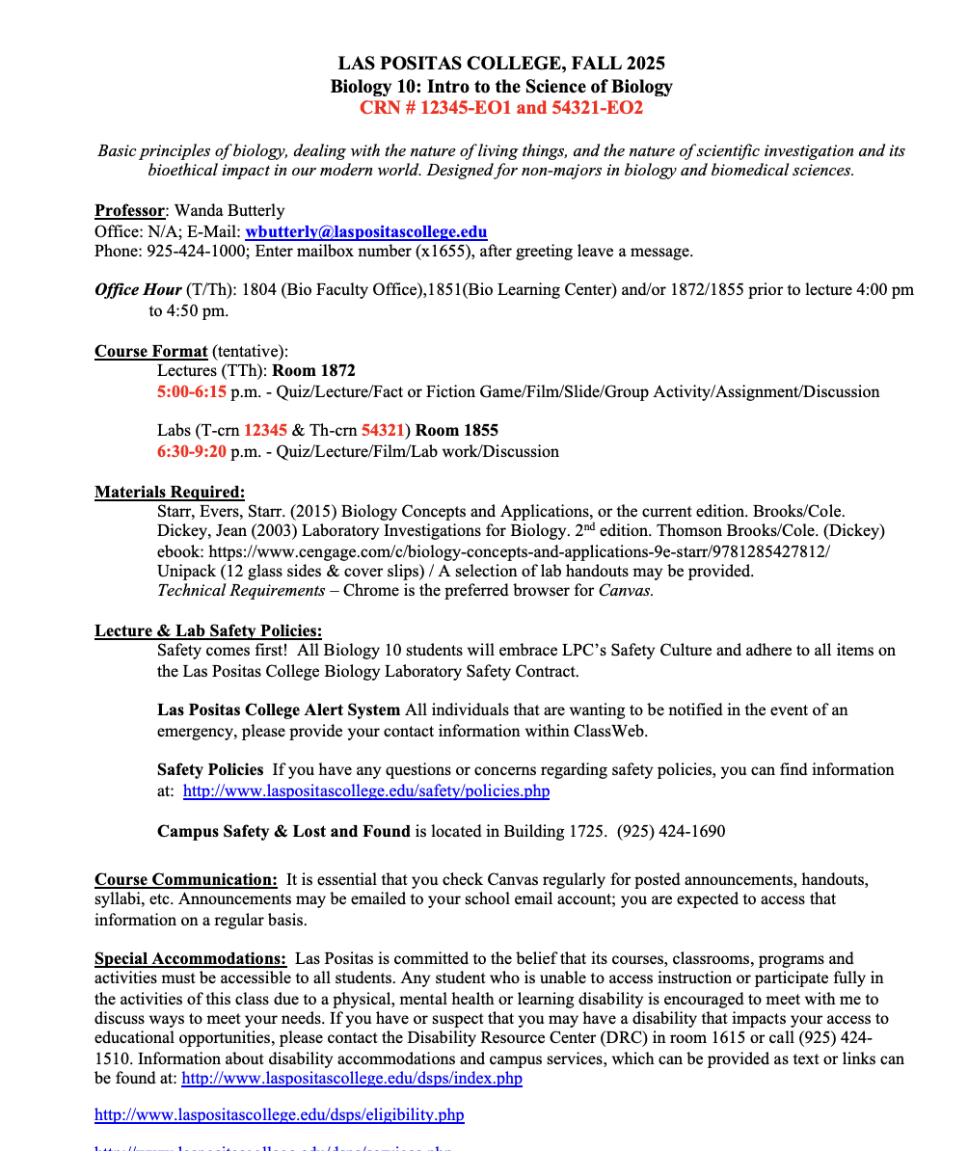
Video Tutorial: Document-to-Document
Improves accessibility; applies heading structure, creates descriptive links, etc.

Slide 12
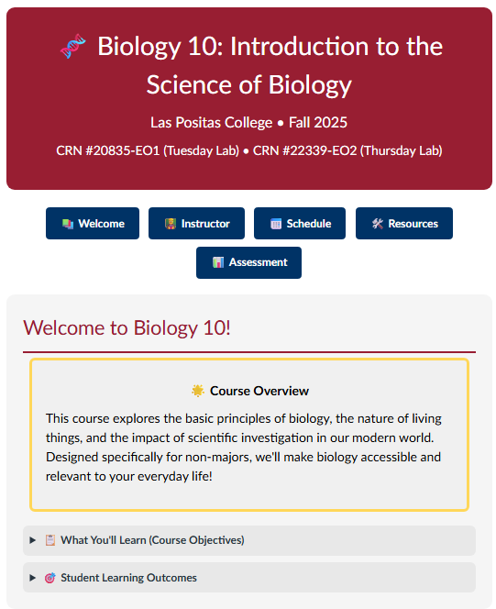
Video Tutorials: Doc-to-Canvas or Canvas-to-Canvas
Fixes for accessibility + adds design features like buttons, callout boxes, and accordions

Slide 13
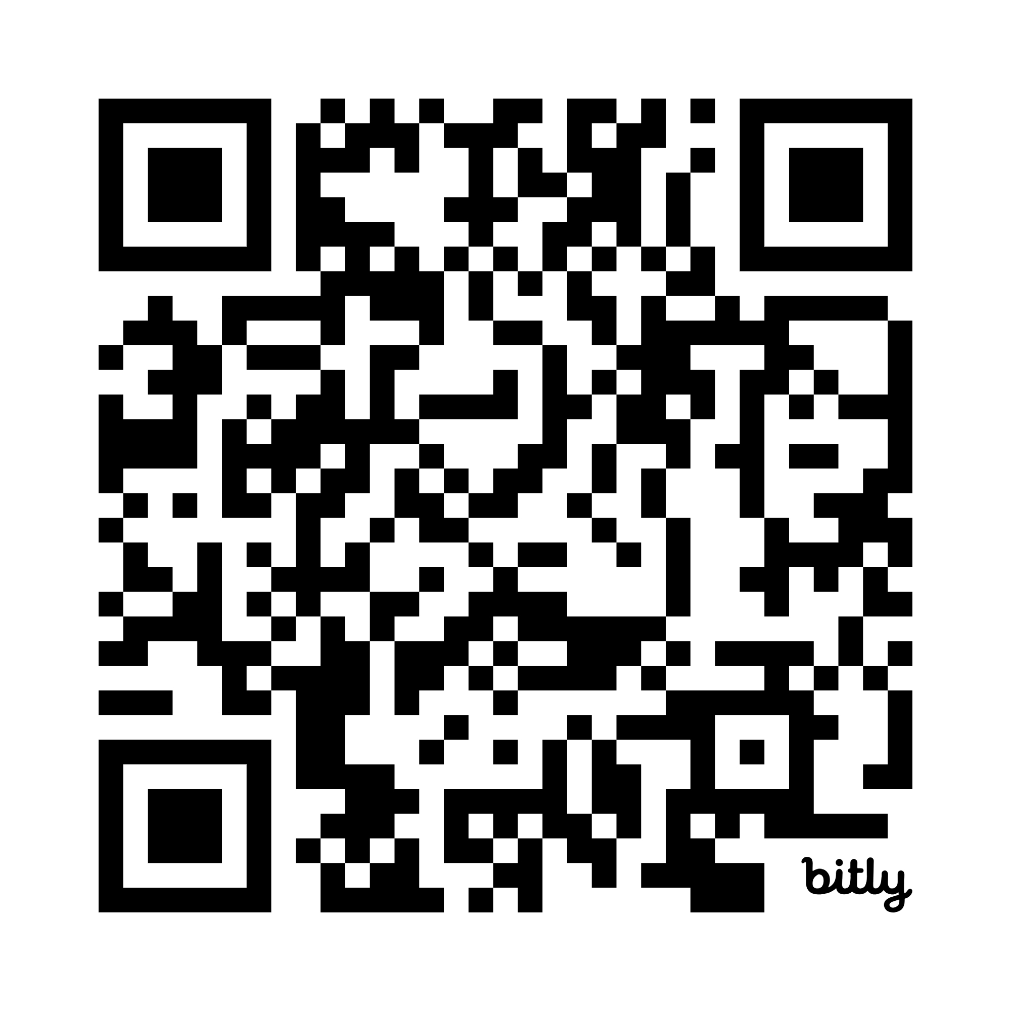
Tinker Time
Open your Canvas course.
Run a Pope Tech scan.
Work on fixes with the Pope Tech Accessibility Guide.
Or work on fixes with ComplyBot. (Always review results!)
Ask questions as they come up!
Scan for slides or go to bit.ly/4uBpK8v

Slide 14
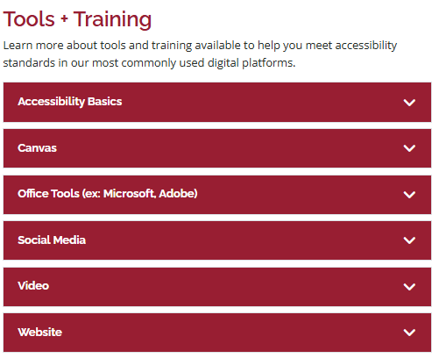
What other tools/training are available?
Explore options on LPC's Web Accessibility webpage.
Don't see training or tools you need? Reach out to the Teaching + Learning Center or Disability Resource Center.

Slide 15
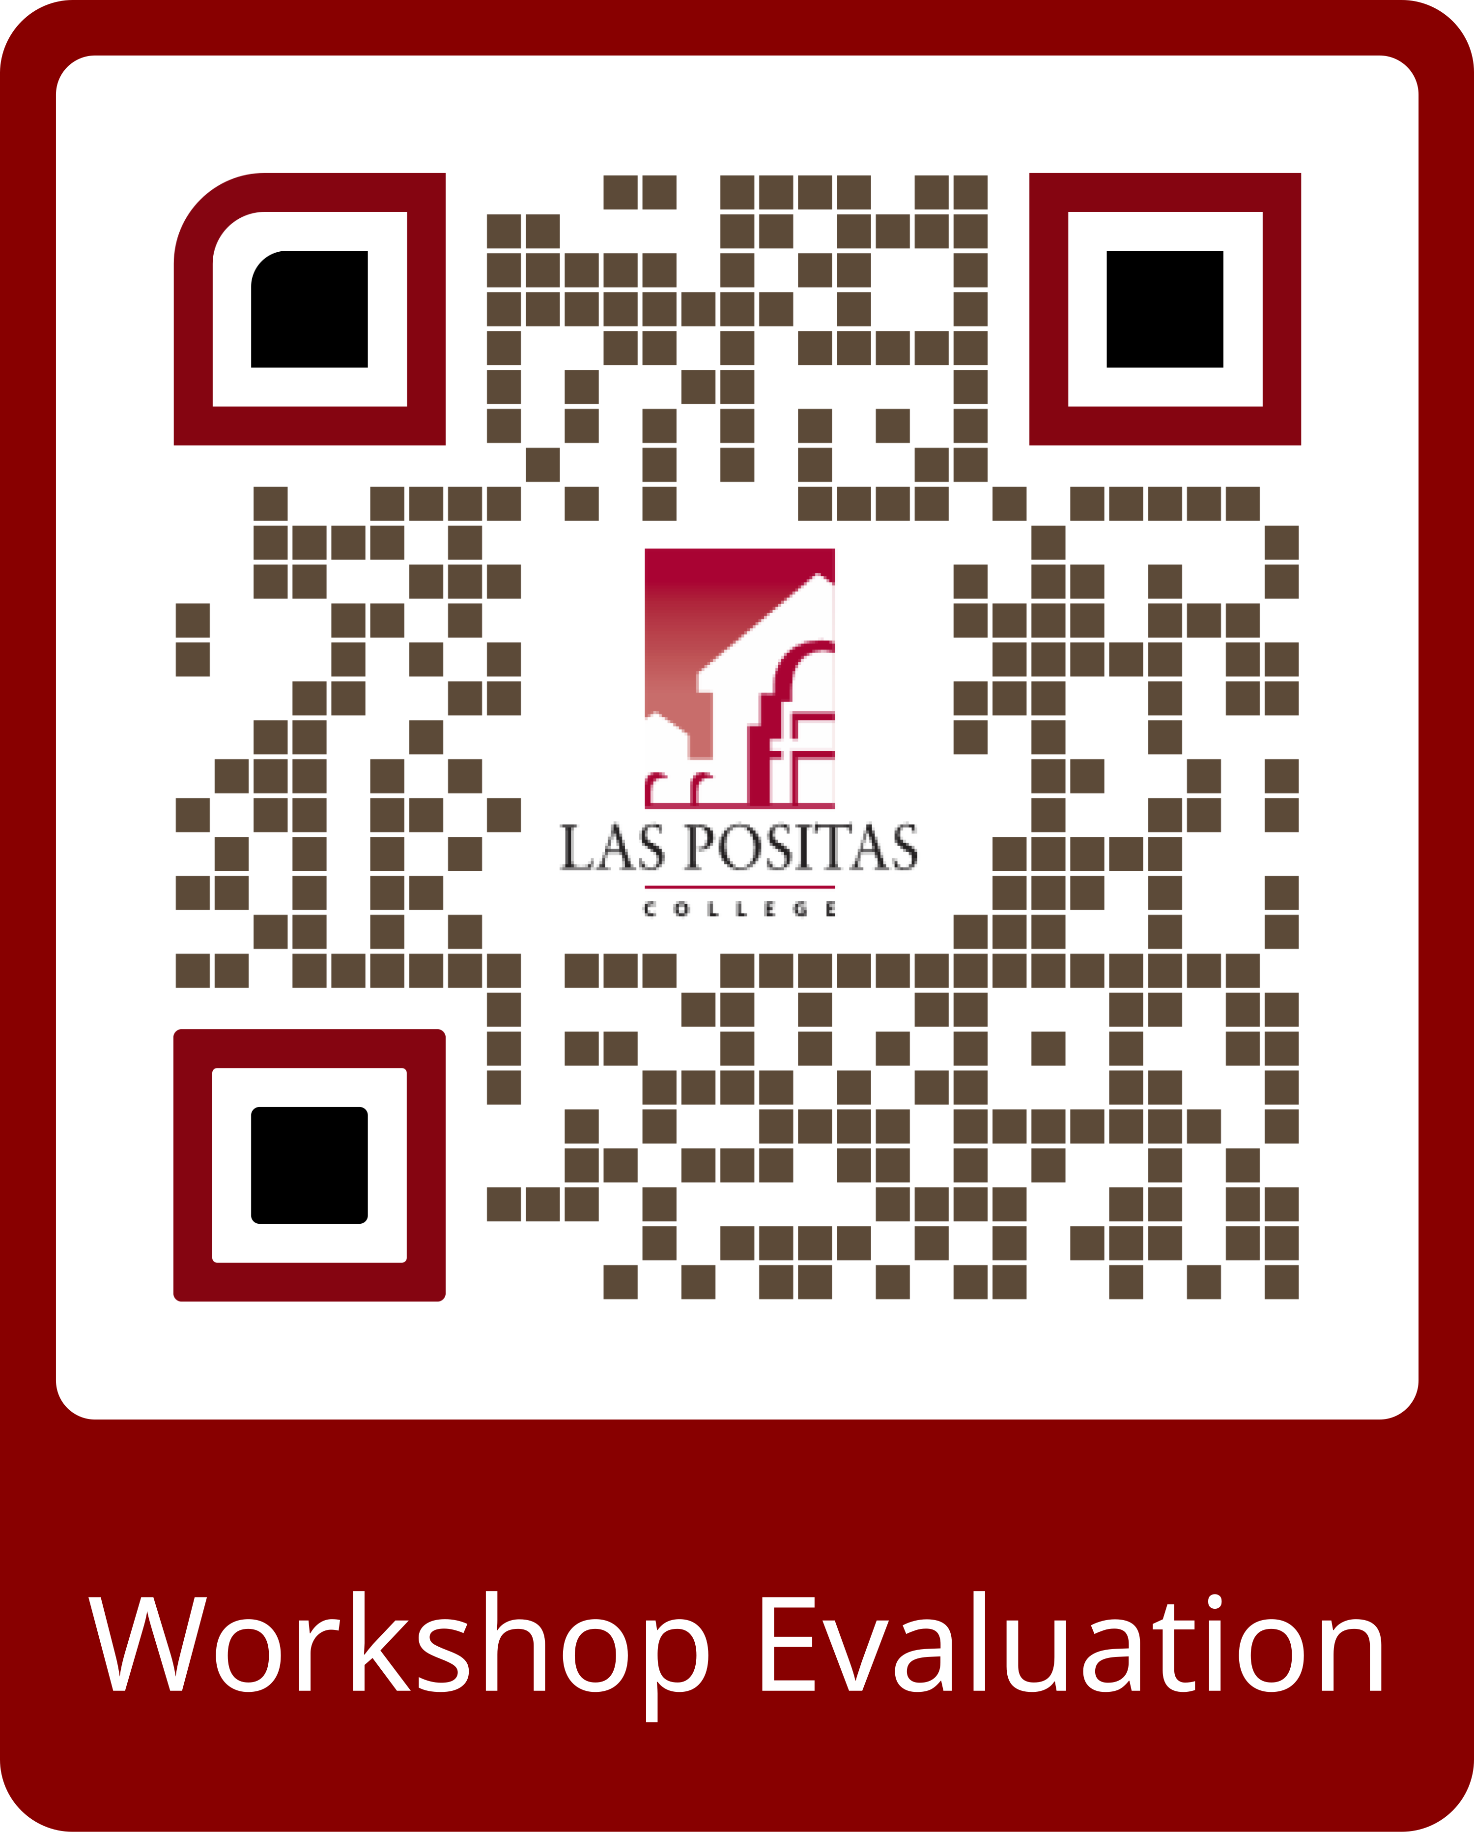
Thank you for attending today!

