Slide 1




Beyond Discussion Boards: Improving Regular + Substantive Interaction in Online Courses
Kat King
Instructional Technology Coordinator
kmking@laspositascollege.edu
Wanda Butterly
Instructional Technology Specialist
wbutterly@laspositascollege.edu

Slide 2

Workshop Description
Teaching online? Join us for a refresher on Regular and Substantive Interaction (RSI) requirements. We'll review what’s needed to be in compliance while exploring strategies that make interaction more meaningful. You’ll leave with practical ideas to build stronger connections between you and your students – and to foster a greater sense of community among students themselves.

Slide 3
Agenda
Part 1: RSI from a "Compliance" Perspective
What is RSI?
Who wrote the rules?
What are the rules?
How is it evaluated?
Part 2: RSI from a "Human" Perspective
Why RSI matters?
Examples of regular interaction
Examples of substantive interaction
Q+A

Slide 4
RSI: What is it?
A requirement that DE courses include "Regular and Substantive Interaction"
Idea is that students have an equitable experience – whether they take classes on campus or online, students should expect the same level of regular, meaningful interactions with their instructors (and peers)
RSI distinguishes "DE" courses from "Correspondence" courses – and that "DE" designation is critical for funding

Slide 5
RSI: Who wrote the rules? (hint: everyone)
Federal Regulations: Title 34 CFR §600.2
State Regulations: Title 5 CCR § 55204
ACCJC (accreditation): Policy on Distance and Correspondance Education
CLPCCD Policy + Procedures: BP 4105 and AP 4105
Faculty Contract: Minimum Standards for DE Instruction 19E
DE Addendum: Identifies how your course outcomes will be achieved online

Slide 6
RSI: What are the rules?
Substantive interaction is engaging students in teaching, learning, and assessment, consistent with the content under discussion, and includes at least 2 of the following:
Providing direct instruction;
Assessing or providing feedback on a student's coursework;
Providing information or responding to questions about the content of a course or competency;
Facilitating a group discussion regarding the content of a course or competency; or
Other instructional activities approved by the institution's or program's accrediting agency.
Regular interaction is demonstrated by both:
Providing the opportunity for substantive interactions with the student on a predictable and regular basis commensurate with the length of time and the amount of content in the course or competency; and
Monitoring the student's academic engagement and success and ensuring that an instructor is responsible for promptly and proactively engaging in substantive interaction with the student when needed on the basis of such monitoring, or upon request by the student.

Slide 7
RSI: How is it evaluated?
Individually > Evaluations
Institutionally > Accreditation
During the faculty evaluation cycle, outlined in Article 19F:
Course tour with your evaluator to show examples/evidence of RSI
Online evaluation form (evaluator completes while in your online course)
Students have an opportunity to provide feedback through surveys
ACCJC Peer Review teams review a previous term's online sections and:
Use the DE Assessment Tool for Peer Reviewers to determine if we meet the 85% threshold for RSI
Complete an Addendum to the Protocol for DE Review to summarize findings
Use the Quality Continuum Rubric for DE to provide feedback about areas the college could improve

Slide 8
Agenda Check-in
Part 1: RSI from a "Compliance" Perspective
What is RSI?
Who wrote the rules?
What are the rules?
How is it evaluated?
Part 2: RSI from a "Human" Perspective
Why RSI matters?
Examples of regular interaction
Examples of substantive interaction
Q+A
Watch out for 10 Tips to Better RSI!

Slide 9
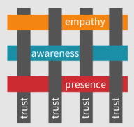
RSI: What does it matter?
Stronger instructor presence = more student success
Stronger interactions = happier humans (instructor + students)
The "human" is needed now more than ever in the "age of AI"
Michelle Pacansky-Brock: Humanize Your Online Class
How do you show human instructor presence...and how can you connect online?

Slide 10
Reminder: What does "regular" mean?
Regular Interaction between a student and an instructor is demonstrated by both:
Providing the opportunity for substantive interactions with the student on a predictable and scheduled basis commensurate with the length of time and the amount of content in the course or competency; and
Monitoring the student's academic engagement and success and promptly and proactively engaging in substantive interaction with the student when needed on the basis of such monitoring, or upon request by the student.

Slide 11
Unpacking "Regular" - Part A
"Providing the opportunity for substantive interactions with the student on a predictable and scheduled basis commensurate with the length of time and the amount of content in the course or competency."
Doing some math can help here! Ex: Typical 3 unit course has 54 "lecture/inside class hours" + 108 "outside of class hours"
Instructor "lecture" expectation:
18-week term: 3 hrs/week
16-week term: 3.375 hrs/week
8-week term: 6.75 hrs/week
Additional student "outside" expectation:
18-week term: 6 hrs/week
16-week term: 6.75 hrs/week
8-week term: 13.5 hrs/week
Note: "Lecture" has room for interpretation...

Slide 12
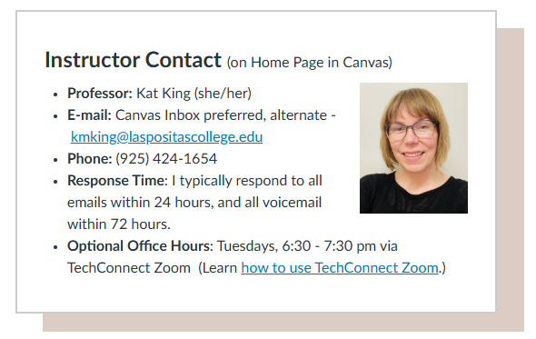
Make Your Presence Clear
A Home Page is a great place for easy-to-find contact info and expected response times; optional office hours
Tip #1: Make sure your students know you are a human and that they can reach out to you!

Slide 13
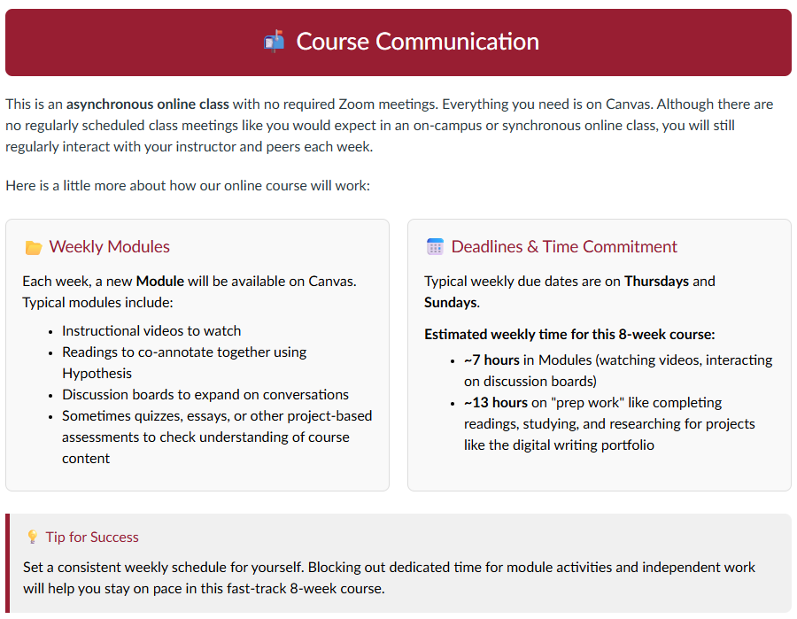
Make Interaction Expectations Clear
Students don't always know what to expect in an online course – so take a moment to explain it in your syllabus or orientation module. How will they spend their time with you and on their own?
Tip #2: Explain what interaction looks like in your online course.

Slide 14
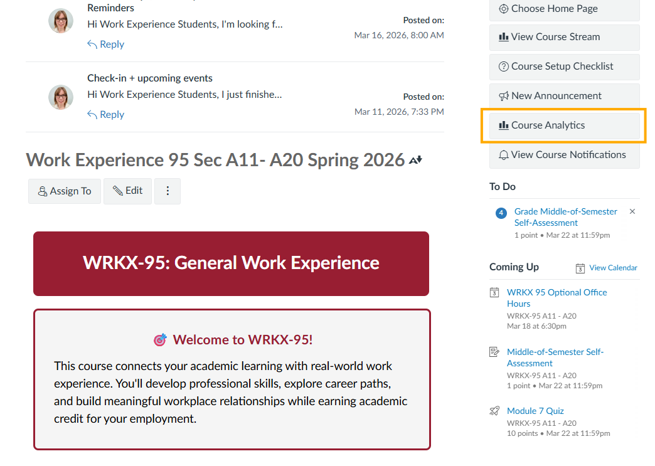
Unpacking "Regular" - Part B
Click "Course Analytics" to check on student engagement and success.
Monitoring the student's academic engagement and success and promptly and proactively engaging in substantive interaction with the student when needed on the basis of such monitoring, or upon request by the student.

Slide 15
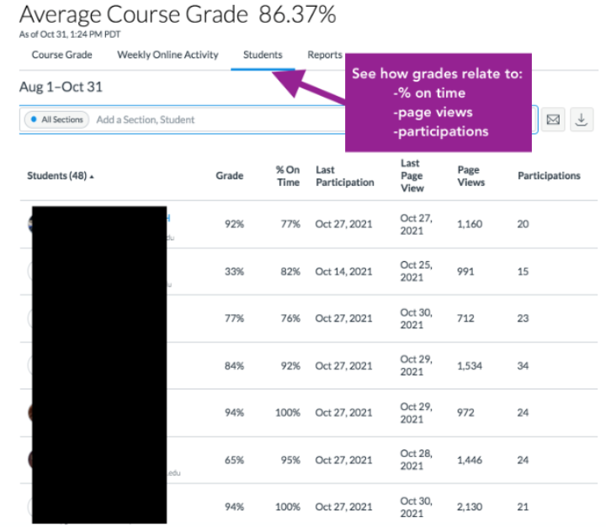
Course Analytics = Aha Moments
Myth: students struggling just aren't putting in the effort
Data: students with learning disabilities may be working even harder than students with high grades and may need help connecting to support resources
Tip #3: Check your "Course Analytics" this week for your own "aha moments."

Slide 16
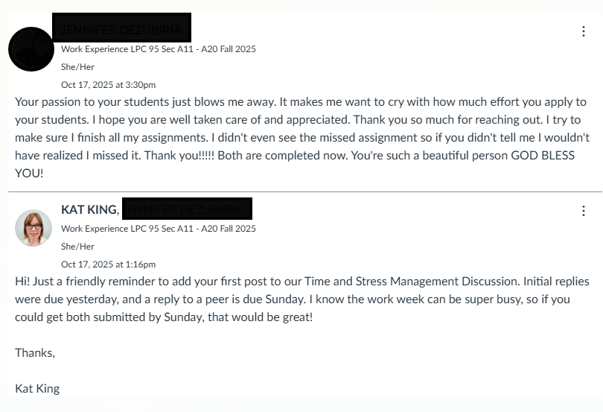
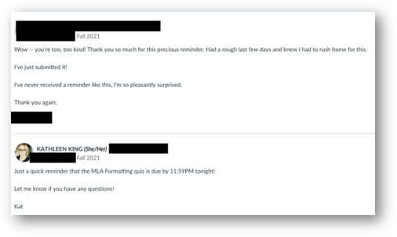
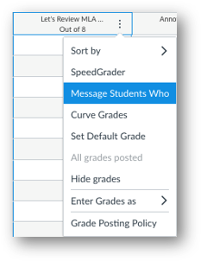
Monitoring the Gradebook
Tip #4: Use "Message Students Who" from the Gradebook this week.

Slide 17
Reminder: What does "substantive" mean?
Engaging students in teaching, learning + assessment of the content in your course, including 2+ of these strategies:
Providing direct instruction
Assessing or providing feedback on a student's coursework
Providing information or responding to questions about the content of a course or competency
Facilitating a group discussion regarding the content of a course or competency
Other instructional activities approved by the institution's or program's accrediting agency. (N/A)
From ACCJC Policy on Distance Education

Slide 18

Unpacking "Substantive" - Part A
"Providing direct instruction"
Only applies to online courses with synchronous instruction (classes on Zoom)
Lecture (screenshare of PPT slides)
Demos/Practice (digital whiteboard)
Engaging class in discussion (audio and/or chat)
Engaging students with Zoom polls/surveys
Tip #5: Try a new strategy to engage students in Zoom, like a poll or emoji reactions.

Slide 19
Unpacking "Substantive" - Option B
"Assessing or providing feedback on a student's coursework"
Need more than automated feedback (like auto-graded publisher quizzes)
In Speedgrader, consider adding:
Assignment comments (written or audio/video) with personalized feedback (ex: one thing that's great; one thing to work on)
Annotations that show a student one thing that is working well/one thing to work on
Tip #6: After grading, post an announcement reminding students to check for feedback.

Slide 20
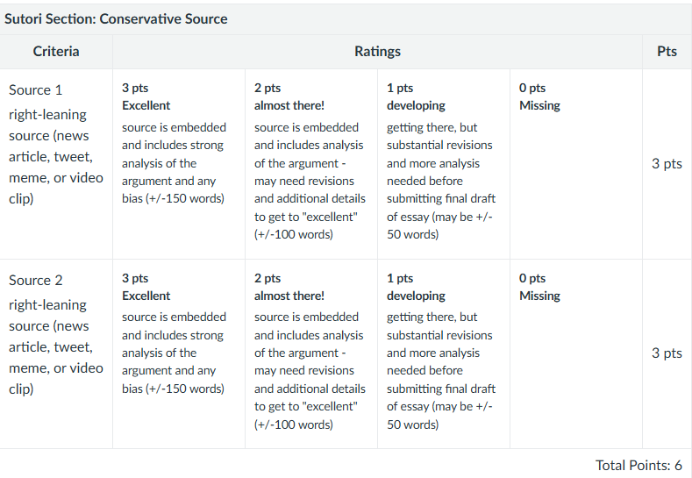
Sample Rubric
Rubrics that help students understand how to improve are another great way to provide feedback.
Tip #7: Adding a rubric can save you from writing the same comment over and over!

Slide 21
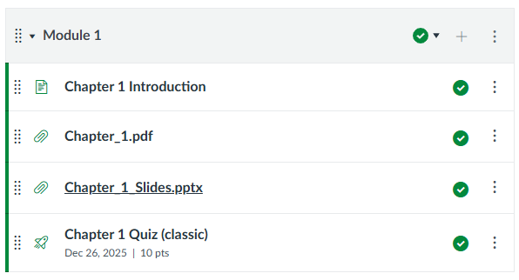
Unpacking "Substantive" - Option C
"Providing information or responding to questions about the content of a course or competency"
People often try to meet this with links to PowerPoints or publisher materials, but remember the idea of parity with on campus: would you show up to class and tell students to read a chapter and review slides on their own during class?

Slide 22
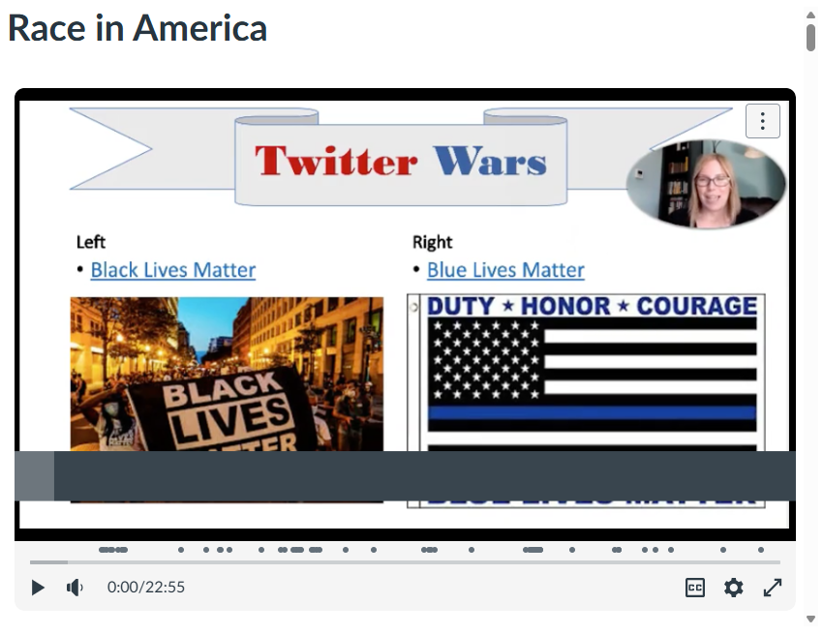
Sample Video Using "Studio"
Instead of just dropping in your slides, make a recording using Studio. You can even allow for discussion or add quiz questions!
Tip #8: Use Canvas Studio to create "evergreen" videos that you can reuse again!

Slide 23
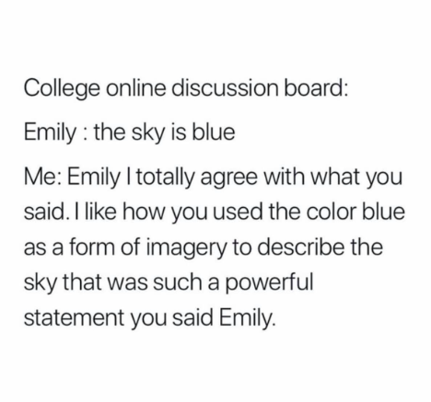
Unpacking "Substantive" - Option D
"Facilitating a group discussion regarding the content of a course or competency"
Canvas Discussion Boards are often used to meet this requirement...but they can start to feel repetitive and downright meaningless without careful planning.

Slide 24
Designing Better Discussion Boards
Avoid:
Creating discussions where there is only 1 right answer, or only a couple of possible answers.
Especially avoid this if you are doing a full class discussion (or even worse – a discussion in a merged course with mutliple sections all participating in one giant conversation)
Try this instead:
Designing discussions that ask students to contribute something unique (share their research, a personal connection, a draft of a project).
Use "group settings" to create smaller, more meaningful conversations (more like "turn and talk" in on campus classes).
Tip #9: Make these small tweaks to make your discussion boards more meaningful.

Slide 25
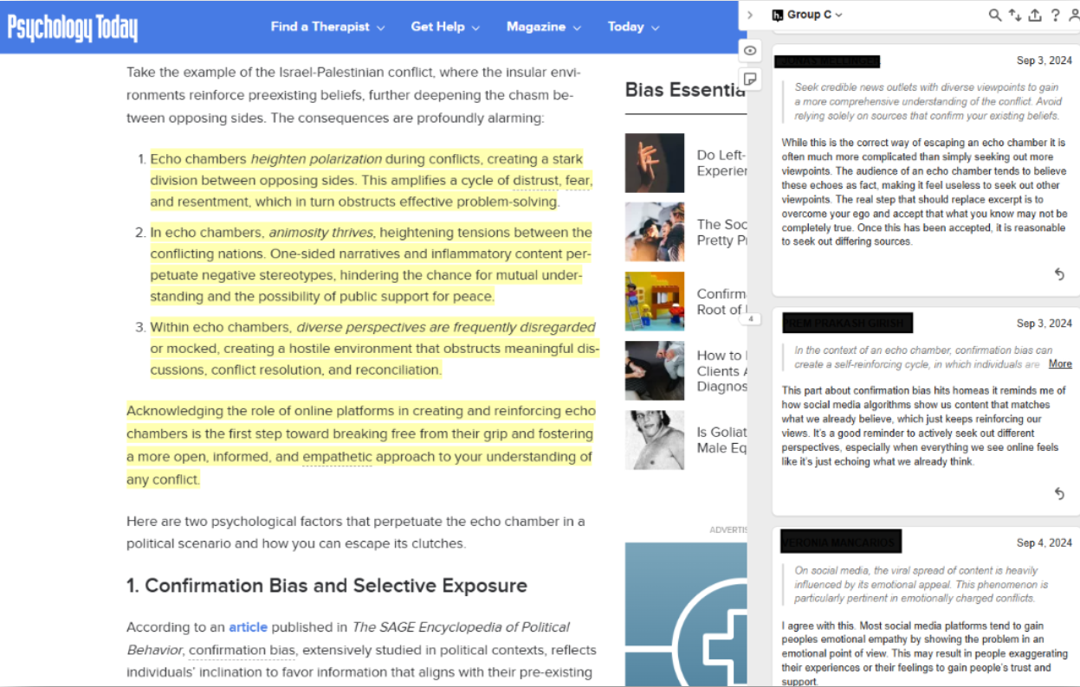
Mix it Up with Social, Digital Annotation
Social annotation helps students see what is important and explain to each other...and helps teachers see where students may need more support understanding content
Tip #10: get started with the Hypothesis AI Literacy Starter Pack or attend Trying Hypothesis Mid-Semester!

Slide 26
Q + A
Helpful Resource: ACCJC: DE Review, Frequently Asked Questions

Slide 27



RSI Tools Quick Guides
Canvas Tools:
Announcements
Assignment Comments
Course Analytics
Discussions
Peer Review
Rubric Feedback
Canvas Integrations:
Hypothesis (social, digital annotation)
Pronto (instant messaging/polls)
Studio (video recording + engagement)
TechConnect Zoom (video-conferencing)

Slide 28
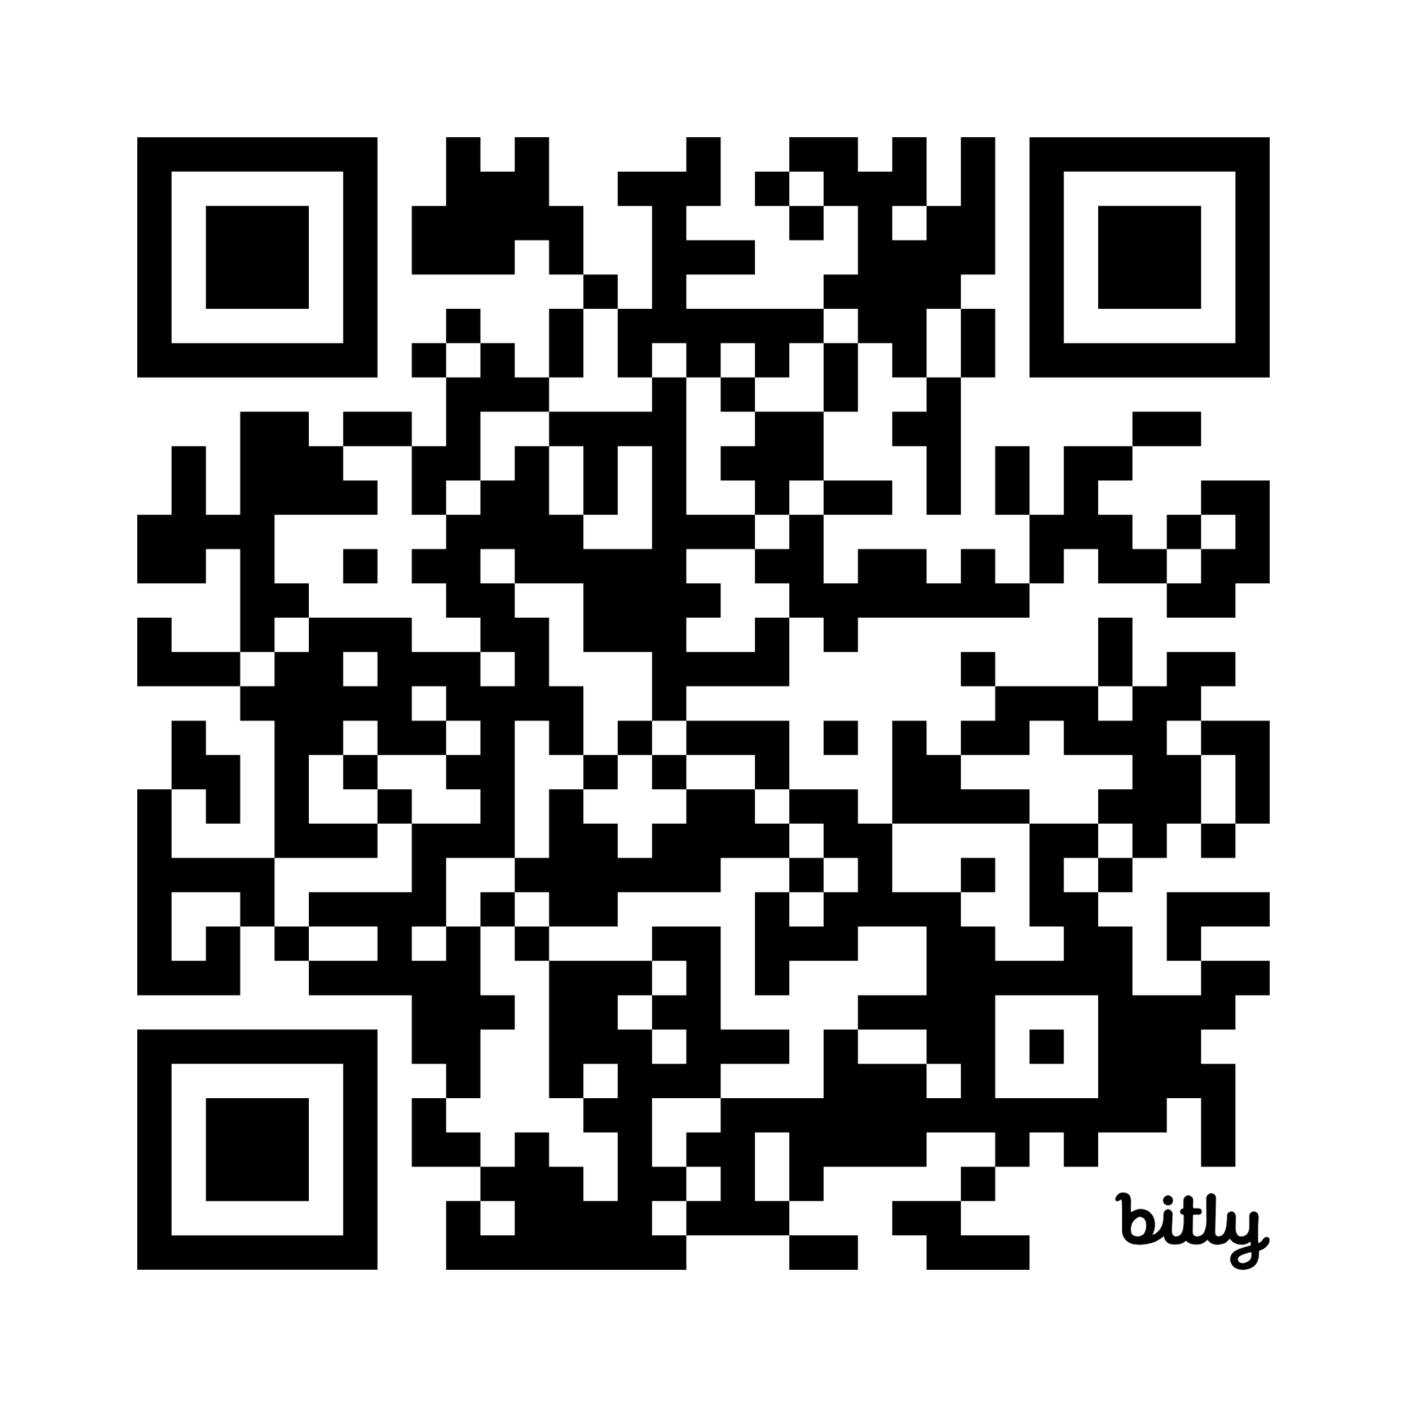

Thank you for attending today!
Scan for slides or go to bit.ly/4dtFbcw

