Slide 1
What is the CVC OEI Rubric?
Standards used by all CVC OEI consortium colleges for course quality
Endorsed by the State Academic Senate
Endorsed by the LPC Academic Senate

Slide 2
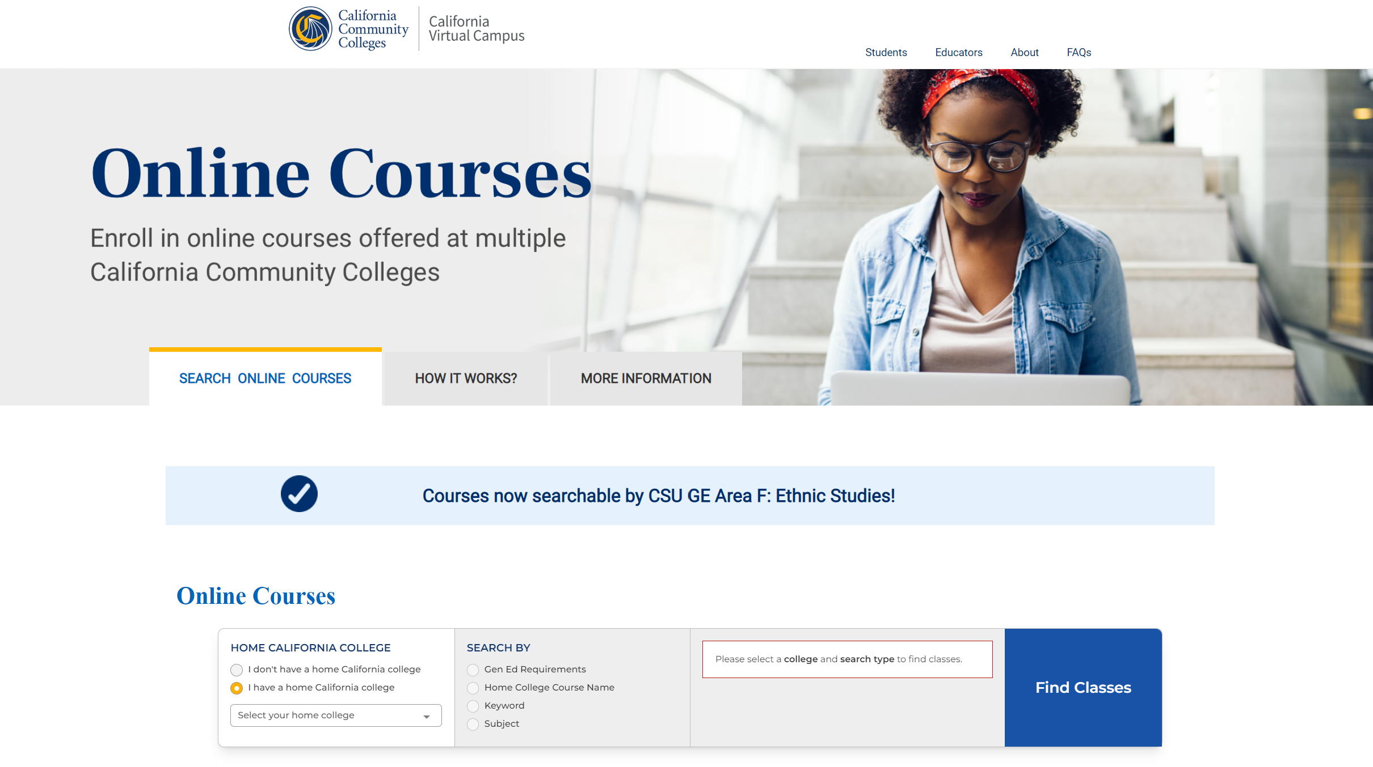
Why do this work? What's in it for You?
A Quality Reviewed “Badge”
Priority listing in the statewide Course Finder
Confidential feedback and course design recommendations
Support from our Instructional Designer
Hands-on assistance from our Accessibility Specialist
The satisfaction of teaching a course that has met the CVC's highest level of design standards of quality and accessibility to support online student success...and increase retention!

Slide 3
A completed search example

Slide 4
Does it make classes better?

Slide 5
Instructor voices: Mary Lauffer
BUSN 52 Business Communications
WRKX 95 General Work Experience
WRKX 94 Occupational Work Experience

Slide 6
Truths and fictions
Truths
Fictions
It’s a lot of work
Your course will meet tested quality standards
Your students will do better
Your course still belongs to you
The LPC Template makes alignment easier to do
Your course will look like all the other aligned courses
You will have to completely redo your course
You will at some point be required to alignall online courses to the rubric
Alignment affects your evaluation

Slide 7
Eligible Courses
Taught asynchronously online by you at LPC at least one semester
Fully asynchronous online
The course is one of these
Part of an ADT (Associates Degree for Transfer)
Part of a General Education Transfer Pattern (CSU or IGETC)
In the CTE (Career Technical Education) program

Slide 8
The Process
Application
You submit an application to your dean for approval
Preparation
Scott creates a blank Master Shell for you to work on your course
You work towards meeting all CVC OEI rubric standards
Review
Your course is reviewed by the LPC POCR team and Accessibility Specialist
You revise course as needed
You import course content

Slide 9
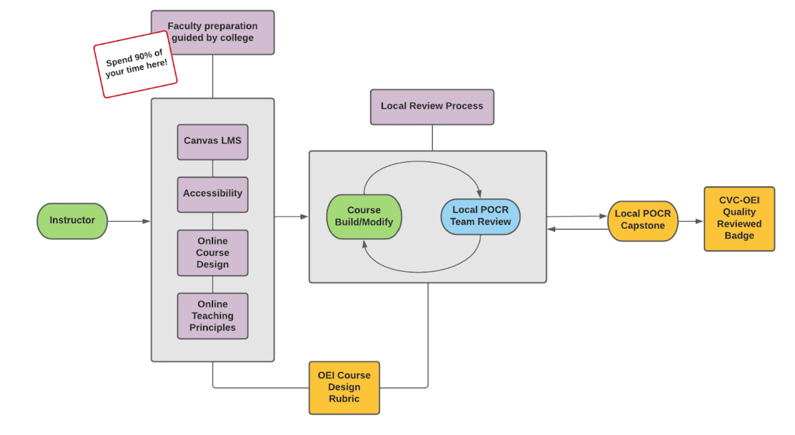
Courtesy of the CVC OEI Local POCR Resource Center https://sites.google.com/cvc.edu/localpocrresourcecenter/instructors?authuser=0#h.p_v8ztPURmVB2j

Slide 10
What’s in the rubric?
Section A
Content Presentation - how content is organized and accessed
course navigation and use of Canvas features
learning objectives
access to student support information
Section B
Interaction: instructor-initiated and student-initiated communication
regular effective contact, both between and among instructors and students.
Section C
Assessment - variety and effectiveness of assessments
alignment of objectives and assessments
clarity of instructions for completing activities
evidence of timely and regular feedback
Section D
Accessibility
- Images
- Documents
- Videos
- External Content
- Publisher Content

Slide 11
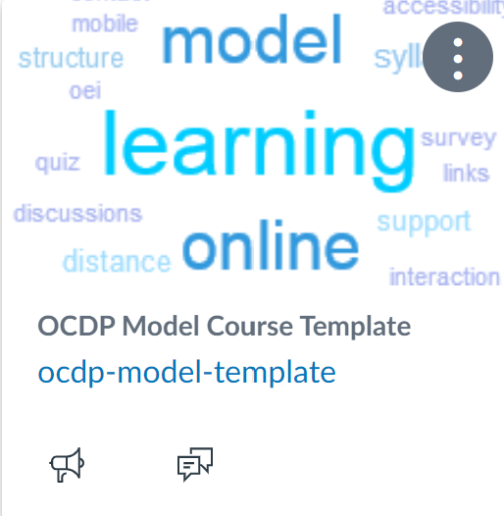
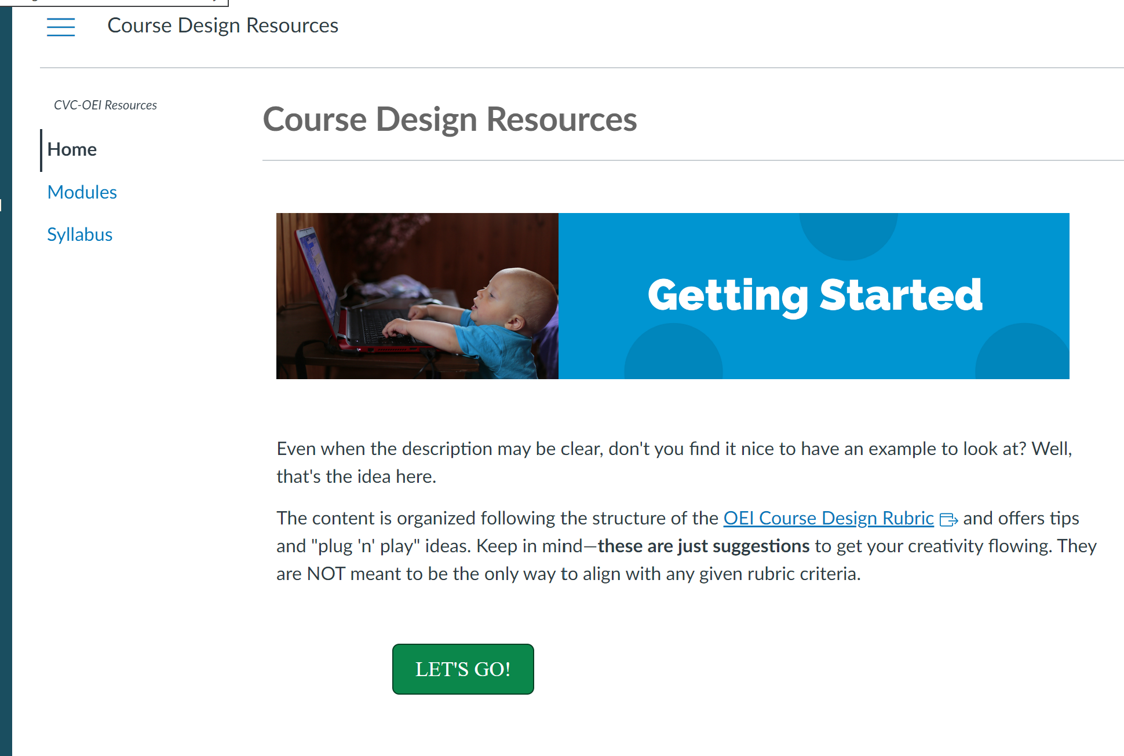
Resources to meet alignment standards
The rubric itself
Scott’s Model Template
CVC-OEI Course on alignment

Slide 12
Example: A4 Course Navigation

Slide 13
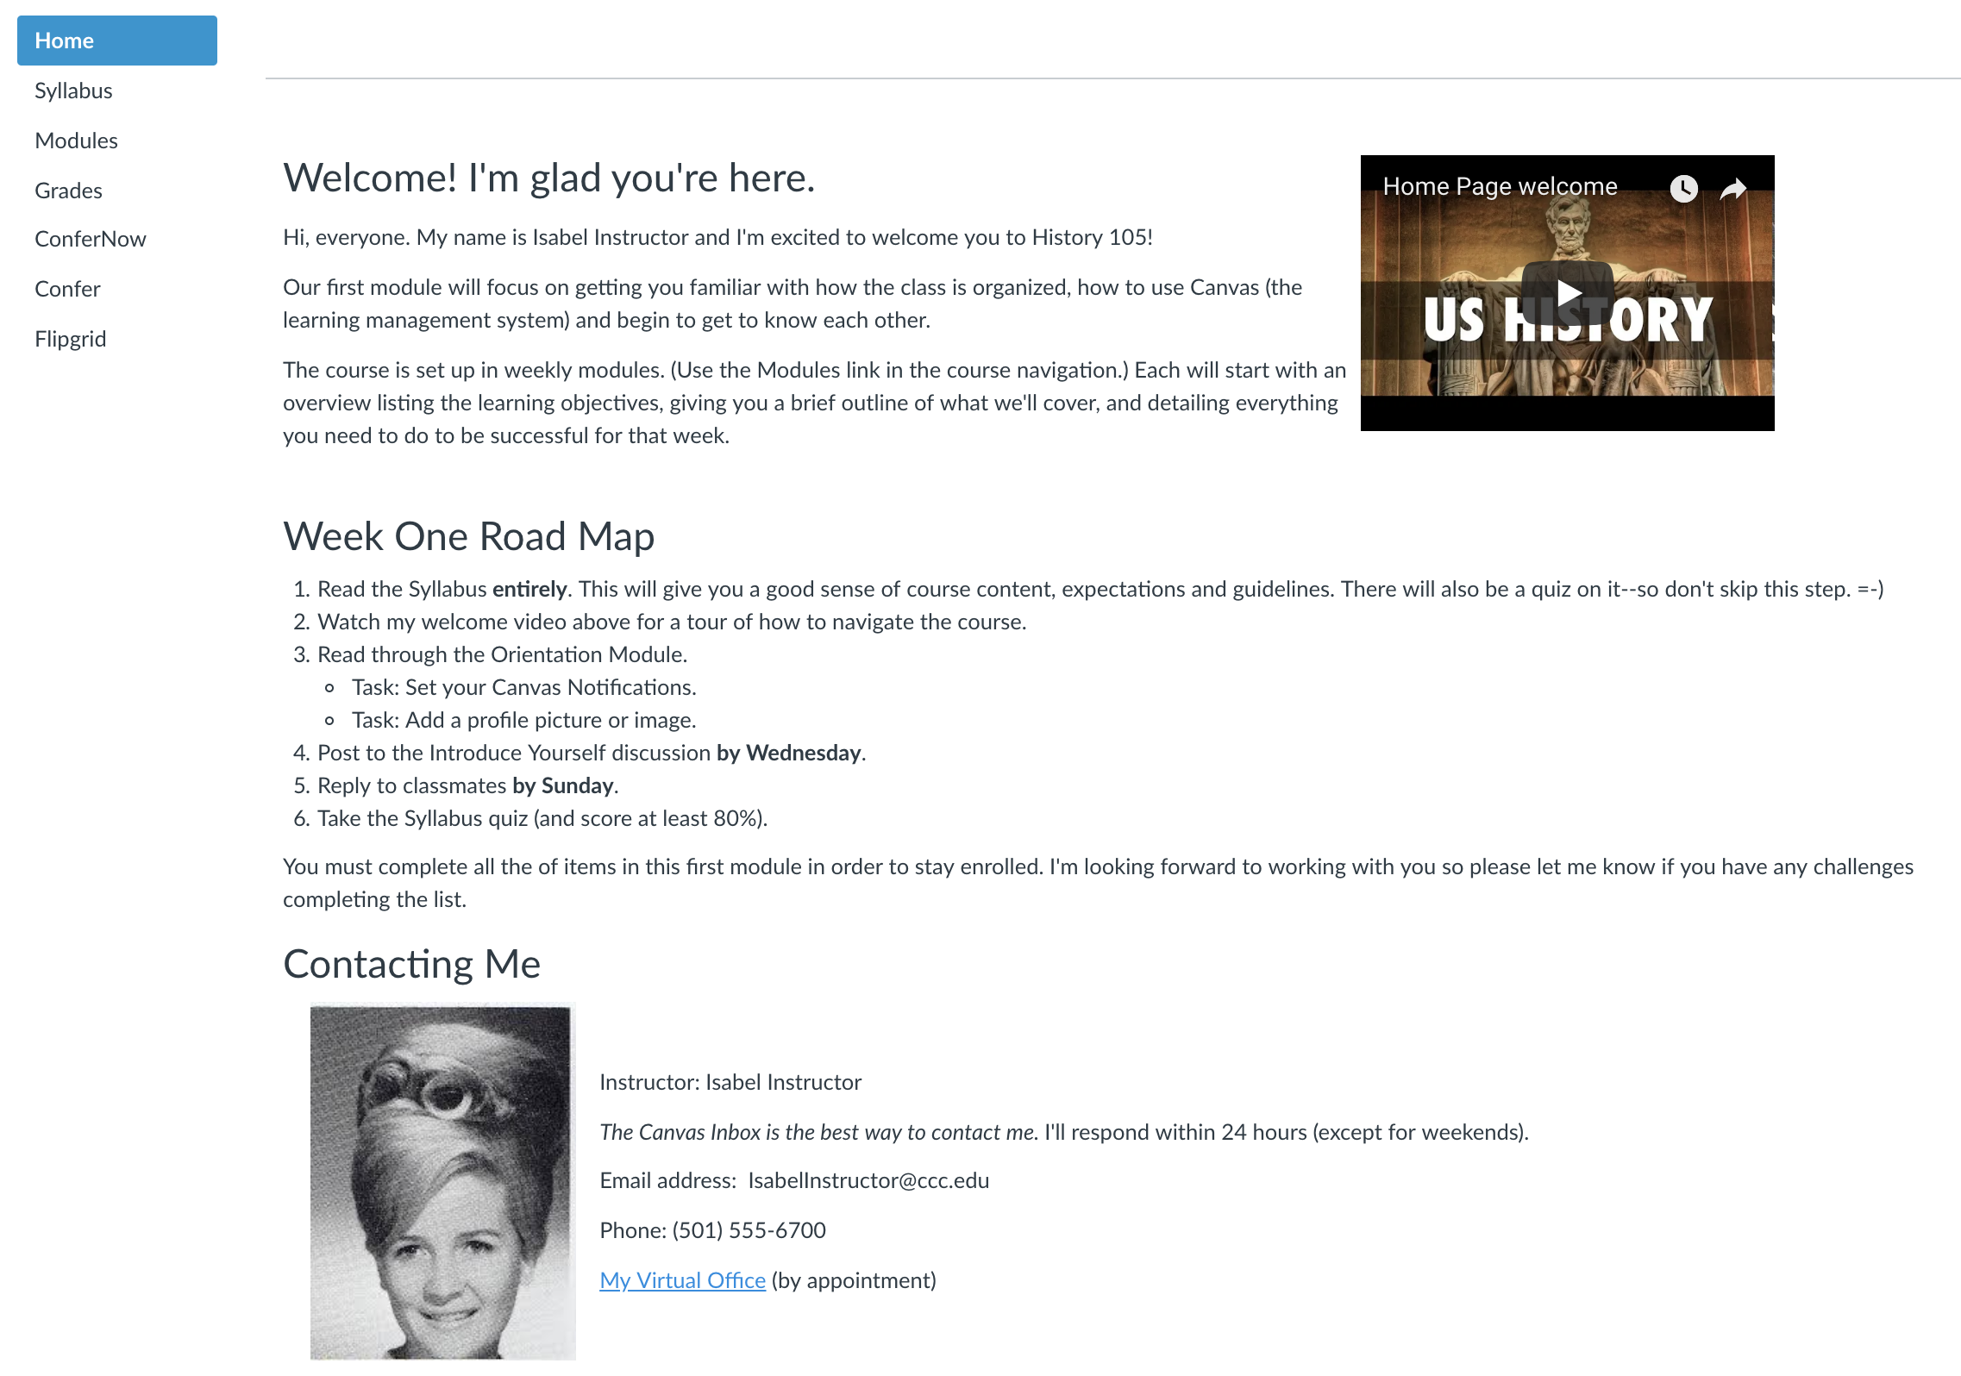
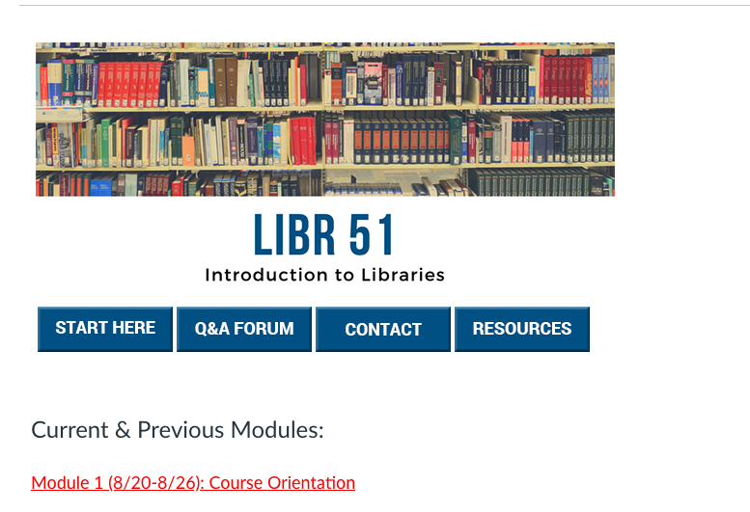
Questions to answer for A4
Can the student figure out where to start the class?
Is the course flow predictable and consistent?
Are unused links disabled?
Remember to check Student View

Slide 14
In the Model Course Template

Slide 15
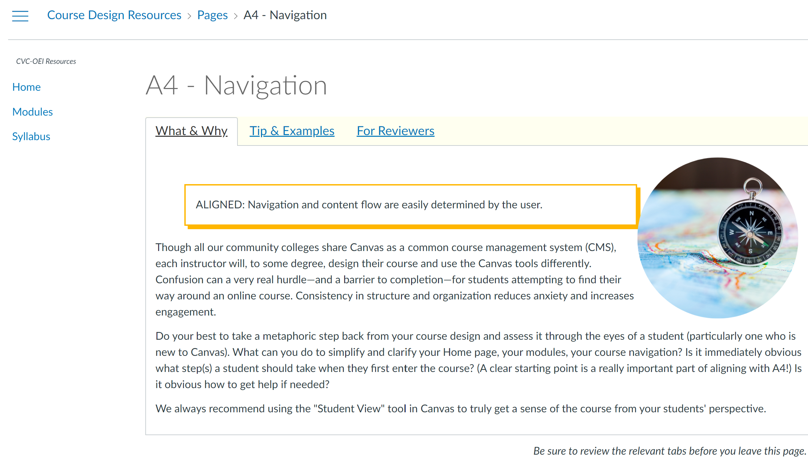
The CVC OEI Course Design Resources course

Slide 16
Example: B2 Regular and Effective Contact in the rubric

Slide 17
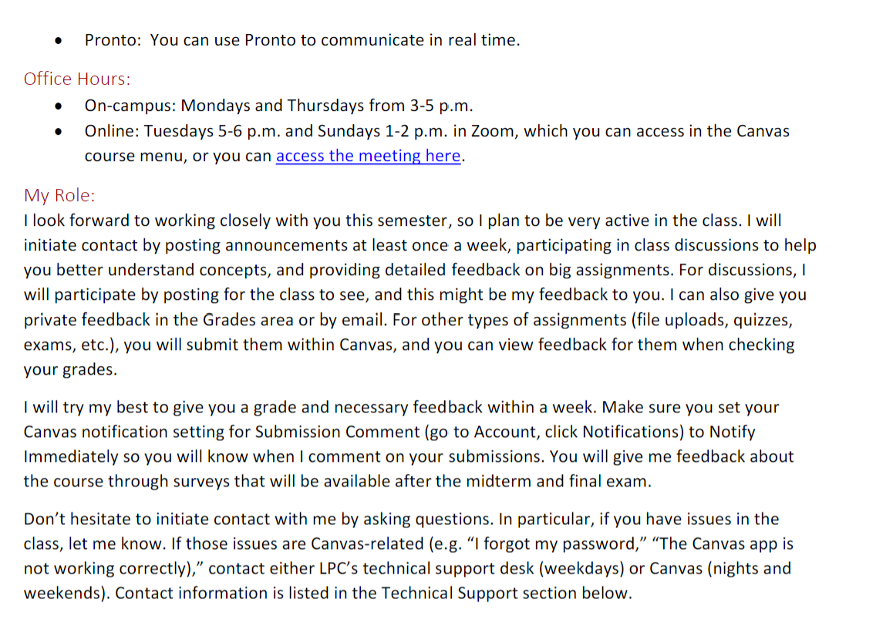
In the model course template

Slide 18
In the CVC OEI course on the rubric

