Slide 1
Registration Now Open!
Notes:
T, R, M

Slide 2
AMERICAN BOOK AWARD Winner
#1NY TIMES BEST SELLER, POETs LAUREATE, LOCAL AND Internationally ACCLAIMED AUTHORS FREE AND IN-PERSON Native Dance Troupe LITERARY PANELS AND WORKSHOPS FOOD TRUCKS, MUSIC, AND ACTIVITIES FOR KIDS FROM OUR LOCAL LIBRARIES
Notes:
R

Slide 3
Tommy Orange in Conversation with Michelle Gonzales
American Book Award Winner
LPC Spring Read
Pulitzer Prize Finalist
Oakland Author
Citizen of the Cheyenne and Arapaho Tribes of Oklahoma
Preceded by Dance troupe and Land Acknowledge-ment Ceremony
Notes:
T

Slide 4
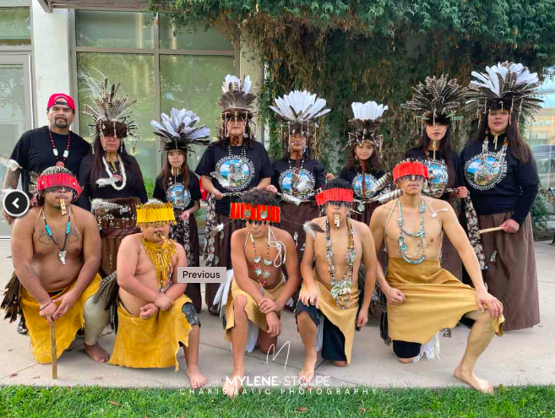
Muwekma Ohlone Tribe Dancers

Slide 5
Tommy Orange on PBS NewsHour

Slide 6
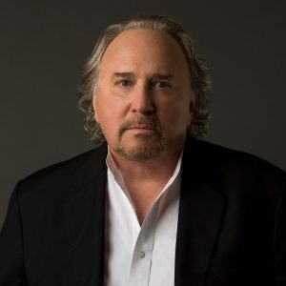
Bruce Henderson, Jim Ott, and LPC Student Veterans
#1 New York Times bestseller
Sons and Soldiers made into a highly-rated television miniseries.
Author of:
Bridge to the Sun
Sons and Soldiers
Rescue at Los Baños
Notes:
M

Slide 7
Bruce Henderson’s Sons and Soldiers

Slide 8
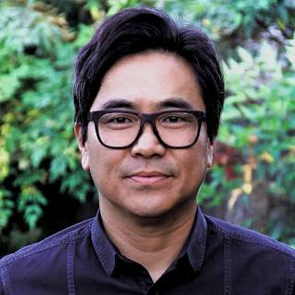
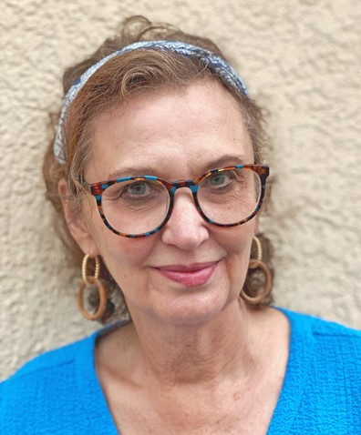
California and Livermore Poet Laureates in Conversation Lee Herrick and Peggy Schimmelman
California Poet Laureate, born in Daejeon, South Korea, adopted at 10 months old, and grew up in California.
Poet Laureate of Livermore, CA. Crazy-town and TickTock & the novels Insom-niacs, Inc. and Whip-poorwills.
Notes:
T

Slide 10
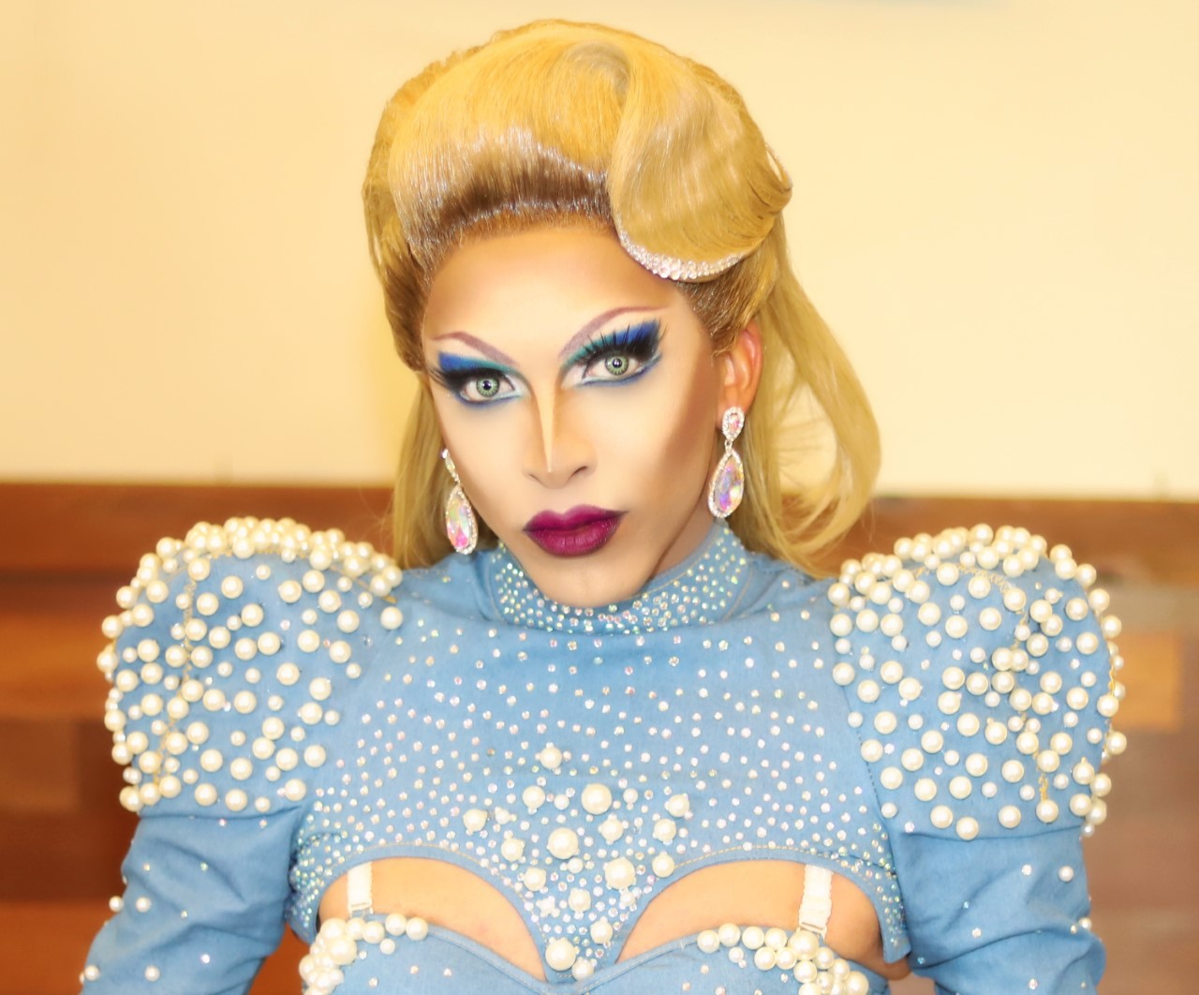
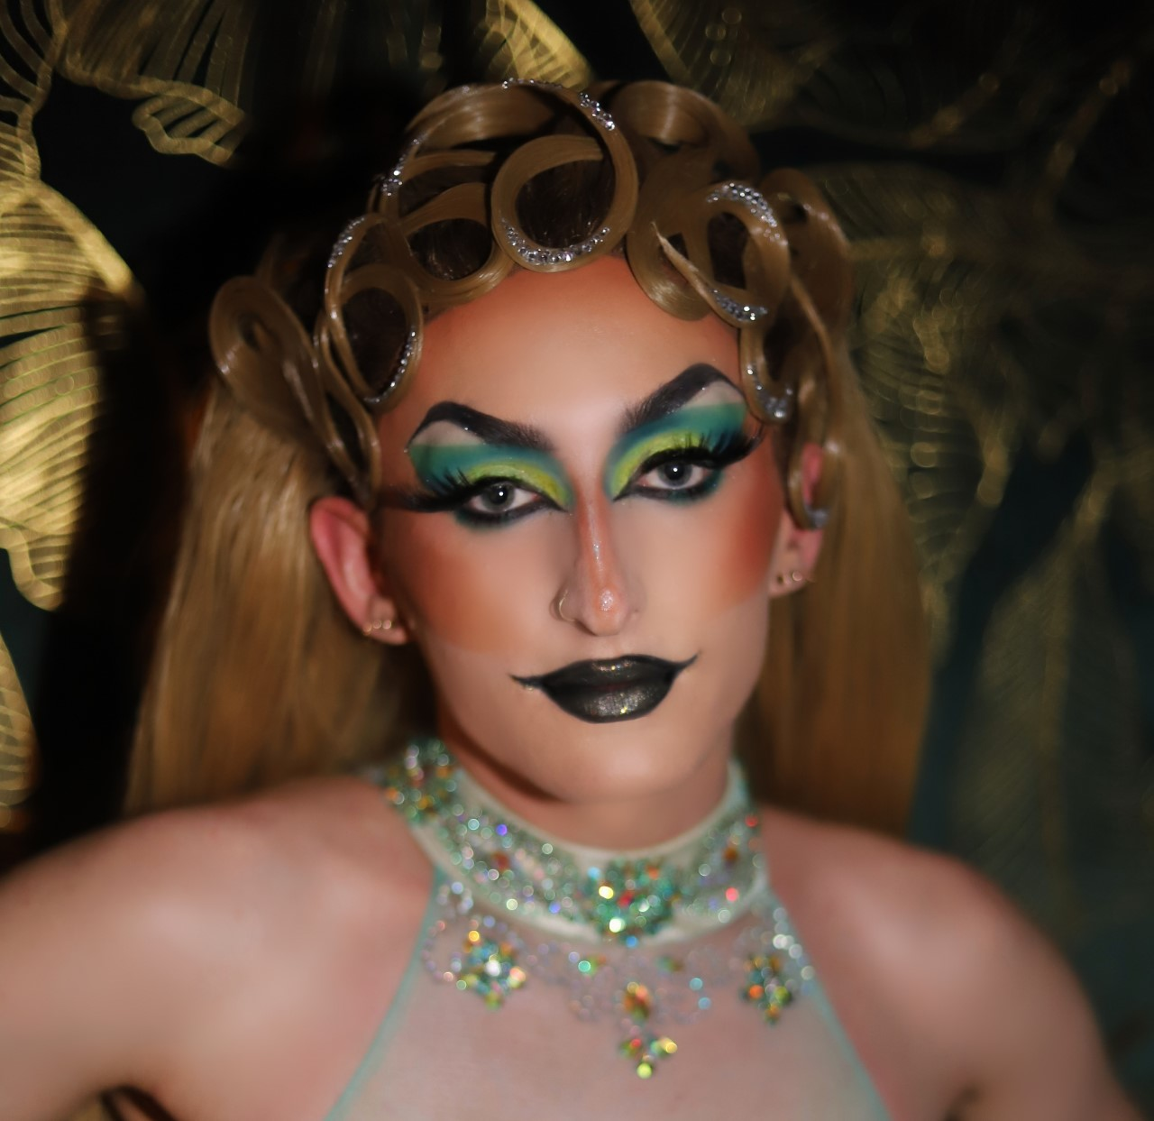
Ava LaShay and Avery Night Drag Queen Storytime for Kids and Kids at Heart
Ava LaShay a
Former student of Las Positas College.
Published in two Las Positas
Hosts drag shows throughout the Bay Area.
Avery Night
She has only been doing drag for 5 months but has over one hundred shows under her belt.
Notes:
T

Slide 11
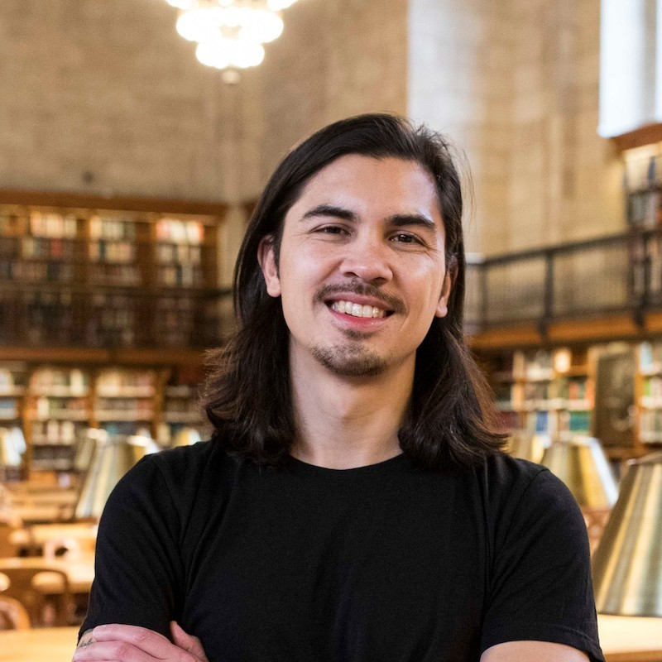
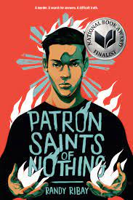
National Book Award Finalist Randy Ribay In Conversation with Anamarie Navarro Young Adult Fiction Workshop
“After the Shot…” Selected as a Freeman Book Award winner, and was a finalist for the National Book Award, LA Times Book Prize, Walden Book Award, Edgar Award, International Thriller Writers Award, and the CILIP Carnegie Medal.
An Infinite Number of Parallel Universes,
After the Shot Drops, and Patron Saints of Nothing—
Notes:
R

Slide 12
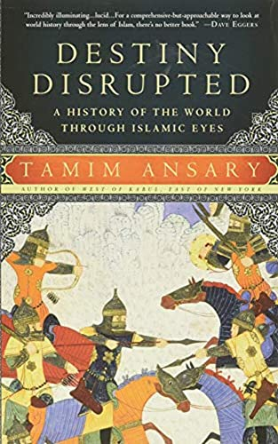
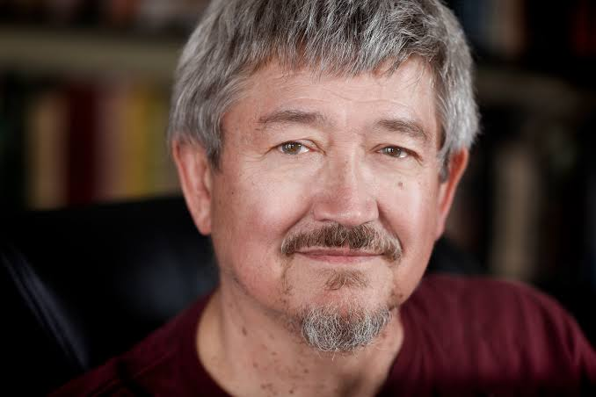
Northern California Book Award Winner Tamim Ansary Memoir Master Class
Afghan-American writer
Became famous after 9/11 for a viral email
Facilitated the SF Writers Workshop for over 20 years.
Won the 2010 Northern California Book Award,
Selected for San Francisco’s One City One Book read, and broadcast on NPR.
Notes:
R

Slide 13
Tamim Ansary on Bleshing (Gesundheit) (min 2:18)

Slide 14
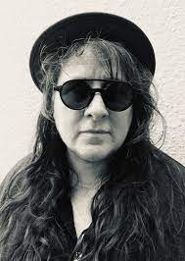
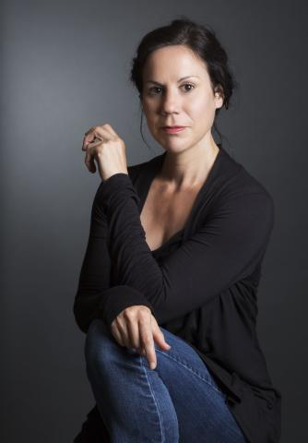
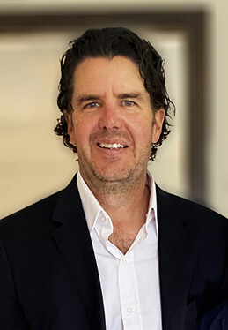
Native American Poetry Panel with 7th Poet Laureate of San Francisco Kim Shuck, Jennifer Elise Foerster, and Dean Rader
Kim Shuck: 7th Poet Laureate of San Francisco
Jennifer Elise Foerster: The recipient of a NEA fellowship and Wallace Stegner Fellow in Poetry Workshop.
Dean Rader:
T.S. Eliot Poetry Prize Winner
Engaged Resistance: American Indian Art, Literature, and Film from Alcatraz to the NMAI
Notes:
T

Slide 15
As part of the 2020 Dear Poet project, students around the country and the world wrote letters to Kim Shuck in response to a video of her reading her poem ”Smuggling Cherokee” aloud.
“Dear Ms. Kim Shuck,
I connected with your poem, “Smuggling Cherokee.” Your unusual oxymorons such as “good mistranslations” helped me discover how I can help identify myself. Throughout the poem, you grapple with your identity and while I read it I did too….”
Ahn,
Grade 9

Slide 16
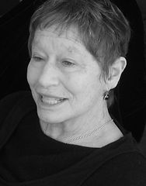
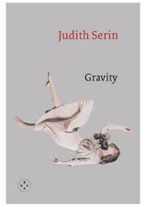
Judith Serin Feminist Writing Workshop
Author of Gravity: Stories about Women, Hiding in the World, &
Days Without (Sky): A Poem Tarot, seventy-eight short prose poems in the form of a tarot deck
She teaches literature and writing at California College of the Arts.
Notes:
M

Slide 17
Judith Serin reads “Mail” from Gravity

Slide 18
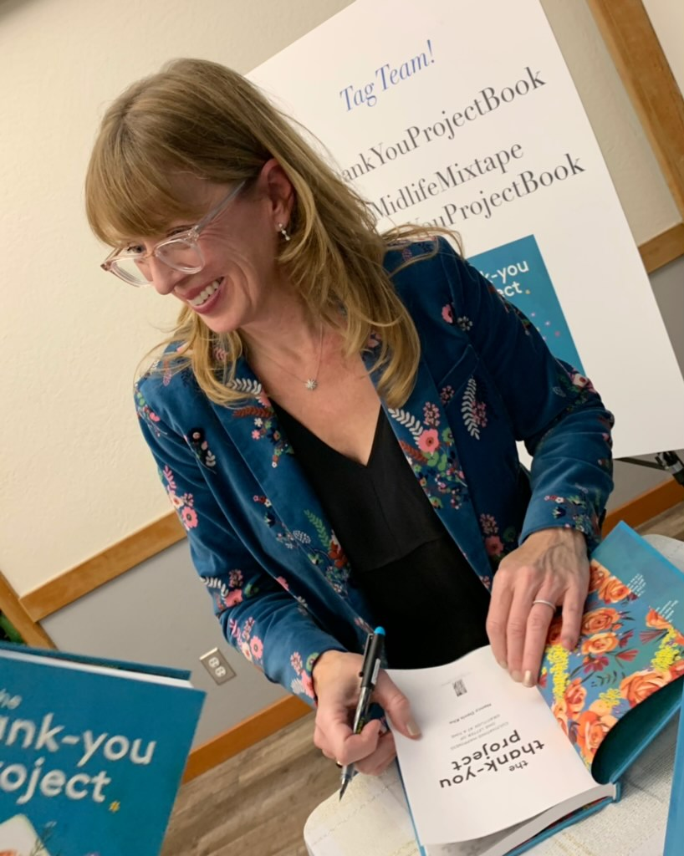
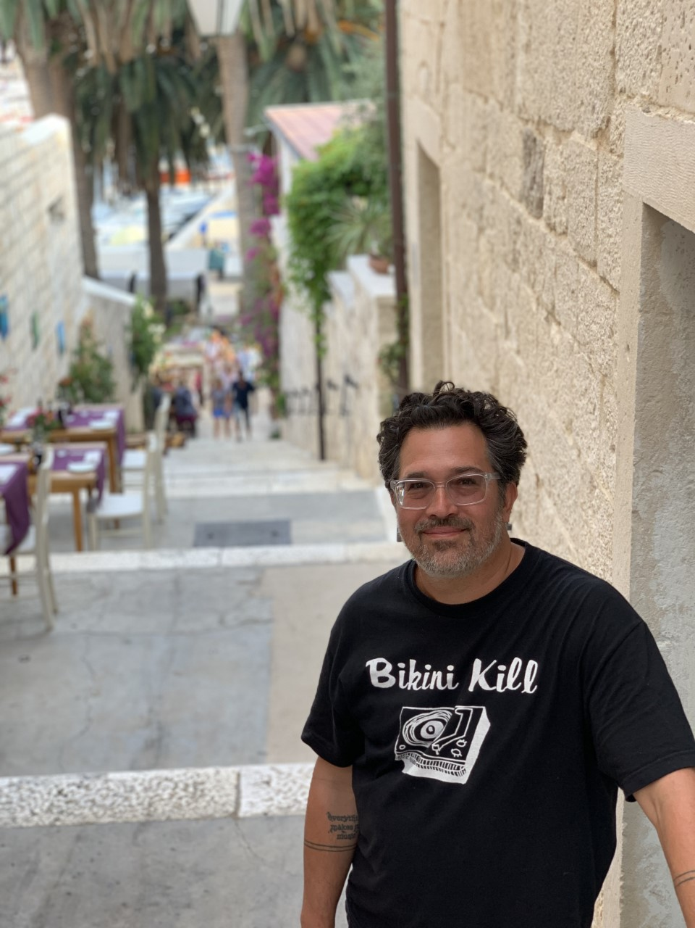
Get Published! Tips & Tricks from Writers Who Lived to Tell the Tale Nancy Davis Kho and Tomás Moniz
Nancy Davis Kho:
speaker, author, and podcaster whose work has appeared
in the Washington Post, San Francisco Chronicle, and NPR affiliate KQED.
His debut novel Big Familia was finalist for the PEN/Heming-way Debut Novel 2020 Award & a finalist for a LAMBDA 2020 award for Bisexual Fiction
Notes:
R

Slide 19
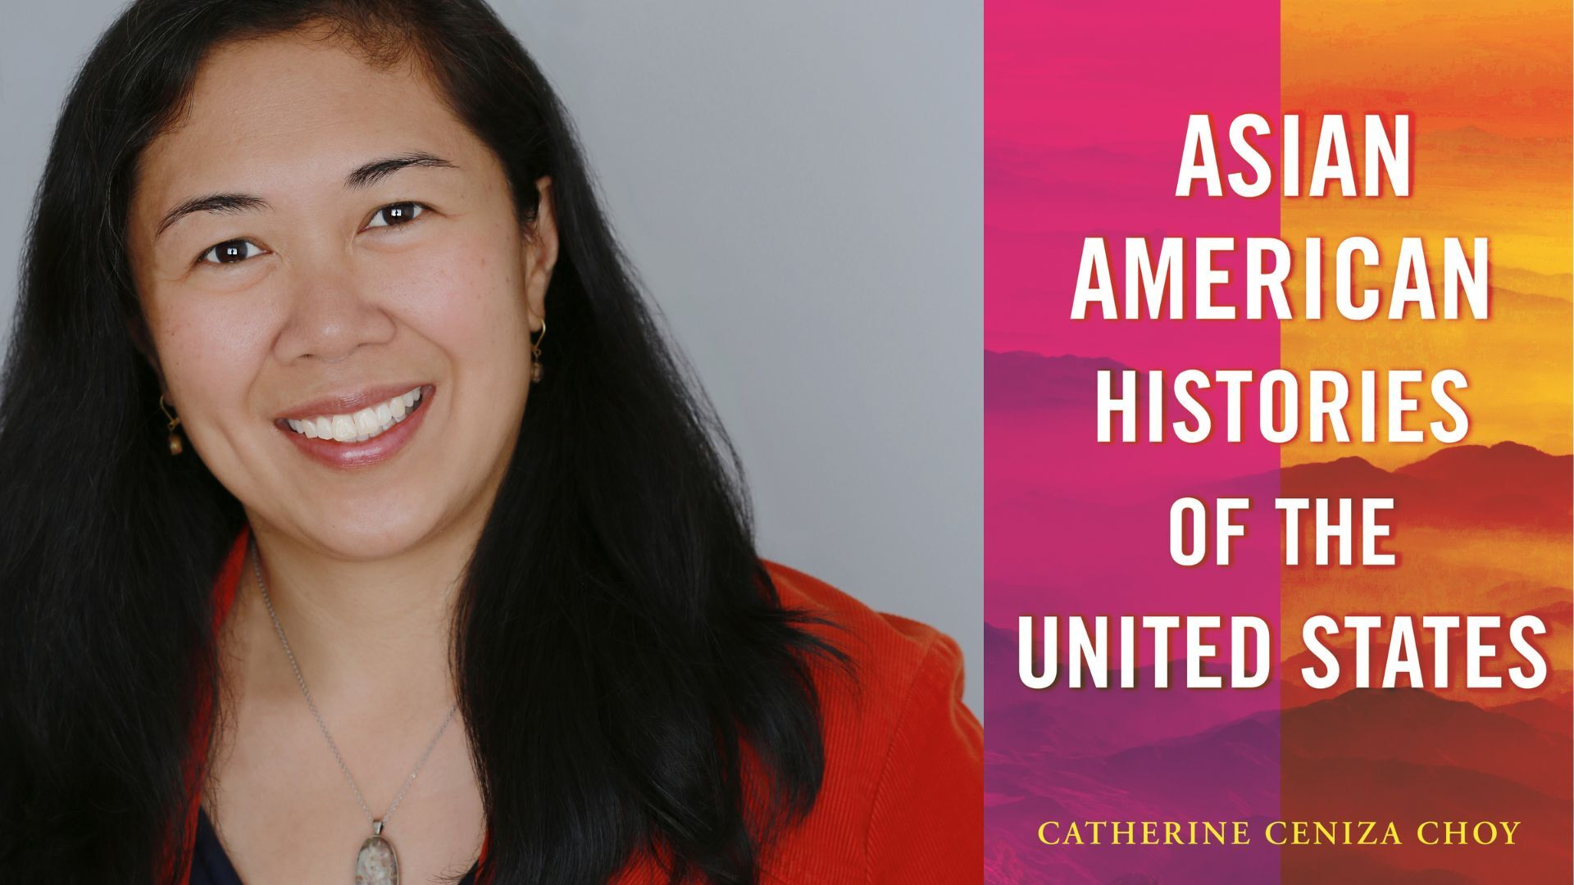
Professor of ethnic studies and an associate dean of diversity, equity, inclusion, belonging, and justice at UC Berkeley and the author of Asian American Histories of the United States.
Catherine Ceniza Choy on Asian Americans in the U.S., Scholarly Writing & Publishing in conversation with LPC Ethnic Studies Professor Thien-Huong Ninh
Empire of Care: Nursing and Migration in Filipino American History,
Global Families: A History of Asian International Adoption in America, and Gendering the Trans-Pacific World.
Notes:
M

Slide 20
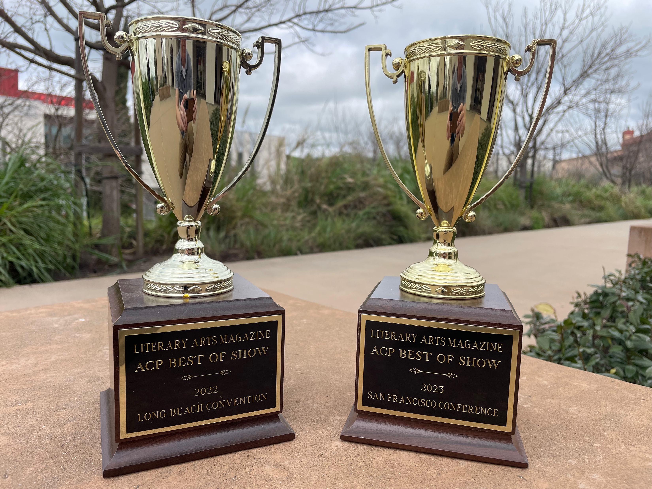
The Havik Publication & Awards Ceremony
Notes:
M

Slide 21
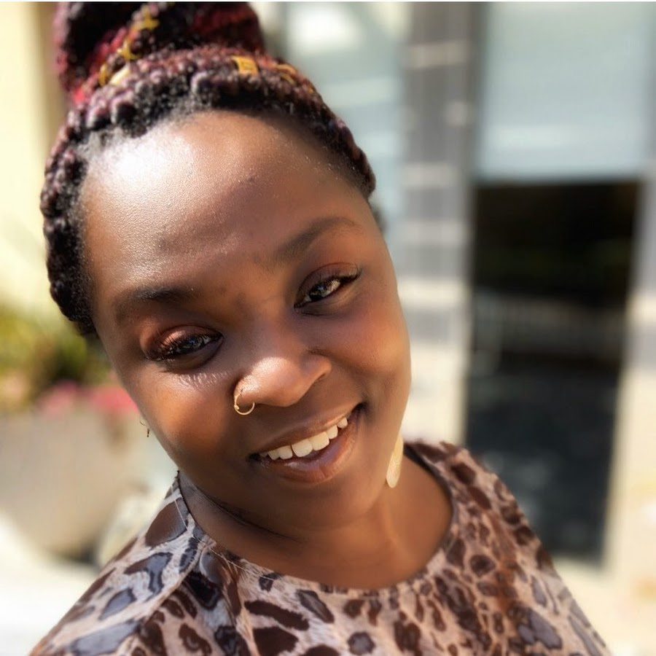
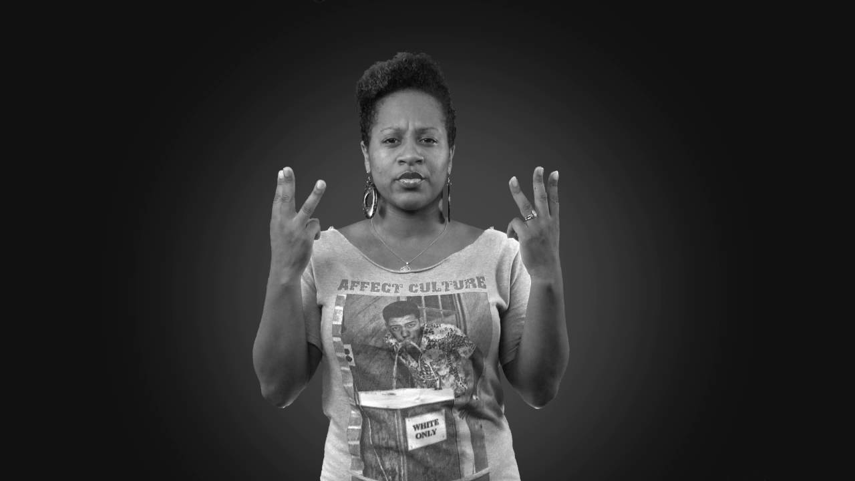
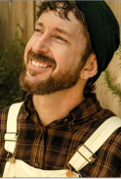
The 20th Annual LPC Poetry Slam
Hosted by Bri and Tri of the Speak East Open Mic
With Special Guests including Ekabhumi Ellik, LPC Slam Host
2003-2011
Notes:
T

Slide 22
LPC 1st Place
Winner of the
First LPC Slam,
“Tara” (2003)

Slide 23
Local
Library
Kids
Storytime
and
Activities
Notes:
R

Slide 24
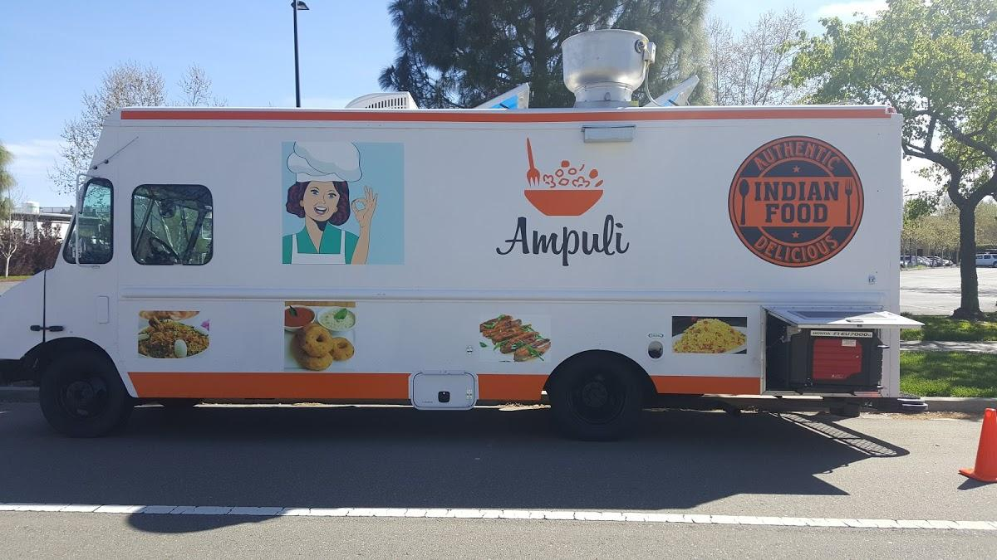
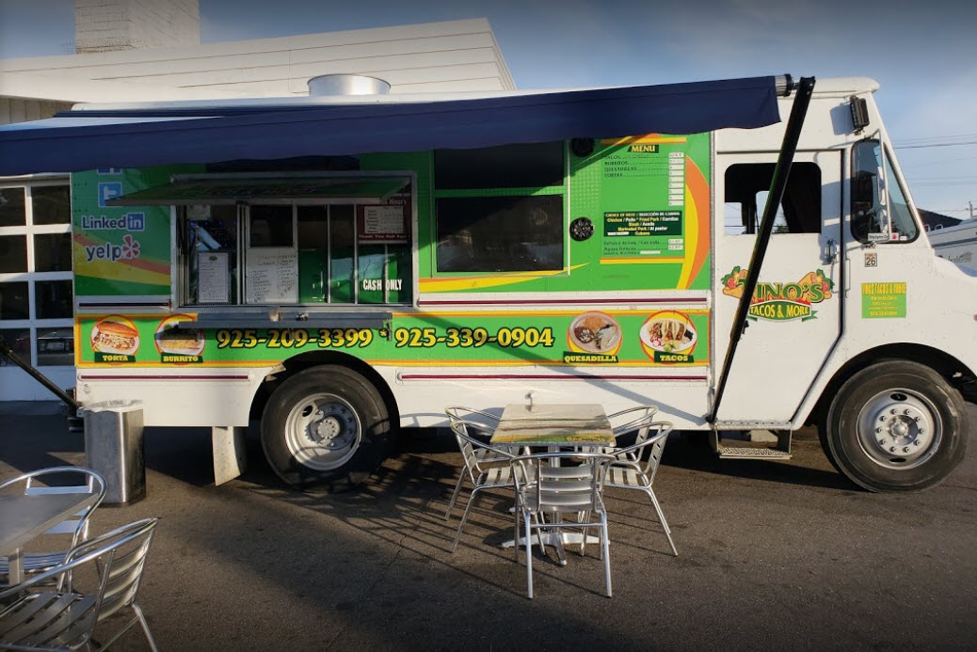
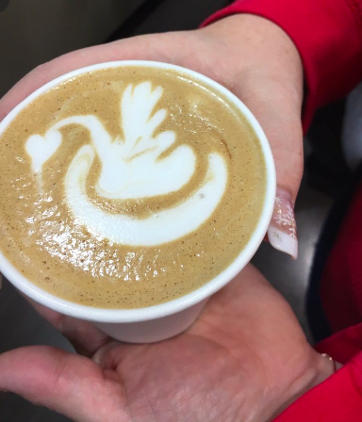
Food Trucks
Ampuli Indian Food & Tino's Tacos
Travelin’ Joe Espresso

Slide 25
Registration Now Open!

Slide 26
Please take this survey if you have a minute.

