Slide 1
Curriculum updates and OER
FLEX Spring 2022
Jennie Graham, Alain Olavarrieta, David Powers, with contributions from Michael Peterson

Slide 2
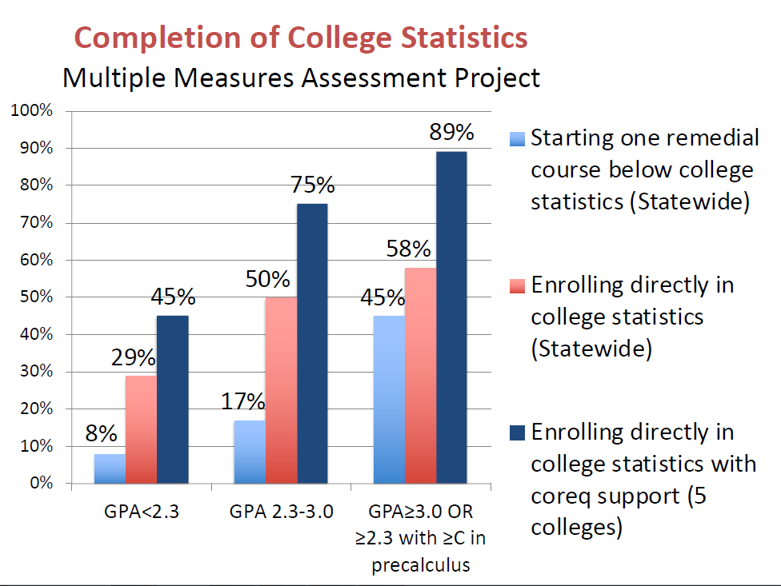
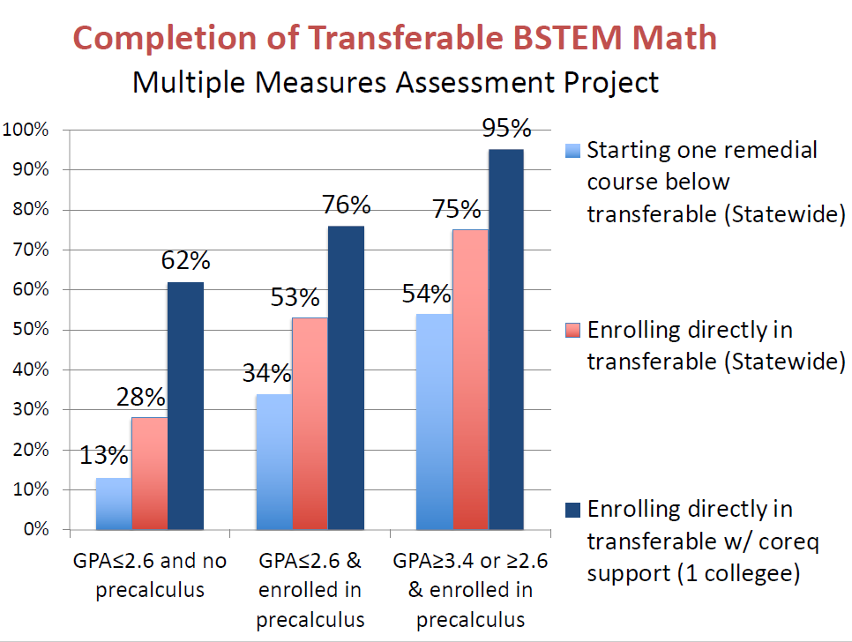

Slide 3
AB 705 Bill Text
A community college district or college shall maximize the probability that a student will enter and complete transfer-level coursework in English and mathematics within a one-year timeframe …
Notes:
Fall 2019: All students had the right to enroll directly into transfer-level math
Fall 2020: Chancellor’s office solicited data from all colleges to assess one-year throughput
Fall 2021: Chancellor’s office shared that colleges maximizing throughput did not offer pre-transfer (basic skills) math courses
So …

Slide 4
From New Chancellor’s Office Memo, Fall 2021
By fall 2022, the California Community College system must complete full implementation of the law and associated regulations …
… all U.S. high school graduate students, both new and continuing, in certificate, degree or transfer programs, will be placed into and enroll in transfer-level English and math/quantitative reasoning courses (whether with or without support) where English and math requirements exist.

Slide 5
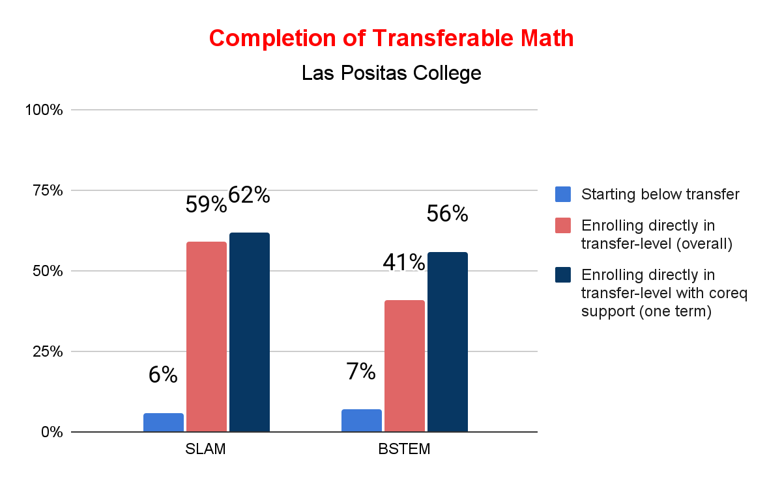

Slide 7
As of Summer 2022
Concurrent support or Math Jam will be required for students based on high school background
For BSTEM, support required for students with:
Highest class successfully completed below Algebra 2
Highest class successfully completed was Algebra 2 AND cumulative GPA under 2.6
For SLAM, support required for students with:
Highest class successfully completed below Algebra 2 AND cumulative GPA under 2.6
Highest lass successfully completed was Algebra 2 AND cumulative GPA under 2.3
Concurrent Support will also be highly recommended for other students, including some Calculus students

Slide 8
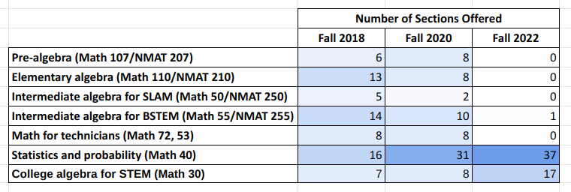
What does this mean for Fall 2022?

Slide 9
State framework for K-12
What is being proposed to the school districts?
Student progress through middle and high school will be normalized.
Expectation is that by sophomore year, students will reach algebra 1 or geometry, but will not need to progress further.
What does this mean for LPC students?
Some students will graduate without knowledge of intermediate algebra content.
Students will only be allowed to enroll in a transfer level math course at LPC.
Notes:
<David>
In the past, students with holes in their education could choose to take a pre-transfer level course. As of Fall 2019, that was something that was still an option. As of Fall 2022, students will be placed in a transfer level course.
What this means for us, is that in our SLAM courses, students will likely still be relatively prepared, but for the BSTEM courses, there may be a gap in knowledge. We need to think about the progression of content needed for our BSTEM transfer level topics and, perhaps, spend just a moment or two more than we usually might to review it.
Or consider scaffolding the homework with questions about the prerequisite information before having them work on the new content.
Since this proposed K-12 framework and AB 705 are statewide mandates, we need to be encouraging and supportive of students when they join our transfer level courses. Our expectation that they have seen the prerequisite material is no longer valid.
Outside of your classroom, we are also offering more support…

Slide 10
Supports for our Students
Math Jam
Math boot camp the week before the semester starts.
Concurrent support
Students get just in time remediation with their transfer level course.
NMAT 202C
Open Entry/Open Exit, non-credit, drop-in tutoring that students can use throughout the semester.
Improved SmartShops to cover topics as most classes are approaching them.
http://www.laspositascollege.edu/smartshops/index.php
Notes:
<ALAIN>
Explain each a little more.
If folks have Smart Shop ideas they can contact Ashley Young.

Slide 11
What else is LPC doing to facilitate student success?
Local High School Alignment meeting
LPC Math Faculty Outreach to High Schools
Different modes of offering
Emporium: Semi-flexible pacing, allows for students to continue into the next semester if necessary.
HyFlex: Students attend in person and online.
Asynchronous/Synchronous fully online
Traditional in-person
Working with learning communities to create Math cohorts: Puente, Umoja, Veterans
Goal is to create an equitable learning experience for our students. To that end…
Notes:
<Alain>
Last sentence is a lead in to the next part of the talk.

Slide 12
Open Educational Resources
Definitions provided by Kali Rippel, LPC’s OER Liason

Slide 13
OER Vocabulary
OER = Open Educational Resources
Teaching, learning, and research materials that are either (a) in the public domain or (b) licensed in a manner that provides everyone with free and perpetual permission to engage.
ZTC = Zero Textbook Cost
Courses with no textbook-related costs, including access fees for online materials. Exact definition at LPC is TBD.
LTC = Low Textbook Cost
Courses with “low” textbook-related costs, including access fees for online materials. Exact definition at LPC is TBD.

Slide 14
Why OER?
Textbook costs can be a barrier ”with a disproportionately negative effect among racial/ethnic minorities, low-income students, and first-generation college students” (Equity & OER).
OER encourages student success ”decrease non-tuition costs, while simultaneously increasing student access, academic performance, and time-to-graduation rates (Jenkins, et al., 2020, 9).

Slide 15
OER + Math
Notes:
<Jennie>

Slide 16
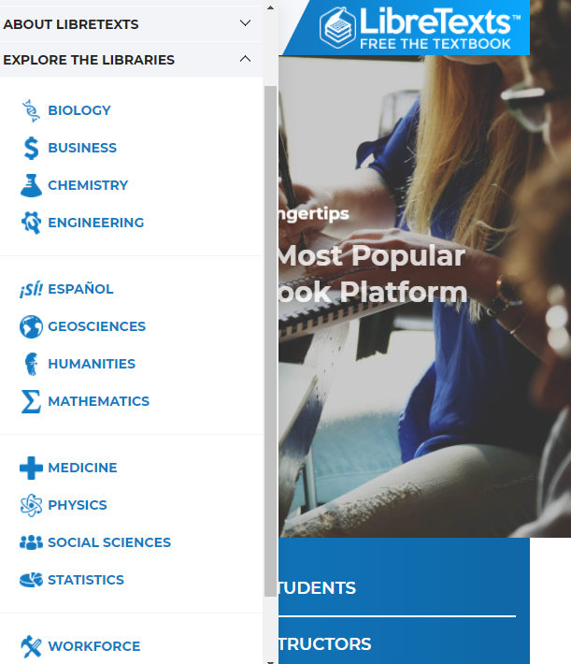
“The LibreTexts mission is to unite students, faculty and scholars in a cooperative effort to develop an easy-to-use online platform for the construction, customization, and dissemination of open educational resources (OER) to reduce the burdens of unreasonable textbook costs to our students and society.”
LibreText, Mission and Values Statement

Slide 17
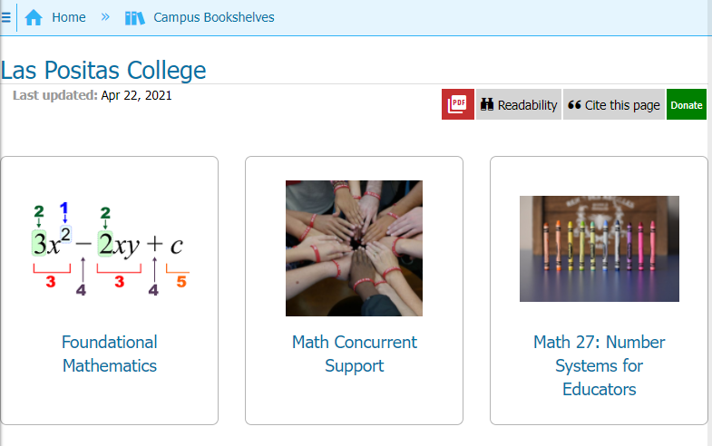
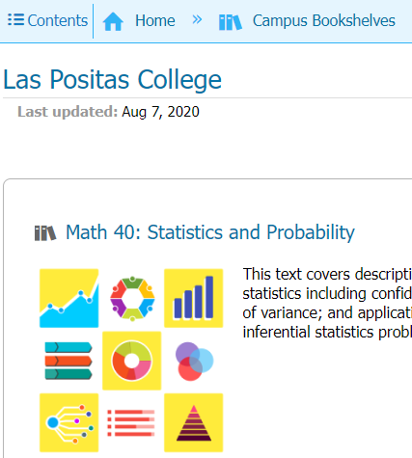
LPC: Campus Bookshelves
Ability to adjust existing OER textbook through
Editing pages
Adding pages
Mixing content from different books (same/different subjects).
Free = 10 books per campus across all library campus hubs.
Central campus hub is possible with unlimits textbooks if part of the LibreText Consortium (payment of $500/year).

Slide 18
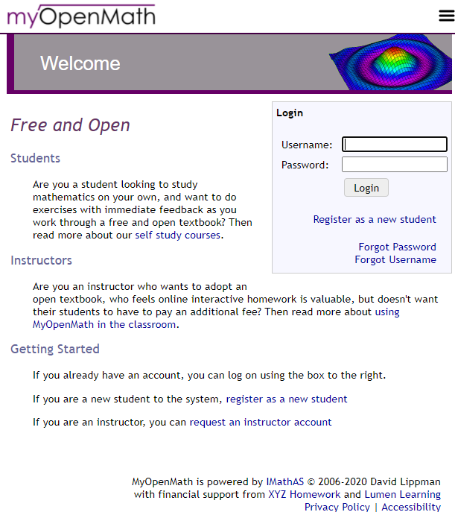
“MyOpenMath is an online course management and assessment system for mathematics and other quantitative fields. MyOpenMath’s focus is providing rich algorithmically generated assessment to support the use of free, open textbooks like the ones listed on OpenTextBookStore.com.
MyOpenMath is a collaborative community of users. MyOpenMath.com provides managed hosting of the open source IMathAS online assessment software. Questions and pre-built courses are all created by faculty in the user community and shared with others in the spirit of openness. Experienced users provide peer-to-peer support through discussion forums.
MyOpenMath.com is operated by the non-profit organization MyOpenMath.”
- MyOpenMath, About Us

Slide 19
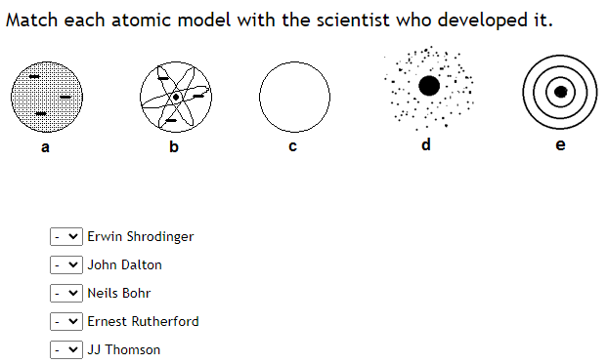
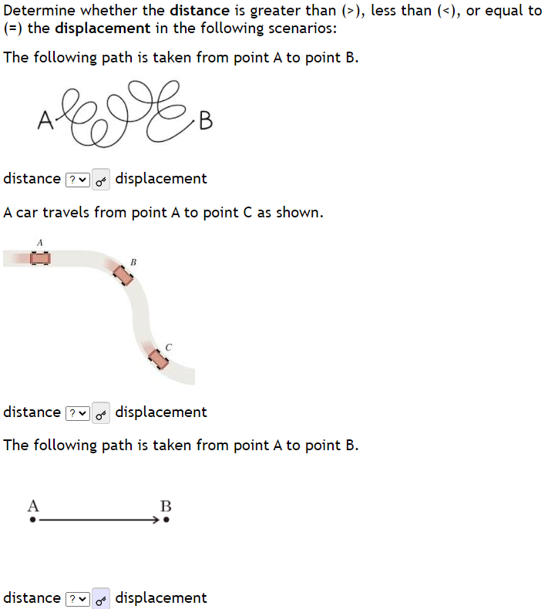
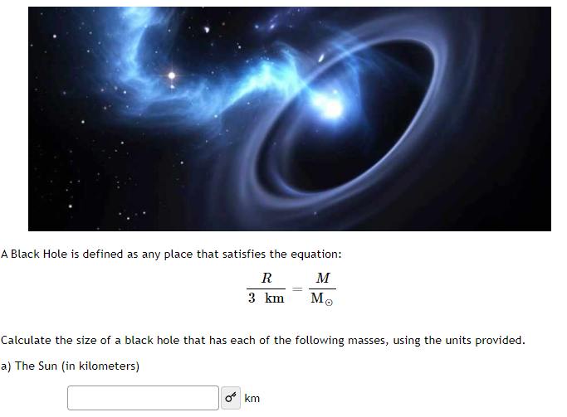
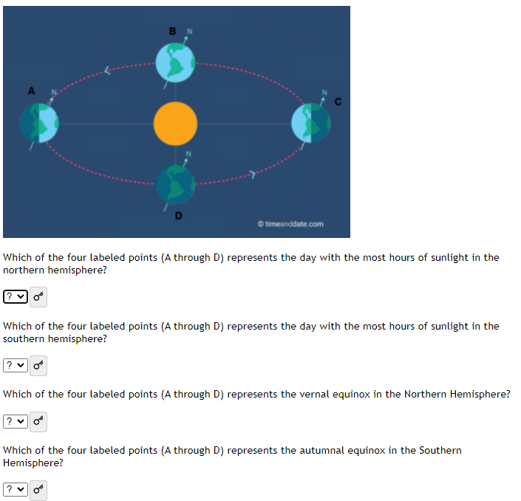
MyOpenMath
Publishers charge students $$$ to use these types of platforms.
The caliber of questions/student supports in MyOpenMath have nearly reached publisher level.
Questions are easily created or edited to meet your needs.
Easy integration into Canvas.
Not just for math. Libraries exist for:
Chemistry
Physics
Astronomy
...more

Slide 20
Math’s Progress on OER Materials:
Book and Homework Sets Complete
Math 40: As of Fall 2022, everyone teaching this course should shift to the OER materials.
Math 39: As of Su 2022, material will be piloted, and available for department use Fa 2022.
Book and Homework Sets are in progress
Math 30: As of Su 2022, material will be piloted, and available for department use Fa 2022.
Math 47: As of Fall 2022, everyone teaching this course should shift to the OER materials.
Notes:
Next we’d like to give you a tour of some of these items as well as give you an opportunity to explore them. David will give a quick overview of what we’re planning for Math 47 in My Open Math and Alain and I will show what a completed course could look like using the integration of Canvas and My Open Math.

Slide 21
Let’s explore
Math 47 - Math for Liberal Arts
My Open Math
Math 39 - Trigonometry
Canvas
My Open Math
Libre Text
https://forms.gle/wU8EbJhT9r493Xxr9
Notes:
David (Math 47)
Structure
Tour
Question selection policy
Alain (Math 39 - tour of part of his Canvas course)

Slide 22
Let’s explore
Math 40 - Statistics and Probability
Canvas
My Open Math
Libre Text
Notes:
Structure
Tour
Question selection policy

Slide 23
Let’s practice with MyOpenMath:
Copy course from the Math Department MyOpenMath Group: Department, Math to your MyOpenMath account.
Make adjustments.
Create Export Package
Import into your Canvas course
Make some adjustments

