Slide 1
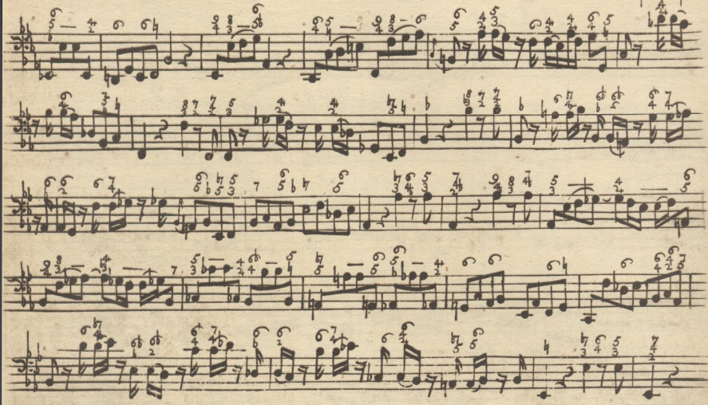
Mathematics and Music:
Singing the Same Tune
Michael Peterson
Spring, 2022

Slide 2
Discipline Organization at Las Positas College
STEM
Mathematics
Physics
Chemistry
Computer Science
Biology
Others!
Arts and Humanities
Music
Art
Dance
English
Foreign Languages
Others!

Slide 3
Discipline Organization in the Middle Ages
Quadrivium
(“Arts of the Number”)
Arithmetic
Geometry
Astronomy
Music
Trivium
(“Arts of the Word”)
Grammar
Logic
Rhetoric
Notes:
https://www.hillsdale.edu/hillsdale-blog/academics/understanding-trivium-quadrivium/

Slide 4
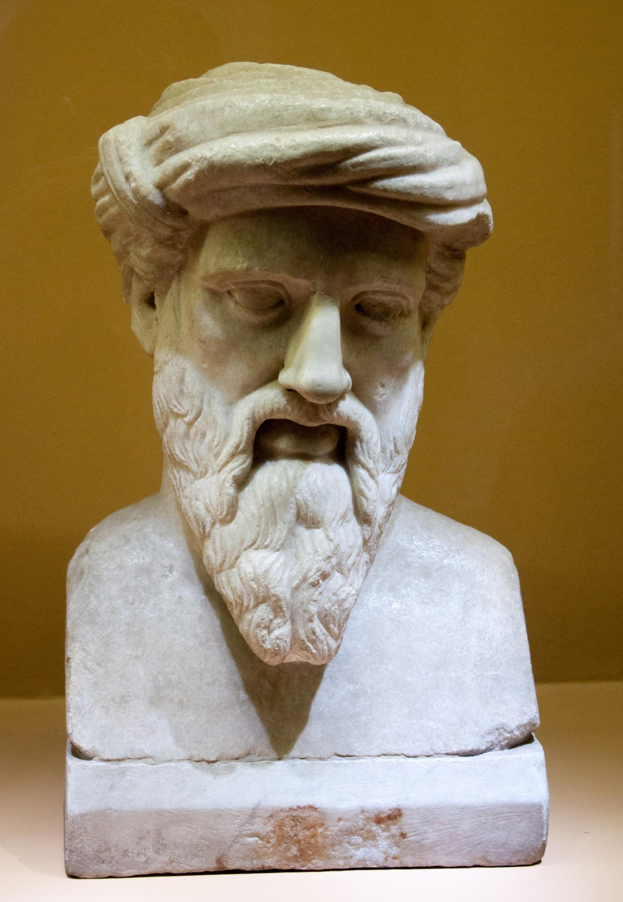
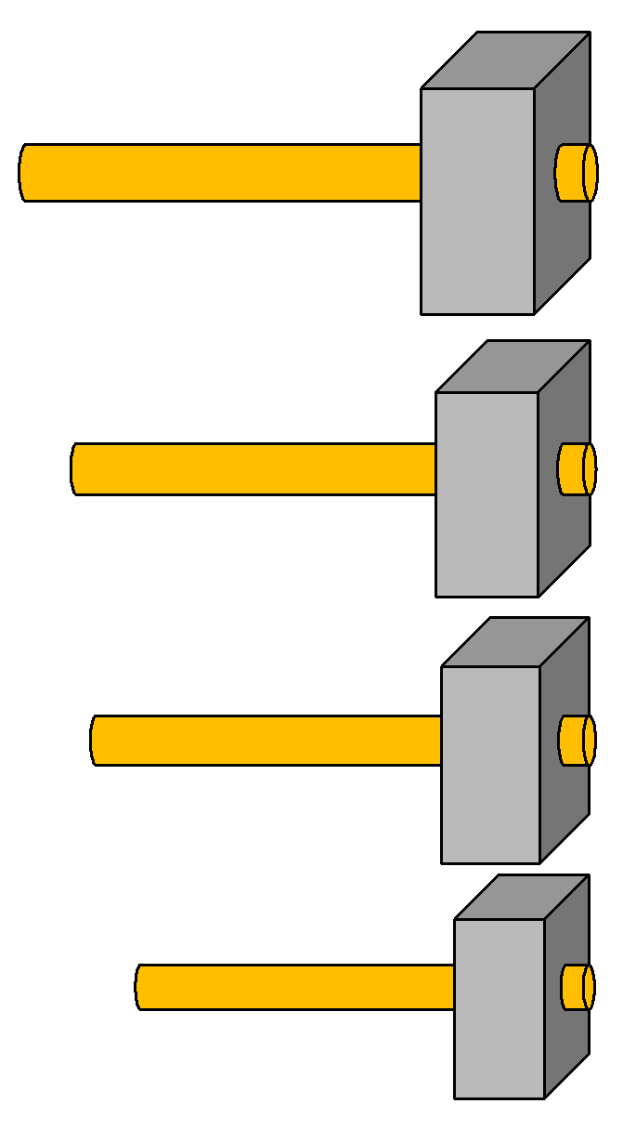
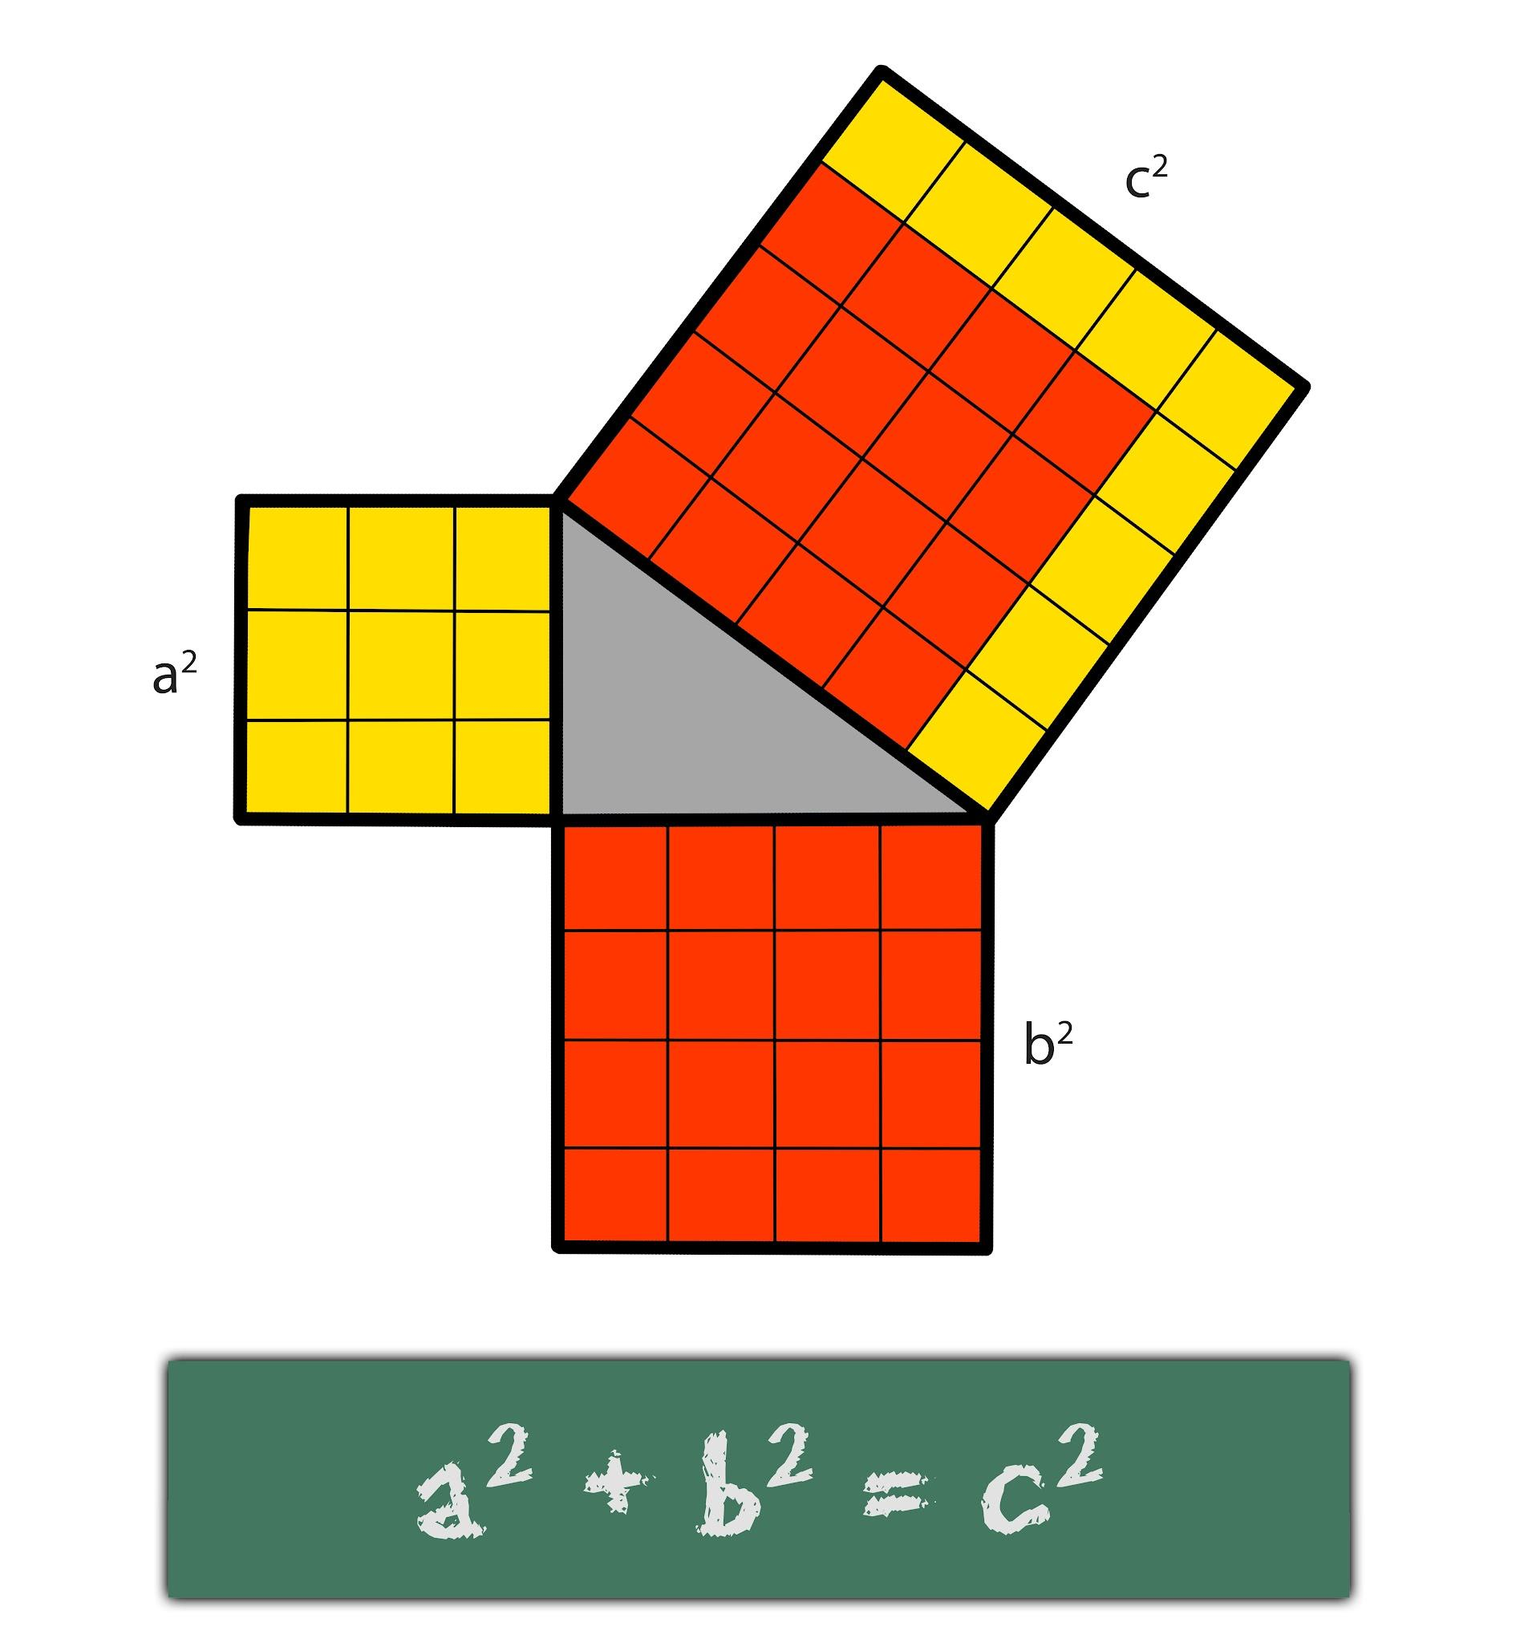
Pythagoras of Samos
c. 570 - c. 495 BCE

Slide 5
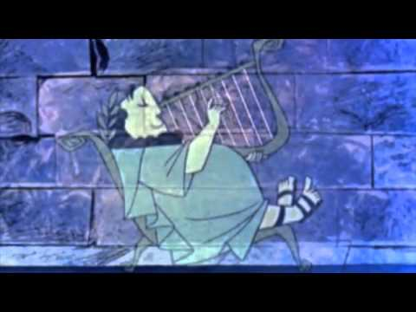

Slide 6
Every music interval corresponds with a ratio.
Fifth 3:2 Major third 5:4 Whole step 9:8
F C F G B C D E F
Octave 2:1 Fourth 3:2 Minor third 6:5

Slide 7
Leonhard Euler classified intervals by dissonance/consonance
(i.e. “order of softness”)
Interval | Ratio | Order of Softness
Unison | 1:1 | 1
Octave | 1:2 | 2
Octave + Fifth | 1:3 | 3
Two octaves | 1:4 | 3
Three octaves | 1:8 | 4
Two octaves + Major third | 1:5 | 5

Slide 8
Euler’s Gradus Function

Slide 9
But …
On a keyboard, not possible for every interval to have these ratios

Slide 10
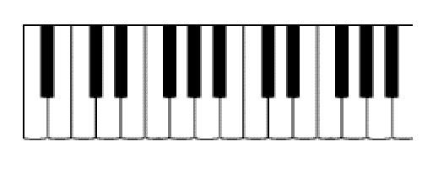
Tuning from C to E Differently Results in Different E’s!
Pure 8ve
Pure 8ve
Pure 3rd
2/1 x 2/1 x 5/4 = 5
C
G
C D
A
C
E
3/2 x 3/2 x 3/2 x 3/2 = 5.0625
Pure 5th
Pure 5th
Pure 5th
Pure 5th

Slide 11
Tuning Octaves using Thirds Gives Out of Tune Octaves!
Pure Octave
5/4 x 5/4 x 5/4 = 1.953125 ≠ 2
C E C
G#
Pure Thirds

Slide 12
What do we do?
Pick an interval to be in tune

Slide 13
Quarter-Comma Meantone
Common in 16th and 17th Centuries
Pure Third!
C G D A C E
Slightly Narrowed (Out of tune) Fifths

Slide 14
But …
As you tune up … you get more sharps
As you tune down … you get more flats
Sharps ≠ Flats

Slide 15
Excerpts of Sonata VII from Sonate di Cimbalo in varie maniere sopra l’Ave Maris Stella by Gioan Pietro del Buono (d. 1657)
Passages that Do Not Work
in Quarter-Comma Meantone

Slide 16
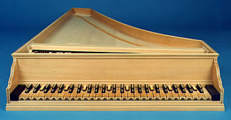
Chromatic Harpsichord

Slide 17
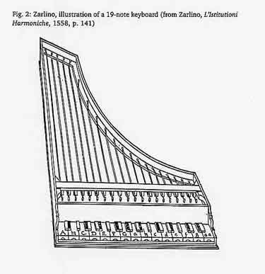
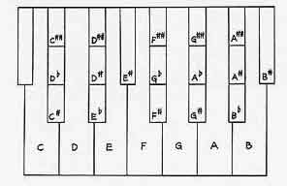
Chromatic Harpsichord
Illustrations
by Giozeffo Zarlino

Slide 18
The Problem with Chromatic Harpsichords
Impractical to Play, Build or Maintain

Slide 19
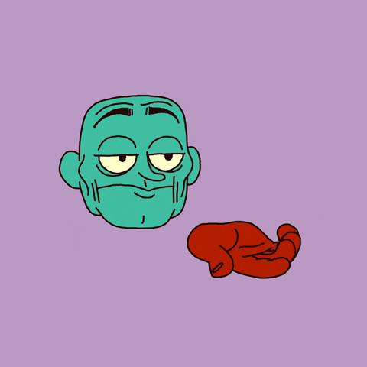
What do we do?
Pick another interval to be in tune
Hmmm … what about octaves?

Slide 20
We can slightly temper the tuning ratios (fifths, thirds, etc) to make octaves pure and all keys possible.
Called “well-tempered”

Slide 21
The Well-Tempered Clavier (1722)
Johann Sebastian Bach
First collection in all possible keys (major and minor) because of this new way of tuning

Slide 22
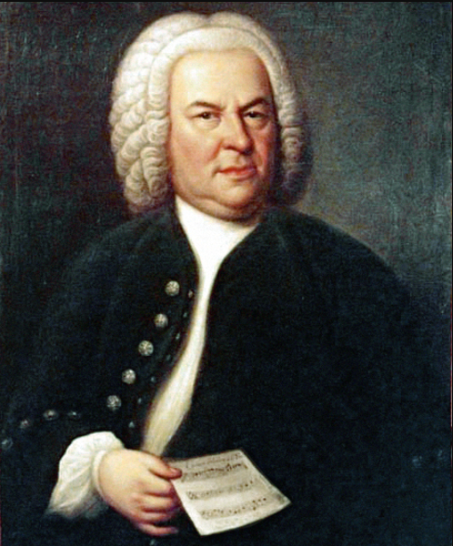
1747: Bach joined the Mizler Society for Correspondence in the Musical Sciences
This society was founded to:
Establish a musical science based on mathematics, philosophy, and connection to nature
Share writings/papers with each other

Slide 23
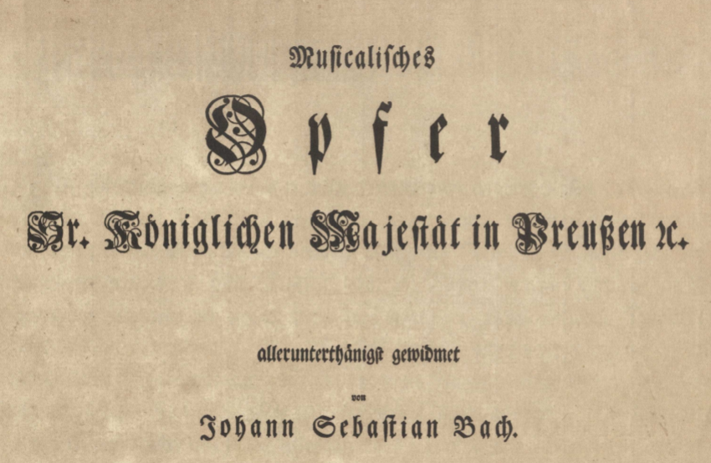
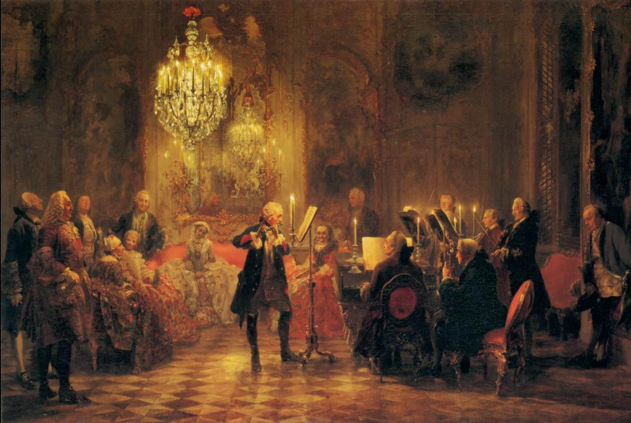
Bach’s first Submission to the Mizler Society: The Musical Offering

Slide 25
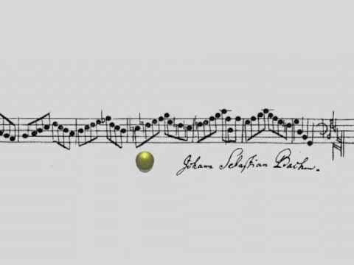

Slide 26
Music, this complex and mysterious act, precise as algebra and vague as a dream, this art made out of mathematics and air, is simply the result of the strange properties of a little membrane.
― Guy de Maupassant

Slide 27
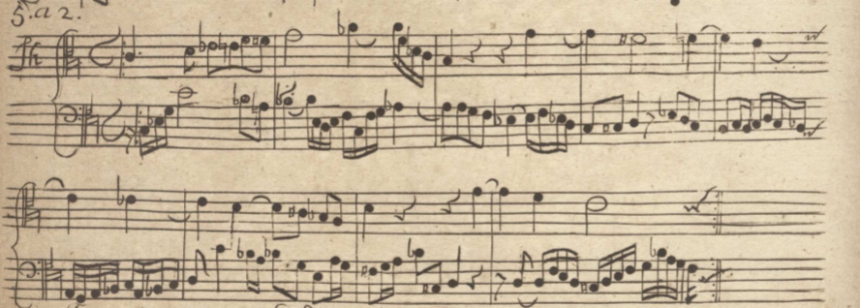
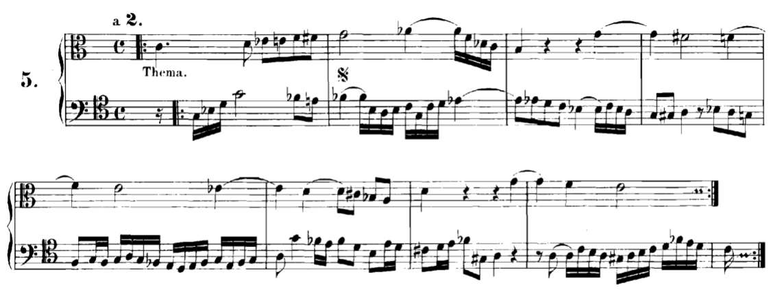

Slide 28
