Slide 1
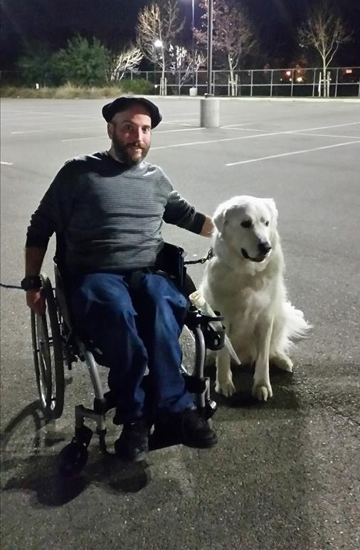
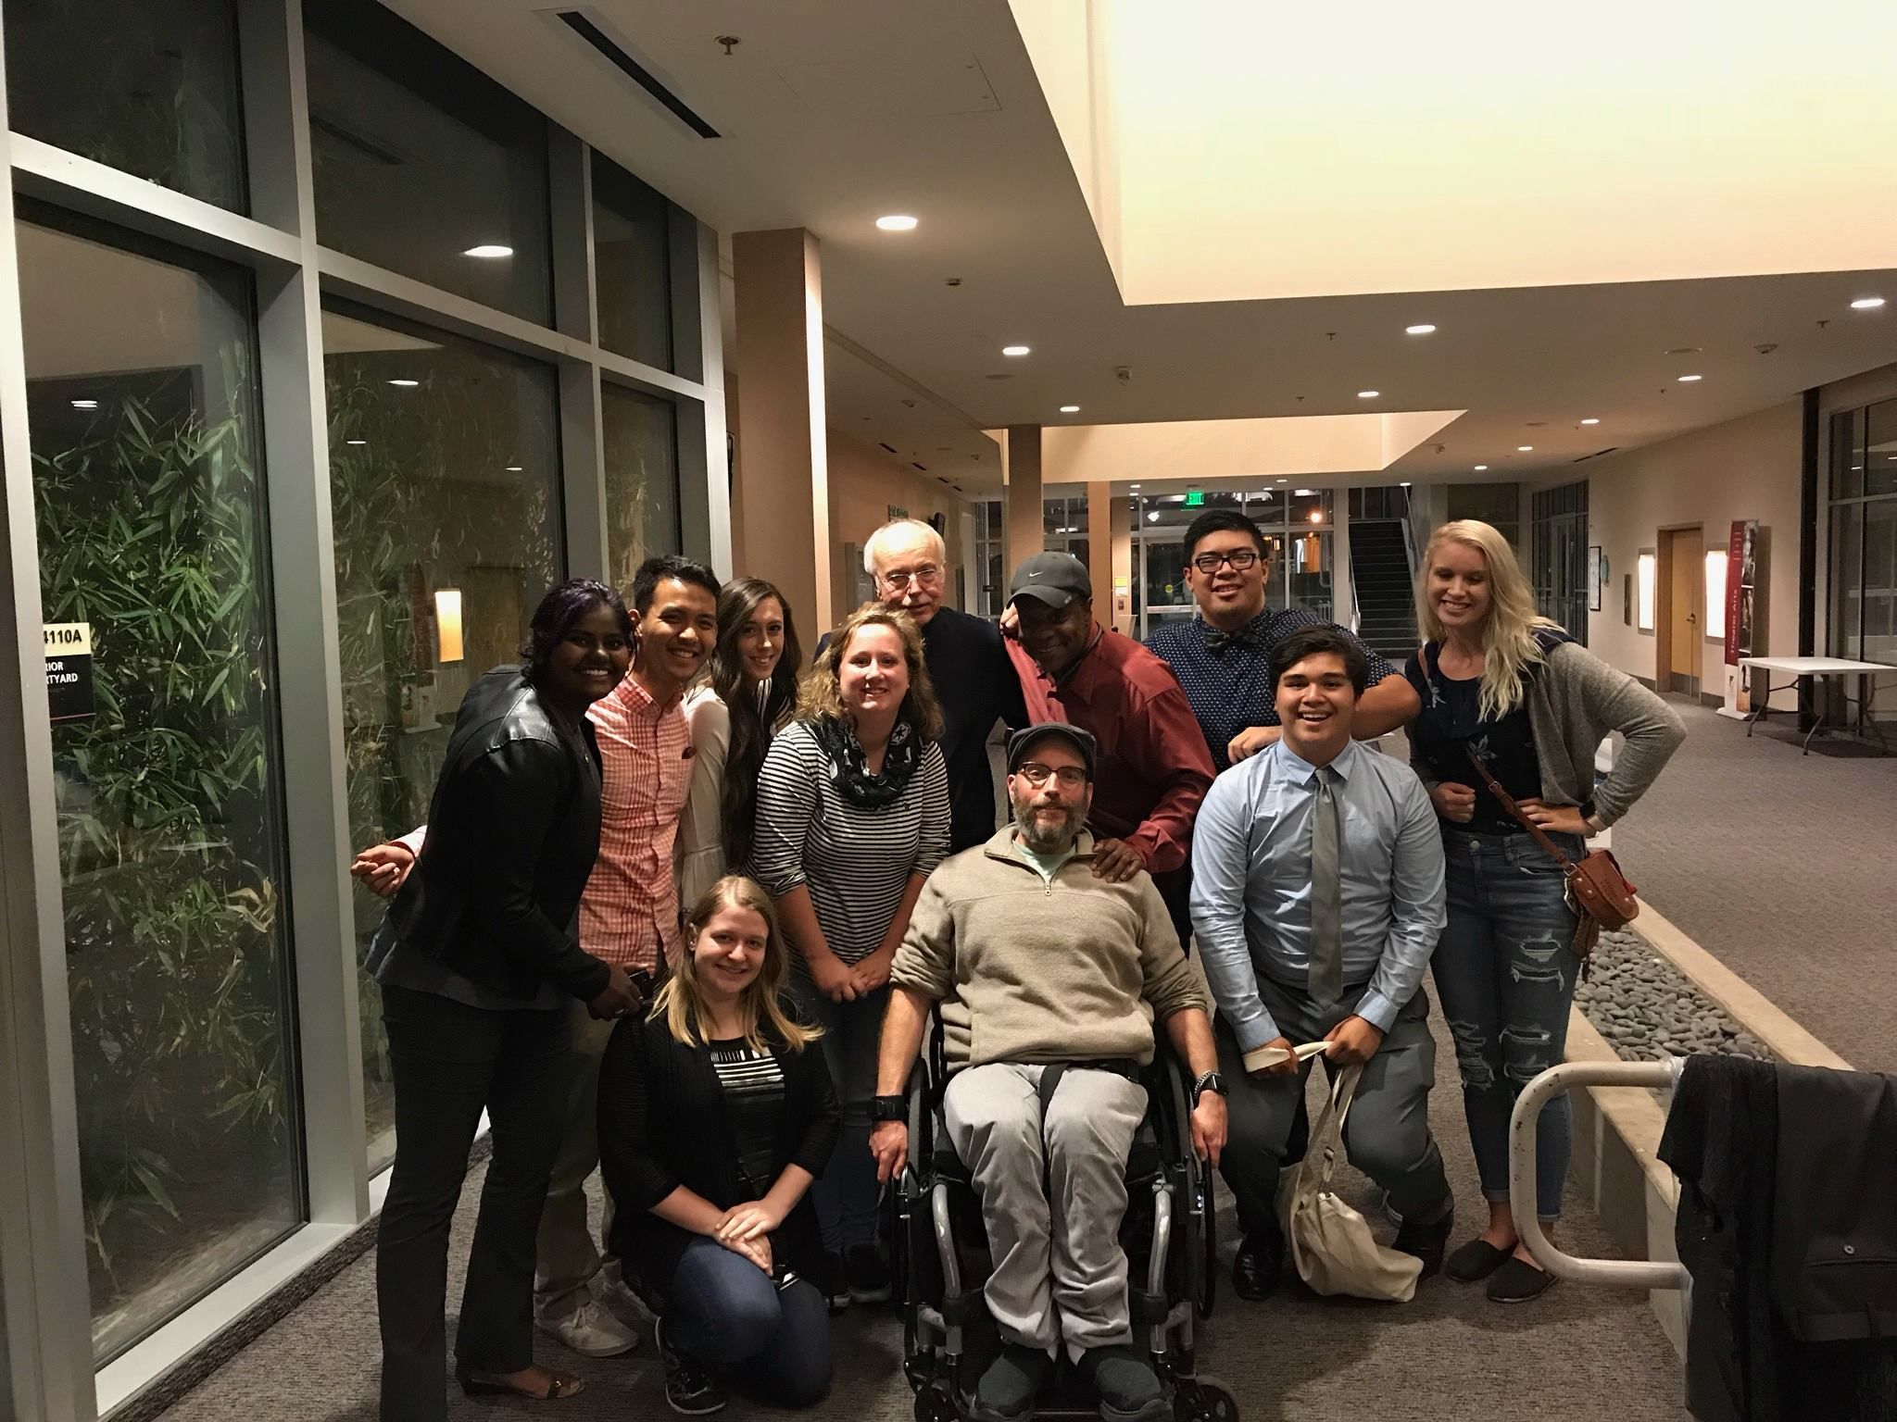
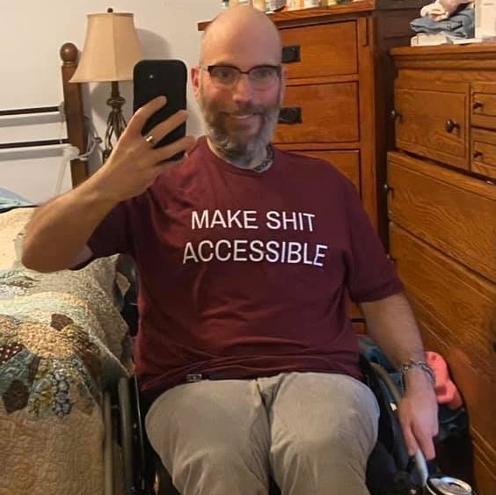
Ableism
Ian Jones (Lifelong paraplegic.)

Slide 2
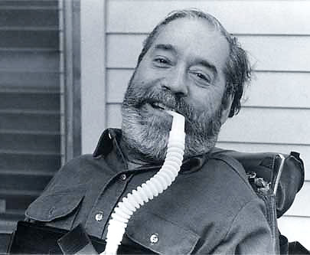
Institutional Ableism
(Unless you count Delaware’s disabled parking placard system in the 1950s,) disability rights really started in Berkeley in the early 1960s.
Ed Roberts
Pioneer
the first student who relied on a wheelchair to attend UC Berkeley.
When he applied to the university in 1962…
https://edo.unt.edu/sites/default/files/Ableism%20-%20What%20It%20Is%20and%20Why%20It%20Matters%20To%20Everyone.pdf

Slide 3
One of the deans said …
“We’ve tried cripples before, and it didn’t really work.”*
https://www.smithsonianmag.com/smithsonian-institution/ed-roberts-wheelchair-records-story-obstacles-overcome-180954531/

Slide 4
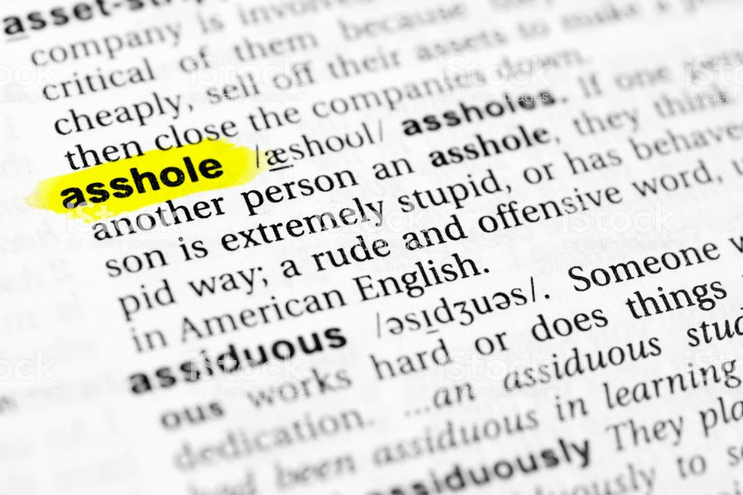
…I KNOW, RIGHT?
(But “Go Bears!”… I guess..?)

Slide 5
ableism: institutional
Inaccessible gov’t facilities
When funding for programs like MediCare is cut.
Focus on disability as something to be “overcome” or inspirational
Lack of books in Braille or on tape. No subtitles available in videos.
No assistive technology for classrooms.
http://www.yodisabledproud.org/resources/docs/fact_sheet_ableism-RevB.pdf

Slide 6
Types of ableism: institutional
In some places in the US, the disabled can be paid less than minimum wage – on average of just $2.15 per hour. – an exception to the Fair Labor Standards Act*
(This is changing…Slowly.)*
If that’s what they can pay us… WHERE IS THE INCENTIVE TO WORK?
http://www.yodisabledproud.org/resources/docs/fact_sheet_ableism-RevB.pdf
https://www.dol.gov/general/topic/wages/subminimumwage

Slide 7
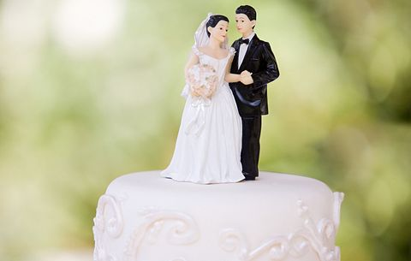
Types of ableism: institutional
Marriage inequality
If you get married, you can lose your benefits.

Slide 8
Types of ableism: psychological
Assumptions
a person’s abilities, physical or mental.
Mocking
Minimizing
a disability is always visible (Not true: cystic fibrosis, epilepsy, diabetes, asthma, ADHD, anxiety, EDS, autism/Asperger’s, Crohn’s, heart conditions, etc.)
Disabled people have no autonomy
Life with a disability is not worth living.
Feeling entitled to know how someone became disabled
Two points here:
It’s cool to be curious
And if people want to talk about it, great…

Slide 9
Types of ableism (psychological) - Language: Slurs
Maybe not so obvious ones
The presumptuous (and offensive) ones
“wheelchair bound/confined to a wheelchair,” “suffers from…” “handicapped.”
The very offensive ones:
“Special needs,” “Handicapable,” “differently abled.”
Phrases like “(succeeded) in spite of their disability,” “turn a blind eye,” “fall on deaf ears,” etc.
These are patronizing or sugar coating

Slide 10
Types of ableism - psychological
Hostility
Avoidance (passive aggression!)
Hate crimes against disabled people (increasing)
The idea that not being vaccinated is better than autism.
The idea that death is preferable to life with a disability.
Being referred to as your disability or diagnosis.
(“This person is Autistic!” vs “person with autism.”*)
Or even being referred to right off the top as DISABLED without the other person knowing anything else about you. There’s more to me than my disability.

Slide 11
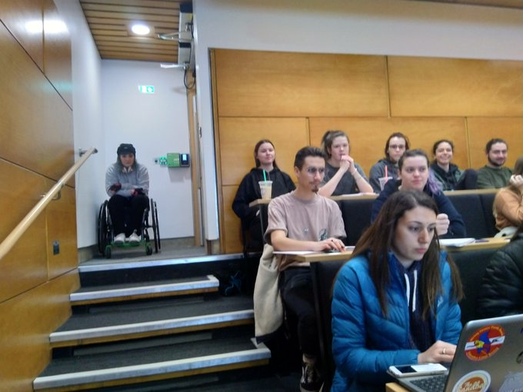
Types of ableism: Physical
Physical barriers
Scheduling gym classes upstairs in new buildings when the elevator is still out of service (Hello, LPC…)
Architectural design

Slide 12
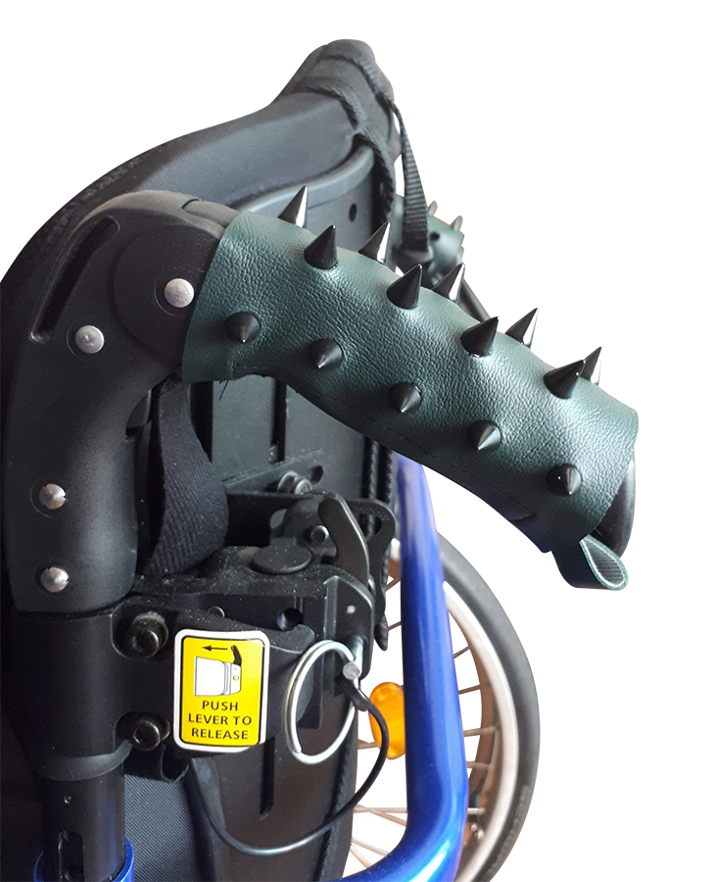
ableism: Physical
Pushing a person using a wheelchair without asking first.
$40 on Etsy

Slide 13
Ableism within disabled communities
GATEKEEPING (“They’re not really disabled.”)
LATERAL (“Glad I don’t have their disability…”)
INTERNALIZED (taking what society believes about the disabled to heart – e.g., “I’m a burden.”)

Slide 14
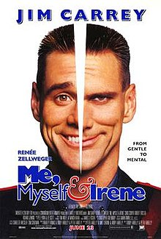
Ableism in AMERICAN pop culture
Notes:
Both include strong themes of assisted suicide, and the idea that a disabled life isn’t worth living.

Slide 15
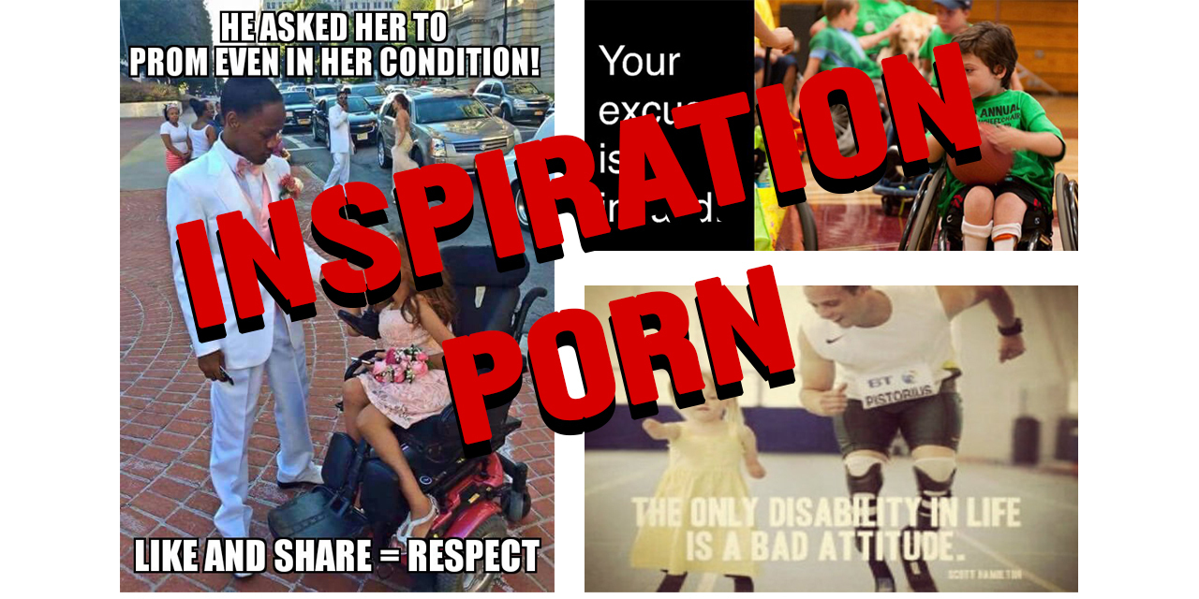
Stella Young
(1982-2014)
Memes and photos of disabled people living (what should be) their mundane daily lives used solely for inspiring able-bodied people.
https://www.youtube.com/watch?v=0iDmvAUokWk

