Slide 1
Dream Big! Aspirations & Obstacles
Flex Day, Spring 2018

Slide 2
Under Pressure…..

Slide 3
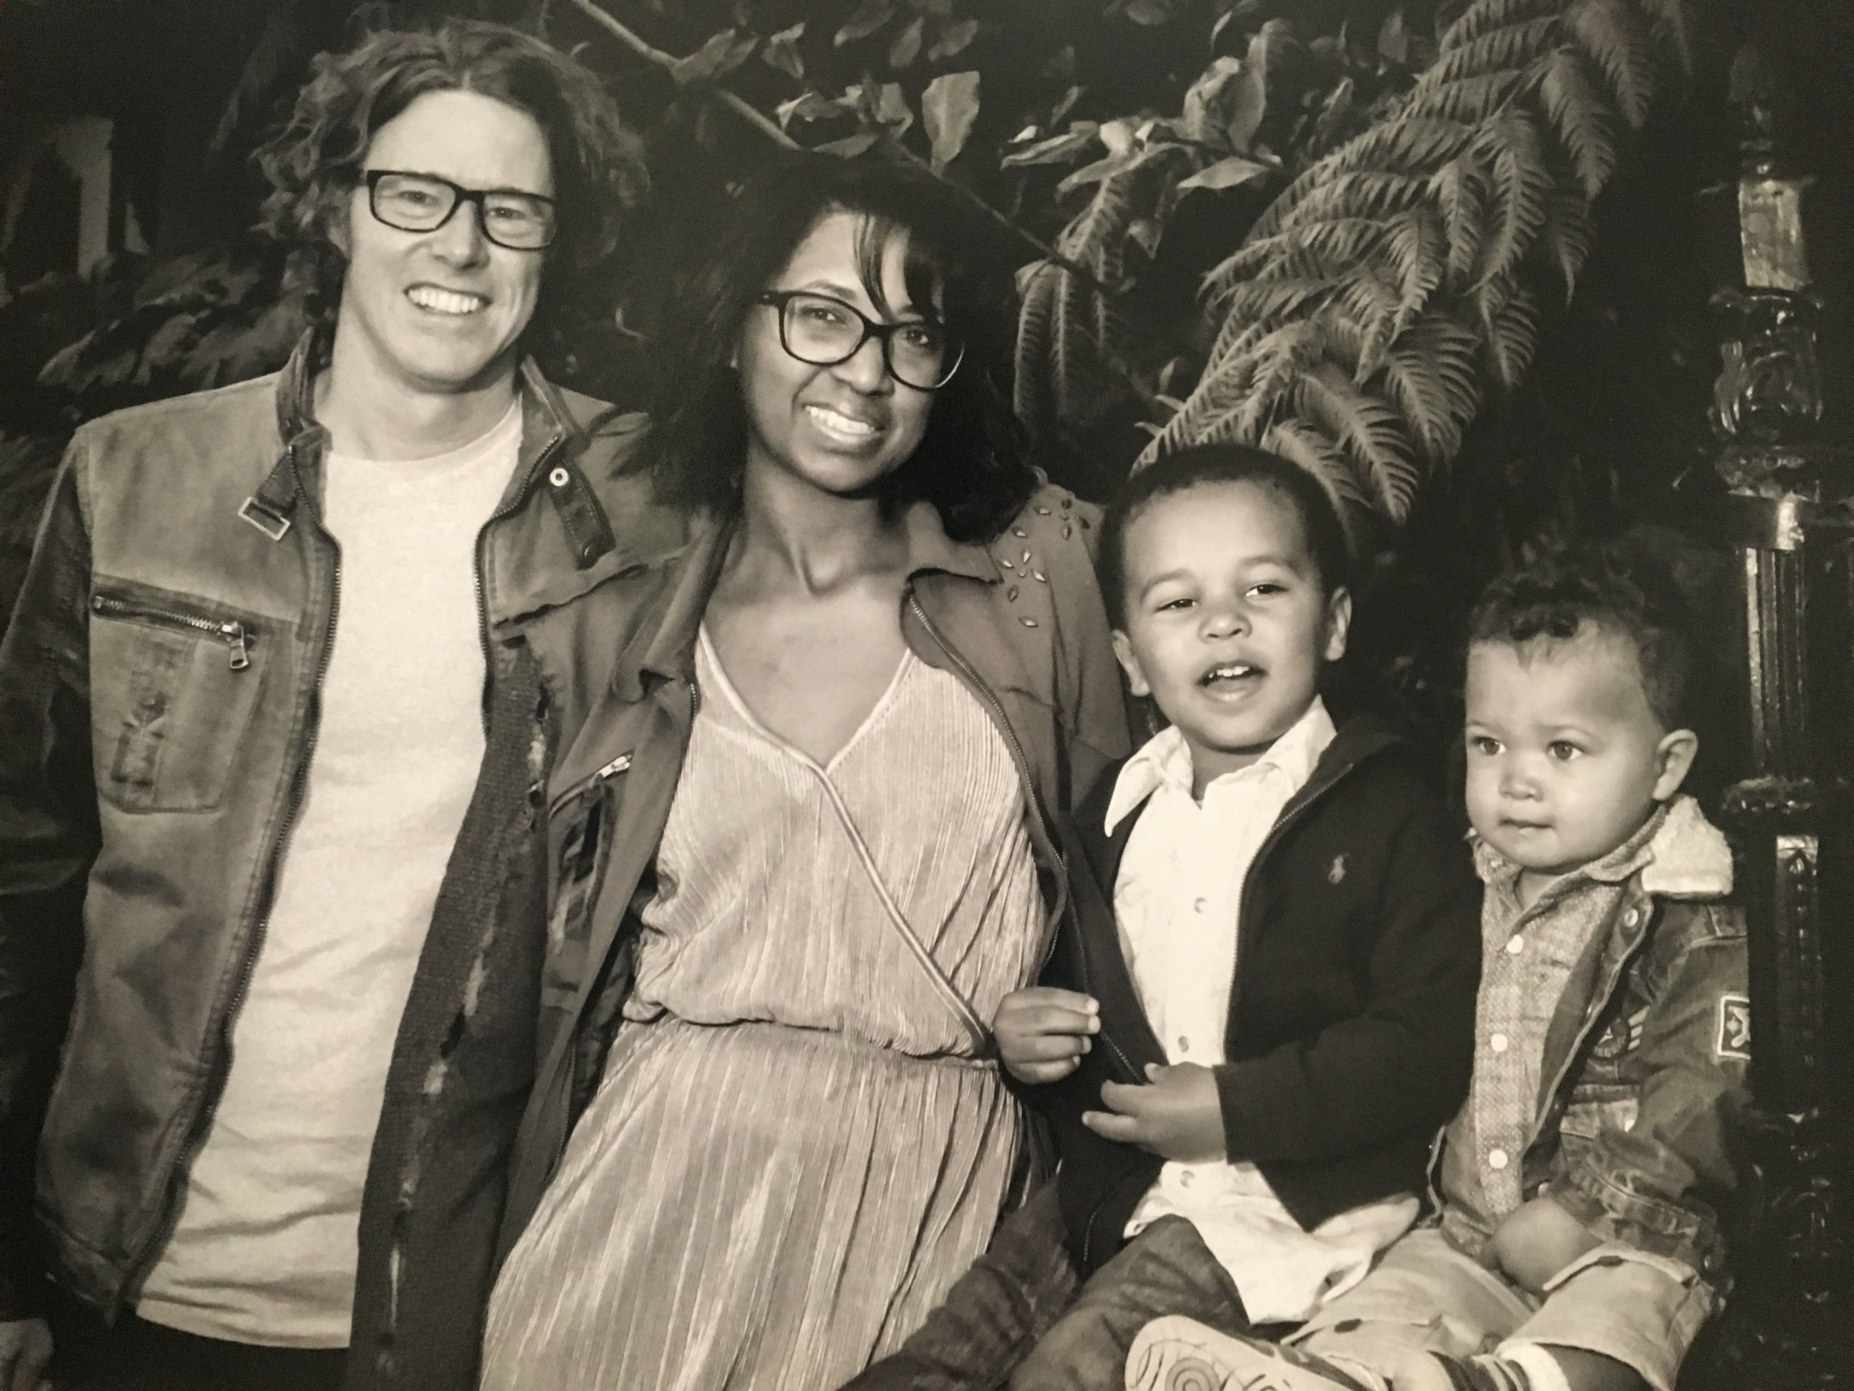
How can I be the best version of myself in the classroom?

Slide 4
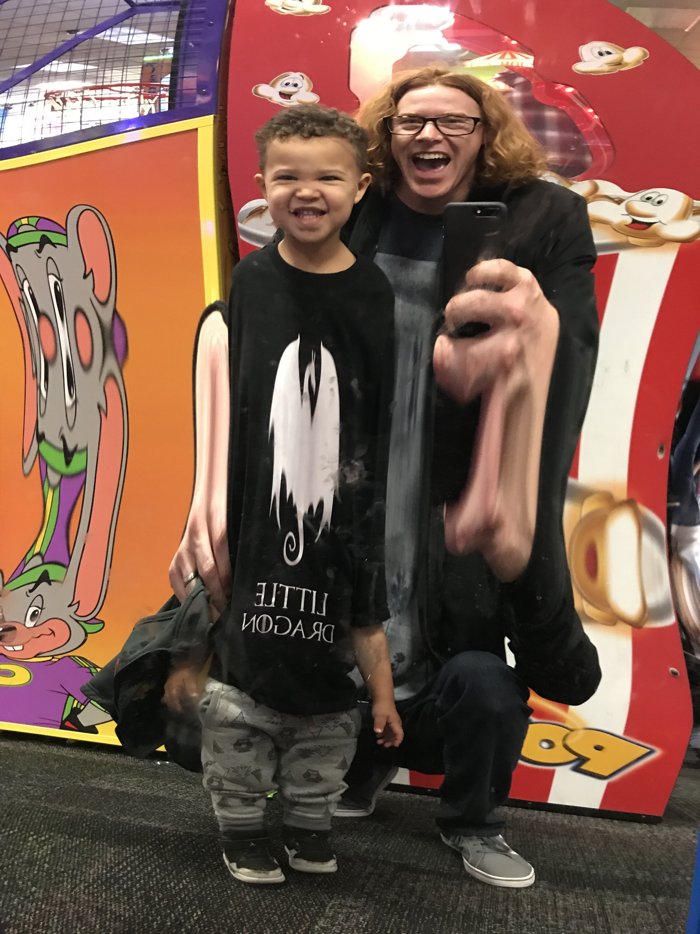
The first weeks of class…

Slide 5
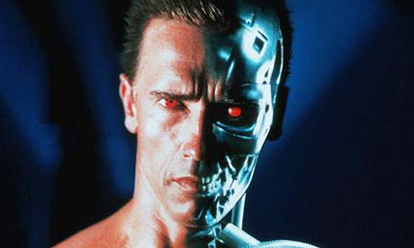
Two months in…
Create the file. Revise the file. Proof the file. Upload the file. Boxes checked? If yes, then go to Submit. If no, then identify box with no check. Do task to complete box’s instruction.

Slide 6
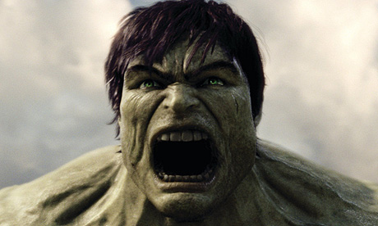
Three months in…
“You STILL don’t know MLA citation rules?!”

Slide 7
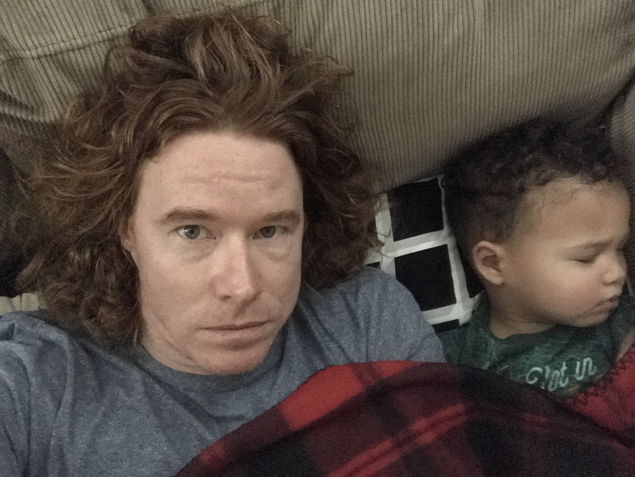
The day after finals…

Slide 8
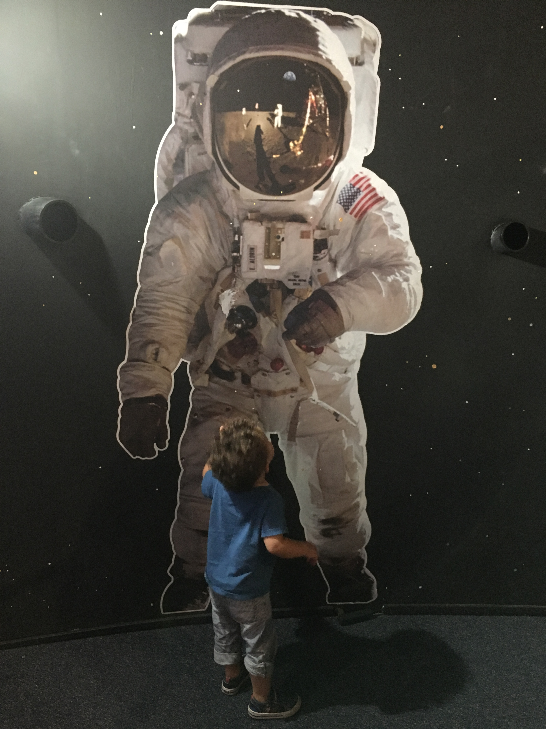
Where I want to be in the classroom…

Slide 9
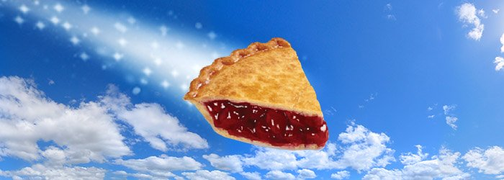
Share and Reflect
What am I doing in the classroom that I enjoy??
What areas do I wish to grow and….what is holding me back?
Dream BIG! What is your “pie-in-the-sky” vision that you would like to see come into fruition in your work or life?

Slide 10
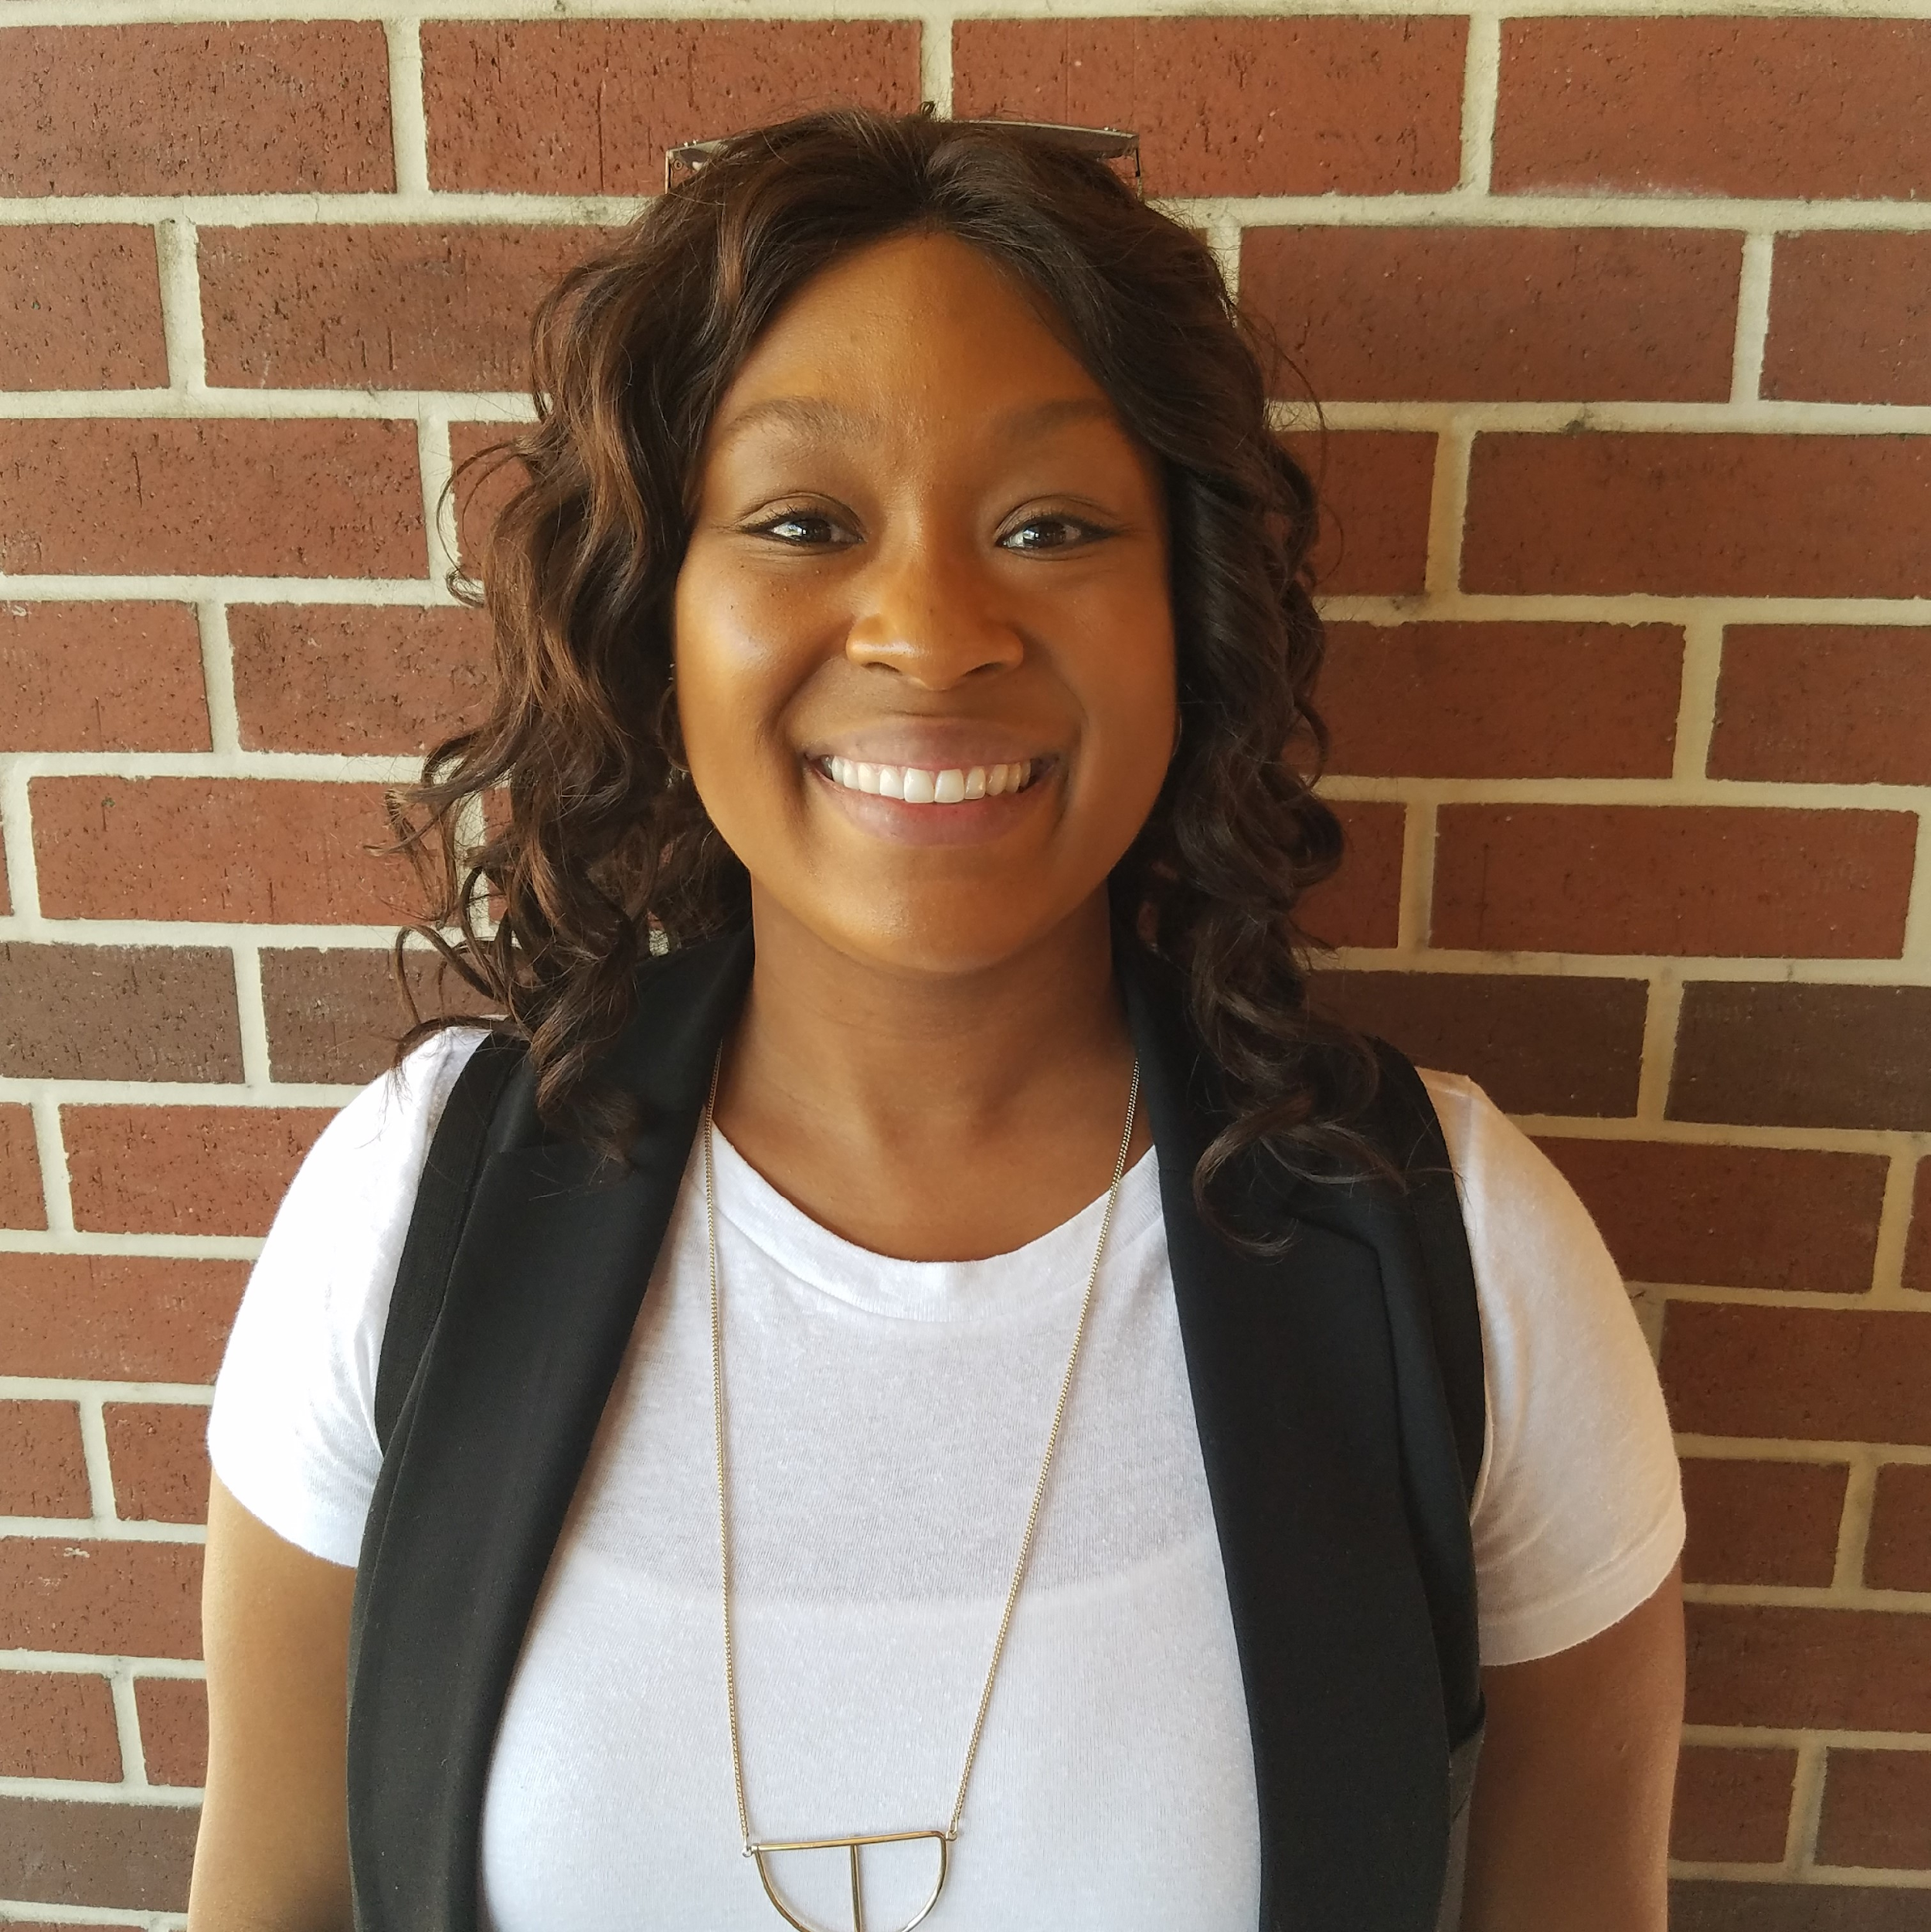
“Reframing my day, setting achievable expectations to combat obstacles.”

Slide 11
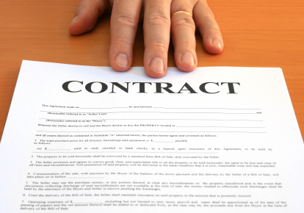
Making it happen!
Work individually on the contracts provided
Once completed work with others to troubleshoot any barriers or challenges you face

Slide 12
Let’s discuss!

Slide 13
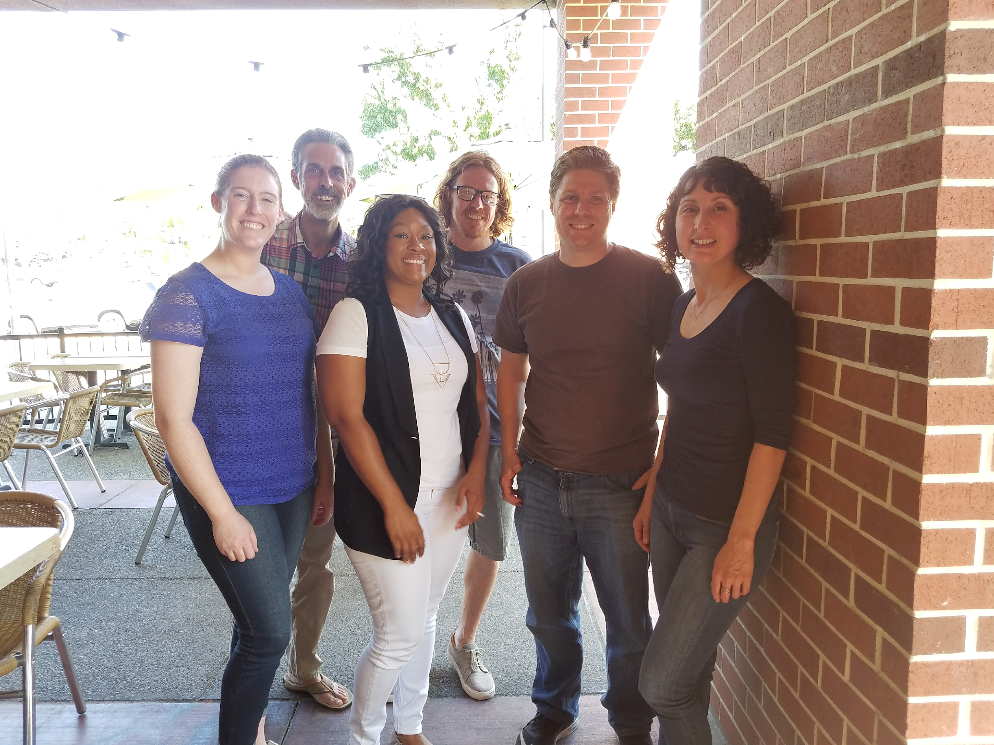
Thank you for participating!

