Slide 1
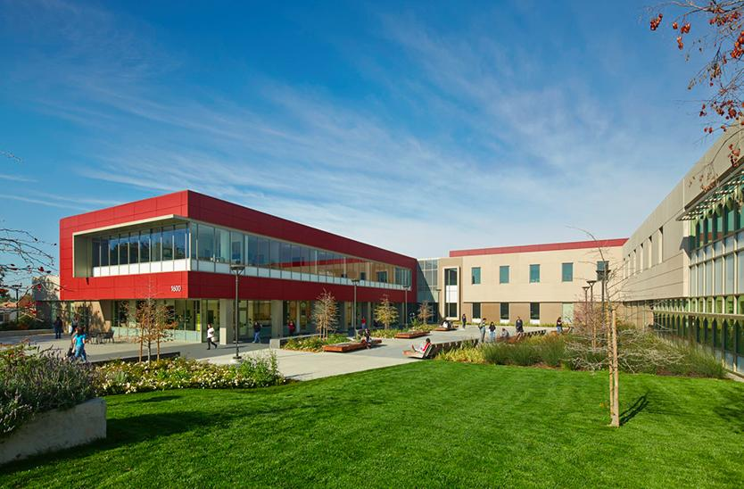
Visioning for Professional Development at LPC
Howard Blumenfeld and Elena Cole

Slide 2
Existing Professional Development Opportunities
P D
C
The Professional Development Committee meets every second Monday of the month from 2:30 PM – 4:30 PM in Room 2410.
The committee is involved in the planning and execution of the following:
Fall and Spring FLEX Days
Funding Conference Requests, Activities, & Guest Speakers
Variable FLEX Activity Planning and Approval
New Faculty Orientation Program

Slide 3
Working Together
A Model for “Grassroots” Professional Development

Slide 4
Working Together
Small group discussions and FLEX Day seminars to discuss topics including the following:
Vulnerability
Sensitive situations
The Performance of Teaching
Reflections & Resolutions
Education in a Post-Election Culture
Community Building on Campus
Appreciating and Celebrating Each Other
The Dilemma of Sisyphus
Work/Life Balance
The “Working Together” Group is having a FLEX Day Session called “Dream Big! What would your Bureaucracy-Free Environment Look Like?” today from 1:00 PM – 2:50 PM in Room 2460

Slide 5
Working Together Websites
Current Events:
http://lpcazure.laspositascollege.edu/gv/pdc/wt.php
Archives of Material from Past Events:
http://lpcazure.laspositascollege.edu/gv/pdc/wtarchives.php
A Model for “Grassroots” Professional Development

Slide 6
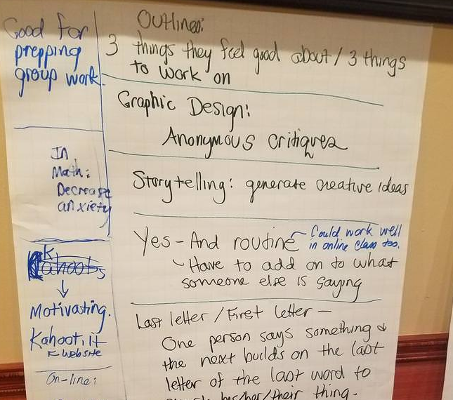
The Teaching Institute
A Model for “Grassroots” Professional Development

Slide 7
The Teaching Institute
Meets once or twice per semester to discuss classroom issues and practices
Formerly known as “Teachers Teaching Teachers”
Meetings include food provided at a restaurant (thanks to the Basic Skills Transformation Grant) and many opportunities for social interaction
Interact within and across different disciplines
The following is a list of topics discussed at past Teaching Institutes:
Tricks of the Trade
Hot Topics
Improv in the Classroom
Great Teachers Seminar
The most recent Teaching Institute meeting occurred at Canton Village Restaurant in Livermore on Wednesday, March 21. The topic was “Classroom Management and Syllabus Contruction.”

Slide 8
Teaching Institute Website
http://lpcazure.laspositascollege.edu/gv/pdc/ti.php
A Model for “Grassroots” Professional Development

Slide 9
The Basic Skills Transformations Grant
There are several Professional Development Opportunities arising from the Basic Skills Transformation Grant.
These include things like Growth Mindset Training, Reading Apprenticeship, and FIGS & POPs in English and Math.
The Grant is about to enter its final year of its cycle, so there is a sense of urgency to maximize the usage of resources.

Slide 10
Growth Mindset & Habits of Mind Training
Training in research and practices that foster in students growth mindset and habits of mind, both proven to help teach students skills making them more successful across the curriculum

Slide 11
Reading Apprenticeship
Reading Apprenticeship is “evidence-based, teacher professional learning to improve academic literacy and social-emotional learning” across the curriculum. In-house RA programs exist in many community colleges where faculty receive on-going training in RA principles proven to improve student outcomes.

Slide 12
FIGS and POPS
Focused Inquiry Groups (FIGS) – Participants identify lines of inquiry that they wish to explore, engage in research focused on their students, and report their findings to the broader campus community.
Peer Observation Pool (POP) – The goal of participating in a POP is to learn from colleagues by observing their classrooms. This is not related in any way to faculty evaluation; this is informal and all about learning as an observer.

Slide 13
Visioning for Professional Development
On page 3 of your handout you will find a couple of questions about Professional Development needs and desires. Please detach this page from your handout and respond to the questions.
We will devote some time to sharing out your ideas in about 15-20 minutes (time permitting).

