Slide 1
HayWired We Can Outsmart Disaster
Jim Yoke
Chabot – Las Positas Community College District
Manager: Emergency Preparedness & Workplace Safety

Slide 2
Today’s Objectives
Understand the risks
Apply the information presented to Livermore and Los Positas College
Review preparedness steps for home and the workplace

Slide 3
Objective #1 – Understanding the risk

Slide 4
Setting the table
So, we live in earthquake country.
This isn’t exactly a big surprise, but how often do people think about what this means for their lives, their communities, and beyond?
Are we inured to our geology, and as a result ignore it?

Slide 5
Generational perspectives
The last big earthquake in this area was the Loma Prieta quake in 1989.
The 29th anniversary was last week.
Curious children need to talk to grandparents about it, because their parents either weren’t alive or are too young to remember.

Slide 6
we are complacent and unprepared
Intellectually, people get it.
Generalization – we’re busy people with fleeting attention spans.
Emotionally, we don’t have a personal frame of reference to draw upon which inhibits contemplation and action.

Slide 7
Haywired – New Information
We have known about our three main fault lines for a long time:
San Andreas
Hayward
Calaveras
The USGS has conducted new research on the Hayward Fault, called “HayWired”.
https://www.youtube.com/watch?v=aRLb3PmIYFc

Slide 8
Checking out the map

Slide 9
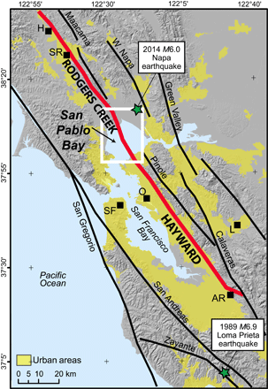

Slide 10
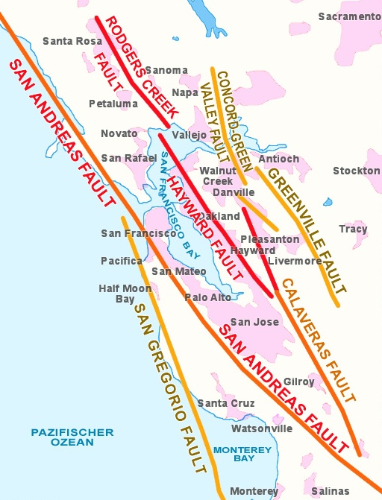

Slide 11
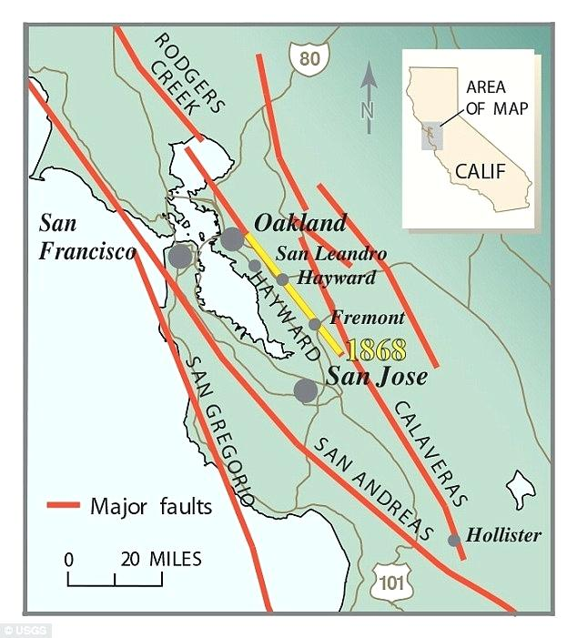

Slide 12
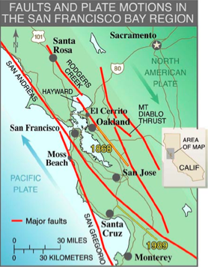

Slide 13
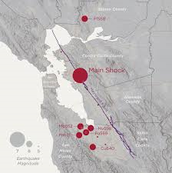

Slide 14
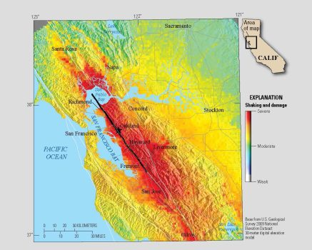

Slide 15
Anticipated consequences
Landslides
Liquefaction
Explosions (like San Bruno on Sept. 9, 2010)
Fires
Aftershocks
Afterslips

Slide 16
More consequences
Approximately 800 people dead
18,000 injured
2500 needing rescue
22,000 trapped in elevators
77,000 – 152,000 displaced
Six weeks to six months with no water
400+ fires with no firefighting water
$82 billion in losses

Slide 17
Water restoration
Current conditions in Alameda & Contra Costa Counties
30% of service returned in 7 days
Full service returned in 210 days

Slide 18
Long-term consequences
Major infrastructure damage in the East Bay and elsewhere:
Major emigration, corporate and personal
Massive economic losses – tax revenue collapse
Costly repairs – insurance will be overwhelmed
Heavy dependence on federal assistance

Slide 19
So – what to do?
Should Miami or Houston give up, throw in the towel, quit, because of the hurricane threat?
Japan is the most seismically active place in the world. Should they cower in dismay?
Or, can preparedness make the difference?

Slide 20
Objective #2 – Applying information to Livermore and Las positas College

Slide 21
LPC Advantages
Modern quake resistant construction
New emergency plans in draft form – should be finalized before the end of the school year
Facility agreements in process with the American Red Cross for sheltering
New communications equipment in the procurement pipeline

Slide 22
Work to be done at LPC
Disaster Home Preparedness training
CERT training
Organizational training
First Aid/CPR/AED training
Skill based drills
Tabletop & Full Scale exercises

Slide 23
Objective #3 – preparedness steps for the home, the workplace, & the community

Slide 24
Disaster Home preparedness in short
Know your risks
Plan accordingly
Make, and maintain disaster supplies kits
Review handout

Slide 25
Know your risks
Earthquake
Fire
Wildfire
Flood
It depends on where you live – region wide risks vs specific local risks

Slide 26
Planning – home, workplace, community
Meeting locations
Communications
Transportation
Exit routes
Hazard mitigation
Access & Functional Needs Planning
First responder resources
Local emergency management
Community volunteerism
Volunteer organization presence

Slide 27
Disaster supplies – see handouts
User needs drive assembly & organization
Water
Food
Medical
Documents – ID, insurance, deeds, medical info, financial, etc.
Mementoes – photo albums, keepsakes, etc.

