Slide 1
U.S. Department of Justice
Civil Rights Division
U.S. Department of Education
Office for Civil Rights
Dear Colleague Letter on Transgender Students Notice of Language Assistance
If you have difficulty understanding English, you may, free of charge, request language assistance services for this Department information by calling 1-800-USA-LEARN (1-800-872-5327) (TTY: 1-800-877- 8339), or email us at: Ed.Language.Assistance@ed.gov.
Aviso a personas con dominio limitado del idioma inglés: Si usted tiene alguna dificultad en entender el idioma inglés, puede, sin costo alguno, solicitar asistencia lingüística con respecto a esta información llamando al 1-800-USA-LEARN (1-800-872-5327) (TTY: 1-800-877-8339), o envíe un mensaje de correo electrónico a: Ed.Language.Assistance@ed.gov.
給英語能力有限人士的通知: 如果您不懂英語， 或者使用英语有困难，您可以要求獲得向大眾提 供的語言協助服務，幫助您理解教育部資訊。這些語言協助服務均可免費提供。如果您需要有關 口譯或筆譯服務的詳細資訊，請致電 1-800-USA-LEARN (1-800-872-5327) (聽語障人士專線：1-800- 877-8339),或電郵: Ed.Language.Assistance@ed.gov。
Thông báo dành cho những người có khả năng Anh ngữ hạn chế: Nếu quý vị gặp khó khăn trong việc hiểu Anh ngữ thì quý vị có thể yêu cầu các dịch vụ hỗ trợ ngôn ngữ cho các tin tức của Bộ dành cho công chúng. Các dịch vụ hỗ trợ ngôn ngữ này đều miễn phí. Nếu quý vị muốn biết thêm chi tiết về các dịch vụ phiên dịch hay thông dịch, xin vui lòng gọi số 1-800-USA-LEARN (1-800-872-5327) (TTY: 1-800-877- 8339), hoặc email: Ed.Language.Assistance@ed.gov.
영어 미숙자를 위한 공고: 영어를 이해하는 데 어려움이 있으신 경우, 교육부 정보 센터에 일반인 대상 언어 지원 서비스를 요청하실 수 있습니다. 이러한 언어 지원 서비스는 무료로 제공됩니다. 통역이나 번역 서비스에 대해 자세한 정보가 필요하신 경우, 전화번호 1-800-USA-LEARN (1-800- 872-5327) 또는 청각 장애인용 전화번호 1-800-877-8339 또는 이메일주소 Ed.Language.Assistance@ed.gov 으로 연락하시기 바랍니다.
Paunawa sa mga Taong Limitado ang Kaalaman sa English: Kung nahihirapan kayong makaintindi ng English, maaari kayong humingi ng tulong ukol dito sa inpormasyon ng Kagawaran mula sa nagbibigay ng serbisyo na pagtulong kaugnay ng wika. Ang serbisyo na pagtulong kaugnay ng wika ay libre. Kung kailangan ninyo ng dagdag na impormasyon tungkol sa mga serbisyo kaugnay ng pagpapaliwanag o pagsasalin, mangyari lamang tumawag sa 1-800-USA-LEARN (1-800-872-5327) (TTY: 1-800-877-8339), o mag-email sa: Ed.Language.Assistance@ed.gov.
Уведомление для лиц с ограниченным знанием английского языка: Если вы испытываете трудности в понимании английского языка, вы можете попросить, чтобы вам предоставили
перевод информации, которую Министерство Образования доводит до всеобщего сведения. Этот перевод предоставляется бесплатно. Если вы хотите получить более подробную информацию об
услугах устного и письменного перевода, звоните по телефону 1-800-USA-LEARN (1-800-872-5327) (служба для слабослышащих: 1-800-877-8339), или отправьте сообщение по адресу: Ed.Language.Assistance@ed.gov.
“Dear Colleague Letter”
https://www2.ed.gov/about/offices/list/ocr/lgbt.html

Slide 2
U.S. Department of Justice
Civil Rights Division
U.S. Department of Education
Office for Civil Rights
May 13, 2016
Dear Colleague:
Schools across the country strive to create and sustain inclusive, supportive, safe, and nondiscriminatory communities for all students. In recent years, we have received an increasing number of questions from parents, teachers, principals, and school superintendents about civil rights protections for transgender students. Title IX of the Education Amendments of 1972 (Title IX) and its implementing regulations prohibit sex discrimination in educational programs and activities operated by recipients of Federal financial assistance.¹ This prohibition encompasses discrimination based on a student’s gender identity, including discrimination based on a student’s transgender status. This letter summarizes a school’s Title IX obligations regarding transgender students and explains how the U.S. Department of Education (ED) and the U.S. Department of Justice (DOJ) evaluate a school’s compliance with these obligations.
ED and DOJ (the Departments) have determined that this letter is significant guidance.² This guidance does not add requirements to applicable law, but provides information and examples to inform recipients about how the Departments evaluate whether covered entities are complying with their legal obligations. If you have questions or are interested in commenting on this guidance, please contact ED at ocr@ed.gov or 800-421-3481 (TDD 800-877-8339); or DOJ at education@usdoj.gov or 877-292-3804 (TTY: 800-514-0383).
Accompanying this letter is a separate document from ED’s Office of Elementary and Secondary Education, Examples of Policies and Emerging Practices for Supporting Transgender Students. The examples in that document are taken from policies that school districts, state education agencies, and high school athletics associations around the country have adopted to help ensure that transgender students enjoy a supportive and nondiscriminatory school environment. Schools are encouraged to consult that document for practical ways to meet Title IX’s requirements.³
Terminology
Gender identity refers to an individual’s internal sense of gender. A person’s gender identity may be different from or the same as the person’s sex assigned at birth.
Sex assigned at birth refers to the sex designation recorded on an infant’s birth certificate should such a record be provided at birth.
Transgender describes those individuals whose gender identity is different from the sex they were assigned at birth. A transgender male is someone who identifies as male but was assigned the sex of female at birth; a transgender female is someone who identifies as female but was assigned the sex of male at birth.
Terminology
Creating a safe and non-discriminatory environment
Identification Documents, Names, and Pronouns
Sex-segregated activities and facilities
Privacy and education records

Slide 3
ED/DOJ Legal Interpretations of Title IX
1. “ED and DOJ (the Departments) have determined that this letter is significant guidance. This guidance does not add requirements to applicable law, but provides information and examples to inform recipients about how the Departments evaluate whether covered entities are complying with their legal obligations.”
2. “The Departments treat a student’s gender identity as the student’s sex for purposes of Title IX and its implementing regulations. This means that a school must not treat a transgender student differently from the way it treats other students of the same gender identity.”
3. “The Departments interpret Title IX to require that when a student or the student’s parent or guardian, as appropriate, notifies the school administration that the student will assert a gender identity that differs from previous representations or records, the school will begin treating the student consistent with the student’s gender identity.”

Slide 4
Terminology
“Gender identity refers to an individual’s internal sense of gender. A person’s gender identity may be different from or the same as the person’s sex assigned at birth.”
Sex
is a biological category
Gender
is a cultural category

Slide 5
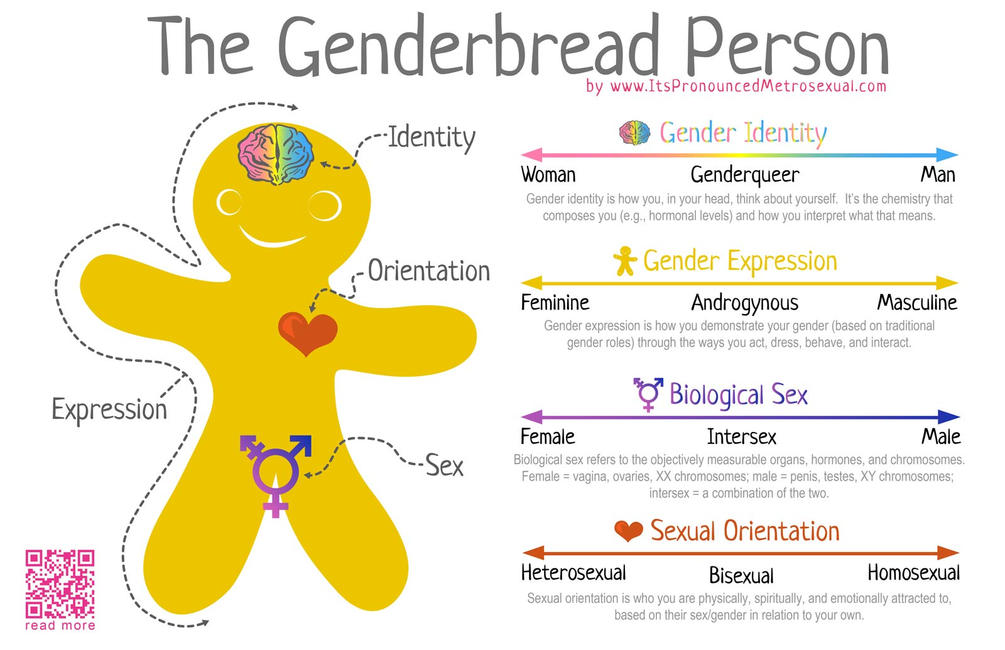
Or, put another way. . .
Sex is your parts.
The rest’s in your heart.

Slide 6
Terminology
“Gender identity refers to an individual’s internal sense of gender. A person’s gender identity may be different from or the same as the person’s sex assigned at birth.”
AFAB
assigned female at birth
AMAB
assigned male at birth

Slide 7
Terminology
“Transgender describes those individuals whose gender identity is different from the sex they were assigned at birth. A transgender male is someone who identifies as male but was assigned the sex of female at birth; a transgender female is someone who identifies as female but was assigned the sex of male at birth.”
Cisgender describes those individuals whose gender identity matches the sex they were assigned at birth.

Slide 9
Terminology
“Gender transition refers to the process in which transgender individuals begin asserting the sex that corresponds to their gender identity instead of the sex they were assigned at birth. During gender transition, individuals begin to live and identify as the sex consistent with their gender identity and may dress differently, adopt a new name, and use pronouns consistent with their gender identity. Transgender individuals may undergo gender transition at any stage of their lives, and gender transition can happen swiftly or over a long duration of time.”
Many transgender individuals do not medically transition for personal, medical and/or economic reasons.

Slide 10
Creating a safe and non-discriminatory environment
“A school’s failure to treat students consistent with their gender identity may create or contribute to a hostile environment in violation of Title IX.”
Deadnaming
Referring to a person by their previous name
Demonstrates thoughtlessness and a lack of respect.
May cause emotional pain and/or trauma.
“Outs” the person without their consent.
May endanger the person.

Slide 11
Creating a safe and non-discriminatory environment
“A school’s failure to treat students consistent with their gender identity may create or contribute to a hostile environment in violation of Title IX.”
Misgendering
Referring to a person by the wrong pronoun
Demonstrates thoughtlessness and a lack of respect.
May cause emotional pain and/or trauma.
“Outs” the person without their consent.
May endanger the person.

Slide 12
Identification Documents, Names, and Pronouns
“The Departments have resolved Title IX investigations with agreements committing that school staff and contractors will use pronouns and names consistent with a transgender student’s gender identity.”
Regardless of what is on their official documents,
schools “must treat students consistent with their gender identity.”
?

Slide 13
“JESSICA DANIELS.”
“JESSICA DANIELS?”
“No JESSICA DANIELS.”
JAMES DANIELS

Slide 14
AHYA SIMONE
“ANTHONY SIMONE”

Slide 15
Binary
FEMALE or MALE

Slide 16
GENDER
- what you look like

Slide 17
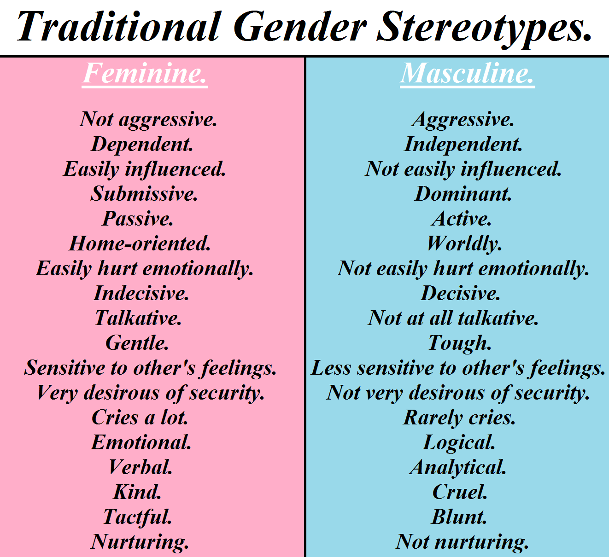
GENDER
- a set of behavioral parameters

Slide 18
GENDER
- your own internal sense of who you are

Slide 19
GENDER
- your own internal sense of who you are
BRAIN SEX
Neuroscience demonstrates:
- there are physical and chemical differences between male and female brains
- differences emerge in utero
- hormones have great influence
- gender identity may begin forming in utero, in a process separate from genital development

Slide 20
GENDERFLUID
AGENDER
NONBINARY
NOT EVERYONE IS BINARY
WHAT SHOULD I CALL YOU?

Slide 21
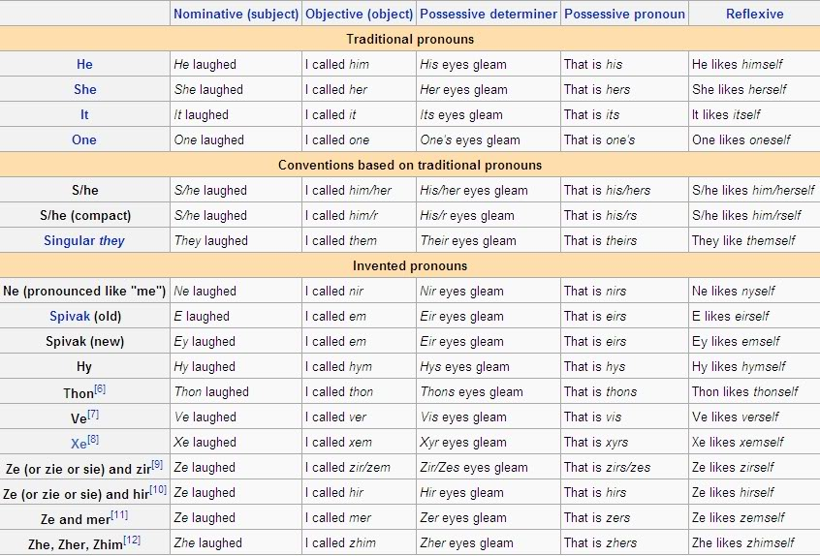
Pick Your Pronoun

Slide 22
Best Practices
- Use names, not pronouns.
- Avoid using gendered language.
- If a student provides you with a pronoun, use it.

Slide 23
Sex-segregated activities and facilities
Restrooms and Locker Rooms
“A school may provide separate facilities on the basis of sex, but must allow transgender students access to such facilities consistent with their gender identity.”
“A school may, however, make individual user options available to all students who voluntarily seek additional privacy.”

Slide 24
Sex-segregated activities and facilities
Restrooms and Locker Rooms
“A school may provide separate facilities on the basis of sex, but must allow transgender students access to such facilities consistent with their gender identity.”
“A school may, however, make individual user options available to all students who voluntarily seek additional privacy.”

Slide 25
Sex-segregated activities and facilities
Restrooms and Locker Rooms
“A school may provide separate facilities on the basis of sex, but must allow transgender students access to such facilities consistent with their gender identity.”
“A school may, however, make individual user options available to all students who voluntarily seek additional privacy.”
What’s the right thing to do?

Slide 26
Sex-segregated activities and facilities
Restrooms and Locker Rooms
“A school may provide separate facilities on the basis of sex, but must allow transgender students access to such facilities consistent with their gender identity.”
“A school may, however, make individual user options available to all students who voluntarily seek additional privacy.”
What’s the right thing to do?

Slide 27
European Restroom

Slide 28
Privacy and education records
“The Departments may find a Title IX violation when a school limits students’ educational rights or opportunities by failing to take reasonable steps to protect students’ privacy related to their transgender status, including their birth name or sex assigned at birth. Nonconsensual disclosure of personally identifiable information, such as a student’s birth name or sex assigned at birth, could be harmful to or invade the privacy of transgender students and may also violate the Family Educational Rights and Privacy Act (FERPA).”
What can we do to avoid this?
“Updating a transgender student’s education records to reflect the student’s gender identity and new name will help protect privacy and ensure personnel consistently use appropriate names and pronouns.”

Slide 29
We Can Already Do This!
To update a student’s name as it appears on college rosters, send that student to:
DEAN SYLVIA RODRIGUEZ
Room 1542
But how do we keep from making the mistake in the first place?

Slide 30
Best Practices
For Instructors:
- Give students an opportunity to inform you privately, before the first day of class.
- Follow up with an immediate referral to Dean Rodriguez.

Slide 31
Sample Student Welcome Email
Hello and welcome to ANTR 1!
Please reply to this email with details ONLY IF one or more of the following statements is true and you would like to address it. Your answers are confidential. If:
1. The name on my class roster does not match the name you use; or
2. You are concerned that I use the proper pronouns when referring to you; or
3. You have a disability that requires accommodation; or
4. You have previously taken this course and failed it; or
5. You are facing medical/psychological/personal challenges that may interfere with your success in the class; then please take this opportunity to inform me privately. This is optional of course, but I'd like to be prepared to ensure your success in the course from the first day. Thank you, Prof. Hasten

Slide 32
Best Practices
For Institutions:
- Make name change information available during the registration process.
- Provide adequate gender inclusive single-occupancy restroom and locker room shower facilities.
- Webpage with information for trans and gender-nonconforming students.

