Slide 1
LPC S.O.M.a.t.i.c.s. pRESENTS
Zoom: Best Practices in Online Office Hours
Presented on 9/27/16 from 10:20 AM – 11:20 AM Room 2410
Howard Blumenfeld

Slide 2
What is this seminar about?
The Purpose of Online Office Hours
What does the FA Contract Say?
What is Regular Effective Contact?
My Struggles with Holding Effective Online Office Hours
Why ZOOM?
A Demonstration of Online Office Hours using ZOOM
Best Practices & the Future of Online Office Hours

Slide 3
The Purpose of Online Office Hours
Section 55204 of Title 5 California Ed. Code states the following:
According to Ed. Code, “Regular effective contact” means that “students should have frequent opportunities to ask questions and receive answers from the instructor of record.”
Ultimately it is up to the District and College to determine the specific details of “regular effective contact.”

Slide 4
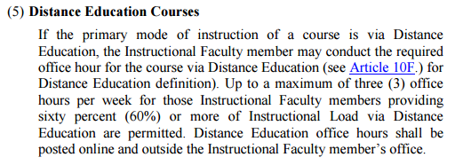
What Does the FA Contract Say?
What is an online office hour? (Section 10D.3 (5))

Slide 5
What Does the FA Contract Say?
What is an online office hour? (Article 10.F.3d)

Slide 6
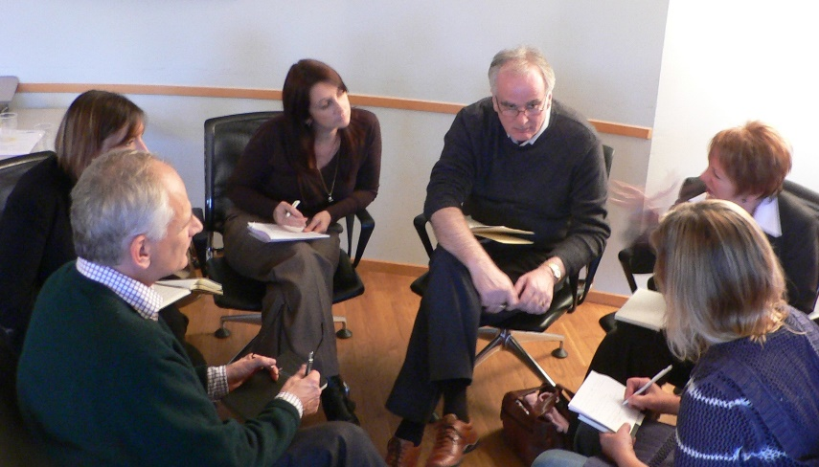
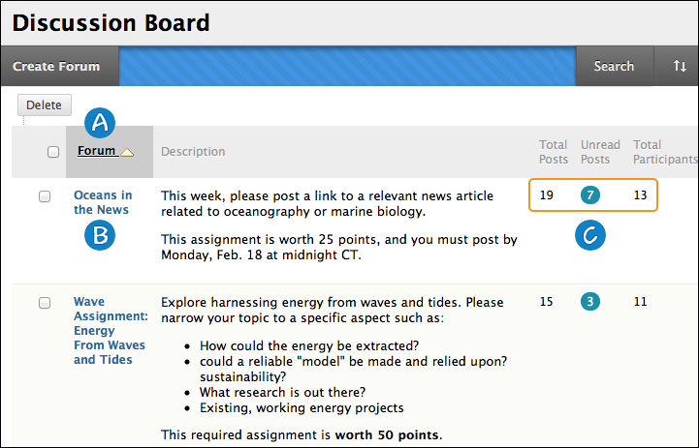
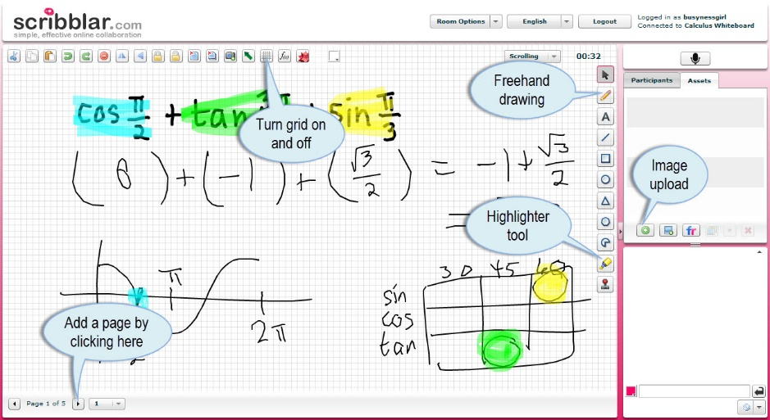
Brief Discussion: What is Regular Effective Contact?

Slide 7
My Struggle with Holding Effective Online Office Hours
How will I motivate students to show up to them?
How can I ensure that they are as effective as face-to-face office hours?
How often do I need to make myself available for them?

Slide 8
My Struggles with Holding Effective Online Office Hours
Email
Discussion Boards
Chat Rooms
Text Messaging
Social Media
Video Chat

Slide 9
Why ZOOM?
Easier to use than Blackboard Collaborate
More teacher-oriented tools than Skype or FaceTime
Free (for basic functions)
Free version allows for unlimited time with two participants in room.
Easy to use for faculty and students
Reliable
Excellent technical support & customer service

Slide 10
ZOOM Precautions
Free version sets time limit to 40 minutes per session when more than two participants are in a session.
Paid version allows for unlimited number of participants and requires annual subscription fee.
Text chatting feature not that useful.

Slide 11
A Demonstration of Online Office Hours Using ZOOM

Slide 12
Thoughts and Reactions to Demonstration

Slide 13
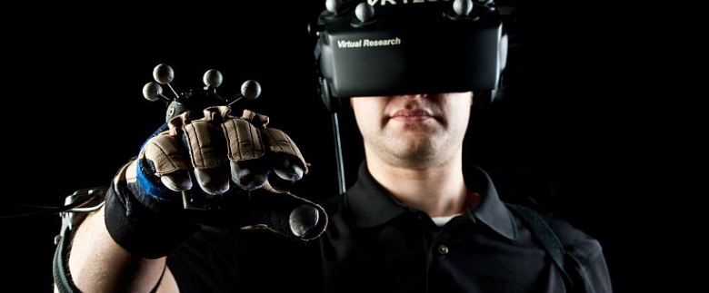
The Future of Online Office Hours
What could the future of online office hour delivery look like?
Virtual Reality meeting rooms

Slide 14
The Future of Online Office Hours

Slide 15
Concluding Thoughts, Remarks, or Questions

Slide 16
You can access this PowerPoint in the Cloud here:
https://goo.gl/q0nMYN

Slide 17
LPC SOMATICS
To keep up to date with the latest discussions involving social media and technology in the classroom, you can join our “LPC SOMATICS” Facebook Group
You can join by clicking here: https://www.facebook.com/groups/740896436025817/
You can also join by searching in the Facebook search box for “LPC SOMATICS.”

