Slide 1
Teaching Men of Color in the Community College
An overview
Erick Bell
Kali Rippel
Michelle Gonzales
September 27, 2016

Slide 2
The Equity Gap

Slide 3
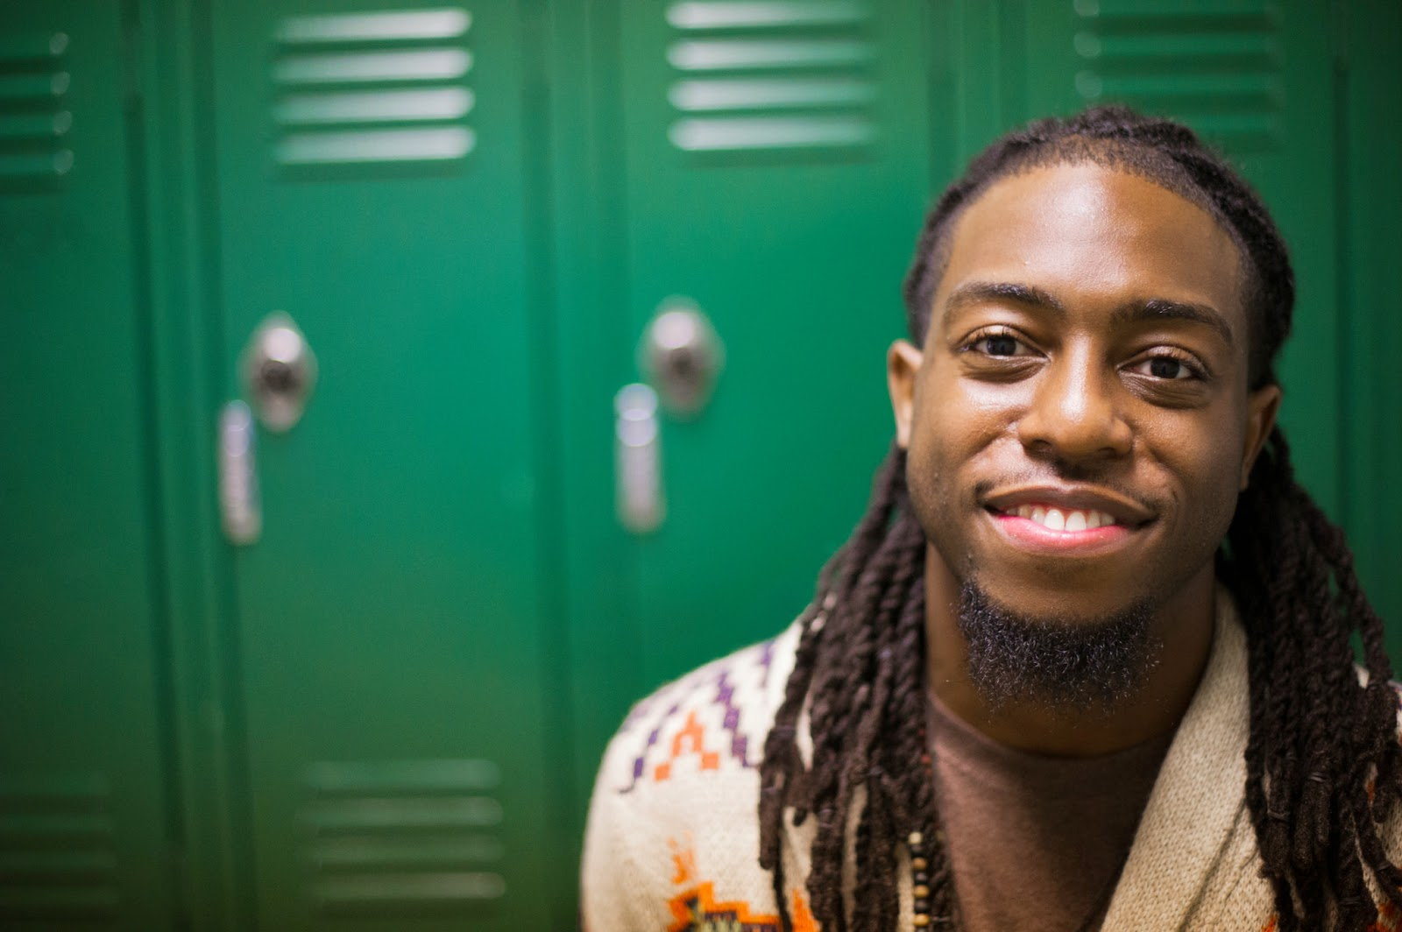
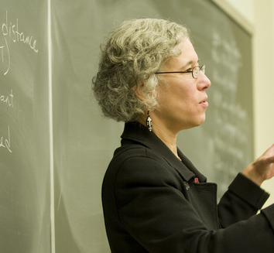
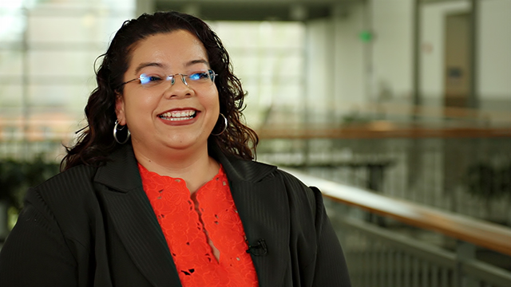

Slide 4
Four essential elements
Challenge
Support
High expectations
Authentic care

Slide 5
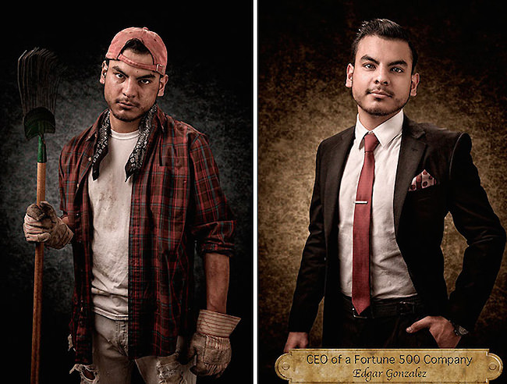
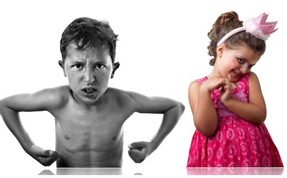
Part 1: Contextual foundation

Slide 6
Part 2: Building relationships with men of color
Positive Messaging
Authentic Care
Intrusive Interventions

Slide 7
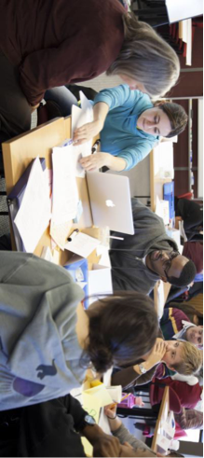
Part 3: Promising teaching practices
Relevant Content
Critical Reflection
Collaborative Learning
Performance Monitoring

Slide 8
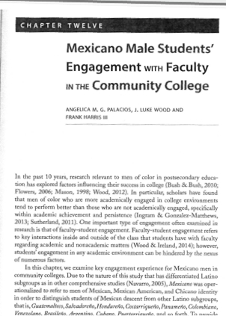
Mexicano Male Students' Engagement with Faculty in the Community College
Summarized by: Michelle Gonzales

Slide 9
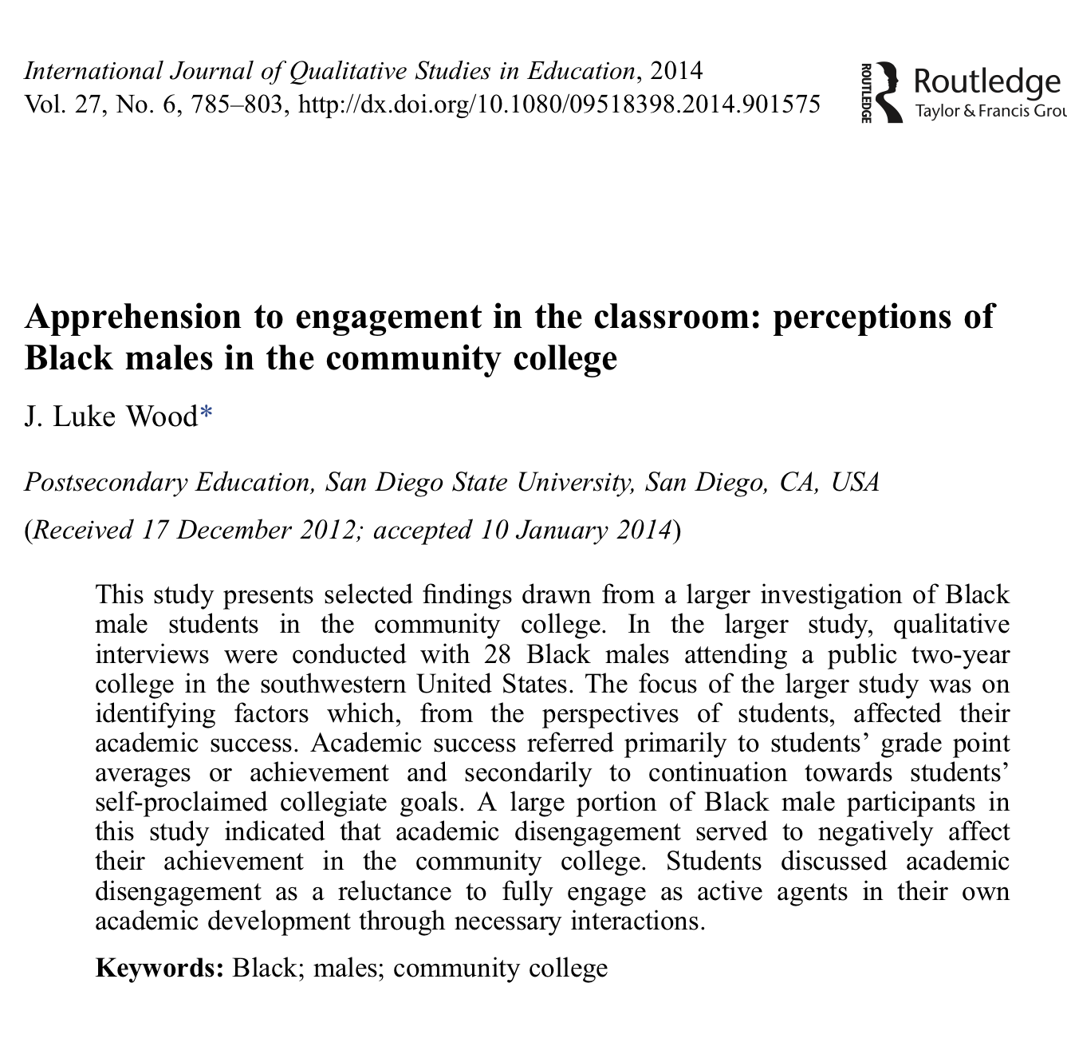
Apprehension to engagement in the classroom: perceptions of Black males in the community college
Summarized by: Kali Rippel

Slide 10
"Some people want it to happen, some wish it would happen, and others make it happen" - Micheal Jordan

