Slide 1
Facilities Modernization Program
Measure B & A - Project Report
April 25, 2022

Slide 2
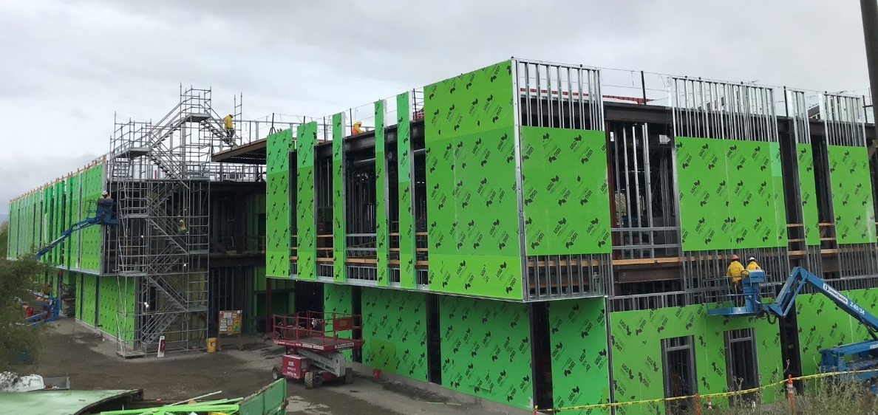
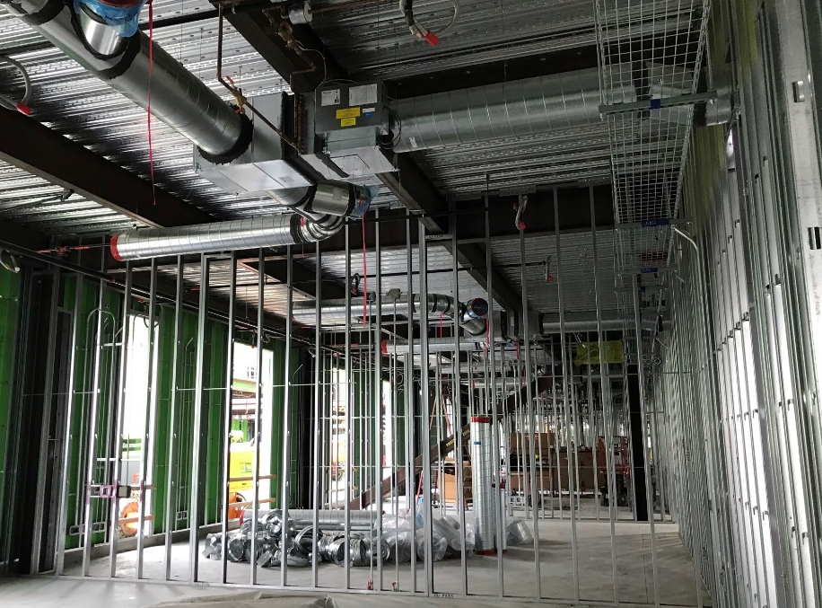
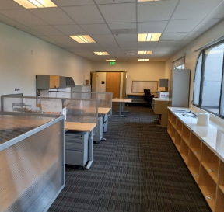
PROJECT PROGRESS REPORT
B2100 New Academic Support & Office Building
LAS POSITAS COLLEGE
April 25, 2022
Project Team
Architect: LPAS
Construction Manager: Swinerton Management & Consulting
Contractor: Flint Builders, Inc.
Project Description:
The new Academic Support and Office building is being built in the location of old buildings 2100 & 2200. The project consists of the following elements and programs: English Center incorporating classrooms, computer lab, tutoring and study areas. Math Center incorporating classrooms, labs and the Math Emporium program. Computer Studies including computer labs, networking, maker space and open labs with the expansion of library functions including reference desk, study areas, computer lab, expanded staff offices and library operational support spaces. Faculty offices, dean’s suite and student gathering and support spaces will also be in the building.
Project Update:
Demolition, grading, underground utilities, footings and slab on grade concrete, structural steel, elevated deck concrete is completed.
Exterior and interior wall framing, mechanical, electrical and plumbing rough-in installation is underway in sector 3 and sector 2. Roofing, exterior wall sheathing and window installation is in progress.
Renovations inside the existing Library building new office space and renovation of the Processing and Workroom is now completed. Library addition slab, steel framing and roof deck is completed.
Occupancy: Fall 2023

Slide 3
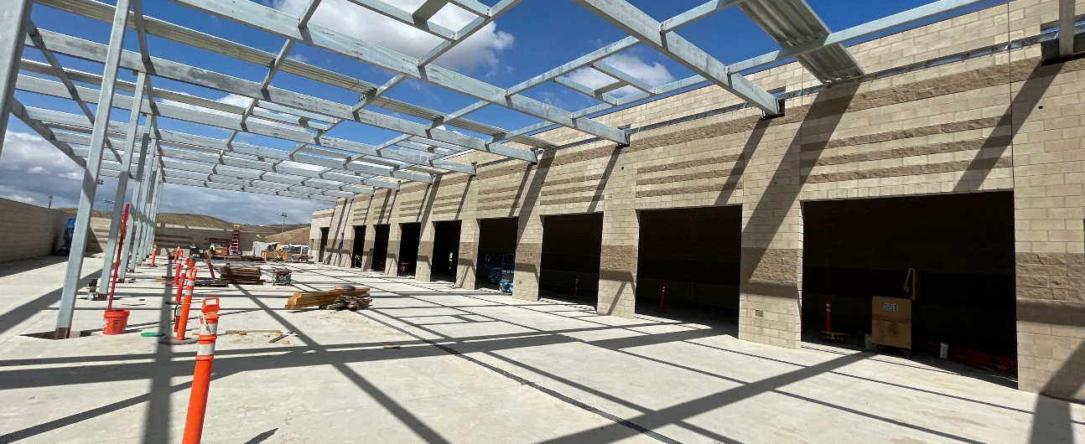
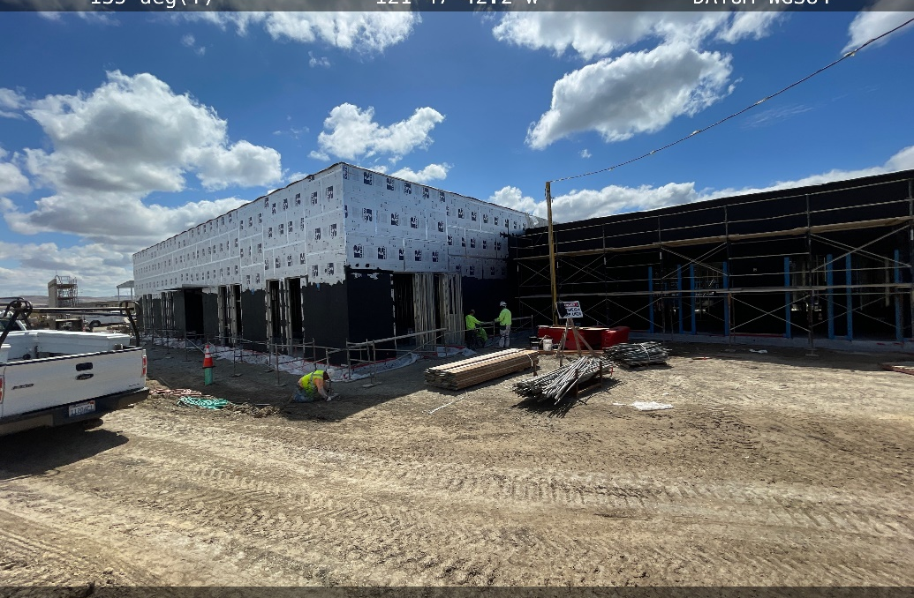
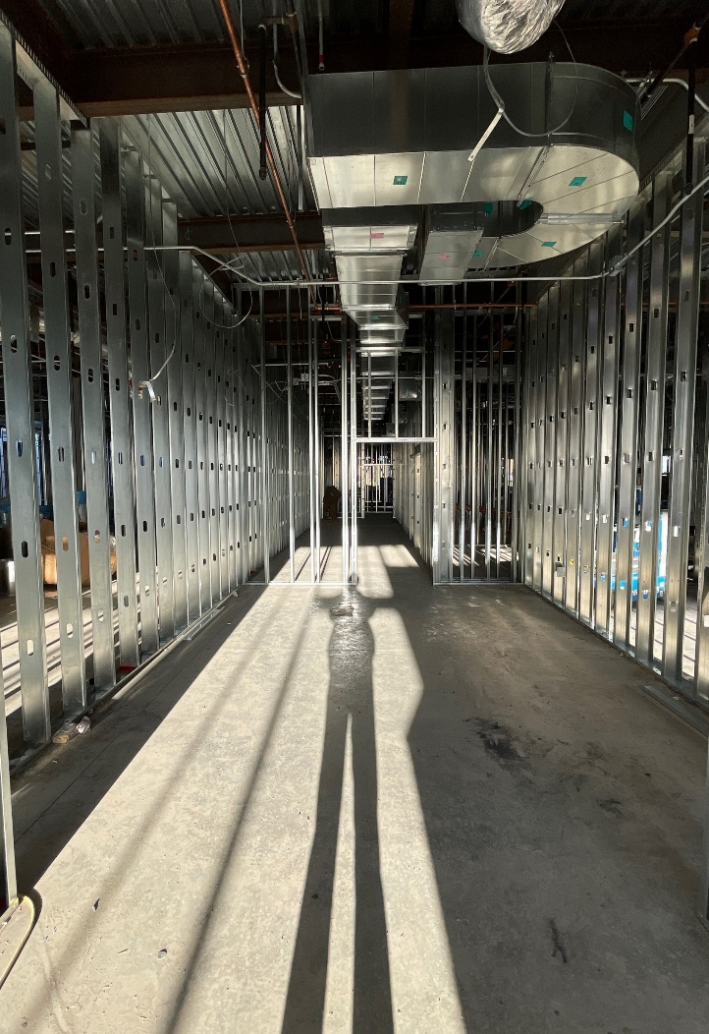
PROJECT PROGRESS REPORT
Public Safety Complex/Advanced Manufacturing
And Transportation
LAS POSITAS COLLEGE
April 25, 2022
Project Team
Architect: Lionakis
Construction Manager: Vanir Construction Management, Inc.
Contractor: Overaa Construction
Project Description:
The new Public Safety Complex (PSC) and Advanced Manufacturing and Transportation (AMT) building will be co-located to allow for shared linkages between the various programs, classrooms and event spaces. The buildings will be built near the existing track and field in the northeastern portion of the upper campus. The PSC project consist of the following elements and programs: EMS Simulation Lab and Situation Rooms, and Fire Training with Class A burn areas. The AMT project will include an automotive tech facility, welding lab, and classroom and lab spaces to provide training of advanced manufacturing processes. Faculty Offices, Dean’s suite and support spaces will also be included in the project.
Project Update:
Structural building components have been erected.
Interior framing and MEP infrastructure rough ins are currently being installed.
Building exterior skin and envelop has begun.
Occupancy: Fall 2023

Slide 4
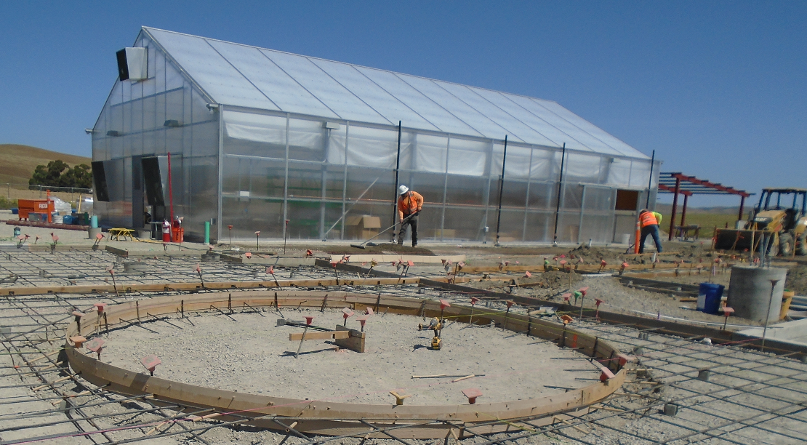
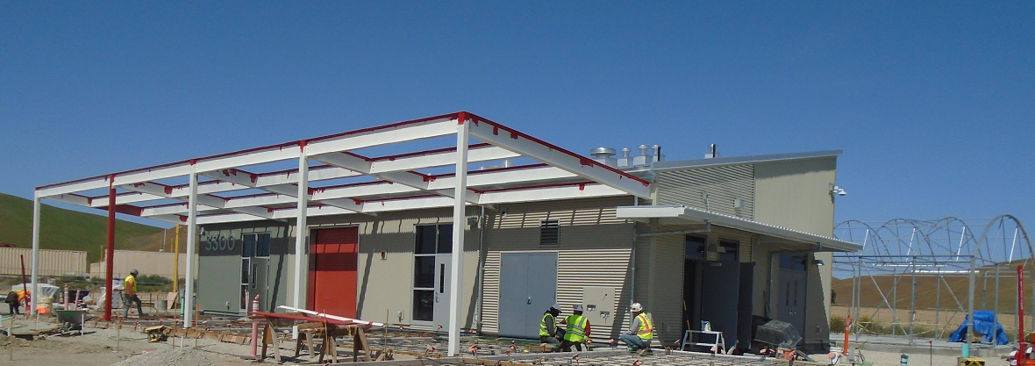
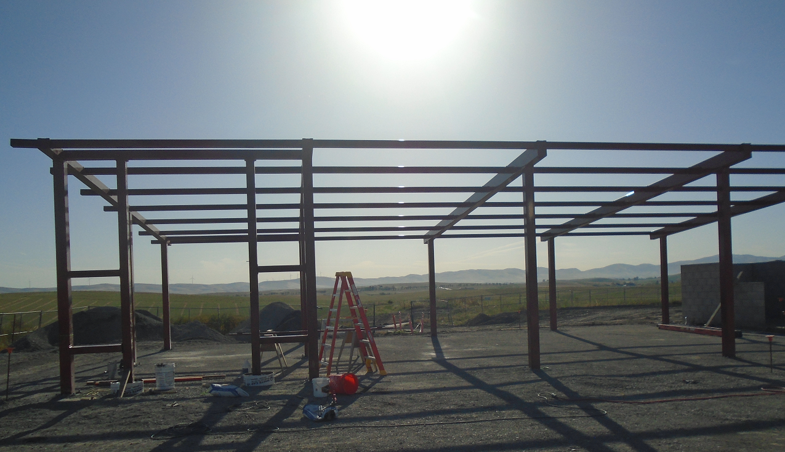
PROJECT PROGRESS REPORT
AG SCI: Horticulture Facility Project
LAS POSITAS COLLEGE
April 25, 2022
Project Team
Architect: ATI Architects and Engineers
Construction Manager: Roebbelen (RCMS)
Contractor: Overaa Construction
Project Description:
The New Horticulture Facility will replace the existing facilities located in Building 800 and outside spaces. It is located near the Maintenance and Operations facility at the upper NE part of campus. The project includes, a 32 space parking lot for faculty and students, classrooms, Labs, offices and resource area, a greenhouse, and shade structures. The outdoor growing areas will have soil bins, equipment storage and an outdoor learning patio.
Project Update:
Site concrete flatwork, irrigation, final grading of growing grounds & paving in progress.
Classroom Building interior finishes in progress.
Greenhouse and Shade house structure erected.
Equipment Storage erected. Metal roof and siding is in progress.
Finalizing Classroom Building systems.
Occupancy: Summer 2022

Slide 5
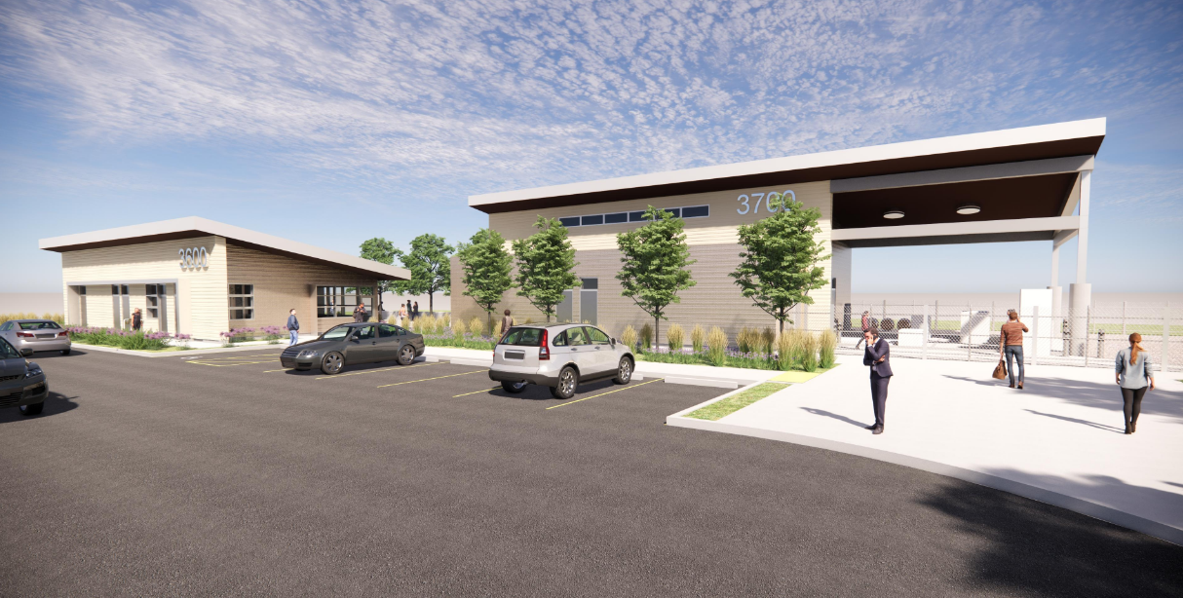
PROJECT PROGRESS REPORT
AG SCI: Viticulture Facility Project
LAS POSITAS COLLEGE
April 25, 2022
Project Team
Architect: tBP/Architecture, Inc.
Construction Manager: Roebbelen (RCMS)
Contractor: TBD
Project Description:
The New Viticulture Facility will replace the existing facilities currently located in/outside of Building 800. The Viticulture Facility will be located at the main entrance off the Campus Hill Road. This new roadway will connect the new facilities into the existing campus. The new facility will be developed at a higher elevation allowing for expansive views. The project will be include general site grading and utility infrastructure; New Roadway and Pedestrian pathways connecting to the existing campus. A Visitor Center with Tasting room, visitor Parking and clear paths of travel, A Winemaking Facility including classrooms and Labs, office and resource areas, Crush pad, Equipment storage, cold storage, and an Outdoor Patio.
Project Update:
Design Team completed addressing constructability review comments.
Design Team has scheduled DSA back-check review for end of April 2022.
Project bidding is anticipated Summer 2022
Occupancy: TBD

Slide 6
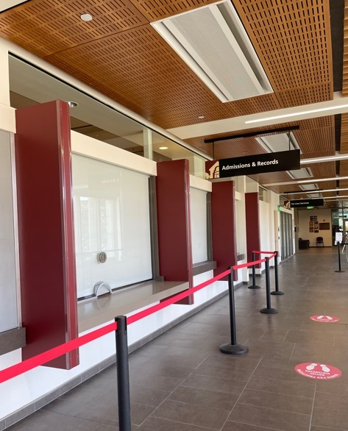
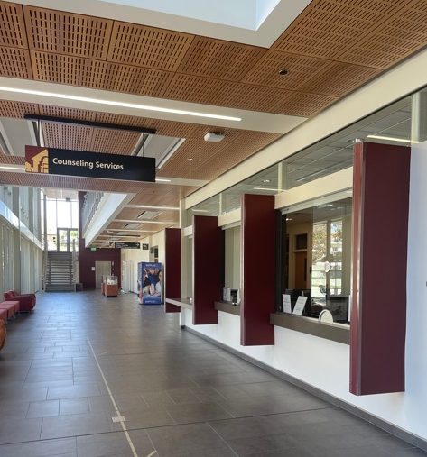
PROJECT PROGRESS REPORT
Architectural Barrier Project
LAS POSITAS COLLEGE
April 25, 2022
Project Team
Architect: Steinberg Hart
Construction Manager: Roebbelen (RCMS)
Contractor: J.D. General Construction, Inc.
Project Description:
Improvements to accessible counters, safety and security of service windows at the Student Services & Administration Building. Service windows include: Information Desk, Student Services Center, Financial Aid and Admission and Records.
Project Update:
Project is complete.
Notice of Completion approved at the December Board 2021.
Occupancy: November 2021

Slide 7
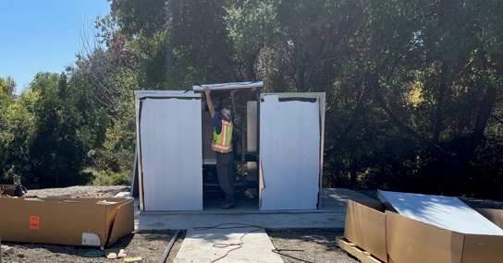
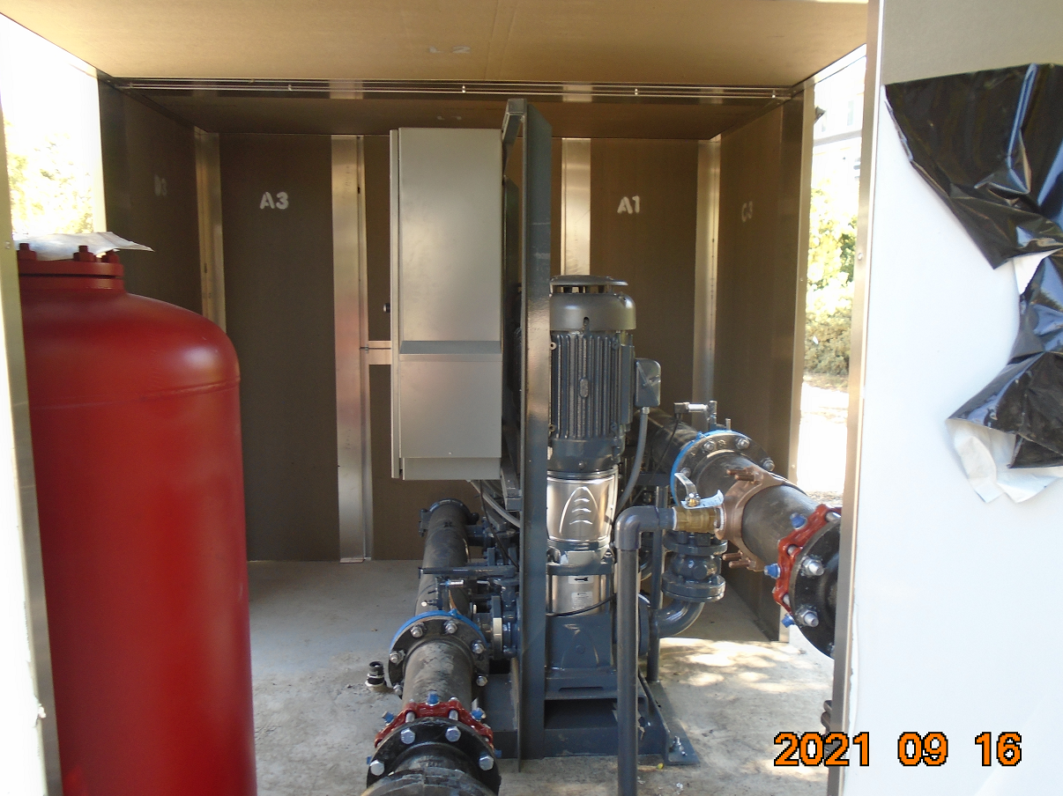
PROJECT PROGRESS REPORT
Domestic Water Booster System Project
LAS POSITAS COLLEGE
April 25, 2022
Project Team
Engineer: Sandis
Construction Manager: Roebbelen (RCMS)
Contractor: Mountain Cascade, Inc.
Project Description:
The project is intended to provide a booster pump system to raise the overall campus domestic water pressure. Pressure reducing valves will be installed at selected buildings to prevent overpressure of the plumbing fixtures.
Project Update:
Domestic Water Booster System Project is complete.
Notice of Completion and Final Change Order was approved in February 2022 Board.
Occupancy: Complete

Slide 8
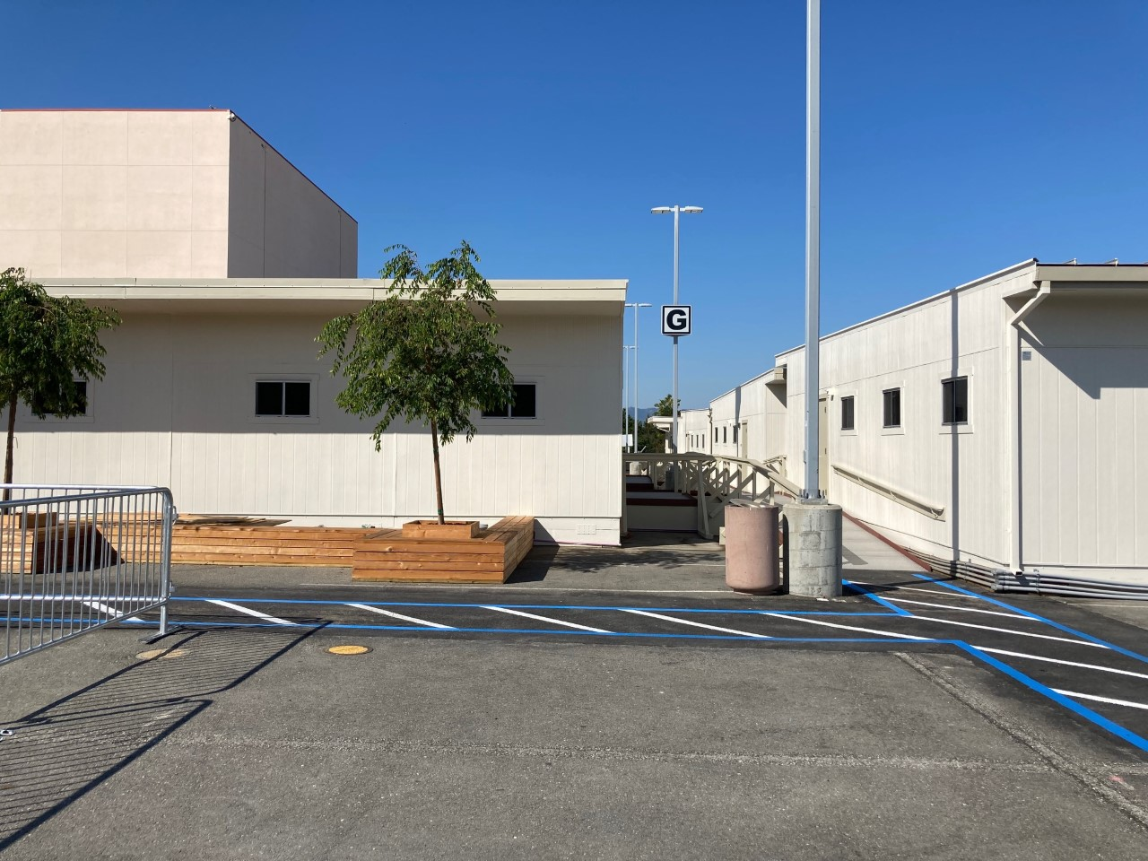
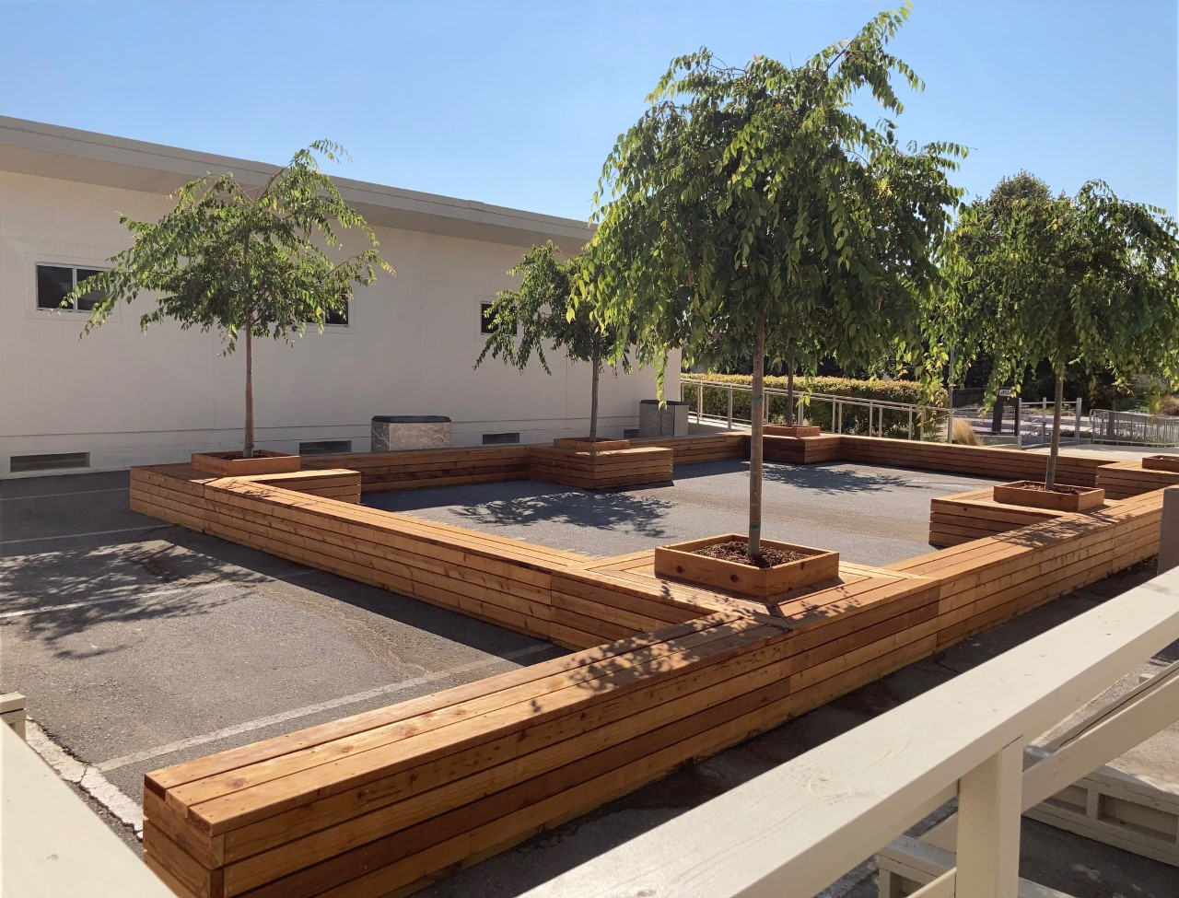
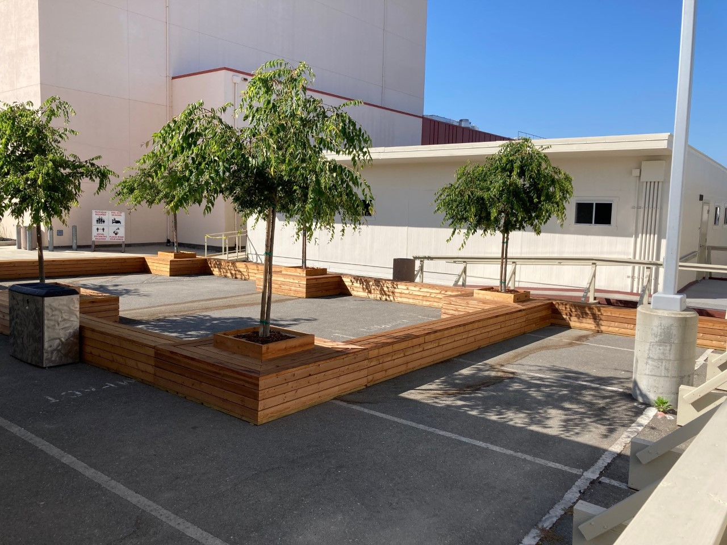
PROJECT PROGRESS REPORT
Temporary Office Complex /
Faculty Office Relocation Village
LAS POSITAS COLLEGE
April 25, 2022
Project Team
Architect: LPAS
Construction Manager: Vanir Construction Management, Inc.
Contractor: Sausal Corporation
Project Description:
The project includes providing modular buildings to accommodate ~ 75 faculty offices, conference rooms, support spaces and a modular restroom unit to support the occupants. A raised walkway will be provided to connect the modular buildings and restroom unit.
Project Update:
Notice of Completion Approved at September 2021 Board
Occupancy: Complete

Slide 9
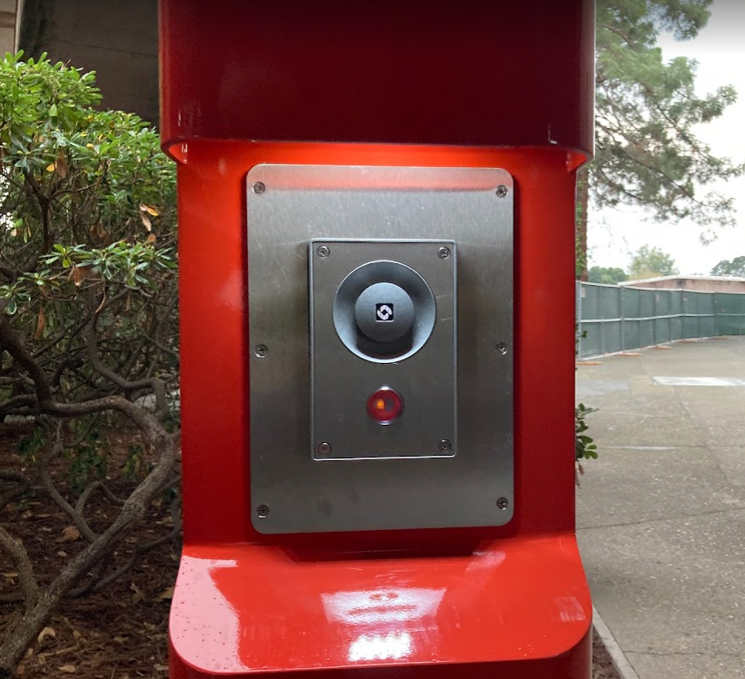
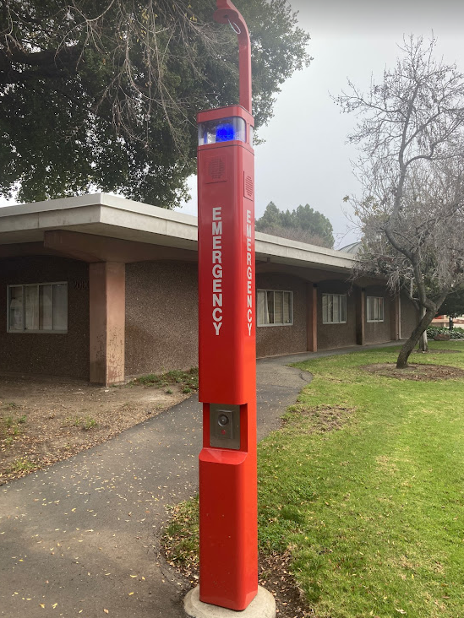
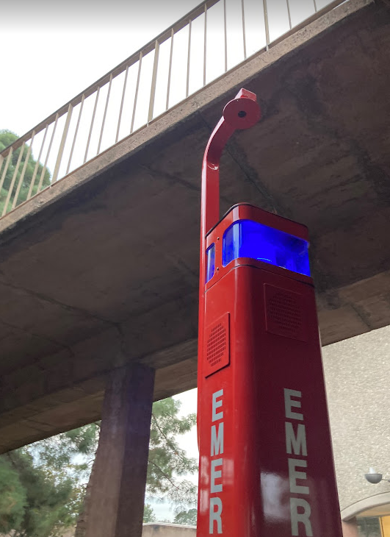
PROJECT PROGRESS REPORT
Emergency Call Station Project
LAS POSITAS COLLEGE
April 25, 2022
Project Team
Architect: Catalyst
Construction Manager: Swinerton Management & Consulting
Contractor: Electronic Innovations
Project Description:
Includes installation and programming of new emergency call stations and retrofitting of existing call stations at both Chabot and Las Positas campuses. The project also includes the installation of a new ECS server at the Las Positas Campus along with the interfacing of the servers to the existing fire alarm control panels.
Project Update:
Notice of Completion filed for both campuses at March 2022 Board.
Minor warranty work in progress
Occupancy: Complete

