Slide 1
Welcome & Announcements
President Dyrell Foster

Slide 2
Welcome & Announcements
LPCSG Updated
Anette Raichbart, Vice President Administrative Services
Outreach Team
Facilities Update
Ann Kroll, Project Planner /Manager for LPC
High School Completions
Rajinder Samra, Director of Planning, and Institutional Effectiveness
EOPS/CalWorks
Owen Letcher, Vice Chancellor Facilities and Bond
Tenured Faculty
Kristina Whalen, Vice President Academic Services
My Portal
Kristen Whittaker, Application Services Manager
Student Housing
Budget Update
Lara Wiedemeier, LPCSG President
Dyrell Foster, College President

Slide 3
College Updates
COVID-19
Our Board of Trustees recently voted to suspend the COVID-19 vaccine mandate effective April 24, 2023
Coincides with the start of the 2023 summer/fall registration period
Ends the online vaccination verification process and the need for Cleared4 Blue Pass
Ends requests for vaccination exemptions
No longer campus-wide communications regarding positive COVID cases on campus (effective immediately)
Alameda County guidance regarding Masking (optional but can require masks in personal space)

Slide 4
College Updates
Town Meetings
Last Town Meeting in which there will be a live stream
May Town Meeting is all about awards and recognitions
In-person, with no streaming option
an event and an opportunity to celebrate our colleagues
Town Meetings for 2023-24 will be held in-person
will be recorded and made available for viewing following each meeting

Slide 5
College Updates
I received and reviewed the Faculty Hiring Prioritization Committee’s (FHPC) recommendation for faculty hiring for the 2023-24 academic year.
The following faculty positions will move forward for hiring for the 2023-24 academic year:
Geologist/Geology Replacement
Counselor General (50% Athletic Counselor) Replacement
Computer Information Systems Replacement
Music Replacement
Biology/Anatomy/Allied Health New

Slide 6
College Updates
I received and reviewed the 2022-2023 Classified and Administrative Position Recommendations from the Resource Allocation Committee (RAC).
The following positions will move forward for hiring to start in the new fiscal year (July 1, 2023):
Library Technician
Performing Arts Center Operations Coordinator (100%/12mo)

Slide 8
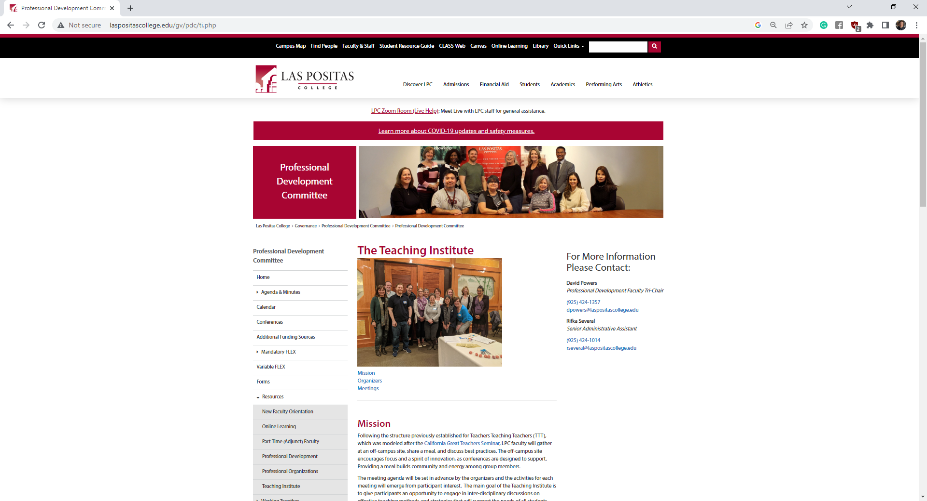

Slide 9
New Faces on Campus

Slide 10
Trevor Penero
Veteran’s Specialist

Slide 11
Beth McCormick
Employer Engagement Specialist

Slide 12
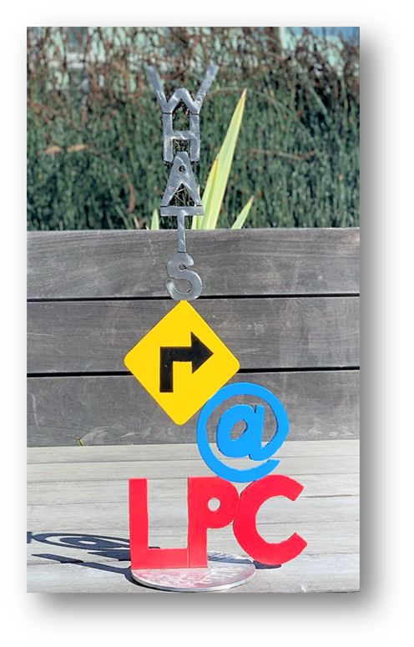
What’s Right at LPC?

Slide 13
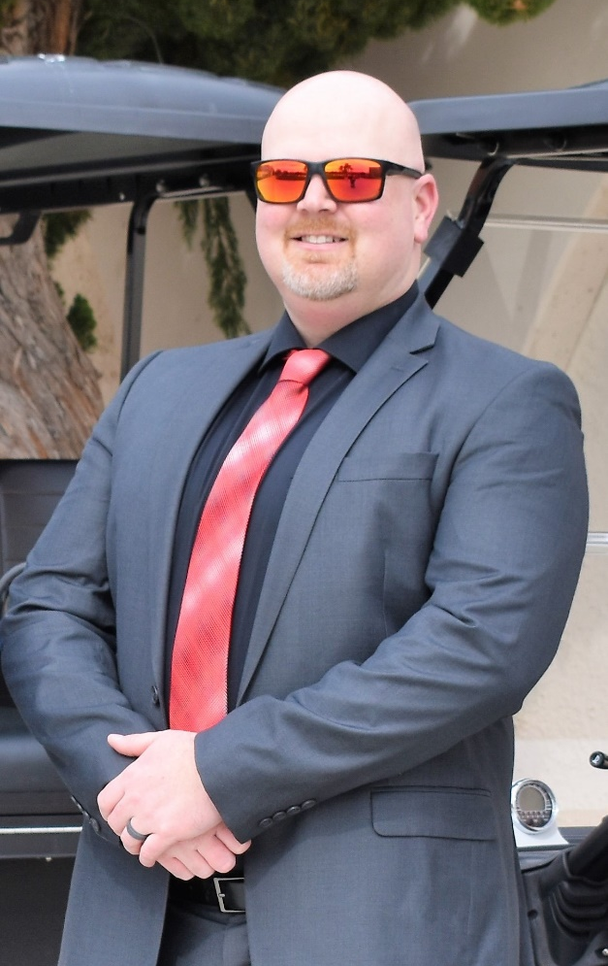
March 2023
Officer Michael Sugi

Slide 14
LPCSG
Las Positas College Student Government
LPC Town Hall - February

Slide 15
Mini Market Services
Mini Market Open Hours:
Monday, Wednesday, Thursday: 9:00 am - 5:00 pm
Tuesday: 9:00 am - 7:00 pm
Friday: 9:00 am - 1:00 pm
Items Offered:
Fresh Fruits & Veggies
Fresh Meat & Eggs
Canned Goods
Toiletries - feminine hygiene, soap, cleaning
Some household items
Snacks + Cup of Noodles & Frozen meals to heat to take or stay and enjoy
Enjoy our Welcome Center Lounge - Come and stay awhile!

Slide 16
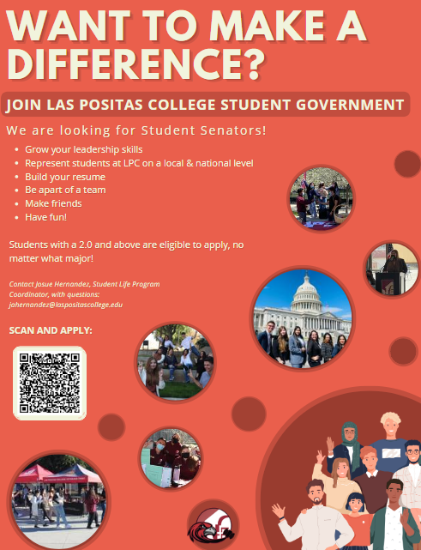
Student Government Open Positions
We are still looking for senators! Encourage your students to apply! - Benefits: Up to a $150 stipend, grow skills, travel to conferences, represent our students, resume builder etc..

Slide 17
Start recruiting for LPCSG 2023-2023 Elections!!

Slide 18
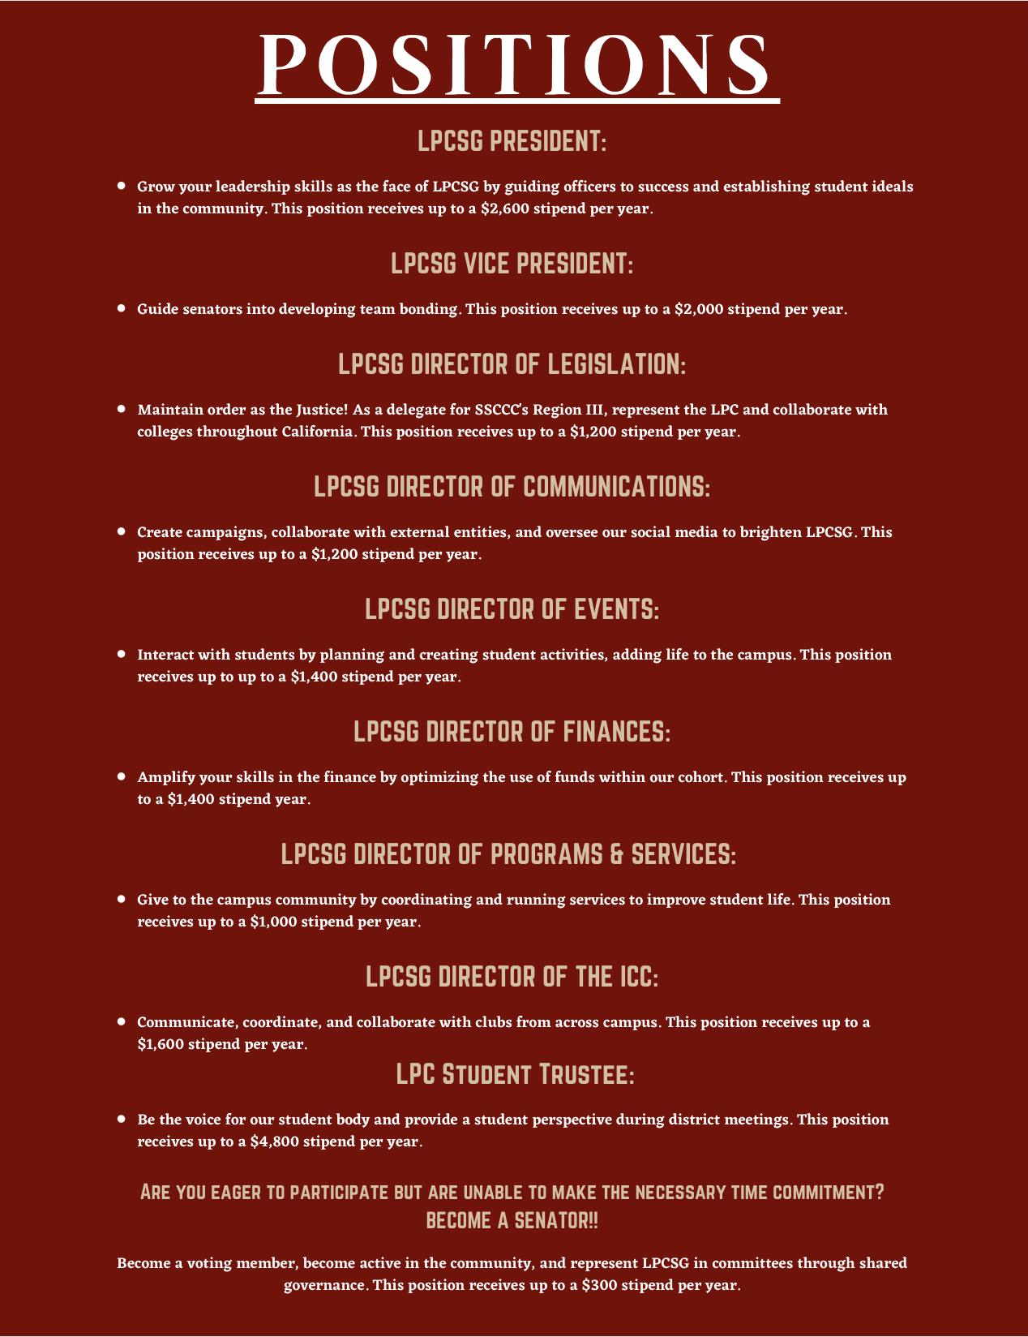

Slide 19
Spring Club Fair

Slide 20
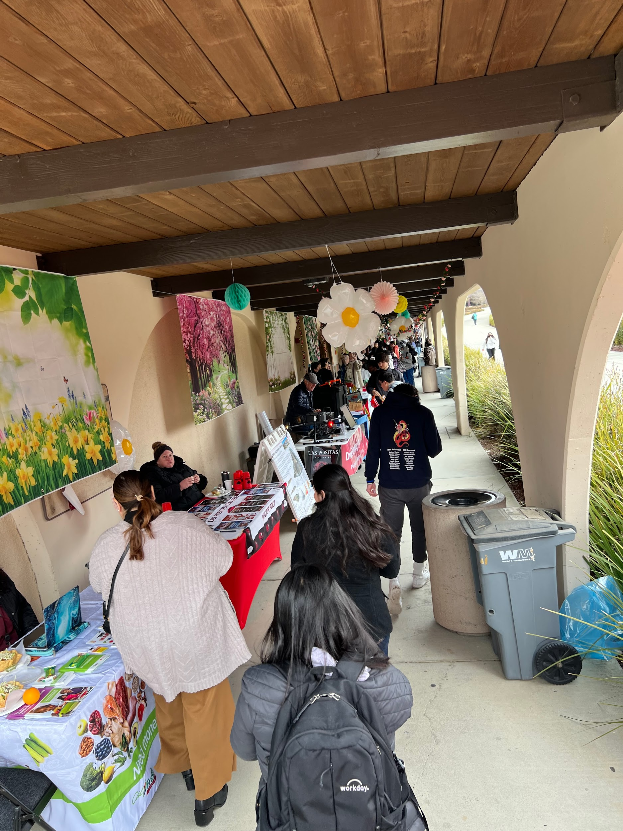
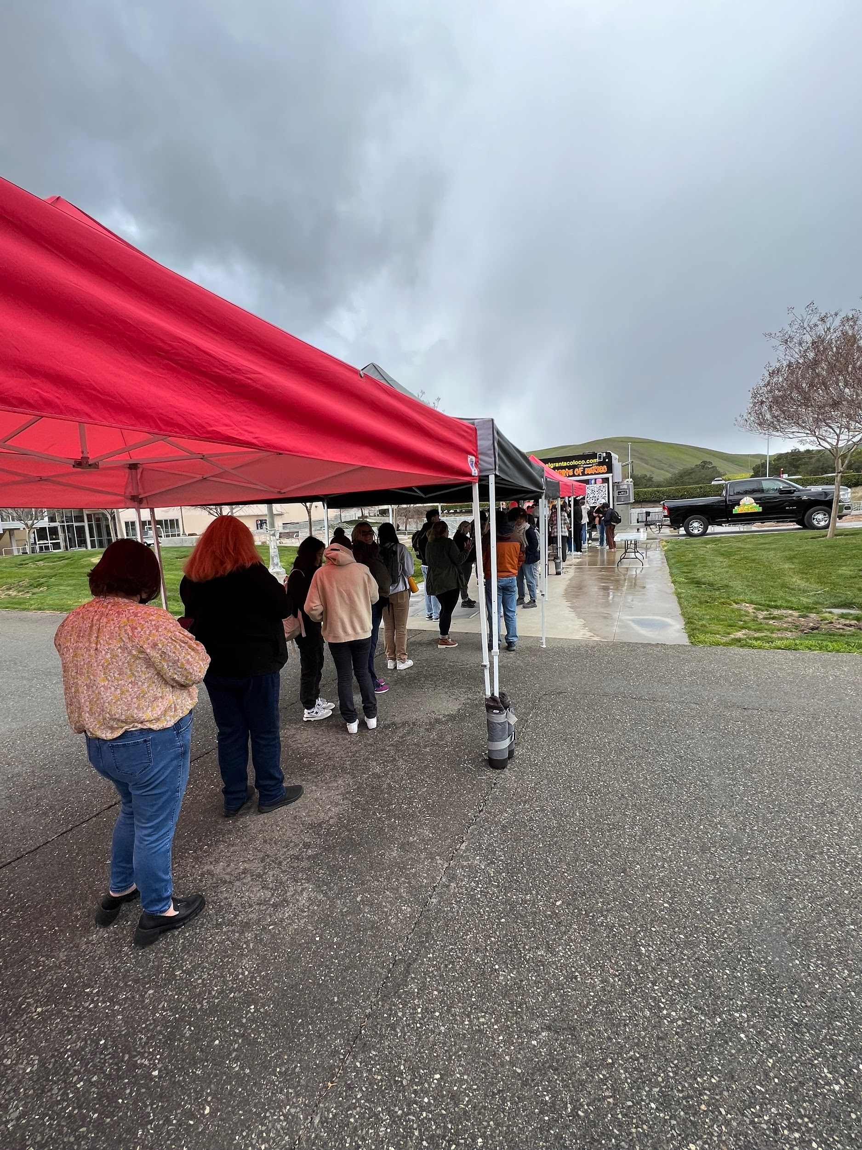
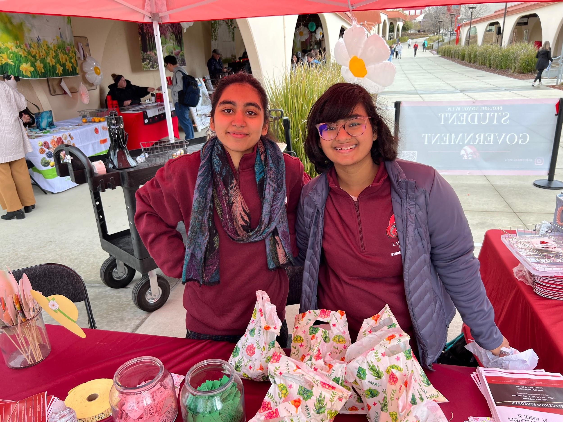
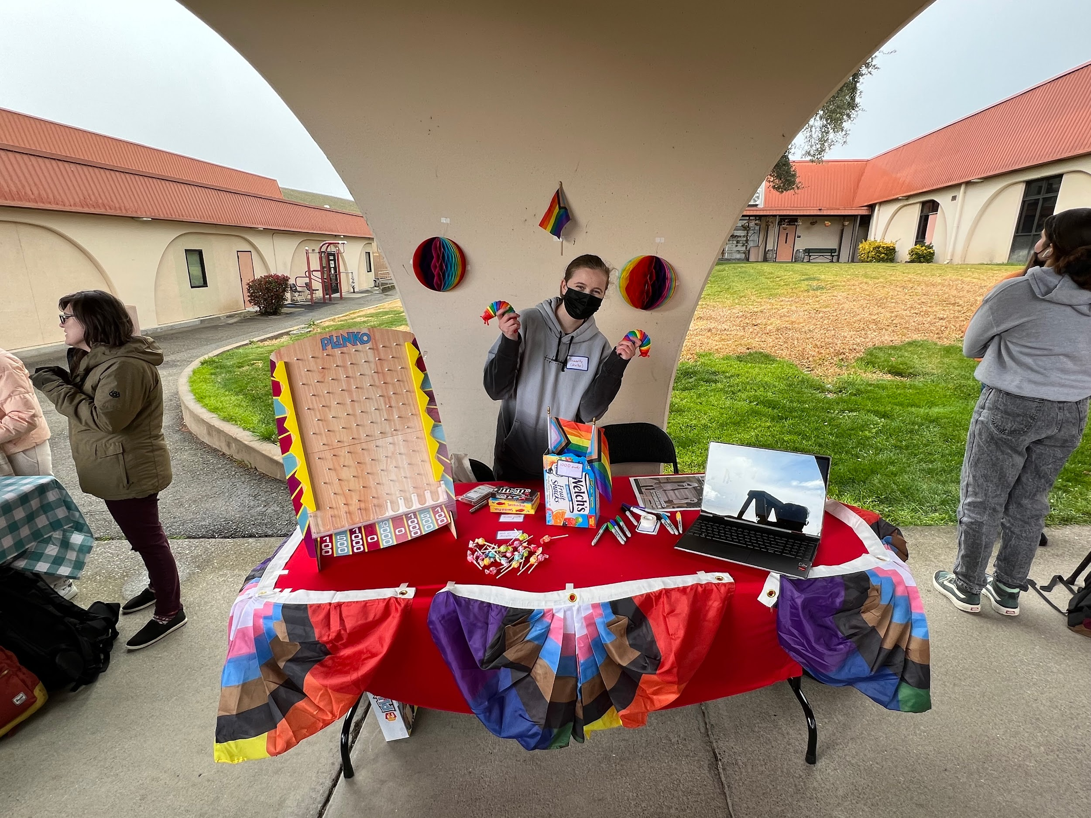
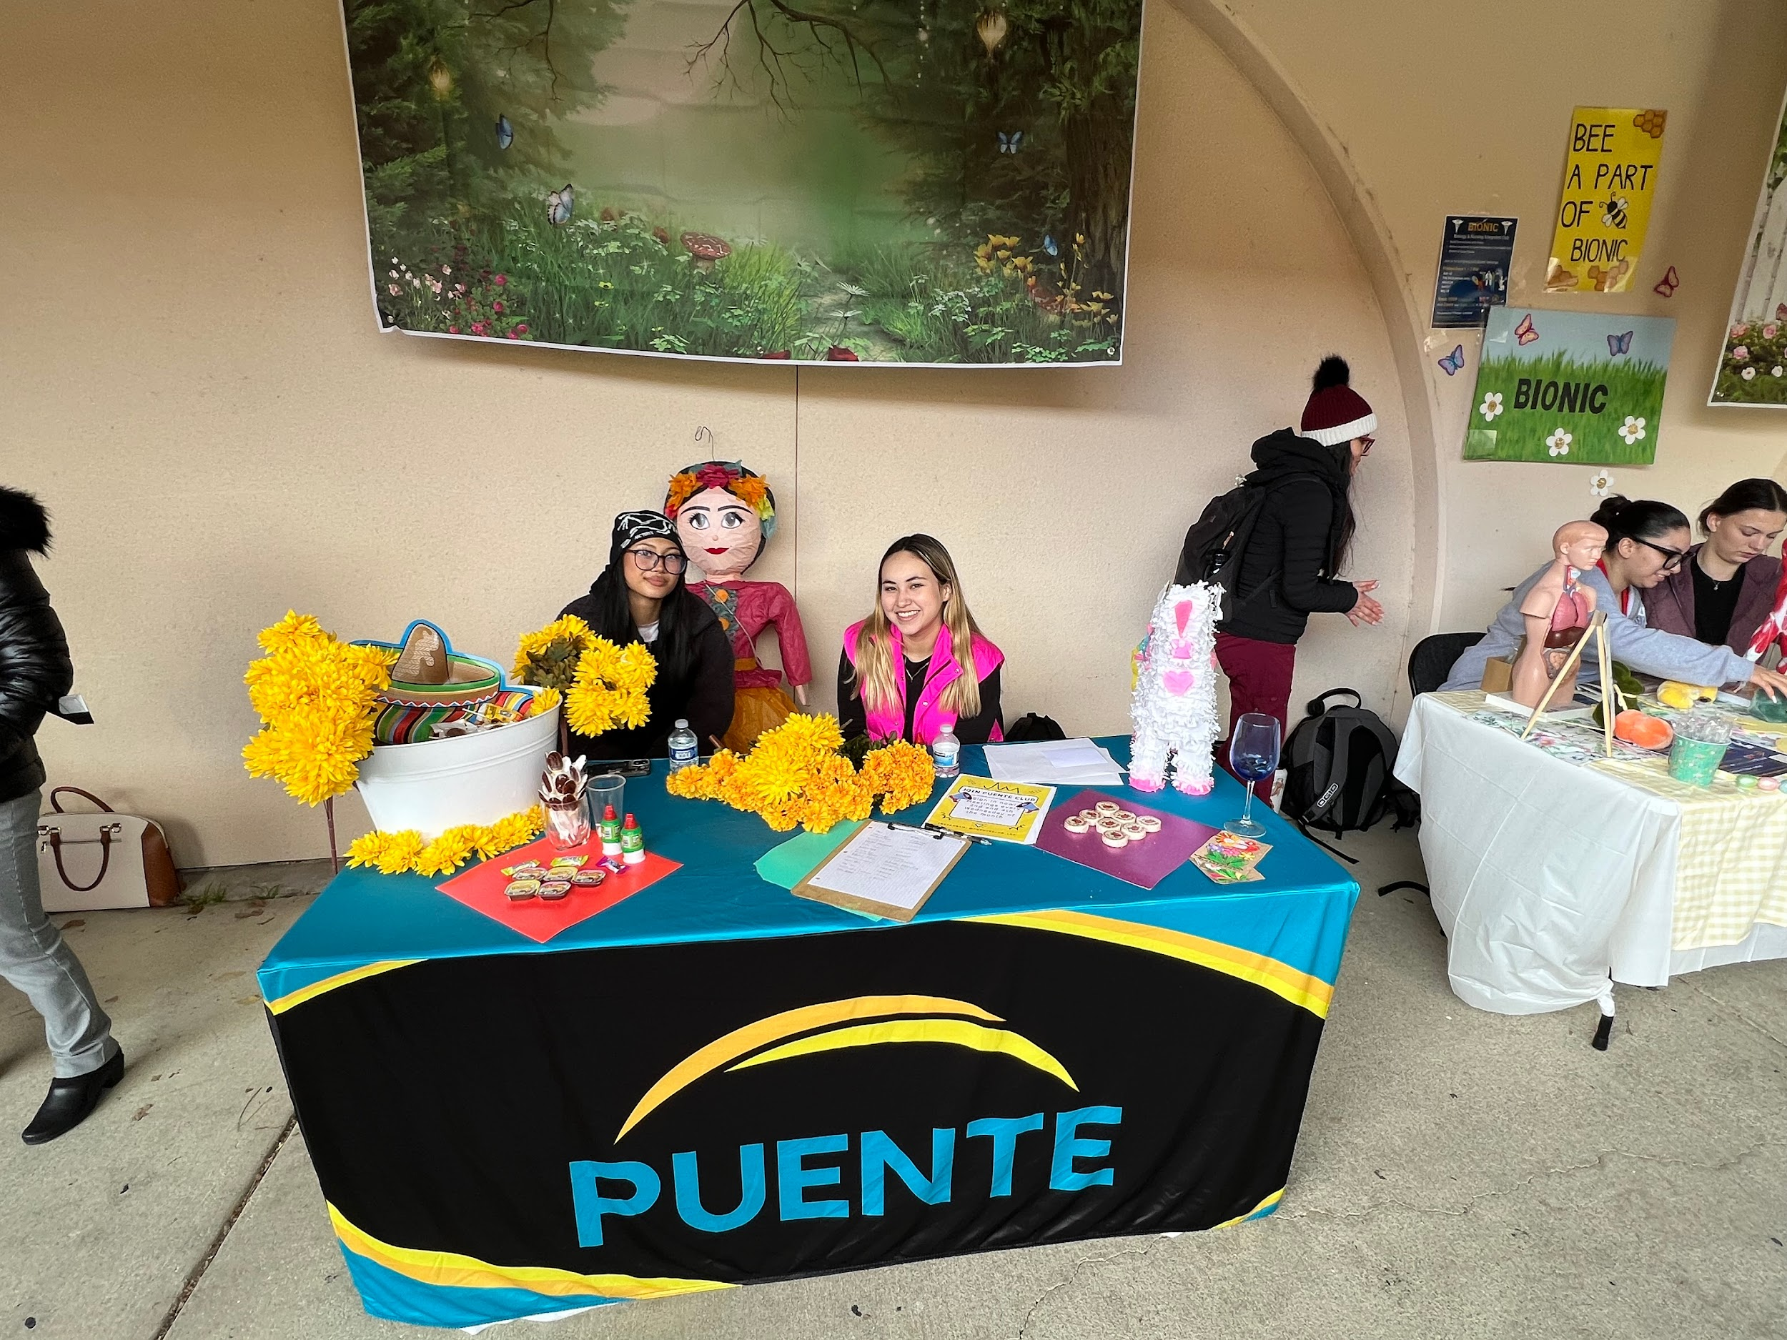
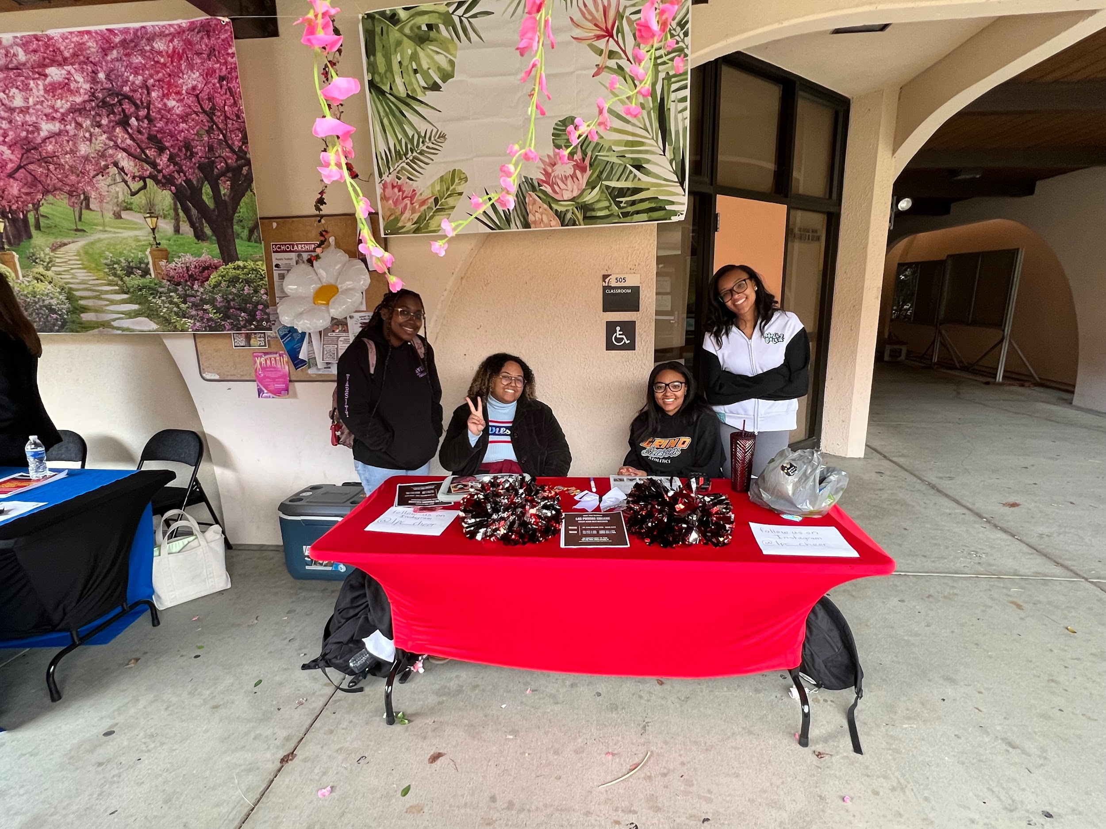
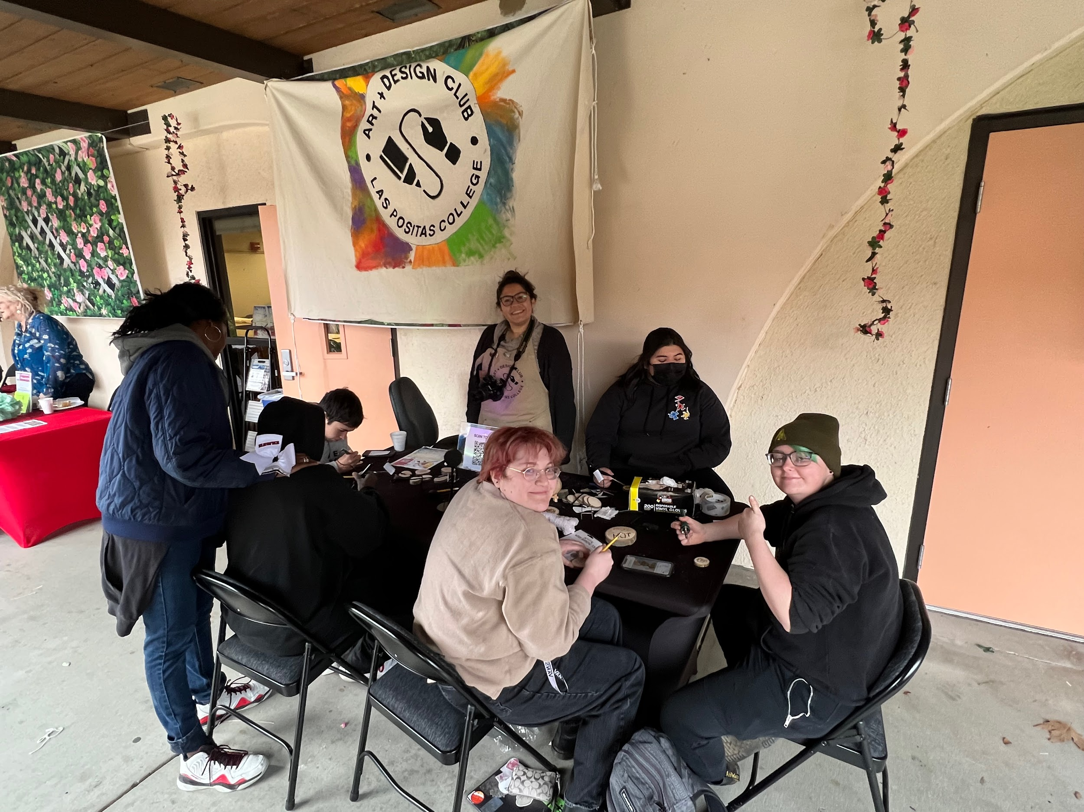
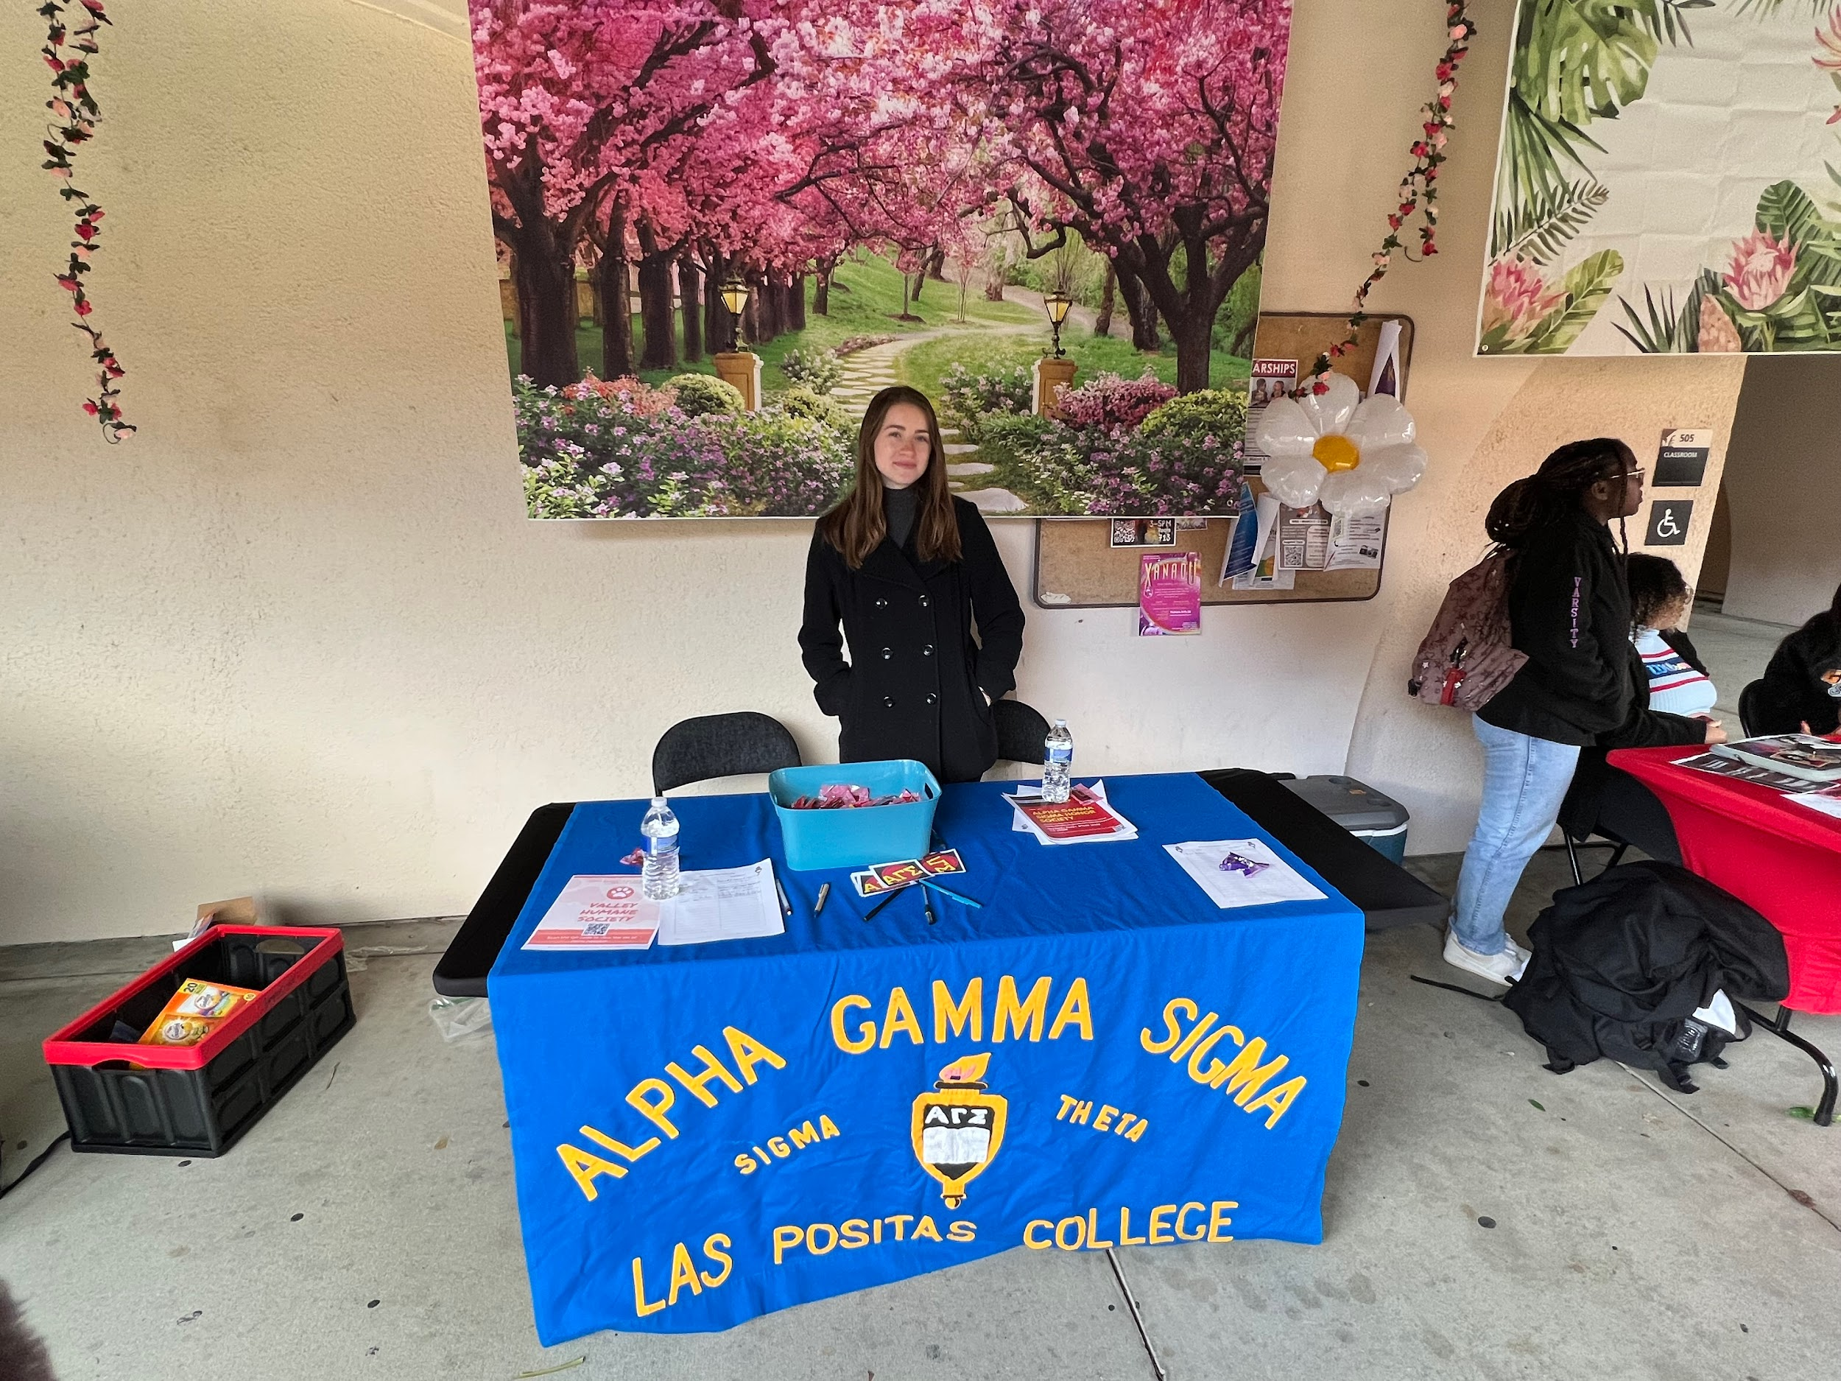
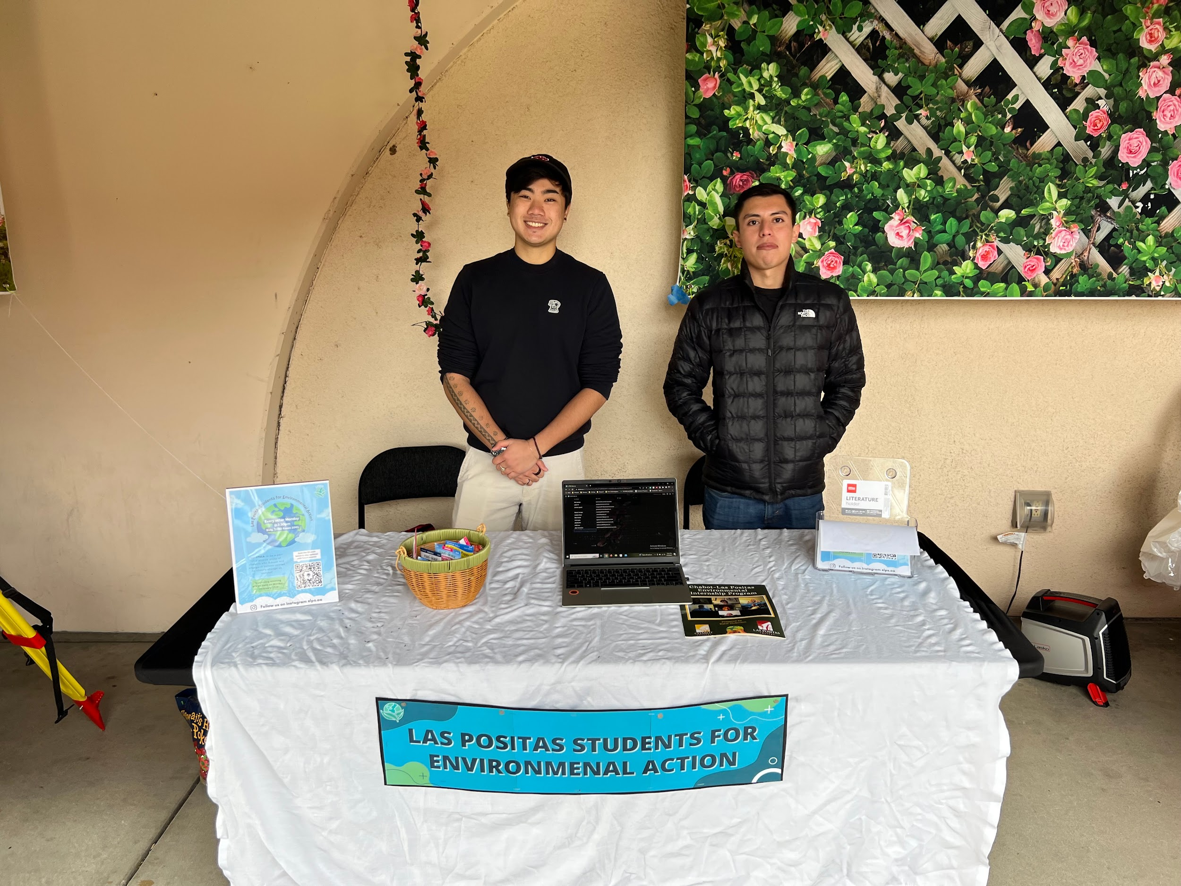
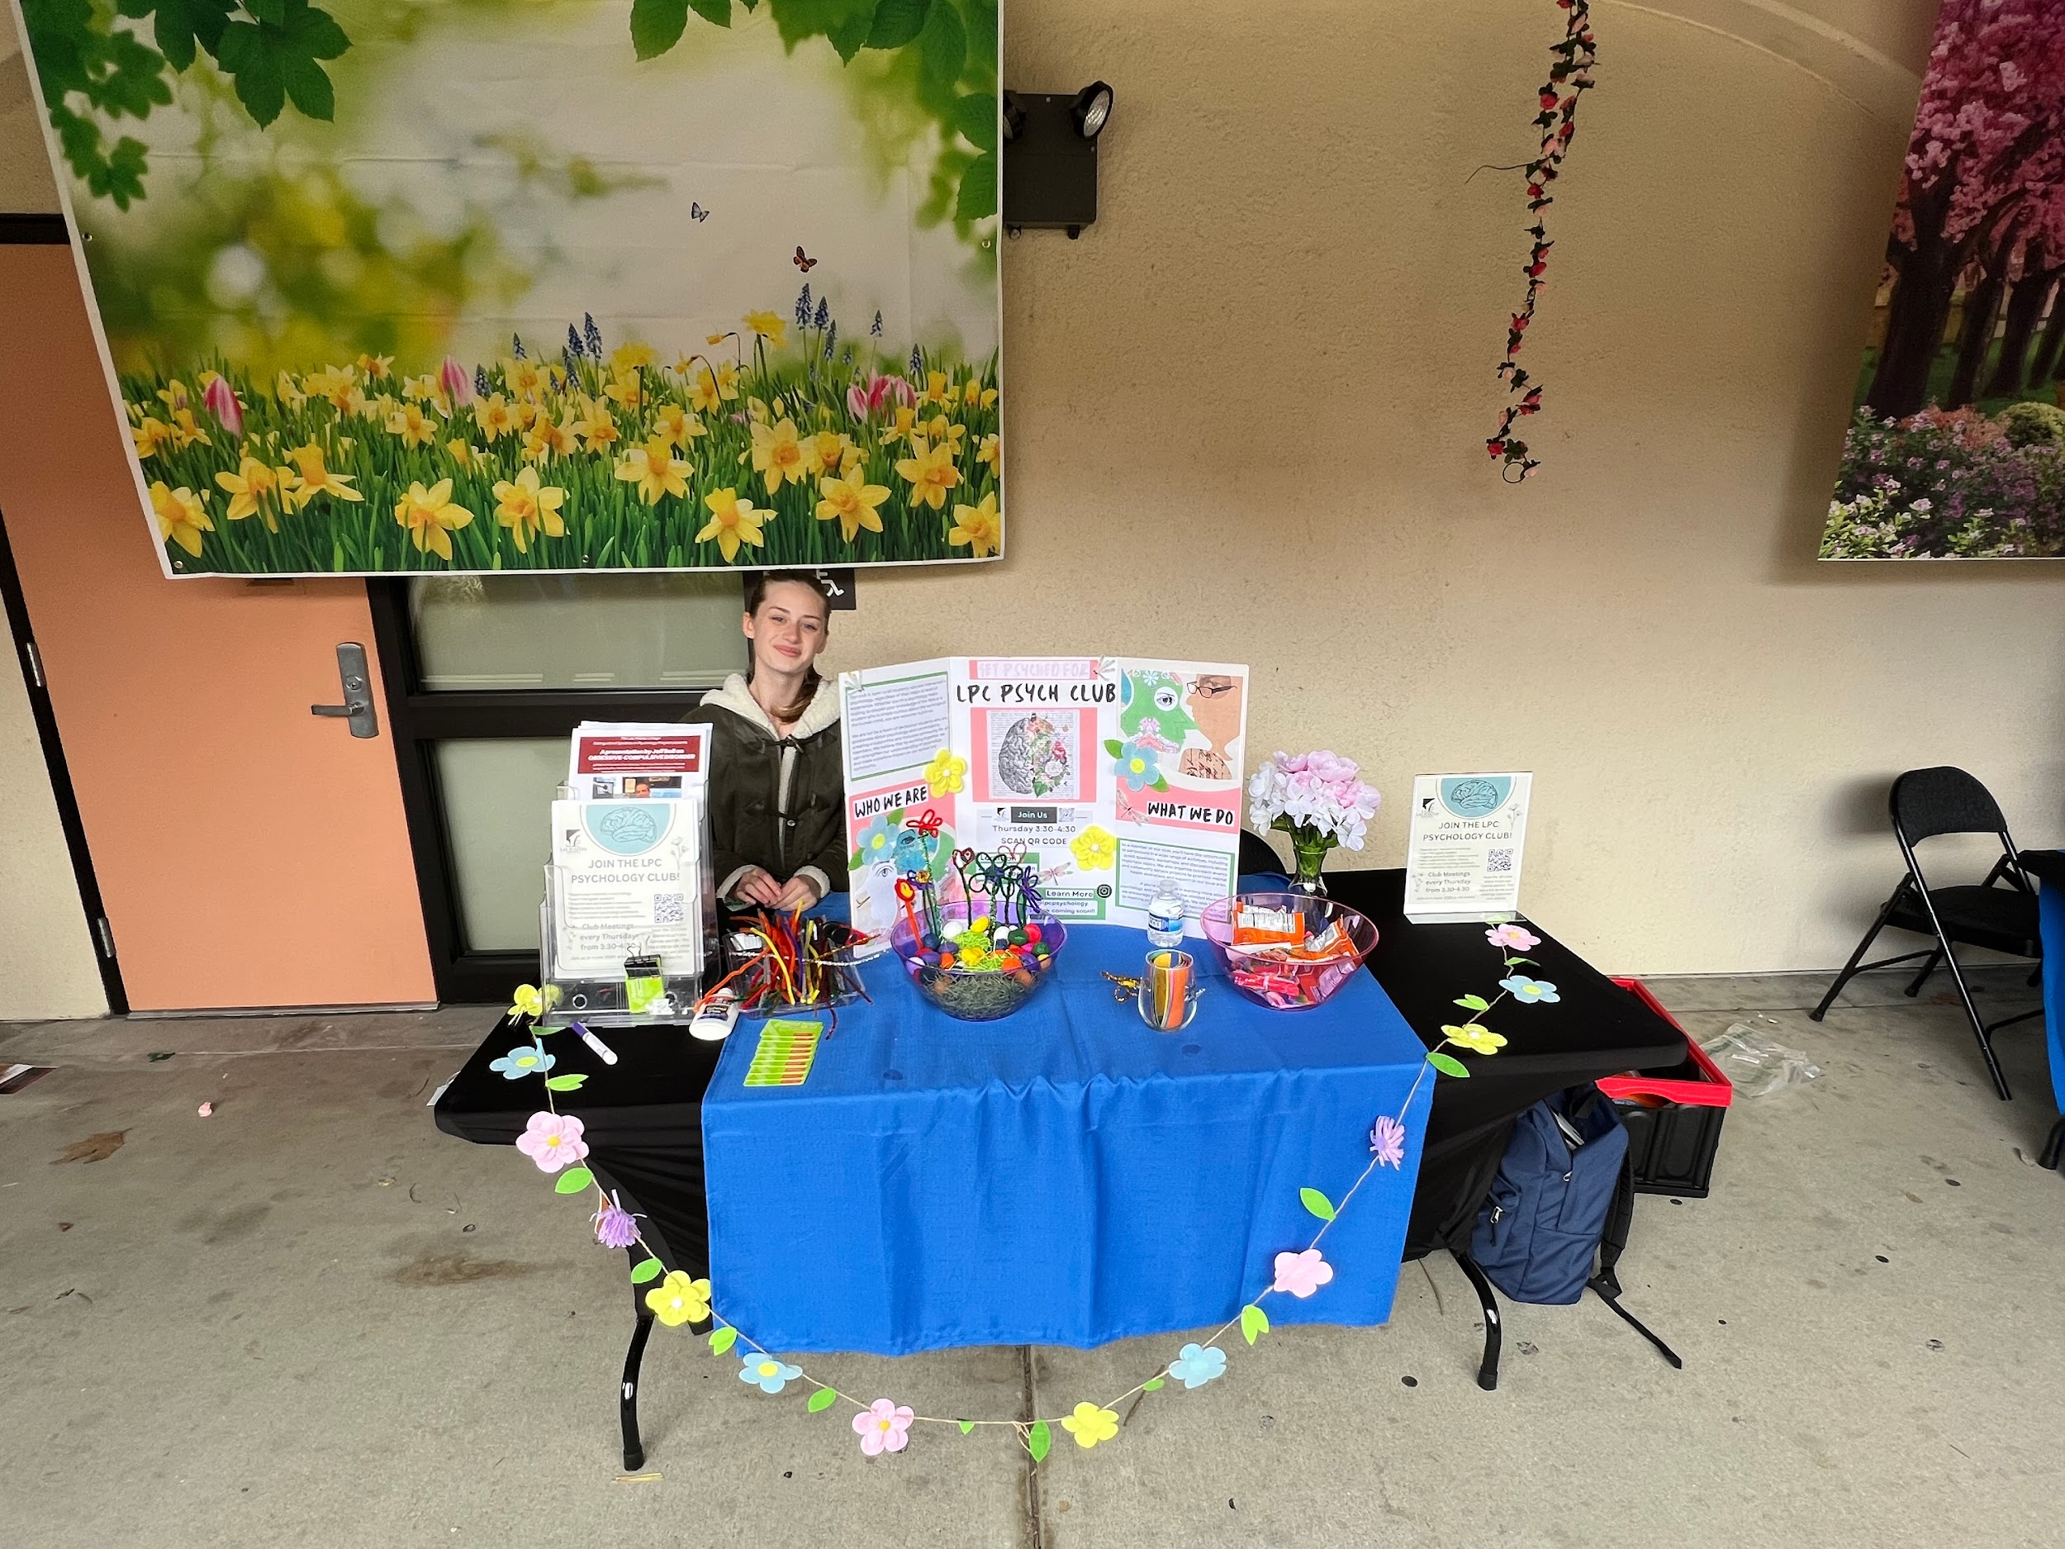
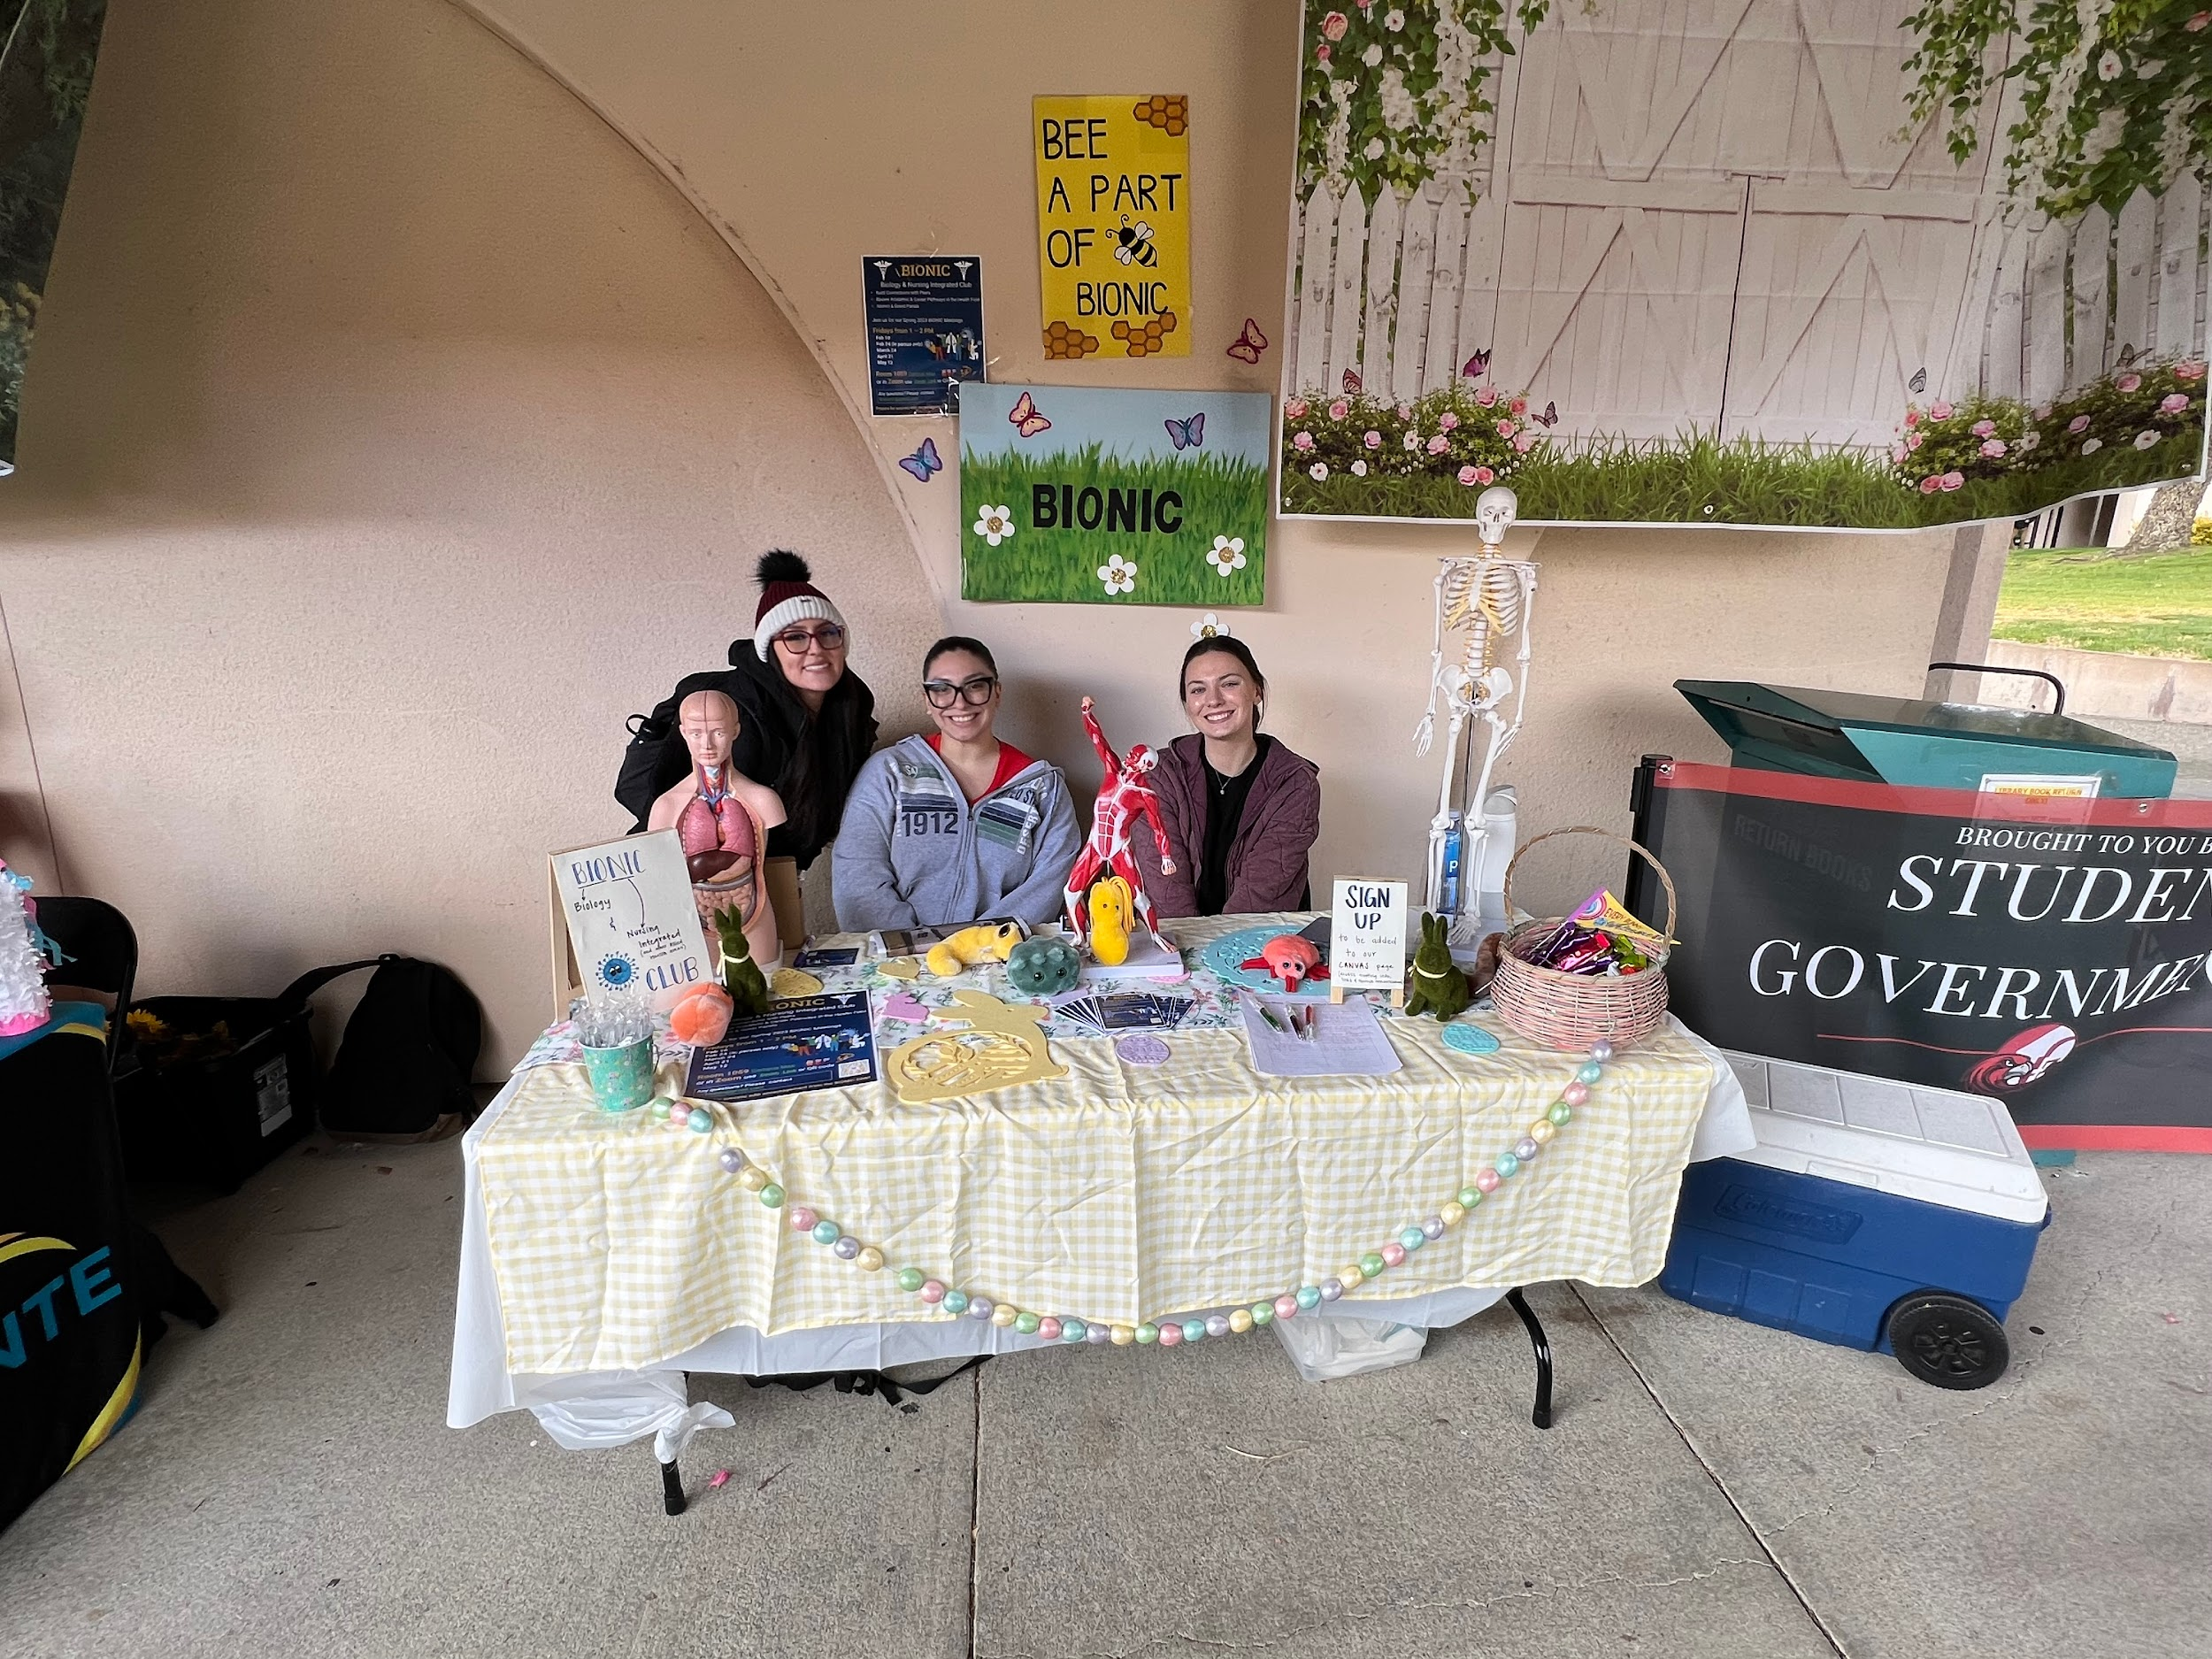
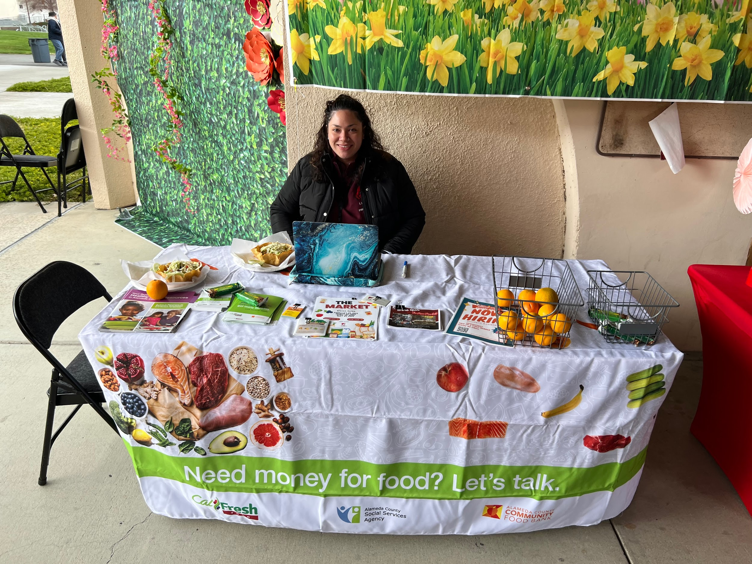

Slide 21
Motivational Speaker:
Tuesday April 11th at 11am
Free Food
Bio: Whether performing in a comedy club, guessing on television, speaking publicly, teaching at camps, or appearing in any number of other settings, Kathy Buckley bears her message that anything can be achieved when the heart and the mind work together. She serves as the national spokesperson for the non-profit organization, “No Limits for Deaf Children” a nationwide theater group, and after school program for low-income families.

Slide 22
THANK YOU!!

Slide 23
Tenured Faculty
Kristina Whalen
Vice President Academic Services

Slide 24
Congratulations to the Tenured Faculty!
Christopher Dudzik, Chemistry
Russell Jensen, Chemistry
John Kelly, Stagecraft & Technical Theater
Carlos Moreno, Computer Science
Jeffrey Weichert, Computer Networking Technology

Slide 25
Administrative Services Updates
Anette Raichbart
Vice President Administrative Services

Slide 26
22-23 BUDGET (February 28, 2023)
Fiscal Year | ACCT | ACCT Description | ADJUSTED BUDGET | YTD ACTIVITY | Available Budget | YTD%
23 | 1000 | Instructional Salaries | 21,601,443 | 17,048,623 | 4,552,819 | 78.92%
23 | 2000 | Classified Salaries | 6,555,889 | 4,248,337 | 2,307,552 | 64.80%
23 | 3000 | Benefits | 10,988,851 | 7,893,239 | 3,095,612 | 71.83%
23 | 4000 | Supplies | 134,393 | 58,352 | 76,041 | 43.42%
23 | 5000 | Services | 900,440 | 506,611 | 393,829 | 56.26%
23 | 6000 | Equipment | 60,500 | 53,332 | 7,168 | 88.15%
23 | 7000 | Transfers | 301,550 | - | 301,550 | 0.00%
2022-23 |  | Feb Total | 40,543,066 | 29,808,494 | 10,734,572 | 73.52%

Slide 27
CARES
313888 | Allocation | Expenses | Balance
HEERF I | $1,437,745 | $1,437,745 | $-
HEERF II | $4,547,129 | $4,547,129 | $-
HEERF III | $5,222,556 | $5,204,874 | $17,682
 | $11,207,430 | $11,189,748 | $17,682

Slide 28
Administrative Services Updates
Key Fob project – Completed 2/2023
Admin Services meeting with Dean’s to discuss position control – Ongoing
Year End Closing Calendar – Available Now

Slide 29
Student Housing
Owen Letcher
Vice Chancellor, Facilities and Bond

Slide 30
SB169 – Student Housing Grants
Campus Objectives – Equity, Diversity and Transculturalism; Recruitment of Students; Retention of Students; Student Engagement.
Requirements – First offer to low-income; Minimum of 12 units/semester; Rent cost cap.
Student Survey Need – 383 to 608 single student beds; 198 to 288 family units.
Next Steps - On-Campus Location, Site Plans, Building Plans for July 3, 2023 submittal
Competition for funding ($250 million)

Slide 31
Facilities Update Measure A & B
Ann Kroll
Project Planner / Manager

Slide 32
Facilities Modernization Program
Measure B & A - Project Report
March 1, 2023

Slide 33
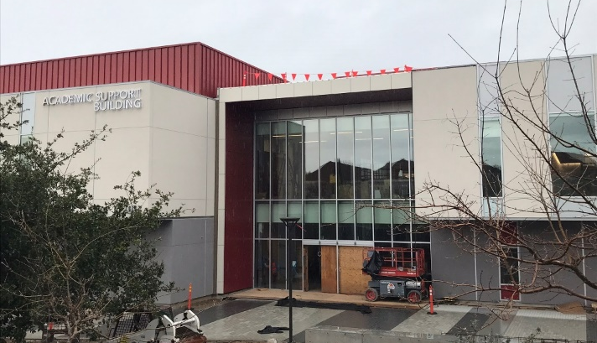
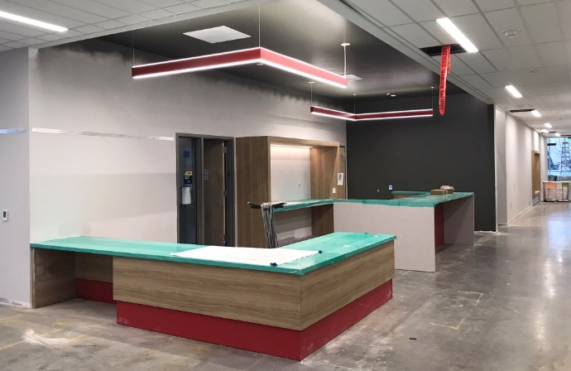
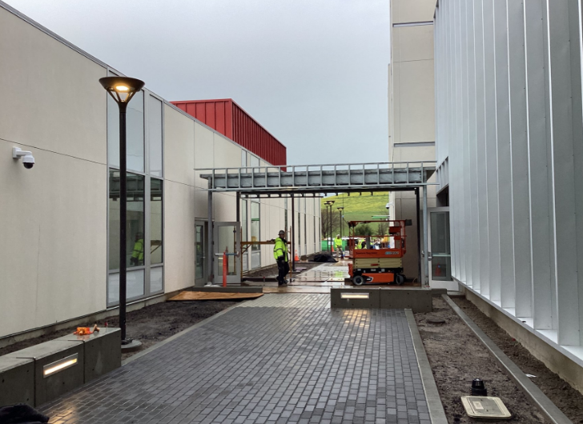
PROJECT PROGRESS REPORT
B2100 New Academic Support & Office Building
LAS POSITAS COLLEGE
March 1, 2023
Project Team
Architect: LPAS
Construction Manager: Swinerton Management & Consulting
Contractor: Flint Builders, Inc.
Project Description:
The new Academic Support and Office Building is being built in the location of old buildings 2100 & 2200. The project consists of the following elements and programs: English Center incorporating classrooms, computer lab, tutoring center and study areas. Math Center incorporating classrooms, labs and the Math Emporium program. Computer Studies including computer labs, networking, maker space. Renovation and Expansion of library functions including reference desk, study areas, computer lab, staff offices and library operational support spaces. 80 Faculty offices, Dean’s suite, Adjunct Faculty Spaces, and student gathering and support spaces throughout the building.
Project Update:
Phase 1 of parking Lot F repaving complete. Phase 2 will happen in May 2023.
Final painting, flooring, linear ceiling, elevator install work and exterior breezeway ongoing.
Library renovations to office spaces complete.
Library addition interior finishes, data cable install, electrical and mechanical trim ongoing.
Occupancy: Fall 2023

Slide 34
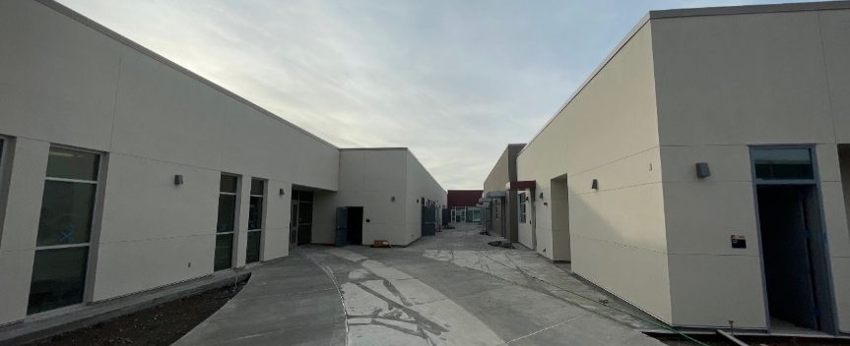
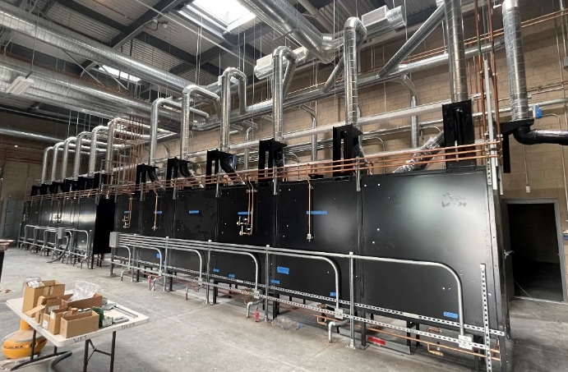
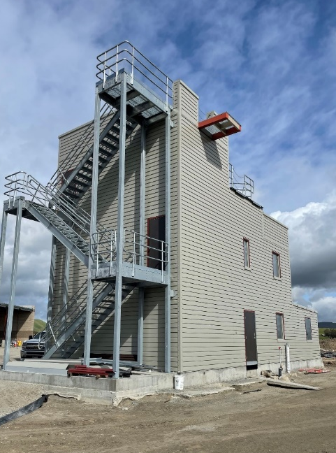
PROJECT PROGRESS REPORT
Public Safety Complex/Advanced Manufacturing
And Transportation
LAS POSITAS COLLEGE
March 1, 2023
Project Team
Architect: Lionakis
Construction Manager: Vanir Construction Management, Inc.
Contractor: Overaa Construction
Project Description:
The new Public Safety Complex (PSC) and Advanced Manufacturing and Transportation (AMT) building will be co-located to allow for shared linkages between the various programs, classrooms and event spaces. The buildings will be built near the existing track and field in the northeastern portion of the upper campus. The PSC project consist of the following elements and programs: EMS Simulation Lab and Situation Rooms, Administration of Justice, Matt room, and Fire Training with Class A burn areas. The AMT project will include an automotive tech facility, welding lab, Tool room, and classroom and lab spaces to provide training of advanced manufacturing processes. Faculty Offices, Dean’s suite, Part Time Faculty offices, and support spaces will also be included in the building.
Project Update:
Building interior finishes including paint, ceilings, doors, cabinets, bathroom partitions and accessories are progressing towards completion.
Risk Mitigation Apparatus Mechanical, Electrical and Plumbing items are progressing.
Site curb and gutter are nearing completion, asphalt sub-base and first course are in progress, landscape irrigation and bioretention areas are in progress along with site fencing.
Occupancy: Fall 2023

Slide 35
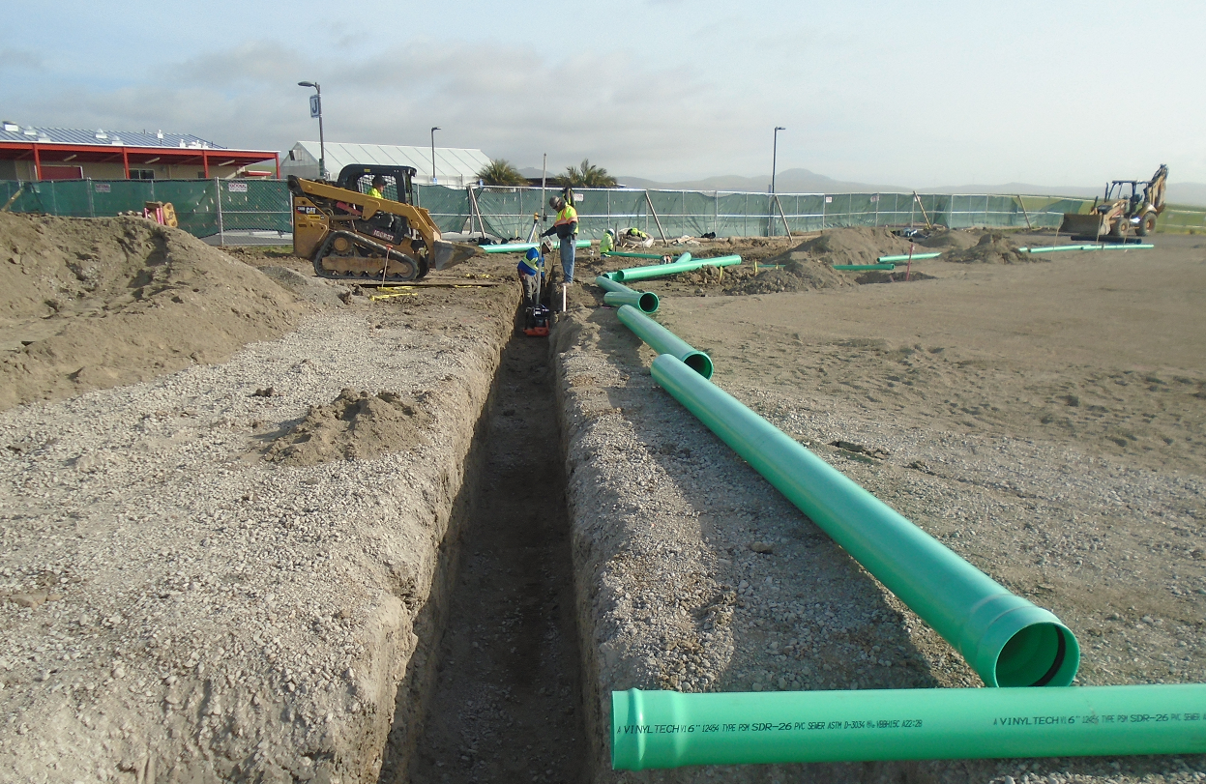
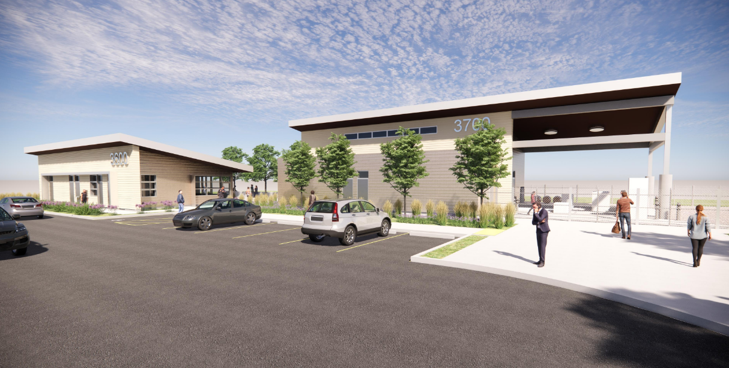
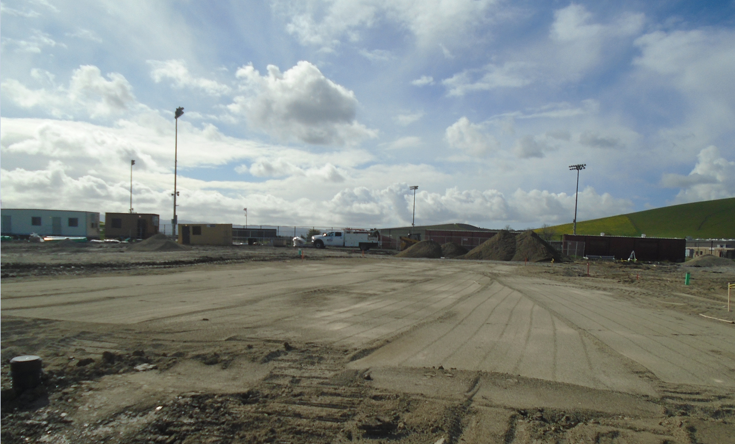
PROJECT PROGRESS REPORT
AG SCI: Viticulture Facility Project
LAS POSITAS COLLEGE
March 1, 2023
Project Team
Architect: tBP/Architecture, Inc.
Construction Manager: Roebbelen (RCMS)
Contractor: Beals Martin & Associates
Project Description:
The New Viticulture Facility will replace the existing facilities currently located in/outside of Building 800. The Viticulture Facility will be located adjacent to the New Horticulture Facility at the upper NE part of campus. The project will be include general site grading and utility infrastructure; A Visitor Center with Tasting room, visitor Parking and clear paths of travel, A Winemaking Facility including classrooms and Labs, Faculty office and resource areas, Crush pad, Equipment storage, cold storage, and an Outdoor Patio.
Project Update:
Grading for pads complete.
Storm lines installed for both buildings.
Trenching for sanitary sewer connection in progress.
Continue layout of remaining underground utilities.
Upcoming layout of footings, follow by footing excavation.
Occupancy: Winter 2023/24

Slide 36
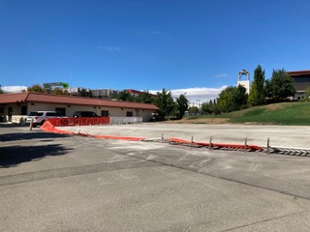
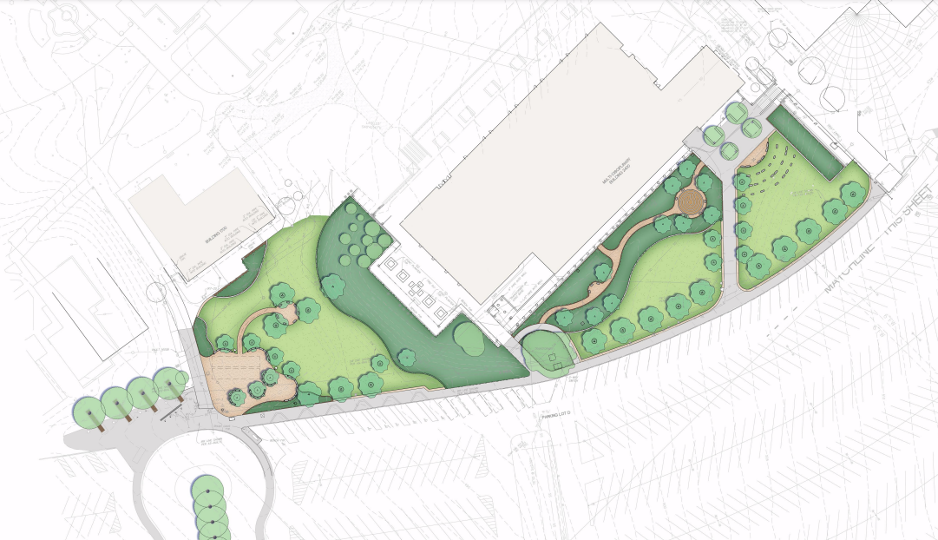
PROJECT PROGRESS REPORT
B100 Temporary Classroom Removal &
Restoration of Site
LAS POSITAS COLLEGE
March 1, 2023
Project Team
Architect: Cupples Keller Design
Construction Manager: Swinerton Construction
Contractor: TBD
Project Description:
The removal of B100 modular classroom buildings. Site restoration of the area and in front of the B2400 Multi-Disiplinary building will provide a welcoming entrance to the campus from the campuses bus stop. New walks, paved seating spaces, landscaping, and trees, lighting, signage and 2 new flag poles.
Project Update:
Bidding in progress with Board approval March 2023.
Start Construction Spring 2023
Project Completion anticipated Fall 2023
Occupancy: Fall 2023

Slide 37
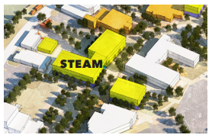
PROJECT PROGRESS REPORT
STEAM – Sciences & Arts Building
LAS POSITAS COLLEGE
March 1, 2023
Project Team
Architect: TBD
Construction Manager: TBD
Contractor: TBD
Project Description:
The new STEAM Building will be developed in the footprint of the existing B600 and B800 bldgs. and adjacent to the campus boulevard. The New STEAM building will have the following elements and programs will reside in the building. Laboratories and preparation spaces for STEAM related programs, Classrooms, Computer Labs, shared Meeting rooms and workrooms. Faculty offices and Shared Adjunct space. Arts, Media and Photography Programs, Outdoor Garden and Display area. Amphitheater Renovations and Renovation to B1800. The Demolition of existing buildings 600, 800 and adjacent covered walkways are included in this project.
Project Update:
RFP for Design services was issued on 2/2/23.
Interviews for design services will take place on 3/24/23.
Anticipated board approval at the April 2023 Board Meeting.
Occupancy: Fall/Winter 2026

Slide 38
My Portal
Kristen Whittaker
Application Services Manager

Slide 39
College-Going Rates of Students from Dublin, Pleasanton, and Livermore Unified School Districts
Rajinder Samra
Director of Research, Planning and Institutional Effectiveness

Slide 40
College-Going Rates of Students From Dublin, Pleasanton, and Livermore Unified School Districts
Presenter: Rajinder S. Samra
Director of research, planning, and institutional effectiveness
march 1, 2023
Las Positas College’s Town Meeting

Slide 41
Dublin Unified School District

Slide 42
2019-20 College Going Rates of Dublin Unified School District
by Race/Ethnicity and Institution Type
N = 746
N = 42
N = 313
N = 45
N = 97
N = 185
N = 62
Source: California Department of Education.

Slide 43
Pleasanton Unified School District

Slide 44
2019-20 College Going Rates of Pleasanton Unified School District
by Race/Ethnicity and Institution Type
N = 1,228
N = 14
N = 481
N = 29
N = 115
N = 552
N = 29
Source: California Department of Education.
Note: Native American, Pacific Islander, and unknown not reported due sample sizes of fewer than 10.

Slide 45
Livermore Valley Joint Unified School District

Slide 46
2019-20 College Going Rates of Livermore Valley Joint Unified School District
by Race/Ethnicity and Institution Type
N = 1,090
N = 12
N = 83
N = 40
N = 312
N = 568
N = 65
Source: California Department of Education.
Note: Native American, Pacific Islander, and unknown not reported due sample sizes of fewer than 10.

Slide 47
Key Takeaways
Around 3,000 high school students graduate from Dublin,
Pleasanton, & Livermore each year
Dublin and Pleasanton have the highest college-going rates (84%)
Livermore’s college-going rate matches Alameda County rate of 70%
Around 920 high school graduates (30%) attend a community college

Slide 48
Key Takeaways
Dublin’s student population is increasing while Pleasanton’s decreasing
Livermore’s student population numbers are relatively stable
with a slight increase expected in Asian students
Overall, Asian students are expected to increase the most in our three cities but are the least likely to attend community college.

Slide 49
Las Positas College Transfer Students
Acceptance Rates to UC and CSU
N = 397
N = 830
Source: UC Information Center, CSU Data Center.
Note: UC acceptance rate is for 2020-21 and CSU acceptance rate is for fall 2021.

Slide 50
Outreach Team

Slide 51
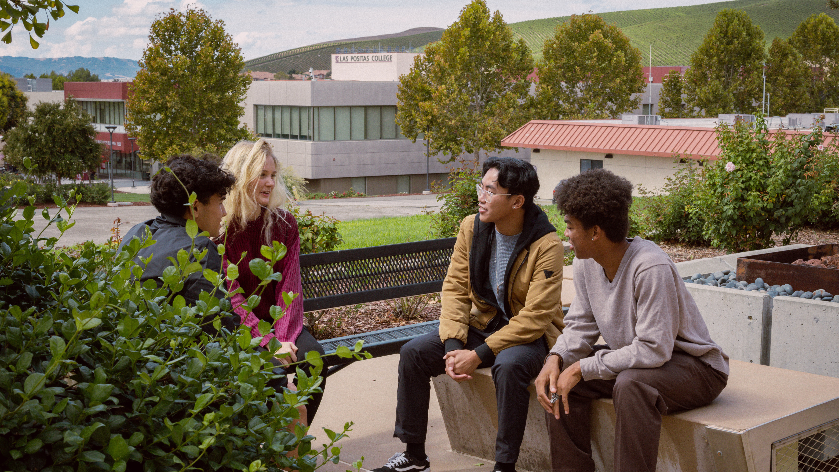
Outreach Team

Slide 52
SARAH ANDERSON,
OUTREACH SPECIALIST
High School Outreach Efforts
Application Workshops at each area High School
Presentations
Tabling at College Fairs
Virtual Information Sessions
Maintain partnerships with High School counselors
Counselor Day
Counselor Open House
Campus tours for prospective students and families
Host high school & community groups on campus
Field inquiries and respond to emails from prospective students, parents, and community members

Slide 53
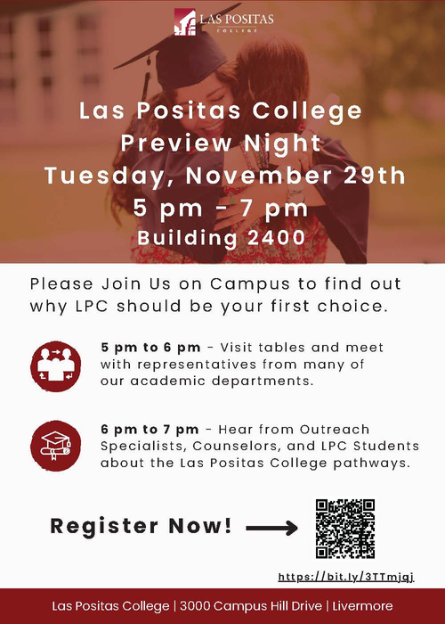
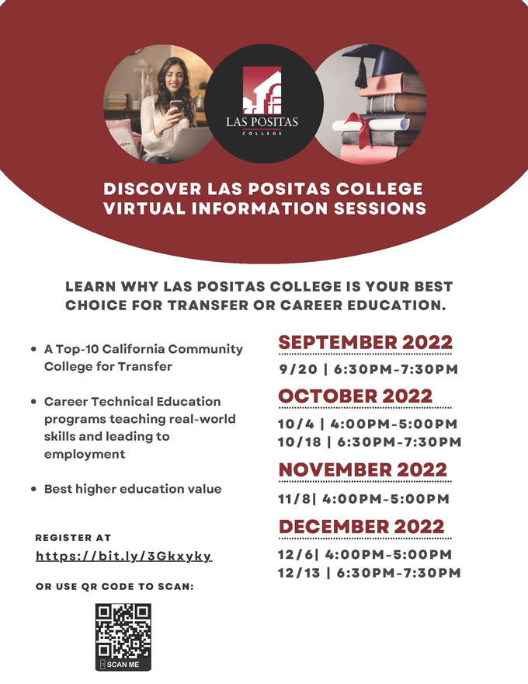
OUTREACH EVENTS

Slide 54
LISETTE ROCHA,
FINANCIAL AID SPECIALIST
Manage Financial Aid Application Workshops and Presentations
Las Positas College Events
High Schools and Continuation Schools
Non-Profits
Conduct online and in-person FAFSA/CADAA drop-in hours
Support Student Athletes, Spanish Speakers, Veteran, and AB 540 students
Responsible for Financial Aid Social Media, marketing material, and outreach software
Provide Financial Aid in-reach on campus to create awareness and assist students with the process
.

Slide 55
ANNE KENNEDY, CTE
BUSINESS STUDIES, PUBLIC SAFETY, KINESIOLOGY, WORK EXPERIENCE
Promote CTE Programs and build enrollment
Exhibit/present at high school events, CTE Fairs, College & Career Nights
Collaborate with TVROP College & Career Counselors
Chambers of Commerce, City & Community Events
Plan and execute information sessions and tours designed to bring prospective students to campus.
Develop partnerships with businesses to bring WBL opportunities to our students, such as Internships, field trips, or guest speakers.
Recruit members for CTE Program Advisory Boards

Slide 56
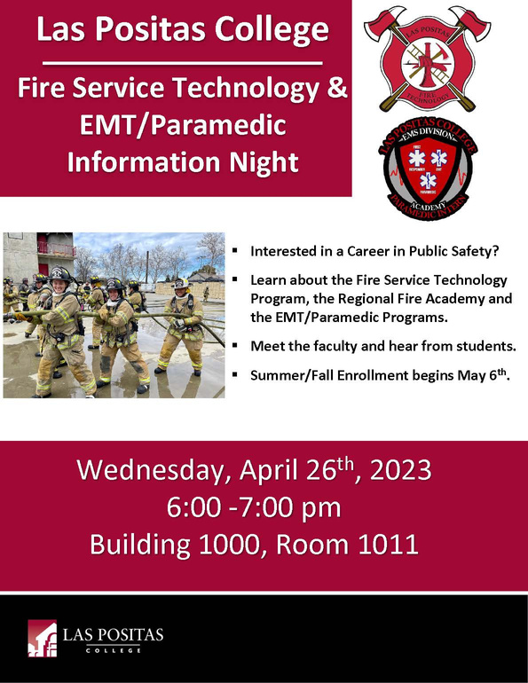
Happenings
OUTREACH EVENTS

Slide 57
JEAN O'NEIL-OPIPARI,
STEM PROGRAM COORDINATOR
Coordinate STEM Events
LLNL Science on Saturday
LLNL/LPC Seminar Series
LLNL IT Hiring Event
SEMI Professional Development Seminar
Manage STEM CTE Advisory Boards
Develop relationships with industry (collaboration, site visits, guest speakers, advisory boards)
Visit High Schools, career fairs
Involved in the Tri-Valley Educational Collaborative
Participate in the Tri-Valley Innovation Fair
Market STEM classes, programs, and summer camps

Slide 58
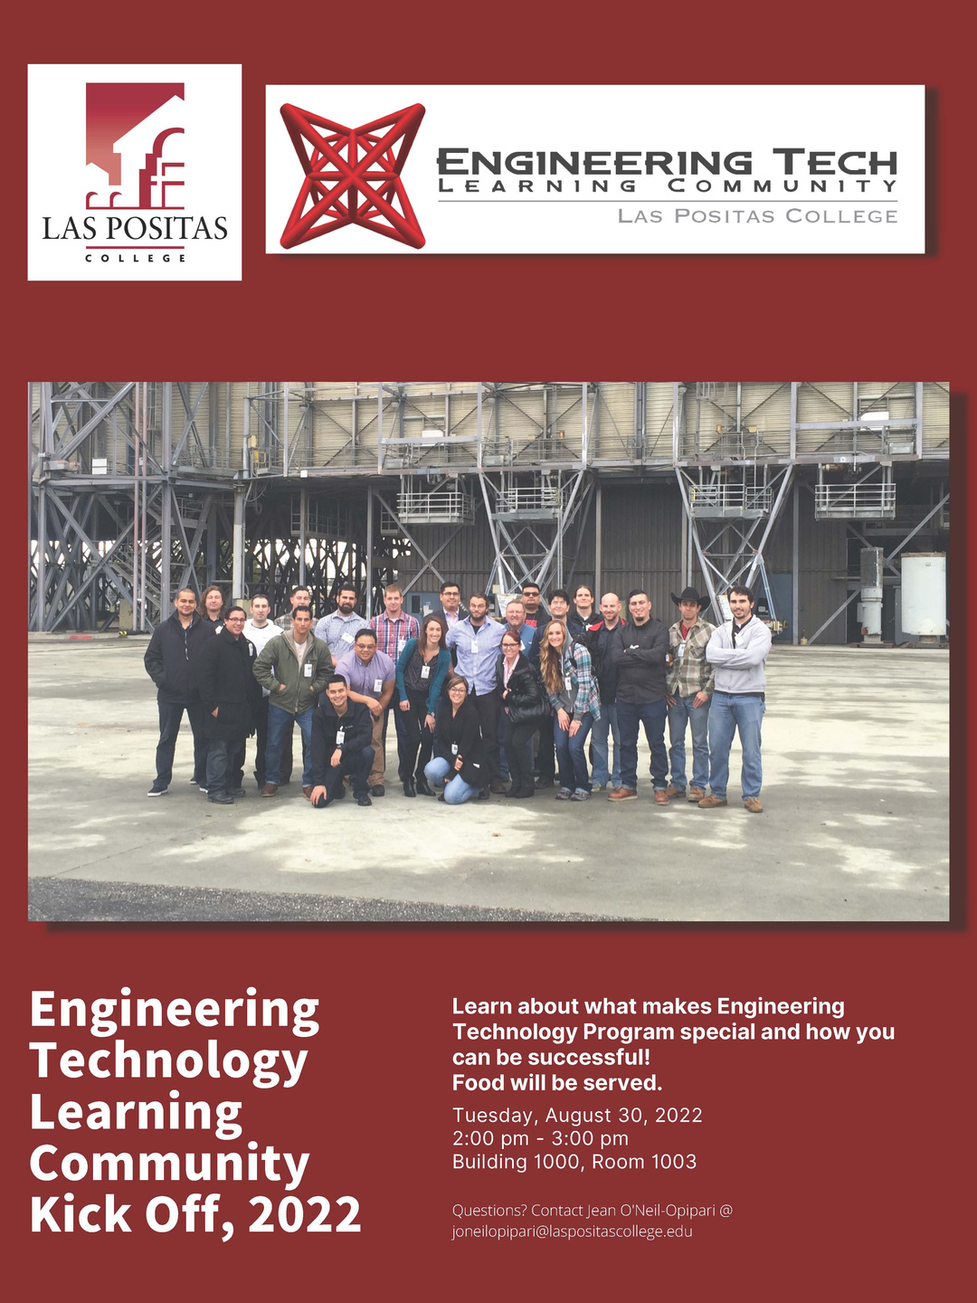
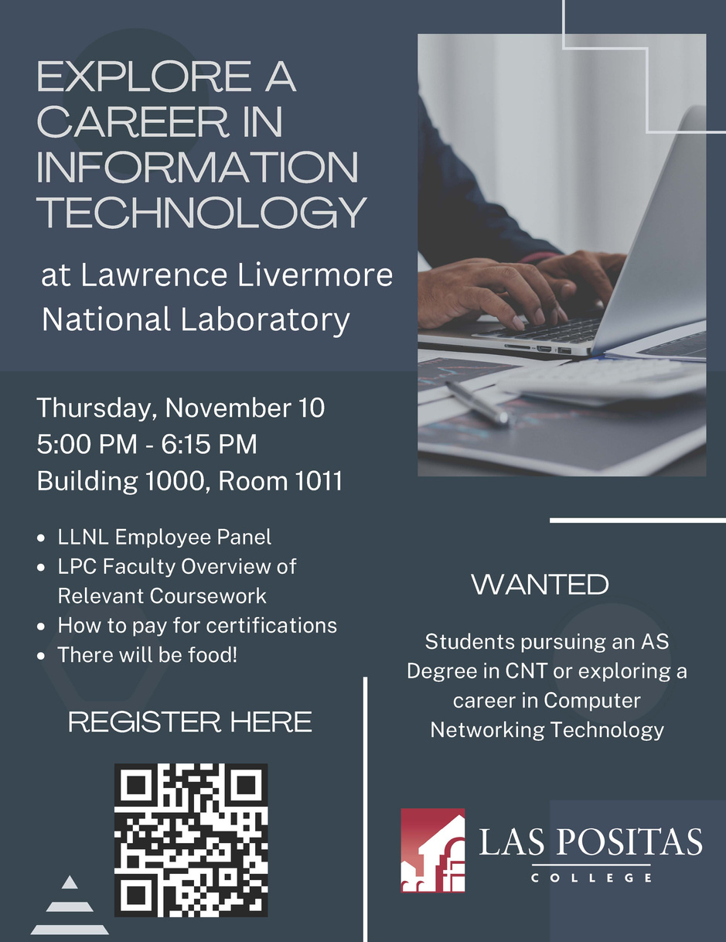
OUTREACH EVENTS

Slide 59
HELENA CRUZ,
CTE OUTREACH SPECIALIST
Present the CTE pathway opportunities to middle school, high school, and adult students
Provide guest speaking opportunities for students on program pathways
Facilitate advisory boards
Attend outreach events at high schools, and community events
Information sessions for Arts & Humanities and Automotive and Welding Technology
Marketing & Advertising - Including updating websites, social media marketing, CTE video production management, and flyers

Slide 60
OUTREACH EVENTS

Slide 61
LPC OPEN HOUSE

Slide 62
OUTREACH TEAM
CONTACT INFORMATION
SARAH ANDERSON -
OUTREACH SPECIALIST
HELENA CRUZ -
CTE OUTREACH SPECIALIST
seanderson@laspositascollege.edu
hcruz@laspositascollege.edu
ANNE KENNEDY -
CTE OUTREACH SPECIALIST
JEAN O'NEIL-OPIPARI -
STEM PROGRAM COORDINATOR
akennedy@laspositascollege.edu
joneilopipari@laspositascollege.edu
LISETTE ROCHA -
FINANCIAL AID SPECIALIST
lrocha@laspositascollege.edu

Slide 63
EOPS and CalWORKs

Slide 64
EOPS & CalWORKs
Extended Opportunities Programs & Services (EOPS)
California Work Opportunity and Responsibility to Kids (CalWORKs)
6

