Slide 1
March Town Meeting

Slide 2
33rd Annual Commencement Ceremony
Saturday, May 27th , 10 a.m. & 12:30 p.m.
Faculty Cap and Gown orders DUE to Bookstore
DUE DATES forthcoming in an email
Volunteer opportunities for Faculty/Staff/Students!
Event Pre-Prep: Week of Ceremony
Registration: Saturday Morning
Ceremony: Saturday Morning/Early Afternoon
Please contact Yvette Nahinu @ x1406
THANK YOU!

Slide 3
MARCH 17-26
Fri/Sat 8PM & Sun 2PM
March 25 Sat 2PM
X
U
THE MUSICAL
ANAD
Tickets on sale at www.showtix4u.com/events/LPCArts

Slide 5
Talk Hawks win 1st Place at Nor Cal Champs, Feb 17-19
3 Days, 25 Schools, 26 Awards…TOP SCHOOL OVERALL!

Slide 6
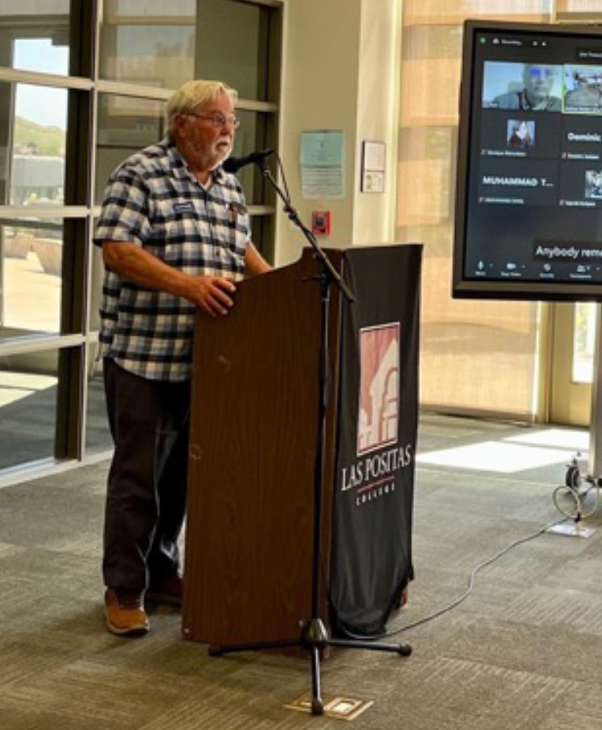
Havik, LPC’s Journal of Arts, Literature, and Academic Writing, is accepting student academic essays
for possible publication in May 2023.
Read any great student essays lately?
If you feel strongly about an academic paper or essay written by one of your students in the past year, please submit it to Havik by February 18, 2023.
To submit, or for more information, contact us: Havik@laspositascollege.edu
Retired English Professor David Wright at the Havik Ceremony May 14, 2022. (Photo courtesy of The Express).

Slide 7
LPC Scholarship Season is Upon Us!
Faculty and Staff, please check your mailbox for this scholarship flyer and display it in your classrooms/offices for students.
Thank you,
LPC Financial Aid Office

Slide 8
LAS PO FILM FEST: April 13, 2023
Presented by the LPC Film Studies And photography Programs:
Las Po Film Fest '23 welcomes short LOCAL community college student films, as well as LPC alumni and local high school student films.
The free LPFF screening and awards night will be held on Thursday evening, April 13th in the Mertes Center for the Arts.
Last year, we screened 24 student films, had 5 judges, gave out 31 awards, and had approximately 150 people attend the festival! we hope to build on That success this year!
Student film submissions due March 19, 2023

Slide 9
There There a novel by Tommy Orange 2023 LPC Literary Arts Festival Keynote Speaker*
Spring 2023
campus read
JOIN us for the
of
Book discussion at FLEX Day, March 16
(pending approval by Professional Development Committee)
*In conjunction with the President’s Speaker Series and with support from the LPC Foundation

Slide 10
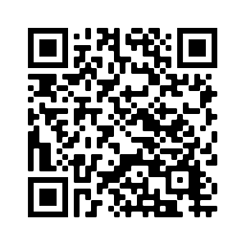
Got Work? Enroll in WRKX & Get College Credit!
If you have a job, internship, or steady volunteer work, GET COLLEGE CREDIT by enrolling now in a Work Experience class: late-start, light workload, asynchronous, completely online, designed for students in all majors.
“The class is great and everyone working and going to college should take it.”
Visit the WRKX Page & FAQs Chart to Enroll

Slide 12
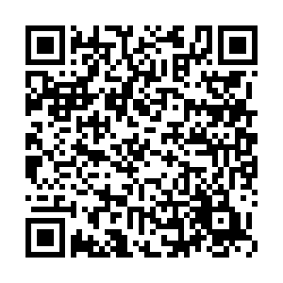
OPEN HOUSE
SATURDAY, MARCH 25, 2023
Join us and promote your program! Connect with prospective students and highlight your pathway.
Attention
Faculty!
EVENT HOURS
10 a.m. - 2 p.m.
ACADEMIC & RESOURCE FAIR
10 a.m. - 1 p.m.
food
CAMPUS TOURS
11 a.m. & 1 p.m.
Music
PROGRAM SPOTLIGHT AND INFO SESSIONS
11 a.m. - 1 p.m.
To participate, contact:
Anne Kennedy, Outreach Specialist
Las Positas College | 3000 Campus Hill Drive | Livermore

Slide 13
Say Hello to Libby! …and goodbye to the Overdrive app
The Overdrive app will be discontinued in early 2023. Continue accessing the LPC Library’s growing collection of ebooks and audiobooks by downloading the free Libby app now.
LPC Literary Festival Books available! “There There”, “Patron Saint of Nothing”, and more

