Slide 1

Welcome & Announcements
President Dyrell Foster

Slide 2
Welcome & Announcements
Lara Wiedemeier, LPCSG President
President Foster
LPCSG Updated
Budget Update
Vice President Anette Raichbart
International Students
Cindy Balero & Heike Gecox
UndocuAlly
UndocuAlly Taskforce
Umoja, BCRC, Black History Month
Black Education Association

Slide 3
Our Purpose & Our Passion
Our Passion:
Advance excellence and equity in student outcomes, in college, after college, and for all students
Our purpose:
Economic Mobility & Talent Development
Who we serve:
Our students, their families, our community, and our region

Slide 4



College Strategic Priorities - Update
Begin Conversations Regarding Institutional Re-alignment
Assess and align organizational structure with strategic goals for effectiveness, stability and long-term institutional health
First Campus Wide Meeting Held: Friday, January 20, 2023

Slide 5


College Rankings
#1 Best Community College in CA
2023 – Intelligent
#2 Best Community College in the Bay Area
#3 Best Community College in California
#6 Best Community College in America
2023 - Niche
Rankings are based on the strength of academic quality, graduation rate, affordability, available student resources, and overall students’ experiences.

Slide 6
Accreditation Update
The ACCJC Commission acted to reaffirm accreditation for seven years!!

Slide 7
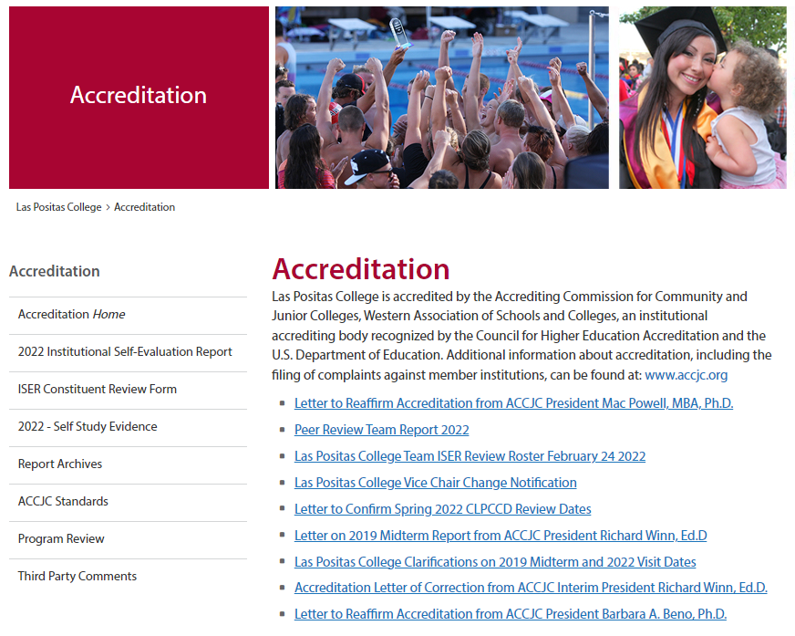
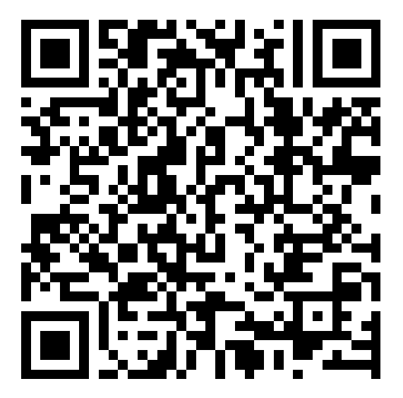
Accreditation Update

Slide 8


Thank You - Accreditation Steering Committee
  Kristina Whalen
  Carolyn Scott
  Stuart McElderry
  Tina Inzerilla
  Tim Druley
  Rajinder Samra

Slide 9

Thank You - Expanded Accreditation Steering Committee
  Mike Ansell
  Angelica Cazarez
  Rajeev Chopra
  Elena Cole
  Jennifer Druley
  Heike Gecox
  Steve Gunderson
  Ann Hight
  Owen Letcher
  Titian Lish
  Stuart McElderry
  Andrea Migliaccio
  Angella Venjohn
  Sheri Moore
  Anette Raichbart
  David Rodriguez
  Sui Song
  Nadiyah Taylor
  Jin Tsubota
  Heidi Ulrech
  Nan Ho

Slide 10



Las Positas College
Equity in Education Challenge Learning
Series
2023 Updates

Slide 11
What's New?
5 Day Challenge Format
Commit to learning for 5 days! Pick a week receive a daily dose of education with an equitable framework in mind.
Each day should take no more than 10 minutes.
Community Page
This feature will enable folks to share their comments and question in either a public or private forum.
01
02
Brown Bag
Whether you have time to engage in the weekly challenges or not, there will be an opportunity to engage in a weekly conversation about each week's theme.
03

Slide 12
INCLUSIVE LANGUAGE LEARNING SERIES
February 13 - March 3rd
1
2
3
Race & Ethnicity
Learning Styles
February 20th - 24th
Gender Inclusivity
February 27 - March 1
February 13th - 17th
Students have different learning styles and ways they receive knowledge. Learn about the language around the varying abilities of students.
The language around gender, sexual orientation, one's sexual identity are addressed in this week's challenge.
This week is a deep dive into the language we use around race and ethnicity in this country.

Slide 13

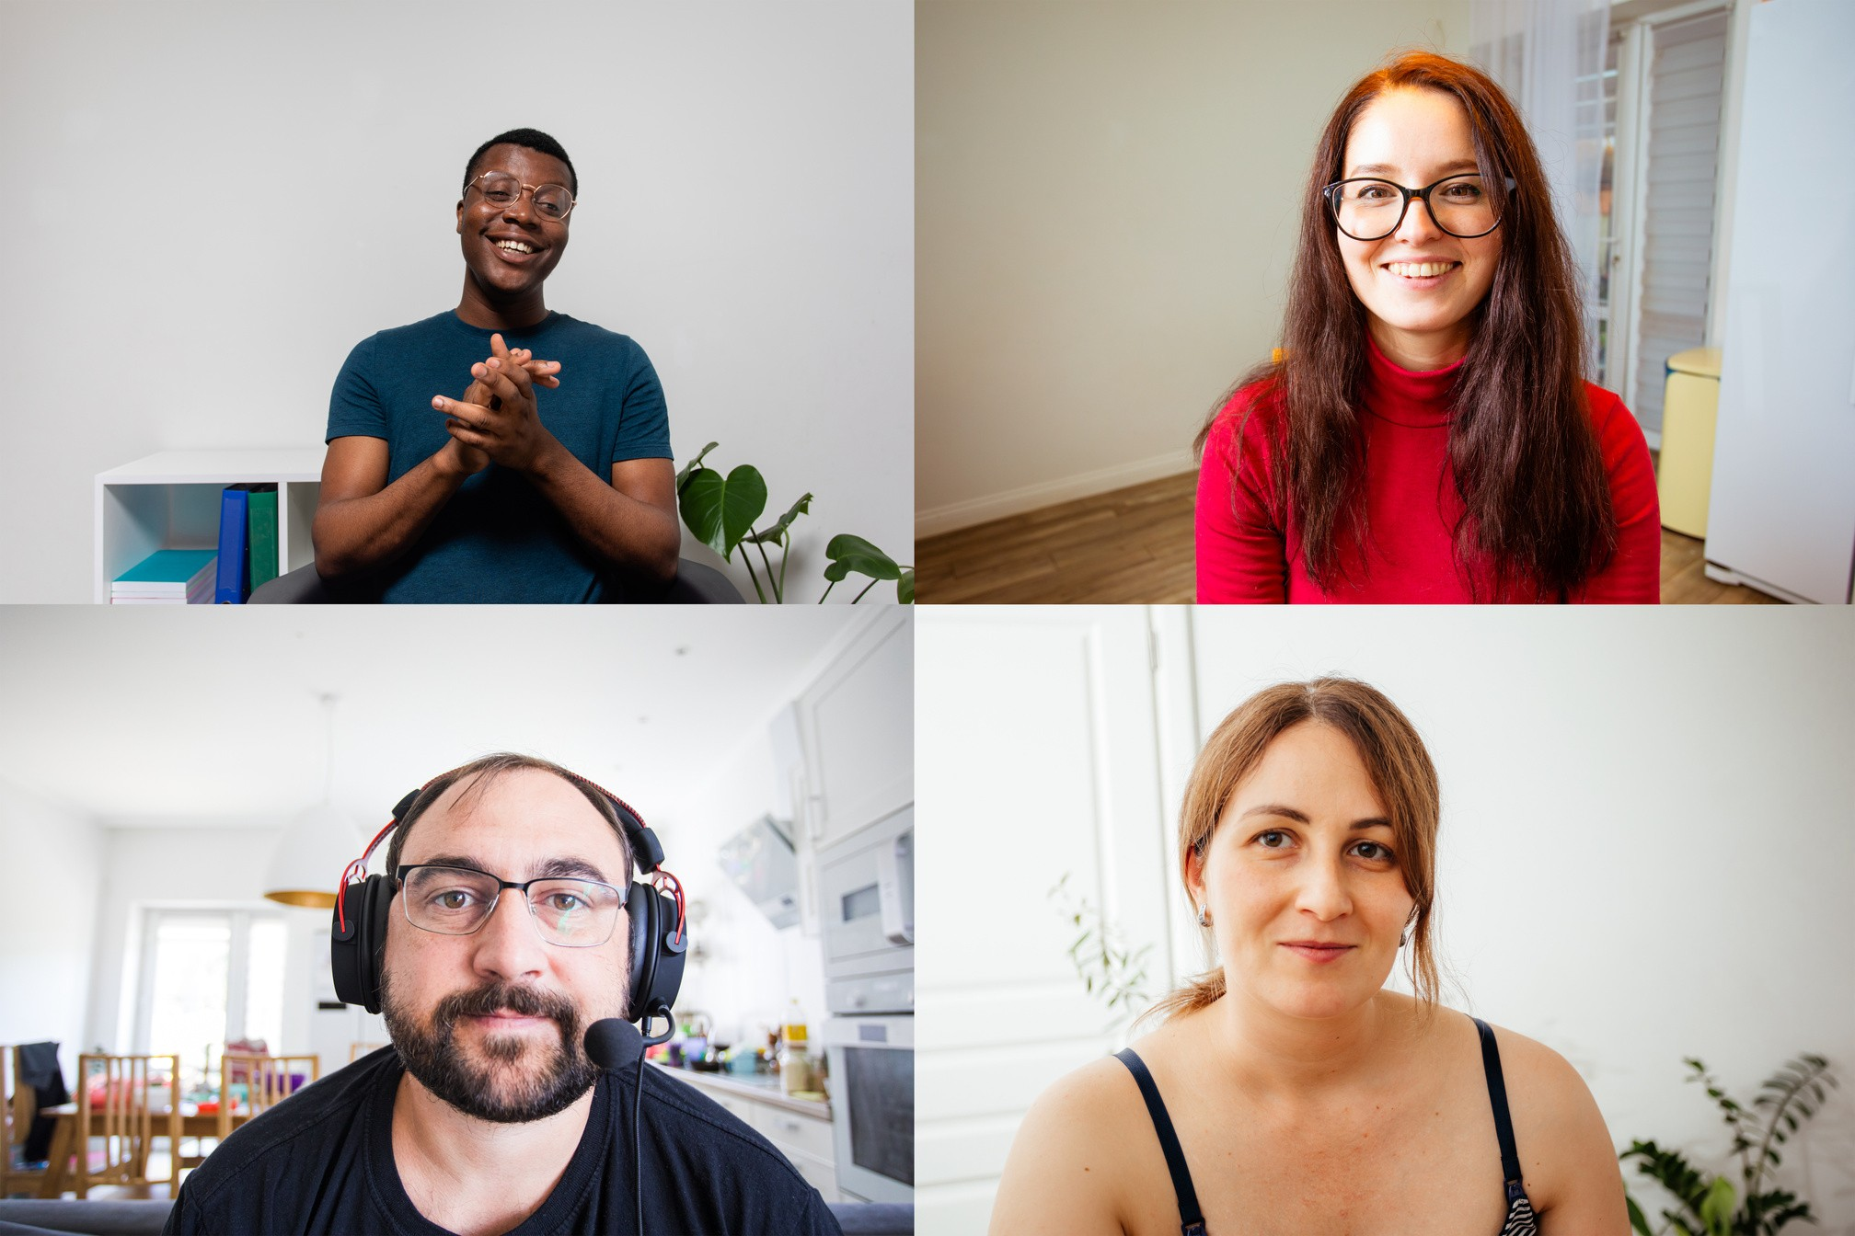


WEDNESDAY BROWN BAG
Wednesdays @ Noon
Pressure free space that support and reinforces awareness & allyship through 1 hr informal group sessions
Thank you for sharing! This was fun, useful and stress free.
01
Building Connections
Wow! I can use this
in my
Informal Learning Through Discussions & Activities
02
I'm so glad I finally get to place a face to the email address.
03
Reflect & Resources
I never thought of it that way!

Slide 14

Register Now!
Inclusive Language Challenge Series
Let's Learn Together

Slide 15
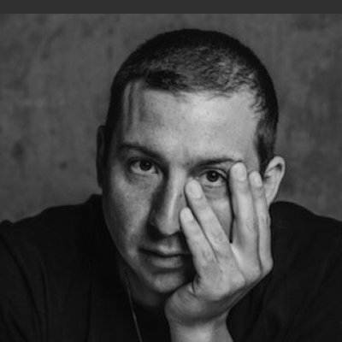
There There a novel by Tommy Orange
2023 LPC Literary Arts Festival Keynote Speaker*
Spring 2023
campus read
JOIN us for the
of
Book discussion at FLEX Day, March 16
(pending approval by Professional Development Committee)
*In conjunction with the President’s Speaker Series and with support from the LPC Foundation

Slide 16
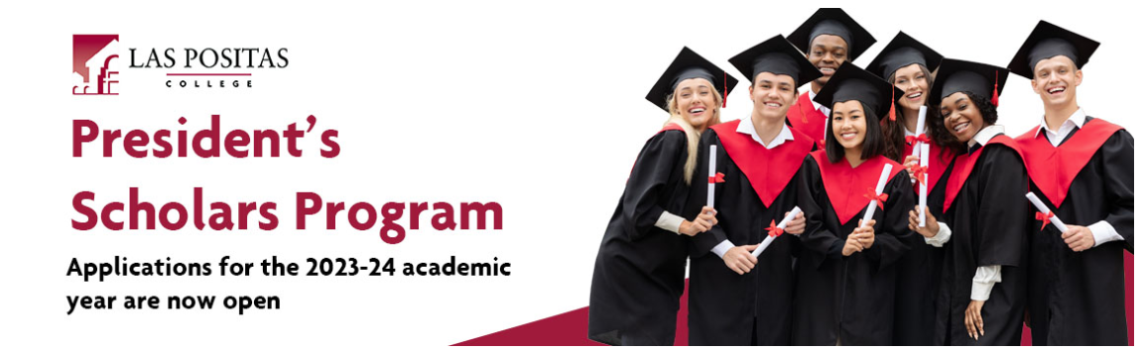
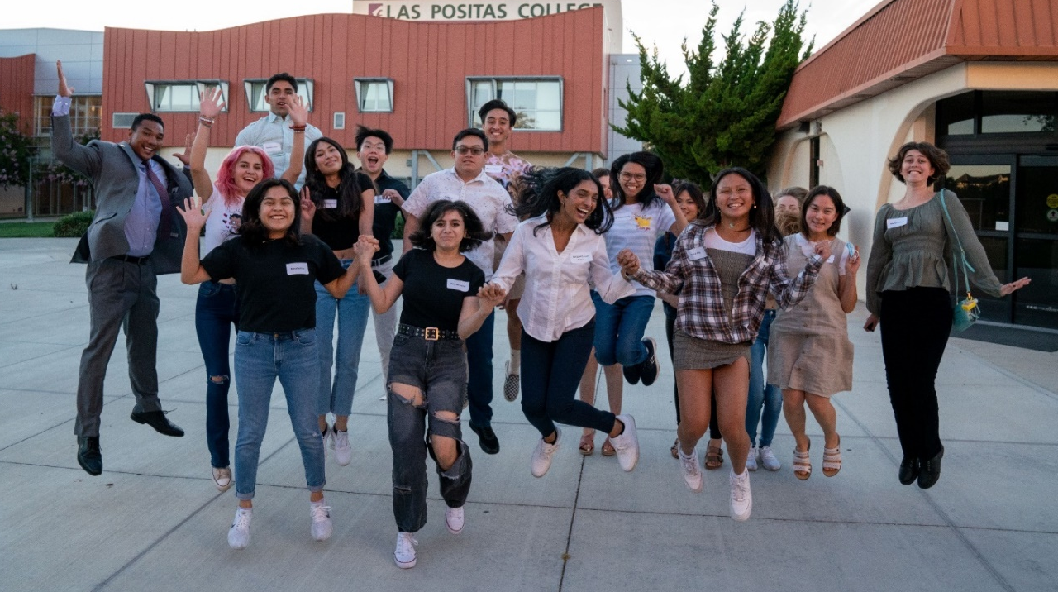
President’s Scholars applications must be submitted no later than Friday, March 24, 2023 by 11:59 p.m.

Slide 17


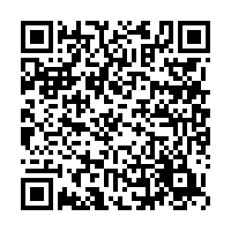



OPEN HOUSE
SATURDAY, MARCH 25, 2023
Join us and promote your program! Connect with prospective students and highlight your pathway.
Attention
Faculty!
EVENT HOURS
10 a.m. - 2 p.m.
ACADEMIC & RESOURCE FAIR
10 a.m. - 1 p.m.
food
CAMPUS TOURS
11 a.m. & 1 p.m.
Music
PROGRAM SPOTLIGHT AND INFO SESSIONS
11 a.m. - 1 p.m.
To participate, contact:
Anne Kennedy, Outreach Specialist
Las Positas College | 3000 Campus Hill Drive | Livermore

Slide 18
New Faces on Campus

Slide 19
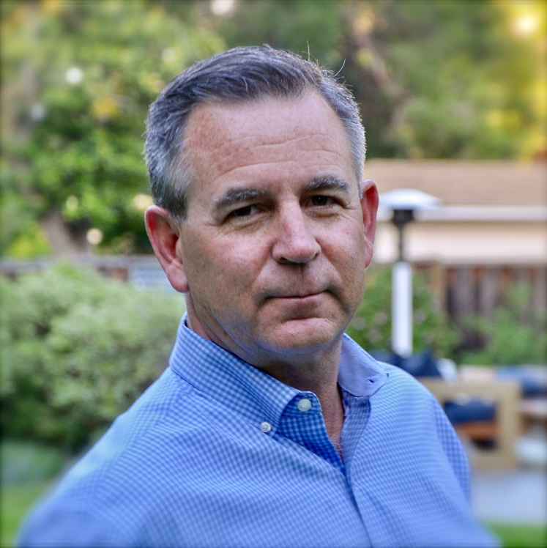
Charles “Chip” Woerner
Director of Marketing and Communication

Slide 20
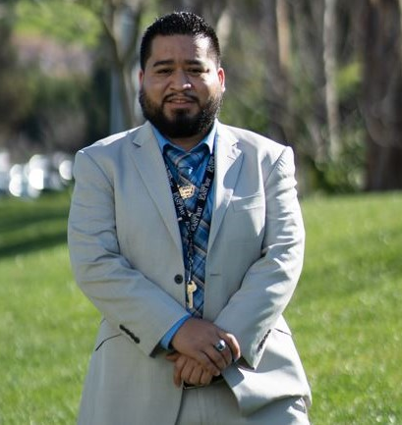
Miguel Pimentel Davila
Dream Center Coordinator

Slide 21
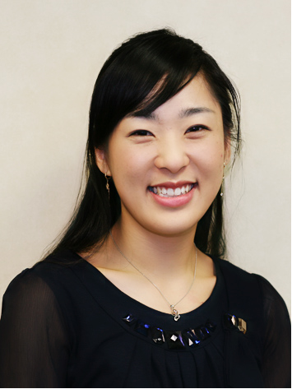
So-Jin Moon
Degree Audit
Educational Planning System Coordinator

Slide 22
Alvin Malaca
Instructional Systems Technician

Slide 23
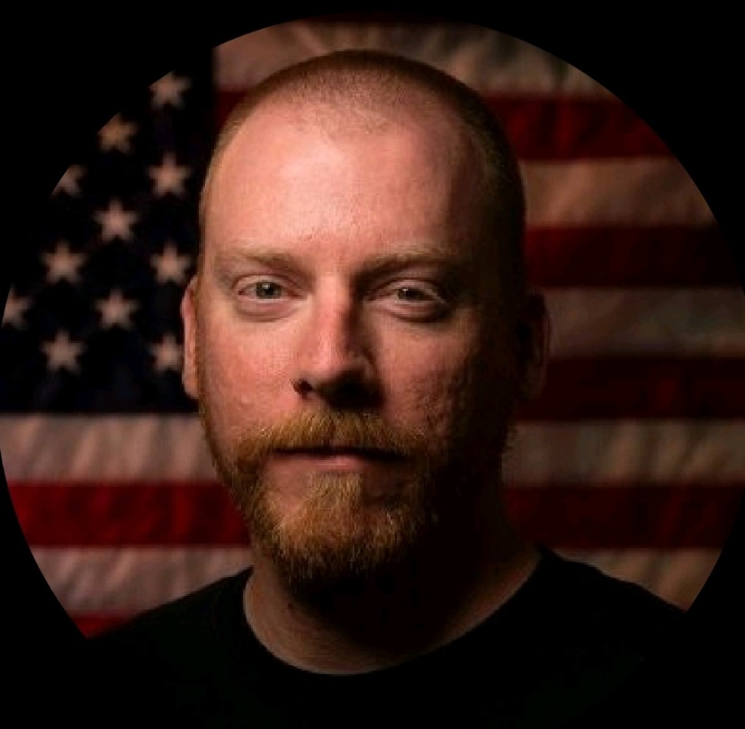
Damian Bramlett
Laboratory Technician
Viticulture and Winery Technology

Slide 24
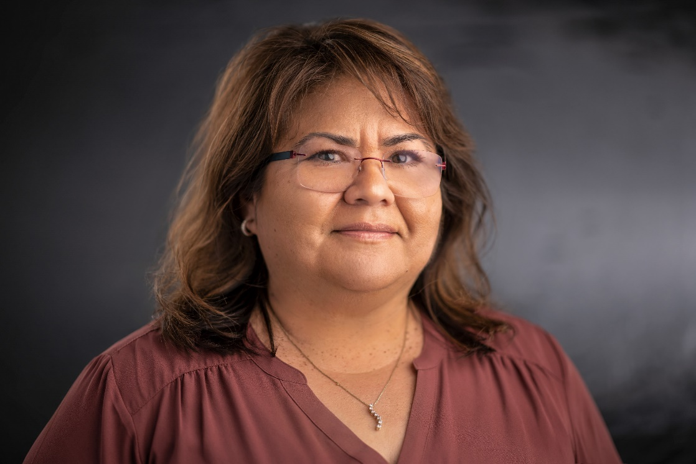
Barbara Chavez
Promotion
Financial Aid Advisor 3

Slide 25
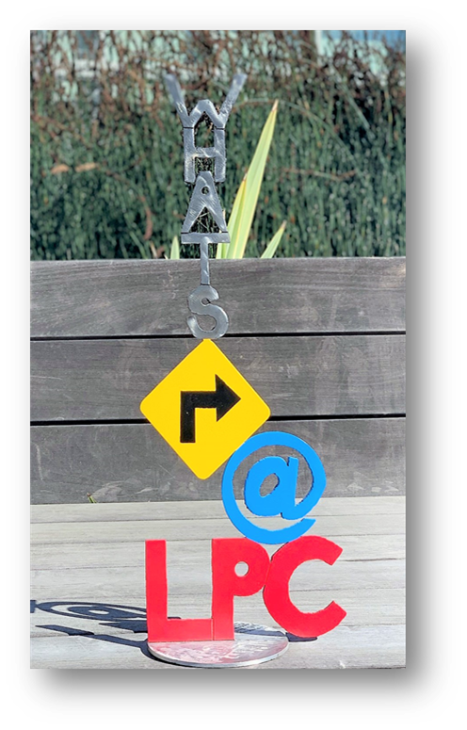
What’s Right at LPC?

Slide 26
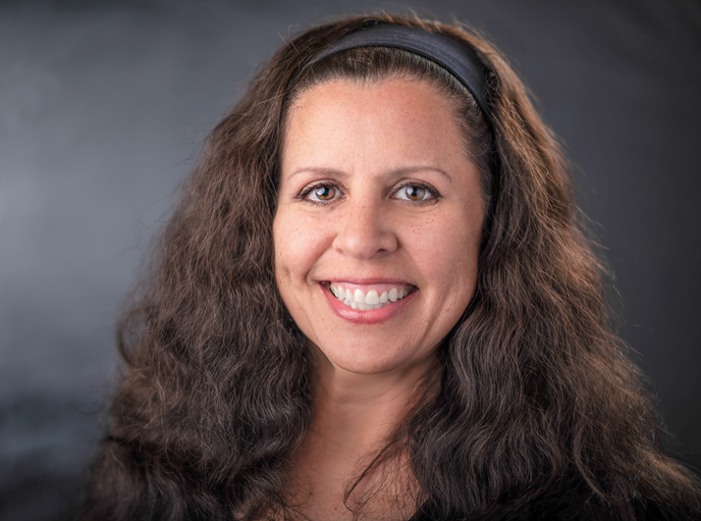
February 2023
Jennifer Farber

Slide 27

LPCSG
Las Positas College Student Government
LPC Town Hall - February

Slide 28
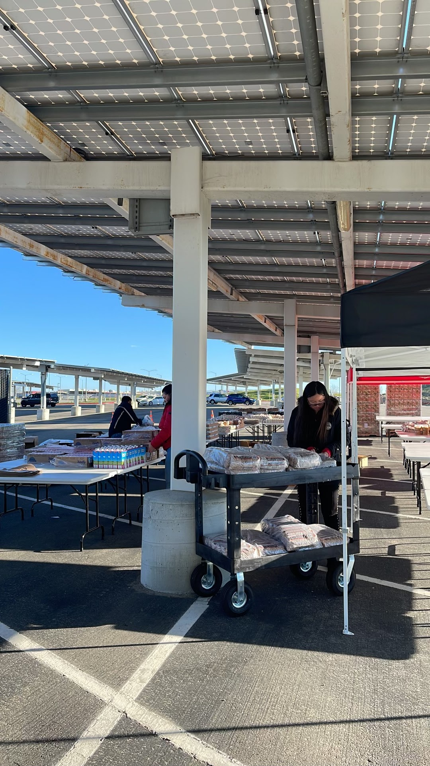
The Monthly Market
The Market is a monthly food distribution open to the students and community
On the fourth Tuesday of every month
Converted to “pick what you want” instead of pre-bagged groceries

Slide 29
Mini Market Services
Mini Market Open Hours:
Monday, Wednesday, Thursday: 9:00 am - 5:00 pm
Tuesday: 9:00 am - 7:00 pm
Friday: 9:00 am - 1:00 pm
Items Offered:
Fresh Fruits & Veggies
Fresh Meat & Eggs
Canned Goods
Toiletries - feminine hygiene, soap, cleaning
Some household items
Snacks + Cup of Noodles & Frozen meals to heat to take or stay and enjoy
Enjoy our Welcome Center Lounge - Come and stay awhile!

Slide 30
All Executive Board positions are filled!

Slide 31
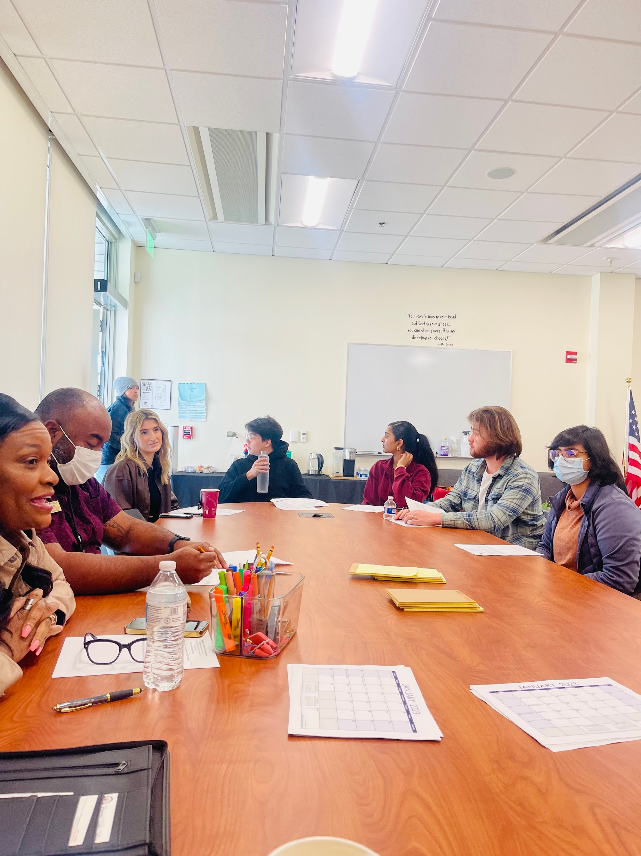
Our Officers:
President: Lara Wiedemeier
Vice President: Morgan Minkler
Director of Legislation: Fernando Torres
Director of Communication: Lena Munad
Director of Events: Mona Gholikhamseh
Director of Programs and Services: Sangavi Suresh Kumar
Director of Finance: Brody Price
Director of Inter-Club Council: Armina Rahman
Student Trustee: Alexa Sumitra
Senator: Omar Au

Slide 32
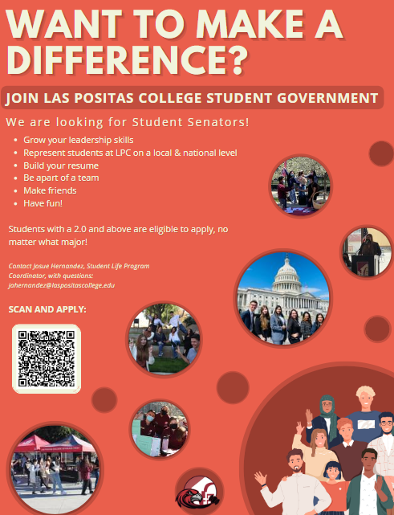
Student Government Open Positions
We are still looking for senators! Encourage your students to apply!
- Benefits: Up to a $150 stipend, grow skills, travel to conferences, represent our students, resume builder etc..

Slide 33
Recruiting for LPCSG 2023-2024 Elections!!

Slide 34
NEXT UP:
Club Fair - February 23, 2023

Slide 35
THANK YOU!!

Slide 36
Administrative Services Updates
Vice President Anette Raichbart

Slide 37
22-23 BUDGET (January 31, 2023)

Slide 38
CARES

Slide 39
International Students
Cindy Balero & Heike Gecox

Slide 40
International Student Program Introduction
Team
Cindy Balero
Heike Gecox

Slide 41
About the Program
The International Student Program serves students who are studying at LPC on a non-immigrant F-1 or M-1 visa or who change their status to F-1
We are a “one-stop shop” from application to program completion
Act as primary liaison with government agencies including Department of Homeland Security (DHS), U.S. Citizenship & Immigration Services (USCIS), Immigration & Customs Enforcement (ICE), and Consular Affairs Offices
Serve as main point of contact for Student and Exchange Visitor Program (SEVP)
Respond to SEVP alerts/action items
File for biennial Recertification to maintain the College’s ability to enroll non-immigrant international students in accordance with DHS regulations.

Slide 42
Past Year Highlights/Successes
• Increased international student enrollment
  Fall 2021 – Fall 2022 – +5.08%
  Spring 2022 – Spring 2023 – +24.14%
Simplified the application procedure to remove barriers for prospective students
Established relationship with Zion Christian Church in Zimbabwe
  Zimbabwe currently is our 2nd largest population
Updated the program website
Assisted prospective students with change of status applications (following a change in immigration regulations)
Targeted emerging markets to increase enrollment
  Zimbabwe
  India
  Colombia
Priority Registration for International Students (Spring 2022)

Slide 43
International Student Program Philosophy
Many Cultures. One Destination.
• Provide students with a successful educational & life experience
• Create opportunities for personal growth
• Offer strong student support services at every level to facilitate progress toward successful completion of individual student educational goals
• Promote global citizens by advancing the mutual exchange of cultural perspectives

Slide 44
Spring 2023 ISP Statistics
72 Students from 28 countries
Top Countries Represented at LPC
Notes:
44

Slide 45
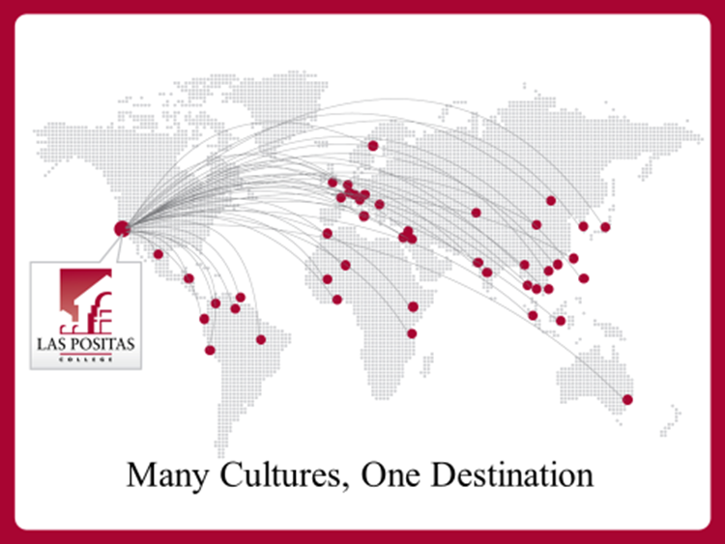

Slide 46
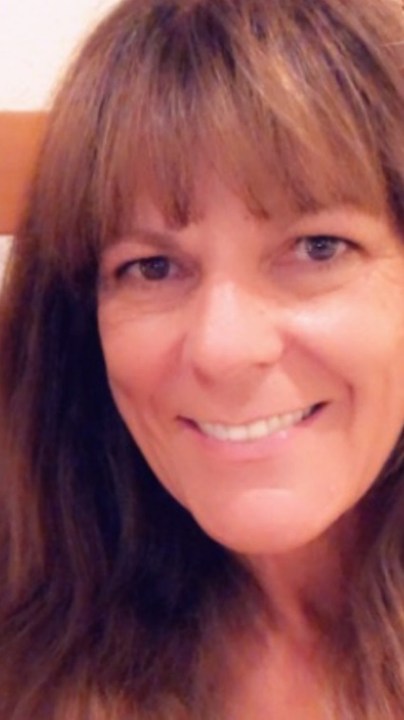
Meet the Team
Cindy Balero
Responsibilities -
PDSO – maintain the College’s ability to enroll non-immigrant international students in accordance with DHS regulations
Drive international student enrollment
Provide international student assistance
Process Admissions & benefit packets
Immigration advising & compliance
New student orientation & workshops
Education
M.A., CSU Dominguez Hills
B.S., CSU Hayward; A.A., LPC
Fun Fact
Loves to run & hike (especially in the rain)
International Student Program Coordinator

Slide 47
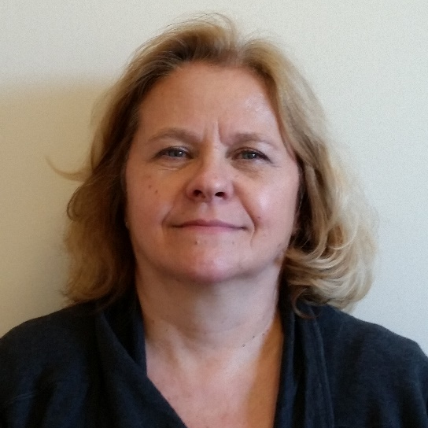
Meet the Team
Heike Gecox
Responsibilities -
Provide academic/personal counseling
Establish Student Education Plan with students
Provide updated SEP for Program Extensions and I-20 renewals
Counselor Recommendation for Post Completion Optional Practical Training
Assist with transfer applications and referral of continued services at transfer institution
Education
M.S. Counseling CSU Hayward,
B.A. Psychology CSU Hayward , A.A. Psychology LPC
International Student Counselor

Slide 48
UndocuAlly &
Dreamers Center
Rafael Valle & Alain Olavarrieta

Slide 49

UndocuAlly Task Force Dreamers Center

Slide 50
UndocuAlly Task Force
The mission of the UndocuAlly Task Force is to provide a safe and welcoming space that fosters a community for Undocumented, AB 540, DACA Recipients, allies, and students from mixed status families. We will provide guidance and support to these students to achieve their academic, career and personal goals. The Task Force provides a holistic approach that strives to advance the educational access, academic success, retention and graduation of the undocumented student population at LPC. In addition, the task force supports the dreamer’s center to educate the campus community, elevate best practices, and ultimately assess student and center outcomes.

Slide 51
Dreamers Center
Services Provided
• Legal services information
• AB 540 affidavit form questions
• AB 540 affidavit form support
• AB 540, SB 68, AB 2000, SB 1141 residency questions
• Admission to LPC Process
• CA Dream Act questions
• CA Dream Act application support
• Scholarship information
• Internship information
• DACA information
• UndocuAlly Training
• Career services referral
• Employment information
• Transfer information
• Transfer application
• Referrals to on-campus clubs/organizations
• Study/tutoring spaces
• Academic & Career advising referral

Slide 52
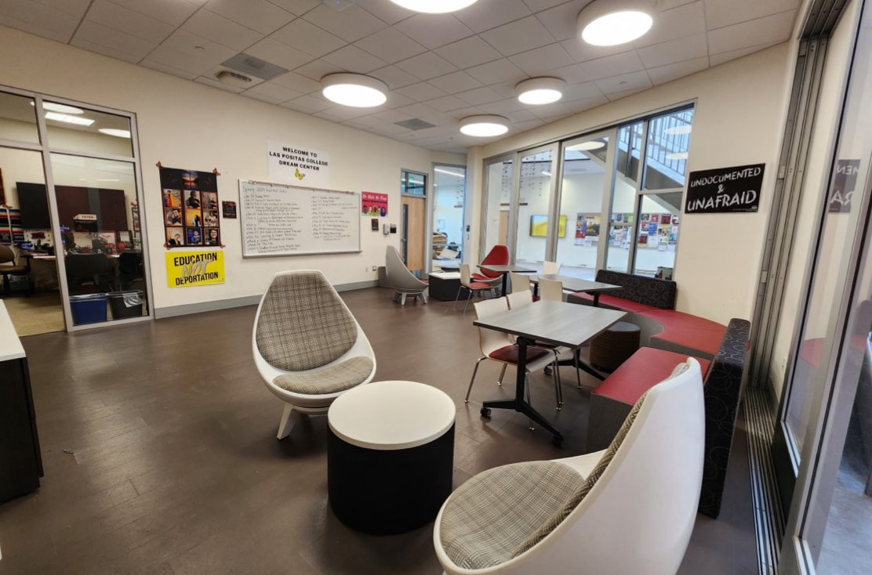
Dreamers Center
Location:
Building 1000, Room 1018
How to Contact Us
IN-PERSON:
BUILDING 1000, ROOM 1018
EMAIL: MPMETEL@LASPOSITASCOLLEGE.EDU
PHONE: (925) 424-1052
Hours of Operation
Monday 9:00 am – 5:00 pm
Tuesday 9:00 am – 6:00 pm
Wednesday 9:00 am – 4:00 pm
Thursday 9:00 am – 5:00 pm
Friday 9:00 am – 1:00 pm

Slide 53
UndocuAlly Task Force
Introduction

Slide 54
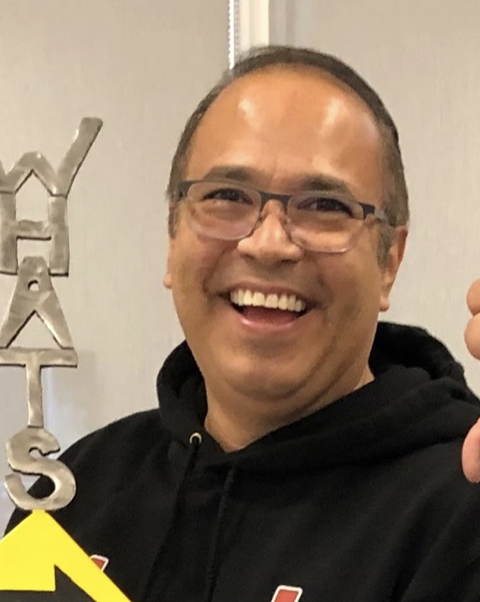
Rafael Valle
Responsibilities:
Puente Counselor/Instructor and Co-chair of UndocuAlly Taskforce
Educational background:
BS Business Administration & Computer Systems - SFSU
MS in Psychology with an emphasis in Counseling - Capella University -
Fun fact:
Worked in the financial field for a little bit over 10+ years.

Slide 55
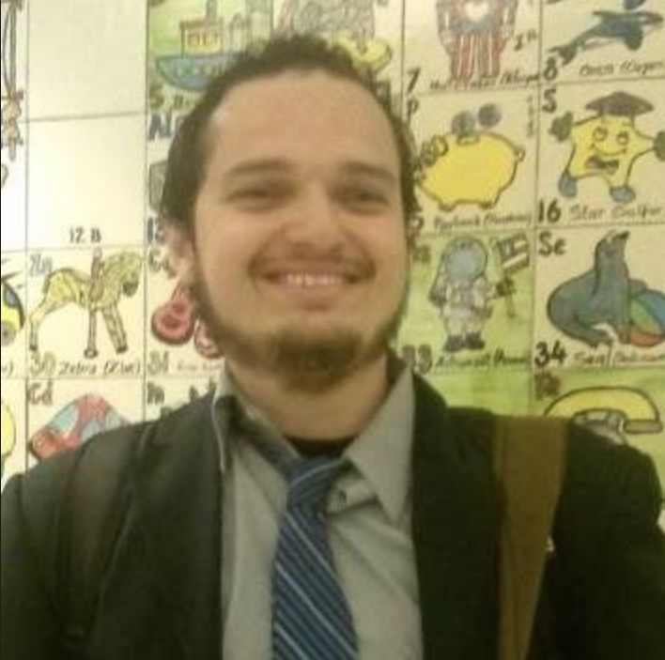
Alain Olavarrieta
Responsibilities:
Mathematics Faculty and Co-chair of UndocuAlly Taskforce
Educational background:
BA Business Economics from UCLA and MS Pure Mathematics from CSUN
Fun fact:
Likes to assemble his own computers.

Slide 56
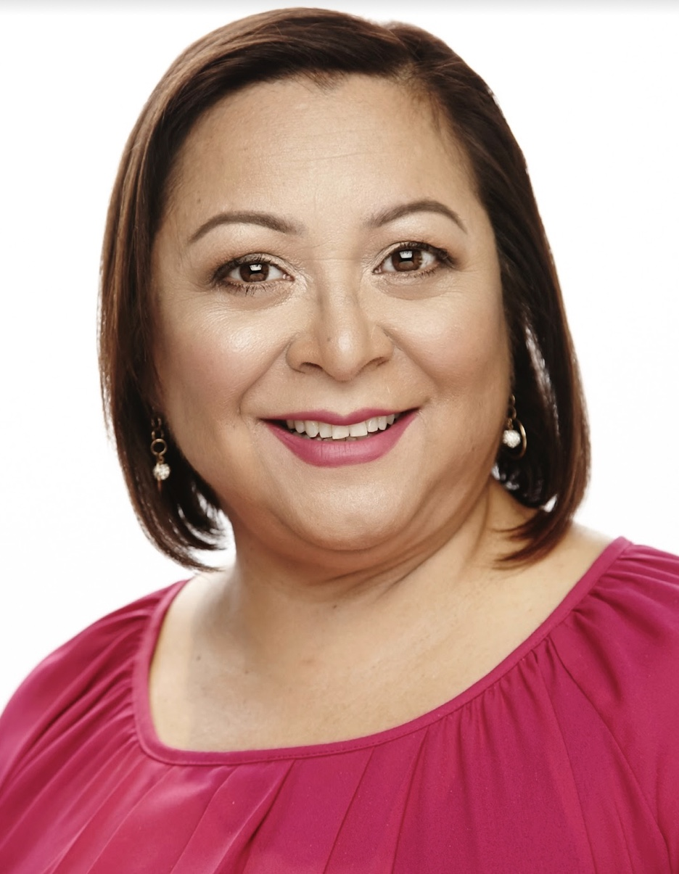
Ana del Aguila
Responsibilities:
ECE Professional Development Coordinator and Part-time faculty
Educational background:
Mills College- M.A. Leadership in Early Childhood Education
La Molina National Agrarian University: B.S. Food Science
Fun fact:
Loves spending time with their pets, 2 dogs and one cat at the moment, and enjoys Zumba classes.

Slide 57
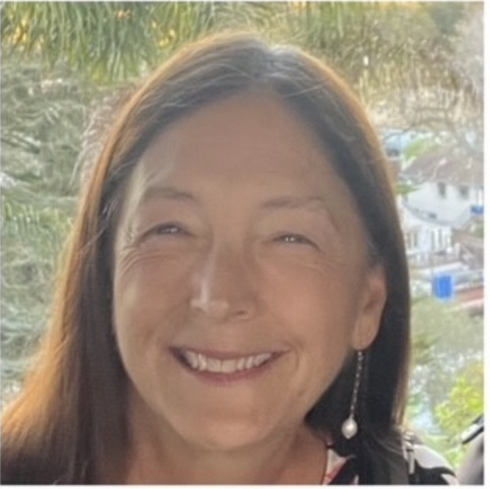
Teri Ann Bengiveno
Responsibilities:
History/Women’s Studies Faculty
Educational background:
PhD in American Studies, University of Hawai’i at Manoa
Fun fact:
Has been in the same book club for 35 years.

Slide 58
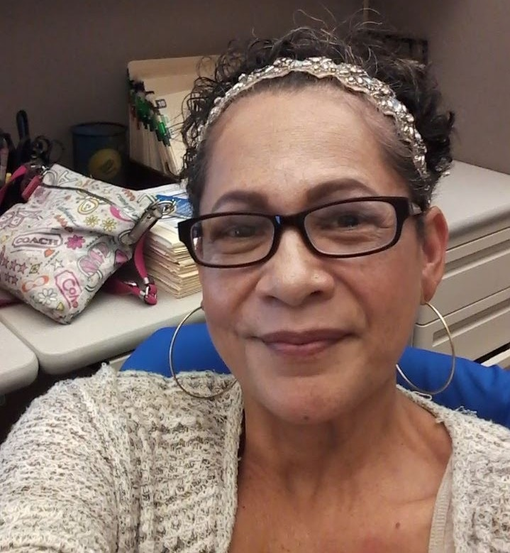
Maria Glidden
Responsibilities:
Counselor Assistant for CalWORKs/CARE
Educational background:
Undergrad at CSUEB in Sociology
MA at SJSU in Sociology
Fun fact:
Enjoys reading horror stories, listening to True Crime Podcasts, and Diamond Painting.

Slide 59
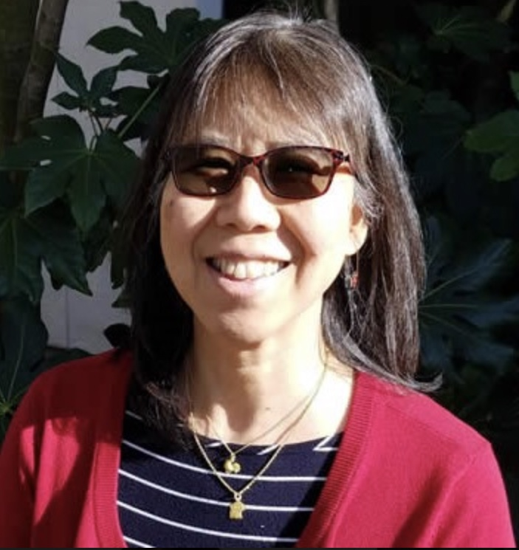
Frances Hui
Responsibilities:
Provides research instruction and reference assistance. In addition, oversees several of the library’s electronic databases and collection. Also coordinates library outreach efforts such as the library card drive and high school/public library workshops.
Educational background:
MLIS – UCLA
Fun fact:
Enjoys the views of the LPC hills.

Slide 60
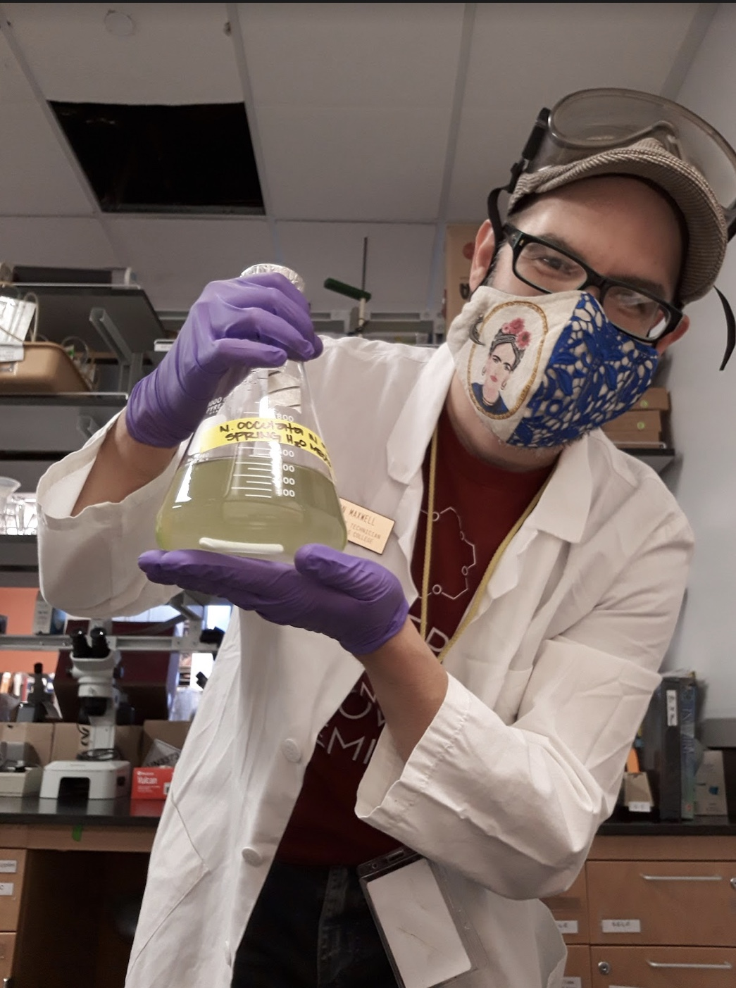
Jason M. Maxwell
Responsibilities:
Prepare biology and chemistry laboratory experiments and care for living organisms in the lab.
Educational background:
CSU East Bay: Chemistry with Forensic Science Emphasis, B.S.
Fun fact:
An LPC/Chabot alumnus. Enjoys comic books, reading, traveling and hiking. Their currently enrolled as a cell and molecular biology graduate student at CSU East Bay.

Slide 61
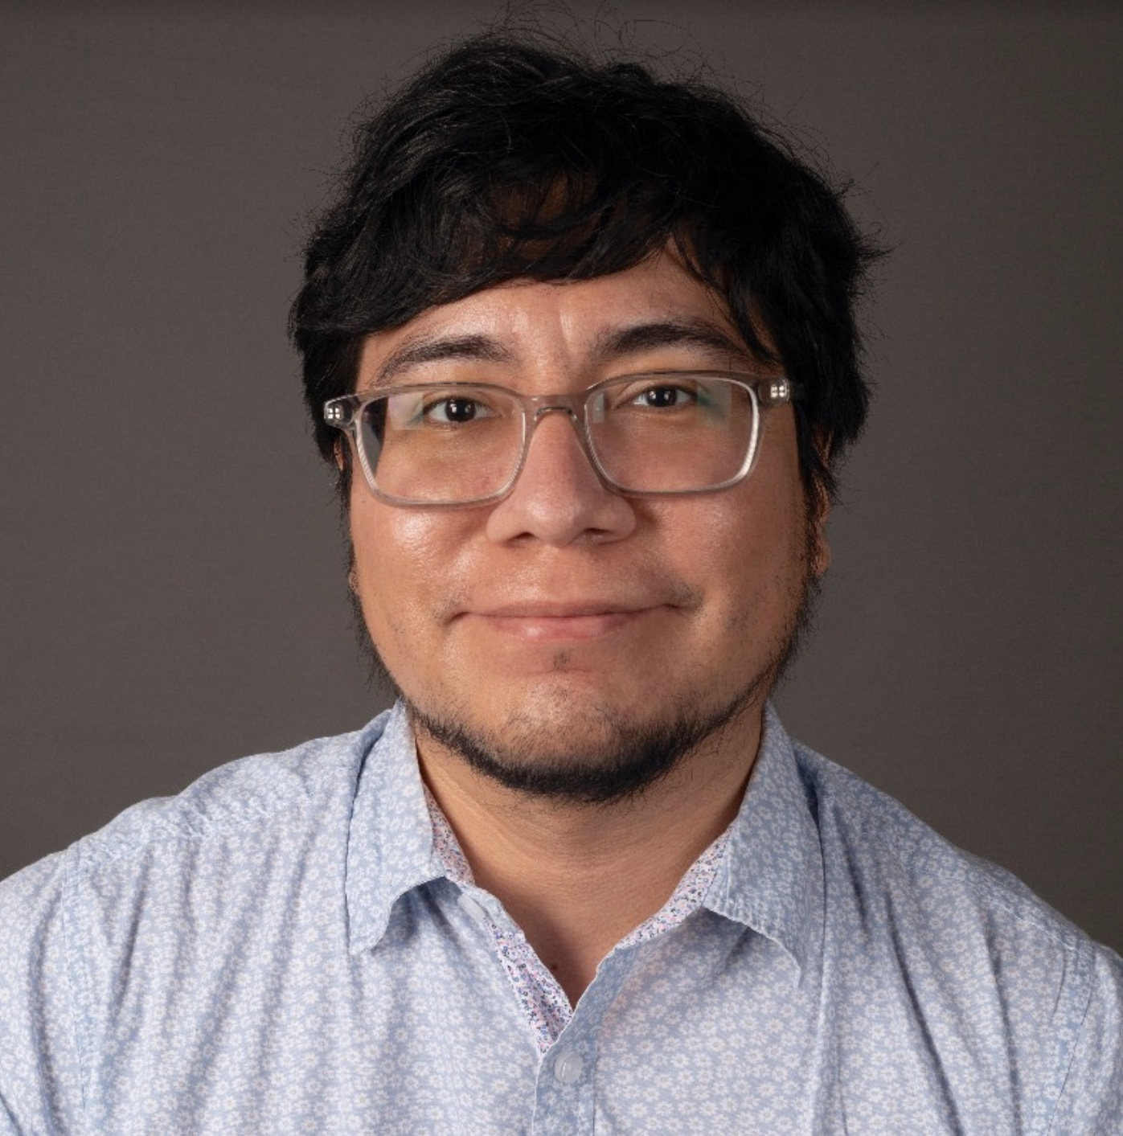
David Montelongo
Responsibilities:
David is a new full-time faculty member in the chemistry department.
Educational background:
UC Irvine: Chemistry PhD
Saint Mary's College of California: Chemistry B.S.
Fun fact:
David spent a summer volunteering for the conservation of endangered sea turtles in Costa Rica.

Slide 62
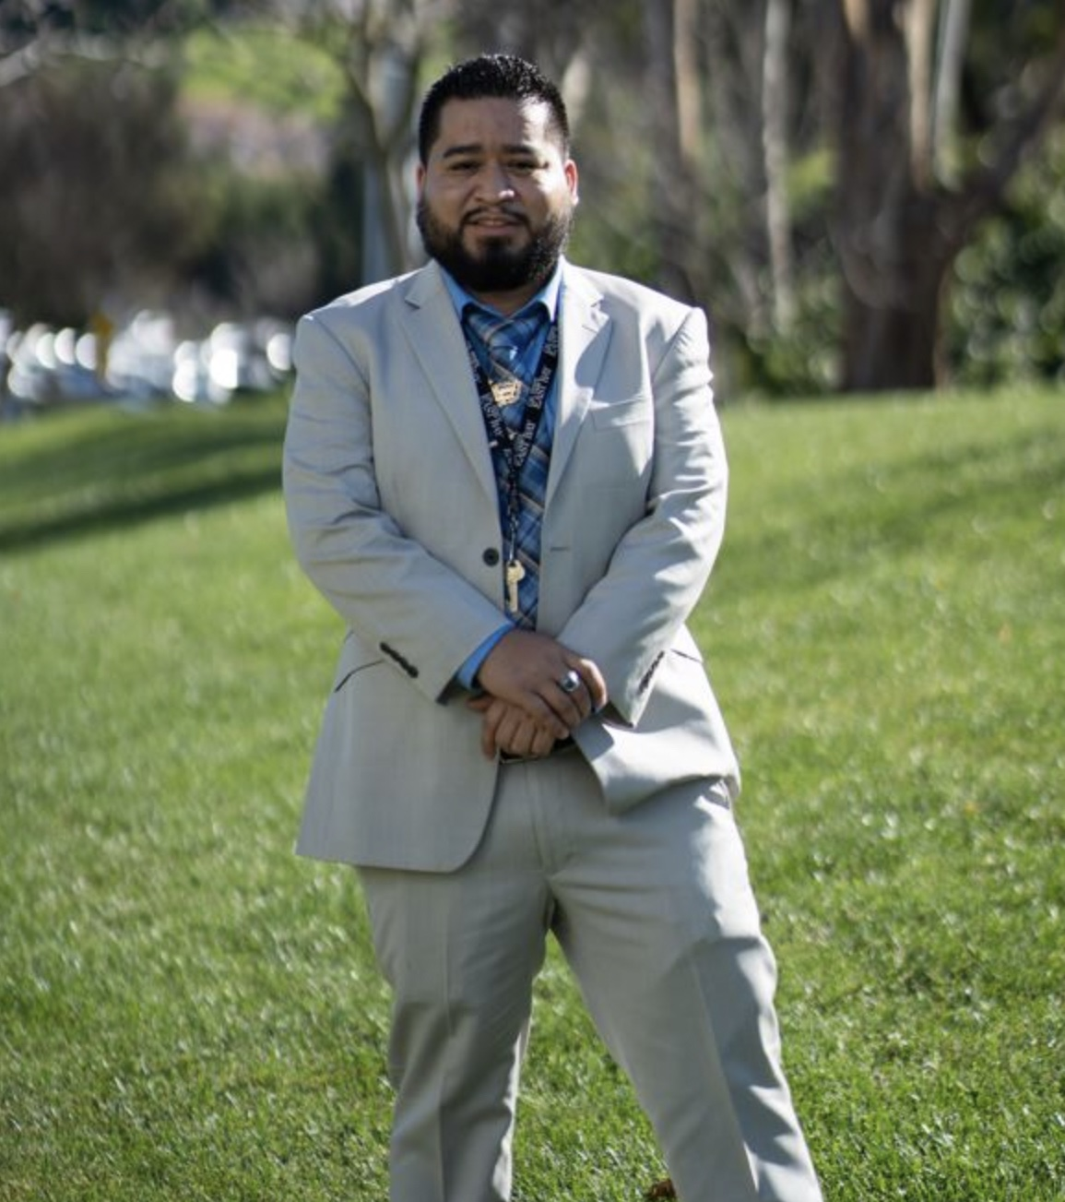
Miguel Pimentel
Responsibilities:
Miguel is a new addition to LPC and will provide guidance and support to undocumented, AB 540, DACA recipients, and students from mixed-status families.
Educational background:
SJSU (2019) | M.A, Education/Counseling and Student Personnel, APCC Credential, PPS Credential, CWA Credential
CSUEB (2012) | Double BA’s, Ethnic Studies with a Concentration in Latino/a Studies and Genders and Sexualities in Communities of Color, Secondary Major: Spanish
Fun fact:
Skipped a grade in middle school, loves helping the community, & loves spending time with family and friends.

Slide 63
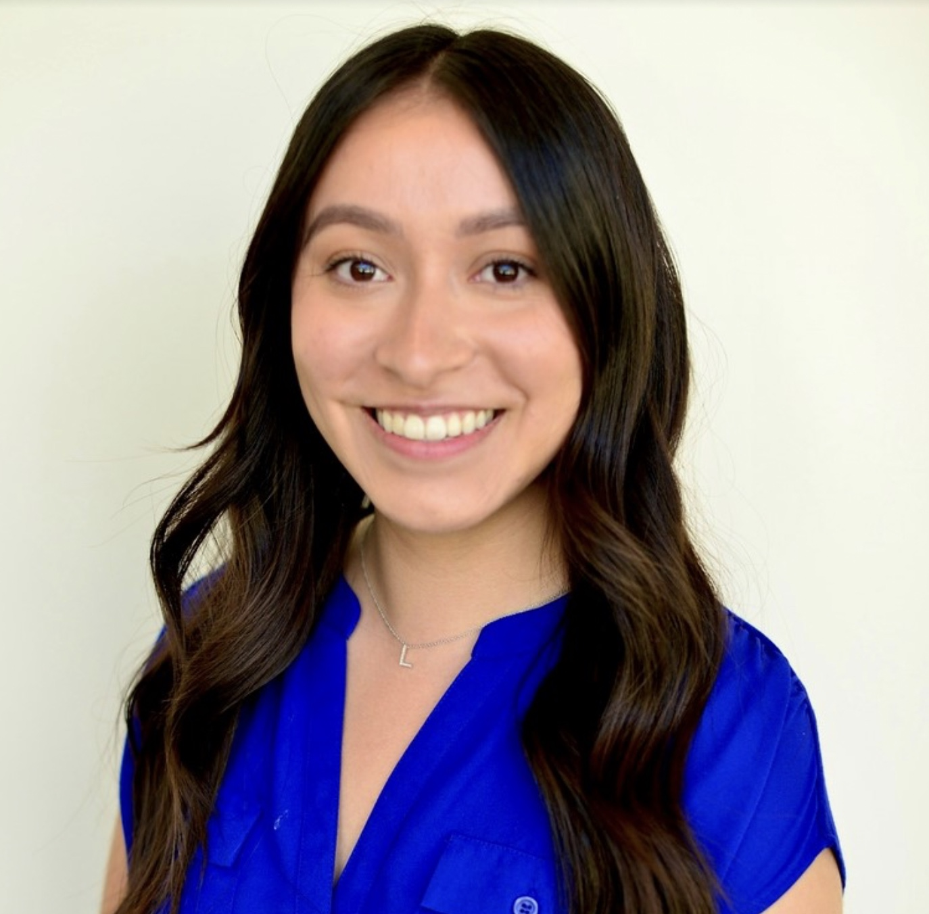
Lissette Rocha
Responsibilities:
Lisette manages Financial Aid Application Workshops and Presentations at LPC, High Schools, and other community partners. Supports Student Athletes, Spanish Speakers, Veterans and AB 540 students. Conducts online and in-person FAFSA/CADAA drop-in hours.
Educational background:
B.S. Managerial Economics UC Davis
Fun fact:
Lisette enjoys doing yoga, reading and traveling.

Slide 64
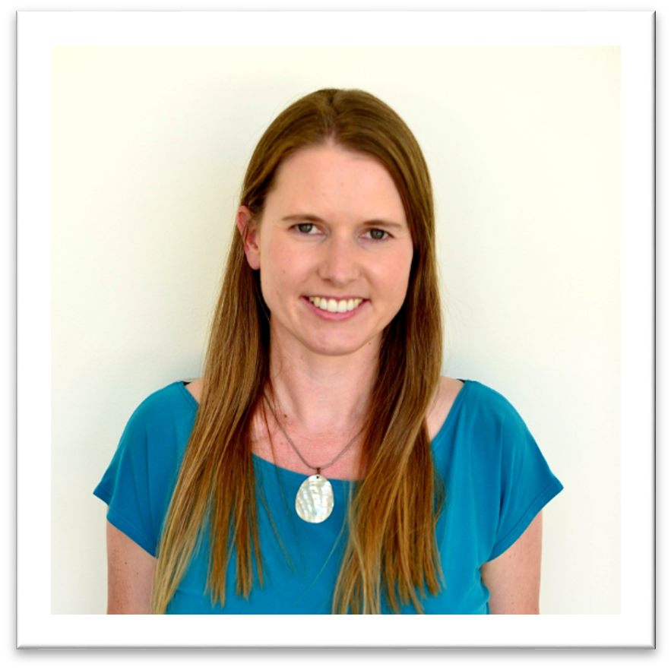
Kristine Vanderhoof
Responsibilities:
Kristi coordinates job and internship fairs, manages Handshake (job/internship board), teaches career and employment workshops, and holds 1-on-1 appointments with students on job search and navigating career exploration resources.
Educational background:
· Global Career Development Facilitator
· MA in Linguistics/Teaching English to Speakers of Other Languages from CSU Fresno.
· BA in Literature (Creative Writing-Poetry) from UC Santa Cruz.
Fun fact:
Kristi taught English in Oaxaca, Mexico, for two years and became fluent in Spanish while she was there.

Slide 65
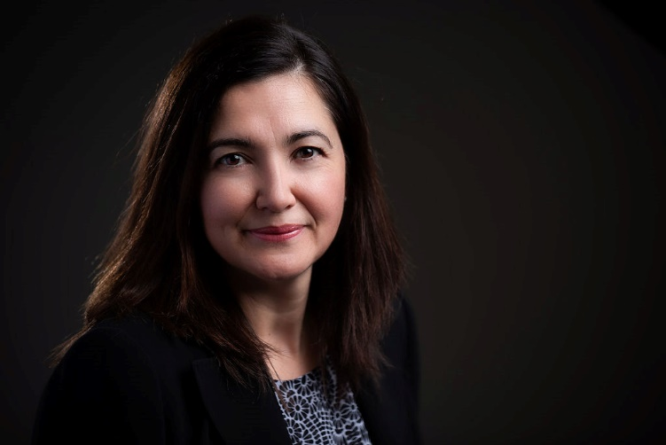
Daysi Valle
Responsibilities:
Financial Aid System Coordinator
Educational background:
Master of Arts in Education (MA Ed)
Fun fact:
Traveling is my favorite pastime

Slide 66
Other Participants
Mike Alvarez:
Assessment Specialist
Josue Hernandez:
Program Coordinator - Student Life & Leadership
Soraya Renteria:
Art Professor
David Rodriquez:
Research Analyst

Slide 67
Black History Month
Black Education Association:
Dr. Jeanne Wilson, Dr. Emerald Templeton,
Danielle Odom, Salem Admassu, Kimberly Burks,
Terrance Thompson, Carolyn Scott

Slide 68


BLACK EDUCATION ASSOCIATION
February is
Black History Month!
This Photo by Unknown author is licensed under CC BY-SA-NC.
Notes:
Welcome (Dr. Wilson)

Slide 69
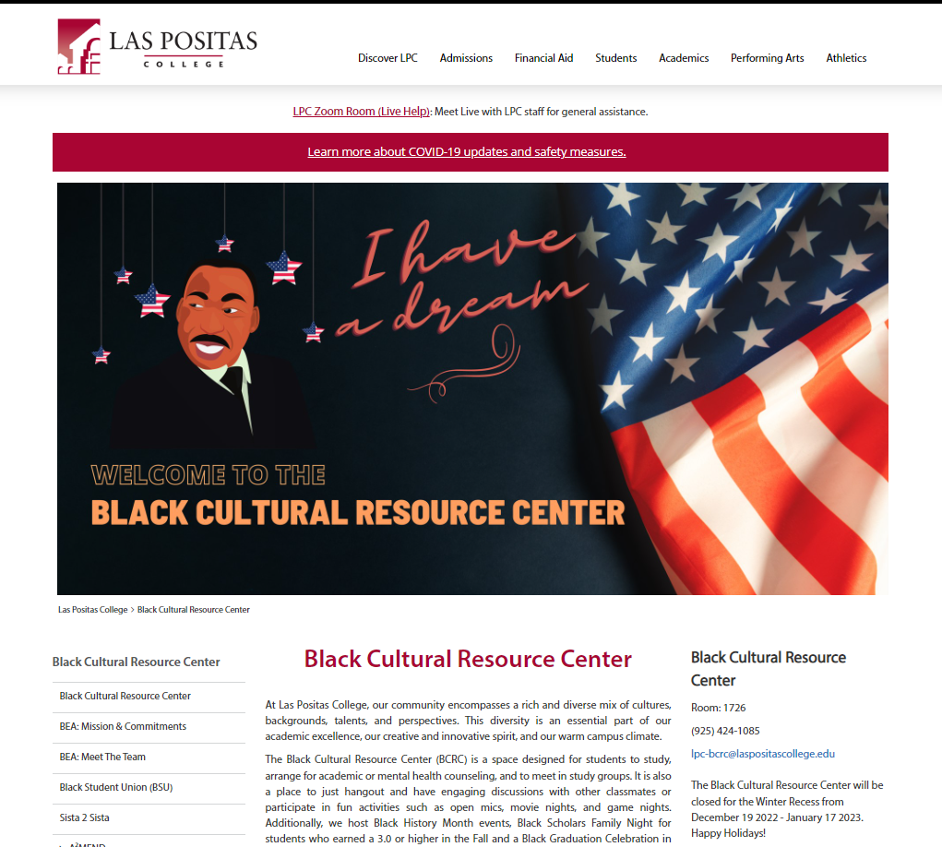
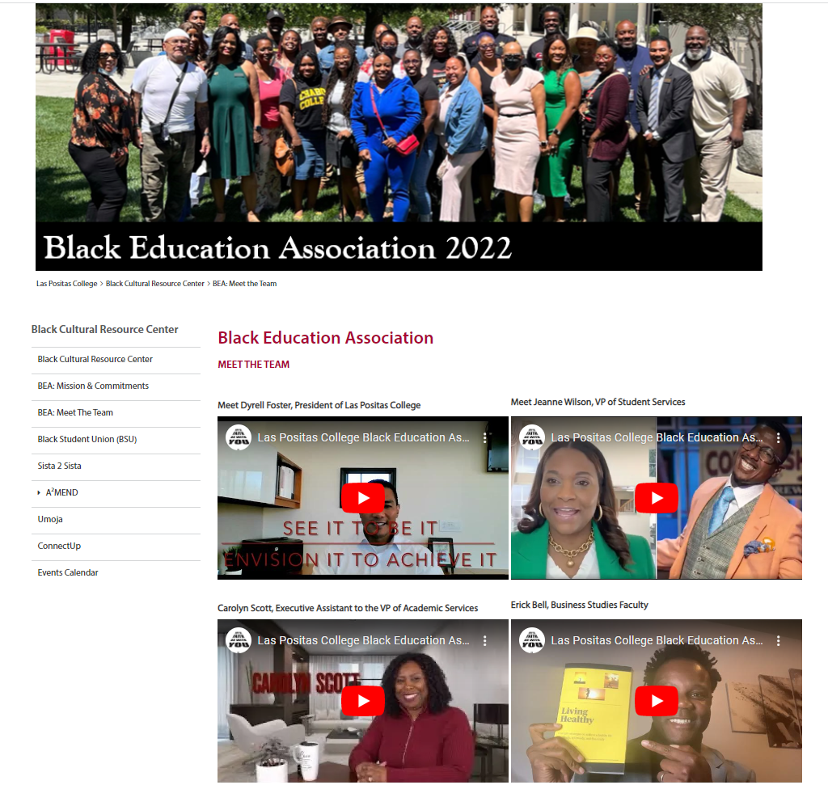
Notes:
Introduction to BCRC [insert]
The Black Cultural Resource Center is a culture-focused hub for students to build community, study, and find refuge. The center house several Black-centered programs at Las Positas College including BSU, Umoja, ConnectUp, A2MEND, Sista 2 Sista, and BEA. You'll have an opportunity to hear from folx about just a few of those programs in a moment.
In our last retreat, we took some time to identify our mission—for the BEA and BCRC—and drafted a schedule of events for our students and the broader community.

Slide 70


BCRC Mission Statement
The Black Cultural Resource Center (BCRC) offers culturally relevant and responsive support, resources, and community to Las Positas College students. Housing LPC's Black-centered programs such as Umoja, A2 MEND, Sista 2 Sista, ConnectUp, BSU, and BEA, the purpose of the center is to provide a sense of community, visibility, and a safe space where Black students are empowered to exist freely with love, self-definition, and self-determination.
The Black Cultural Resource Center is a safe space for Black students to connect to resources and support to achieve their individual goals. Our center's annual goals are informed by students and sponsored by the Black Education Association.
Notes:
Continue [insert]
To begin, I'd like to read our mission statements.

Slide 71
BEA Mission Statement
The Black Education Association (BEA) is an employee development group that provides culturally reflective, responsive, and relevant programs and support to Black identified employees and students at Las Positas College. With radical love and an appreciation for diasporic diversity as core values, we recognize and celebrate the full range of Black identity and sponsor events and programs to trailblaze a path to success for our students. The BEA leverages the participation of Black staff, faculty, and administrators to engage in work to improve college support services and policies for students of African descent and reports these activities annually to the President's office.
The Black Education Association at Las Positas College exists to support Black employees and students through love, promoting a sense of belonging while respecting our individuality. We strive to make our college a welcoming destination for Black employees and students by providing professional development, leading with empathy, demonstrating compassion, and through providing personal and professional development opportunities.
Notes:
Continue [insert]
Now, we'd like to share a bit about some of programs that support the learning and belonging of Black students.

Slide 72

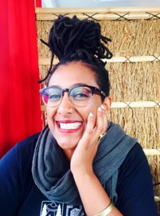
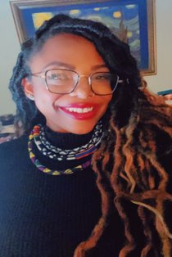
Umoja Learning Community
Umoja, (a Kiswahili word meaning unity) is a community and critical resource dedicated to enhancing the cultural and educational experiences of African American and other students.
Umoja makes your first semester course enrollment extremely easy!
Students take key general education courses towards transfer and AA/AS degrees with other Umoja students as a cohort.
Faculty are trained to support the Umoja student population.
Students are prioritized to receive many benefits and opportunities.
Salem Admassu
Umoja Coordinator
Umoja Tutor
English Faculty
Danielle Odom
Umoja Coordinator
Umoja Counselor
Notes:
Umoja [Danielle/Salem/Kisha]

Slide 73
Benefits to being in Umoja
Priority registration – register early for classes
One-on-one advising/counseling (transfer and degree planning)
Access to in-person village study and gathering place – Black Cultural Resource Center (BCRC)
Virtual village space
Access to technology (laptop loans)
Cultural events
Field trips
Counselor
University campus visits, including an HBCU tour in Spring '23
Transfer planning
Career exploration
Study jams
Cohort classes – Take UC/CSU transferable classes together
3 out of the 4 Umoja classes are hy-flex ---you can attend in-person or on Zoom
Dedicated instructors focused on your success
Dedicated tutor
Semester check-ins
Access to Brother 2 Brother men’s huddle
Access to Sista 2 Sista circle
Umoja is partnered with the University of California system

Slide 74

ConnectUp (CUP)
Is a proactive hands-on support program
Focuses on empowering our first-year Black students and assisting them through their educational journey
Uses a personal approach: students elect to sign up with a ConnectUp Coach who might be a Student, Classified Professional, Faculty member, or Administrator
Supports retention and success of first year Black students

Slide 75
ConnectUp Updates
Non-instructional ConnectUp Canvas Site sign-ups 476 students to date
Canvas home page has 7.1K Views – Quick Video Demo
Virtual Canvas Bulletin Board, started (September 2022) has 1,462 views and 360 viewers
55+ students have been coached
Responsive students (old model – all students assigned to a coach) plus
Students who voluntarily signed up to meet with a coach (new model)
Notes:
Umoja [Danielle/Salem/Kisha]

Slide 76
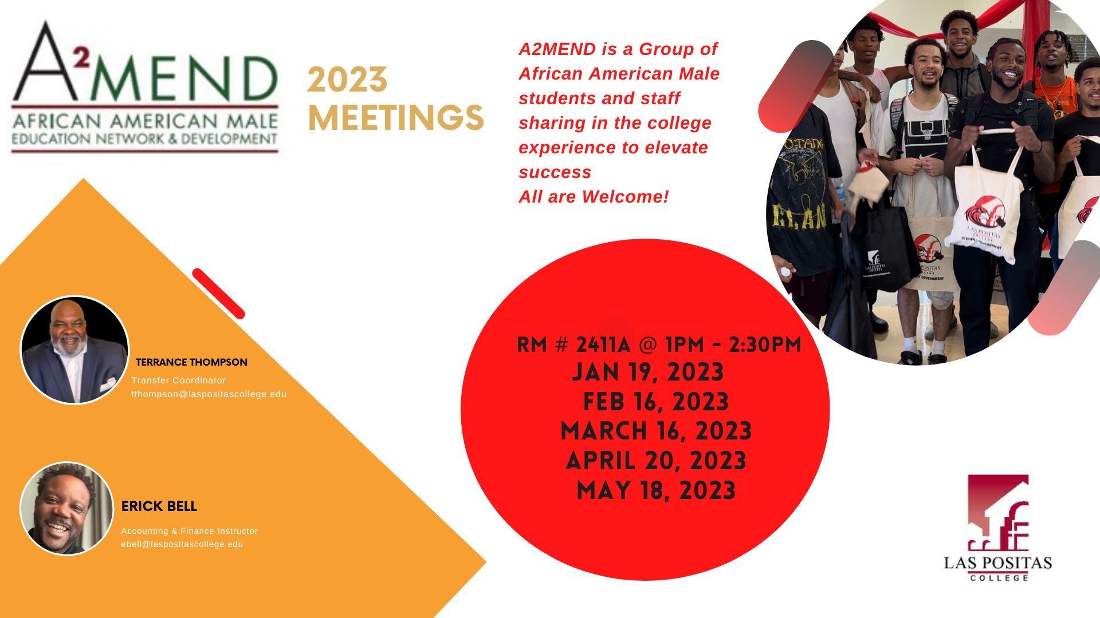
Notes:
A2MEND [Erick]

Slide 77
Black History Month Calendar
1 Feb.
ACAP College Day w/ Oakland High, 9am-1pm; Town Meeting Presentation, 2:30pm-4pm
6 Feb.
Taste of Soul, 12pm-2pm in the Quad; Movie and Porch Talk, 3pm-6pm @BCRC
8 Feb.
LPC vs. Chabot Women's Basketball, 5pm; LPC vs. Chabot Men's Basketball, 7pm
15 Feb.
Self-Care is Afro-Centric: Come and Chill with Us, 12:30-1:30pm in BCRC
23 Feb.
Afro-Centric Healing, 1pm-2pm, in BCRC; BHM Showcase, 6pm-8pm, Mertes Center for the Arts
Fridays 12:00 PM – 1:00 PM
BEA Talks, Zoom
Notes:
BEA-Sponsored BHM Calendar
A district-wide calendar will be shared.

Slide 78
Thank you!
Next Town Meeting
Wednesday, March 1, 2023

