Slide 1
Town Meeting
March 2019

Slide 3
29Th Annual Commencement Ceremony Saturday - May 25th, 10:00 AM
March 2019 Town Meeting
Faculty Cap and Gown Orders Due
Volunteer Opportunities
March 21, 2019
Events Pre-Prep : Week of Ceremony
Registration: Saturday Morning
Ceremony: Saturday Morning/ Early Afternoon
Questions?
Julie Thornburg
x1406

Slide 7
RSVP via - Eventbrite.com
Search: Honoring Women Veterans
March 07, 2019
RM 1628 A & B. - 10:00 AM
Lunch will be provided to those who RSVP and attend presentations

Slide 16
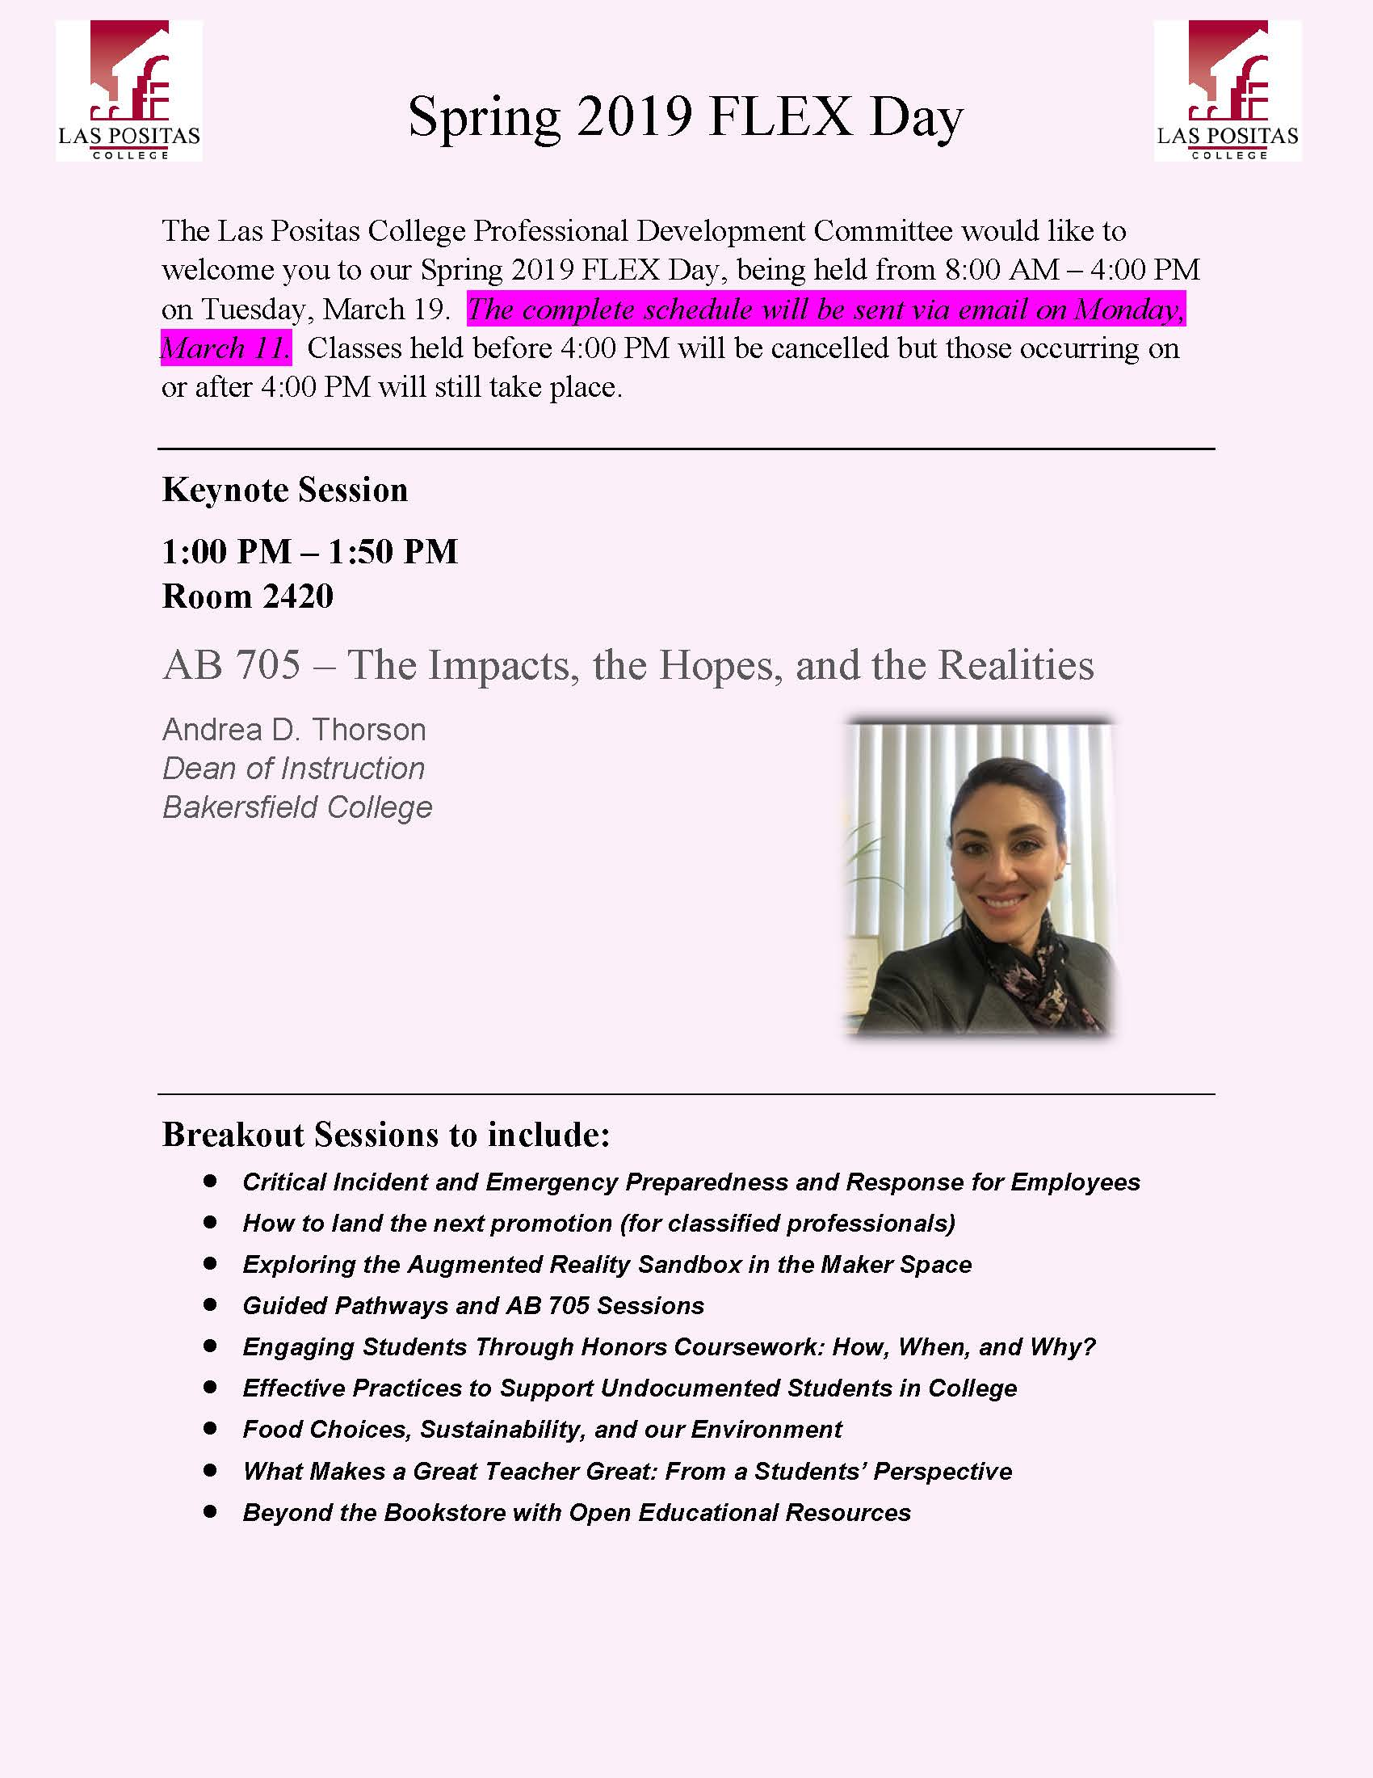

Slide 18
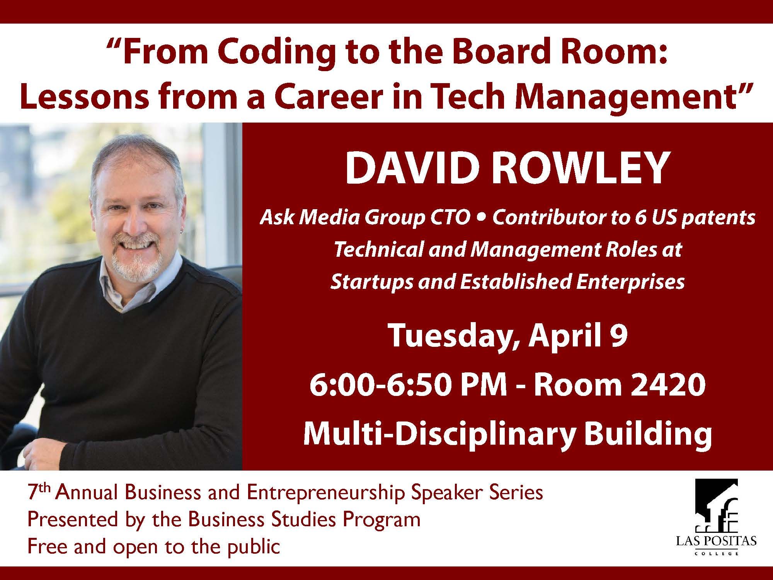

Slide 19
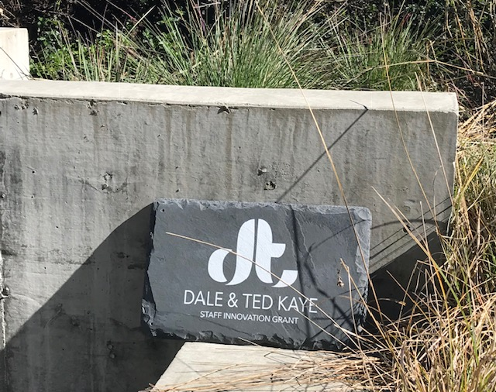
$1000 Grant Available to ALL Departments
Do you have an idea to address challenges in doing your work at LPC?
Apply for a Kaye Innovation Grant!
1-page application will be sent to
LPC in March 2019

