Slide 1

Town Meeting
Welcome Diana Rodriguez
Announcements Diana Rodriguez
Space Allocation Update Doug Horner
Adoption Budget 2014-2015 Jeff Kingston
SLO Update Dr. Tina Inzerilla
SSSP Diana Rodriguez
Town Meeting Breakout Sessions Diana Rodriguez
October 1, 2014

Slide 2

Announcements
The Reading and Writing (RAW) Center
Follow the RAW Center on Twitter for
Weekly Writing Tip Tweets:
@LPC_RAW_Center
Email: LPCEnglishTutor@gmail.com
October 1, 2014

Slide 3
Announcements
The LPC Children’s Theater class presents…
“The Fabulous Fable Factory”
A thirty-five minute play containing the delightful and comedic retelling of some of Aesop’s most famous fables.
&
Saturday afternoon,
October 25th
2:00 p.m.
Black Box Theater
Friday evening,
October 24th
7:00 p.m.
Black Box Theater
October 1, 2014

Slide 4
Announcements
October 1, 2014

Slide 5
Announcements
Please pass on to your students:
Jack Kent Cook Scholarship
webpage:
www.JKCF.org/scholarships
Application process starts October 6th through early December
Webinar available on October 9th @ 1 p.m. PST
October 1, 2014

Slide 6
Announcements
The Fall 2014 Teaching & Learning Center workshop schedule & appointment topics
are set!
Sign up by going to:
www.laspositascollege.edu/staffdevelopment/workshops.php
October 1, 2014

Slide 7
Announcements
i-Gate Innovation Hub is hosting…
The 2nd Annual Startup Weekend Tri-Valley, Oct. 24th-26th. The theme is crowdfunding. Software, hardware, and mobile app developers, as well as designers and aspiring entrepreneurs, are invited to come pitch their product ideas, build teams, and compete for awesome prizes.
  Three scholarships are available for students who can demonstrate, in one tweet, that they are deserving of free entry to the event.
  Tweet @iGATE_iHub for your chance to win.
  Students can also receive a 50% discount on tickets using the code: studentearly.
For information:http://www.up.co/communities/usa/east-bay/startup-weekend/4177.
October 1, 2014

Slide 8
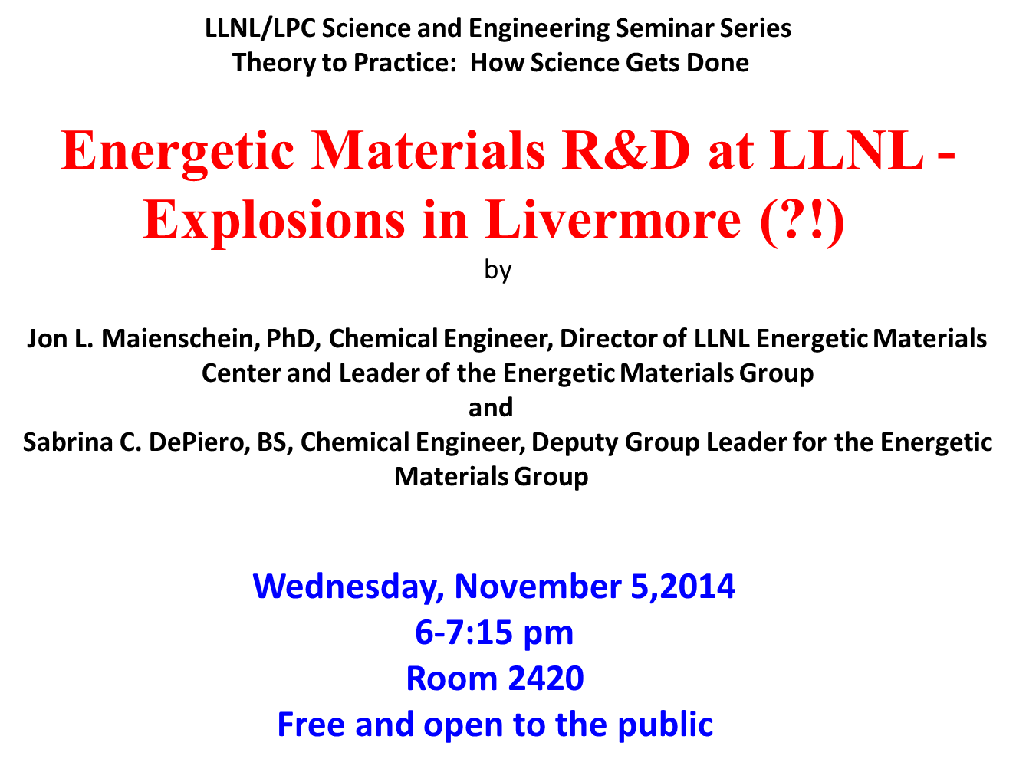
Announcements
October 1, 2014

Slide 9
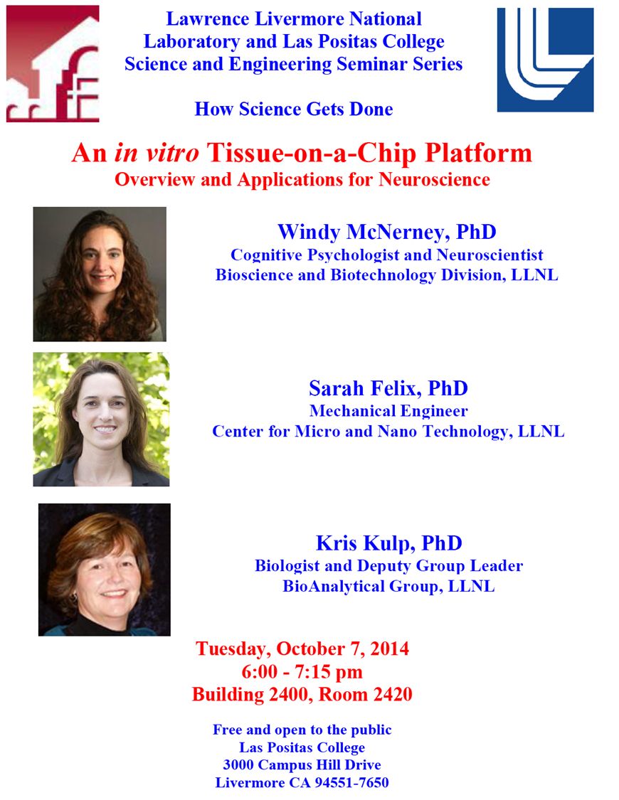
Announcements
October 1, 2014

Slide 10
Performing Arts : October
October 1, 2014

Slide 11
Performing Arts : October
Tickets: www.brownpapertickets.com
October 1, Wed. Brian Copeland, 8:00pm POSTPONED
October 9, Thurs. Tres Vidas, 8:00pm
October 24, Fri. Children’s Theater Aesop’s Fables, 7:00pm Black Box – (free)
October 25, Sat. Children’s Theater Aesop’s Fables, 2:00pm Black Box – (free)
October 29, Wed. Rehearsal Orchestra Concert, 6-9:30pm
October 30, Thurs. Orchestra “Canned” Concert, 7:30pm
All performances in the Main Stage Theater, unless noted
October 1, 2014

Slide 12
Performing Arts : November
Tickets: www.brownpapertickets.com
November 6, Thurs. Veteran’s Affairs, 10:00 a.m.
November 13, Thurs. The Comedy of Errors (Rehearsal), 8:00 p.m.
November 14, Fri. The Comedy of Errors, 8:00 p.m.
November 15, Sat. The Comedy of Errors, 8:00 p.m.
November 16, Sun. The Comedy of Errors, 2:00 p.m.
November 21, Fri. The Comedy of Errors, 8:00 p.m.
November 22, Sat. The Comedy of Errors, 8:00 p.m.
November 23, Sun. The Comedy of Errors, 2:00 p.m.
All performances in the Main Stage Theater, unless noted
October 1, 2014

Slide 13
Performing Arts : December
Tickets: www.brownpapertickets.com
December 3, Wed. Music Department Recital, 12:30 p.m.
December 6, Sat. Dance, 8:00 p.m.
December 7, Sun. Chamber Choir, Orchestra, Wind Ensemble, 3 p.m.
December 11, Thurs. Stories & Speeches, 7:00pm
December 12, Fri. Winter Jazz Night – feat. Mimi Fox (guitar), 8 p.m.
December 16, 17, 18 Auditions and Call back for MUSICAL, 6:30 p.m.
All performances in the Main Stage Theater, unless noted
October 1, 2014

Slide 14
Announcements
LPC’s American Red Cross Blood Drive
FACTS about blood needs:
Every two seconds someone in the U.S. needs blood.
More than 41,000 blood donations are needed every day.
A total of 30 million blood components are transfused each year in the U.S.
The average red blood cell transfusion is approximately 3 pints.
The blood type most often requested by hospitals is Type O.
The blood used in an emergency is already on the shelves before the event occurs.
Sickle cell disease affects more than 70,000 people in the U.S. About 1,000 babies are born with the disease each year. Sickle cell patients can require frequent blood transfusions throughout their lives.
More than 1.6 million people were diagnosed with cancer last year. Many of them will need blood, sometimes daily, during their chemotherapy treatment.
A single car accident victim can require as many as 100 pints of blood.
To schedule your appointment
or for more info, contact: 1-800-RED-CROSS or www.redcrossblood.org
and enter sponsor code: LasPositas
Student Dining Hall
Tues., October 14th
10:00 AM to 4:00 PM
October 1, 2014

Slide 15

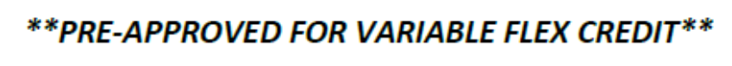
Announcements
October 1, 2014

Slide 16
Announcements
Bidding ends October 29th
October 1, 2014

Slide 17
Announcements
LPC’s Behavioral Intervention Resource Webpage:
http://www.laspositascollege.edu/birt/index.php
The BIRT webpage is designed to provide you with info, tools and resources to best handle dealing with difficult, disruptive, or dangerous situations involving students including:
  Recognizing a student in need and guidelines
  Reporting a student of concern
  Emergency contact for crisis
  Mental health resources on and off campus
October 1, 2014

Slide 18
Announcements
Medical or Mental Health Emergency?
For students or employees
First call Campus Safety X1699
(not 911*)
  *911 personnel cannot find the way to classrooms
  - need to be led by Campus Safety!
October 1, 2014

Slide 19
Town Meeting
For complete announcement details, please visit the Town Meeting page on the Intranet:
http://grapevine.laspositascollege.edu/administration/TownMeeting.php
To send announcements for next meeting:
email to Kelly Abad
October 1, 2014

Slide 20
Break Out Sessions
Breakout Sessions: | Room: | Discussion Leader:
Program Review & Program Level Student Learning Outcomes | 2410 & 2412 | Dr. Karin Spirn & Dr. Tina Inzerilla
Accreditation Update | 2420 | Elena Cole
Equity Plan | 2490 | Michelle Zapata & Jill Oliveira
October 1, 2014

Slide 21
Break Out Sessions
Program Review and Program Level Student Learning Outcomes
– Dr. Karin Spirn and Dr. Tina Inzerilla
All instructional and non-instructional programs are invited to attend a breakout session in which we will continue working on the program update forms. There have been major changes to the forms, in particular to the SLO sections. This is your chance to continue to work on your planning for fall.
Rooms:
2410 Teaching Learning Center
2412 Computer Classroom
October 1, 2014

Slide 22
Break Out Sessions
Accreditation Update – Elena Cole
Room: 2420
This session will provide Accreditation Teams with a chance to report
on their progress as they are working on their part of the Self‐
Evaluation Report, describing problems and asking questions that
have arisen. Information regarding the Recommendations from the
last report, Eligibility Requirements, and consistent approaches to
citing evidence will also be addressed. Staff and faculty from across
the campus who are contributing to the Self‐Evaluation Report or who
are interested in learning more about LPC's current work on
Accreditation are encouraged to attend.
October 1, 2014

Slide 23
Break Out Sessions
Equity Plan - Michelle Zapata & Jill Oliveira
Room: 2490
Las Positas College is enriched by the diversity of all its students. The Governor has proposed additional funding to address underperforming student populations. This November, every California Community College is required to submit a Student Equity Plan that addresses student access and success. At this session, you will learn how our college is approaching the Student Equity Plan and participants will have an opportunity to shape our plan.
October 1, 2014

