Slide 1

Town Meeting
ANNOUNCEMENTS
September 5, 2012

Slide 2

  Pink on Purpose – October 18
  Participating is simple. Just wear pink on October 18th and support the student health club on the cafeteria patio from 11-1 for a campus -wide awareness & fundraising event for the fight against breast cancer . All proceeds will be donated to the American Institute for Cancer Research.
  Please contact Dayna Barbero if you have any questions or would like to be involved in planning our event.

Slide 3

Athletics
Women’s Soccer
  October 5 – Ohlone
  October 16 – Foothill
  October 19 – Chabot
  November 2 - Mission
Men’s Soccer
  Skyline – October 9
  Chabot – October 12
  Santa Rosa – October 19
  Fresno – October 29
  Cabrillo – November 2
Note: M/W Double headers on October 19 and November 2

Slide 4

LPC Children’s Performance
October 19-20

Slide 5

LPC Orchestra
October 12

Slide 6
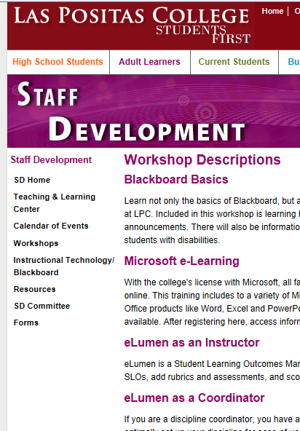
Fall 2012 Staff TLC Workshops
Sign up for a Fall 2012 Teaching and Learning Center workshop and/or appointment by going to the Staff Development home page and clicking Workshops.
http://www.laspositascollege.edu/staffdevelopment/workshops.php

Slide 7
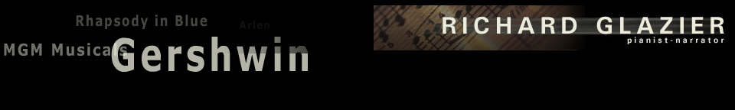
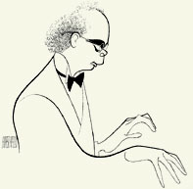
Music Department Benefit Concert Featuring Richard Glazier:
A Salute to Gershwin
October 27 at 8:00 PM
Mertes Center for the Arts

Slide 8
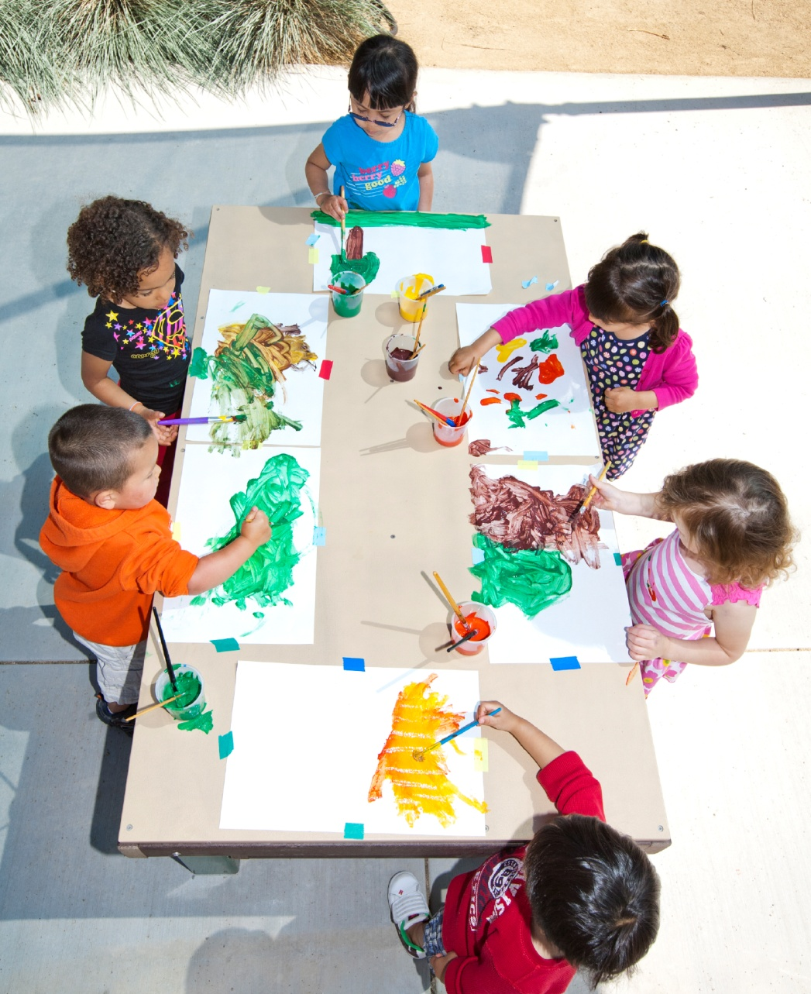
LPC Child Development Center
Full Day Openings for Preschoolers (Ages 3 to 5 years)

Slide 9


Jack Kent Cooke Transfer Scholarship
Up to $30k per year for eligible transfer students!
Details can be found at http://www.jkcf.org/ or contact Sheri Moore

Slide 10


2013 All-USA Community College Academic Team
$2,500 Scholarship awarded to 20 community college students across the nation!
Details can be found at http://www.ptk.org/ or contact Sheri Moore

Slide 11

Coca-Cola Community College Academic Team
Awards of up to $1,500 Scholarship awarded to 150 community college students across the nation!
Details can be found at http://www.ptk.org/ or contact Sheri Moore

Slide 12

Reading and Writing Center
THE READING AND WRITING CENTER FALL OPENING
SEPTEMBER 10TH IN THE READING ROOM (2401)
STUDENTS GET 1-ON-1 TUTORING WITH AN ENGLISH INSTRUCTOR!
MONDAY THROUGH THURSDAY 10:30 - 2:30
TUESDAY AND WEDNESDAY 4:00 – 6:00
More info:
Richard Dry
rdry@laspositascollege.edu
www.laspositascollege.edu/ENG/writingcenter.php

Slide 13

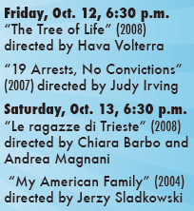
Italian Film Festival
Oct. 12 & 13, Room 2420
More Info:
www.lpcitalianfilmfestival.org

Slide 14

LLNL/LPC
Science and Engineering Series
Running a National Lab
and
What it Takes to Succeed at One
October 8, 6:00 PM in Room 2420
Parney Albright, PhD
Director, Lawrence Livermore National Laboratory
President, Lawrence Livermore National Security

Slide 15
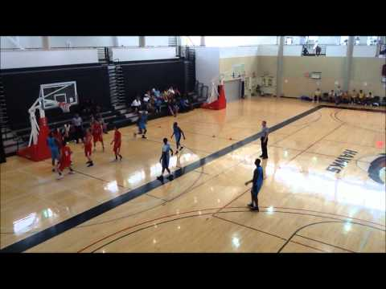
WELLNESS 101
Basketball and Badminton
LPC GYM
Fridays 12:30 – 1:30
All Faculty and Staff
Are
Welcome!
Sign up through Community Ed
More Info: Tom Dodge

Slide 16
International Tutor Appreciation Week
October 1-6
LPC has 33 peer tutors who are either volunteering, tutoring for credit, or receiving pay.
We have 2 community volunteers and 23 instructors who tutor students. In addition, 6 English instructors staff the Reading and Writing (RAW) Center.
Thanks to all of our tutors!

Slide 17

Community Events
Bill Paskewitz featured show and
Article in www.110mag.com at:
http://www.myvirtualpaper.com/doc/110mag/110vp_sept.2012/2012083101/#76

Slide 18
Announcements Wanted
Send Town Meeting Announcements to
Sharon Gach by
Noon on the day before each Town Meeting
Send WEBSITE Announcements to
Sharon Gach (sgach@laspositascollege.edu) ANY TIME.
Use form at bottom of News and Events Column!
Send to Sharon Gach items for new pages on:
Student Achievements
http://www.laspositascollege.edu/news/STUDENTACHIEVEMENTPAGE.php
and
LPC Staff Excellence
http://www.laspositascollege.edu/news/STAFF-fACULTY-aDMIN-eXCELLENCE.PHP

Slide 19
September 5, 2012
For complete announcement details, please visit the Town Meeting page on the Intranet:
http://grapevine.laspositascollege.edu/administration/TownMeeting.php

