Slide 1

The Puente Project
Bridging classrooms and communities since 1981

Slide 2
The Puente Project
The Puente Project is a national award-winning program that for 30 years has improved the college-going rate of tens of thousands of California's educationally underrepresented students.

Slide 3
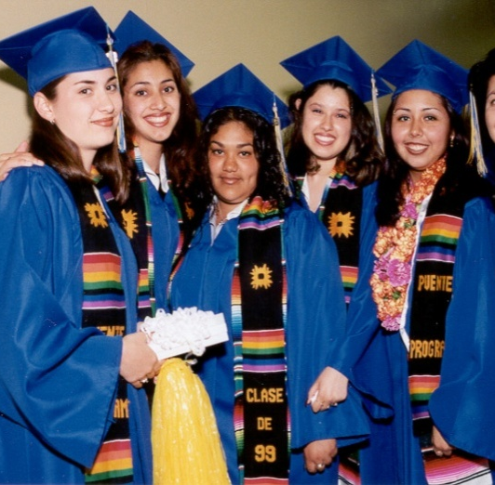
The Puente Project Mission
To increase the number of educationally underserved students who
Enroll in four-year colleges and universities
Earn college degrees
Return to the community as leaders and mentors

Slide 4
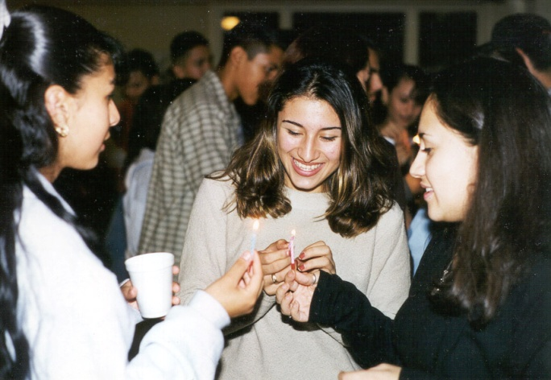
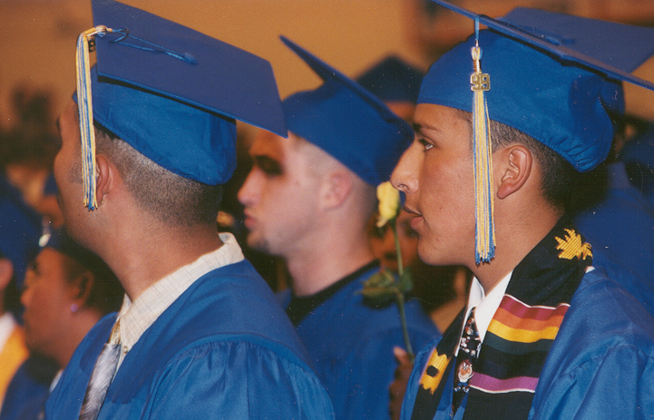
Who We Serve
Puente serves over 63,000 students/year
61 community colleges
34 high schools
24 counties

Slide 5
Puente Model: Cohort Based LC
Counseling
English/Writing
Mentorship

Slide 6
Puente Classes/ Counseling
English – ENG 105 (fall) → ENG 1A (spring)
  Includes a developmental writing course, followed by a college transfer-level English composition course.
  Enroll with the same Puente English instructor
  These classes provide both a personally and culturally supportive and stimulating environment
  Assignments integrate with the PD course
  Literature focuses on the Multicultural experience and perspective

Slide 7
Puente Classes/ Counseling
Counseling –
  Assigned Puente counselor who works closely with Puente students (Meet twice per term)
  Monitoring progress
  Identify career goals
  Develop education plans
  Navigate their way through the community college system in preparation for and application to four-year institutions
  Teach a Personal Develop/Study Skills course in the fall and Transfer Success Planning in the spring

Slide 8
Puente Mentors
Serve as role models of academic and professional success who demonstrate opportunity from within their community
  Introduce students to career opportunities
  Serve as a resource for encouragement & guidance
  Participate in cultural events/activities
  Introduce concepts of leadership & civic engagement
  Expose to diverse professional and cultural environments

Slide 9
Looking Ahead
Mentor component
Service Learning
Student Government and Leadership
Fundraising and Sponsorship
Campus and Community Involvement
Enrollment in Honors coursework

Slide 10
Program Goals
Involvement & Engagement → Persistence & Retention
Graduation and Transfer
Increase access to opportunity
Promote equity and foster success
Provide services above and beyond
Sense of belonging campus/community
Develop leadership skills
Provide opportunity for involvement
Funds of knowledge → Peer support
Multicultural curricular theme across disciplines
Encourage active academic engagement
Promote self-efficacy

Slide 11
Implementation Budget
35K received annually for the first 3 years
  30K – Implementation Costs
  5K – Program Operating Costs

Slide 12
Program Implementation
  30K – Program Implementation
    Counselor Salary and Benefits
    Management of Operational Budget
    Clerical Assistance

Slide 13
Program Operating Costs
5K
  Student Recruitment and Orientation
  Motivational Conference
  University Visits
  Academic & Cultural Events/Activities
  Student/Mentor Functions

Slide 14
Projected Expenses
> Transportation to University Campuses $1400
> T-shirts for Motivational Conference $300
> Costco drinks/Paper products $500
> Food for Student/Mentor Mixers $1600
> Mailers/Printing $200
> Cultural Events/Activity Fees $1000
__________________________________________________
$5000

Slide 15

What does the data say?

Slide 16
Seven-year Transfer (03-10) Rates of All California Community College Educationally Disadvantaged Students, All CCC Students, and Puente Students
CCCCO, National Student Clearinghouse, Puente Project.

Slide 17
Fall 2008 to Fall 2009 College Persistence Rates of All California Community College (CCC) Students Statewide by Ethnicity and of Puente Students
CCCCO, Accountability Reporting for the Community Colleges Draft Report, October 2009, Puente Project. CCCCO calculates a one-year persistence rate for first-time freshmen (FTF) with at least 6 units earned in a fall term who enrolled in the following fall term.

Slide 18
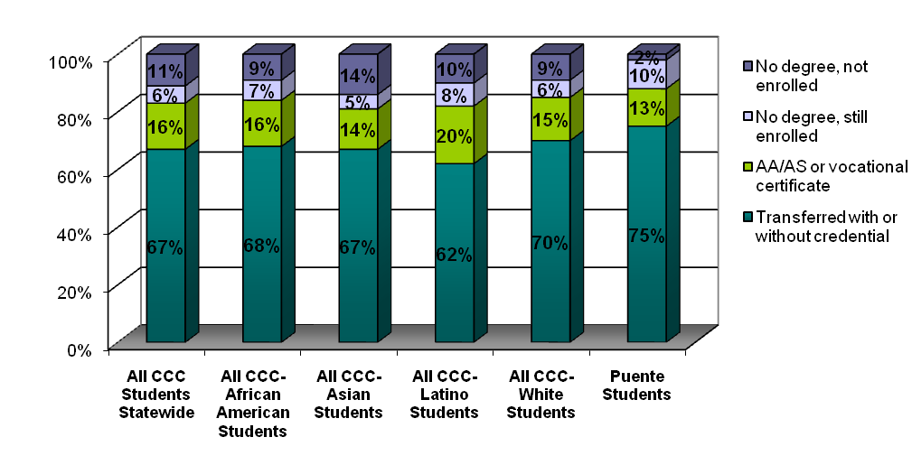
Status after Six Years of Transfer-Ready* CCC Students
Disaggregated by Race/Ethnicity and Puente Students
Source: MPR Unexpected Pathways Transfer Patterns of California Community College Students, Puente Project August 2007
*Transfer-ready is defined as students who complete at least 60 UC/CSU transferable units including their math/English requirements

Slide 19
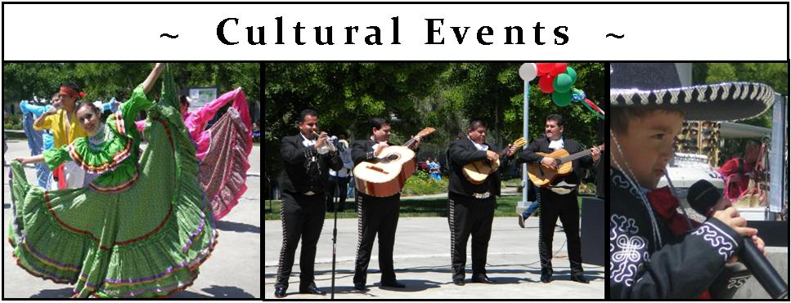
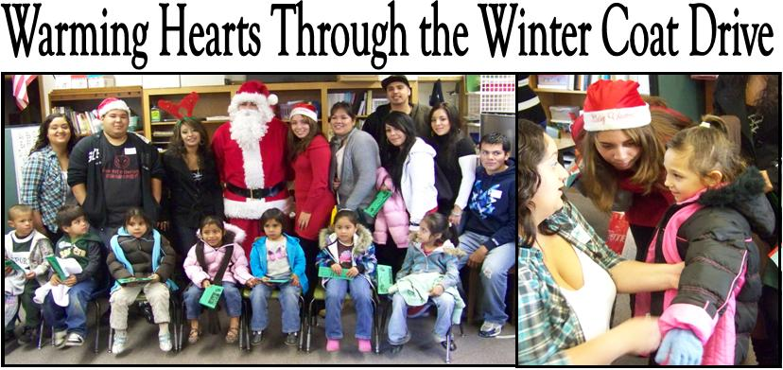
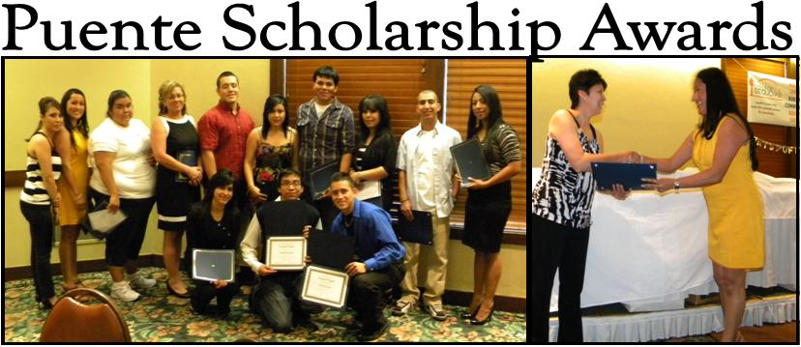
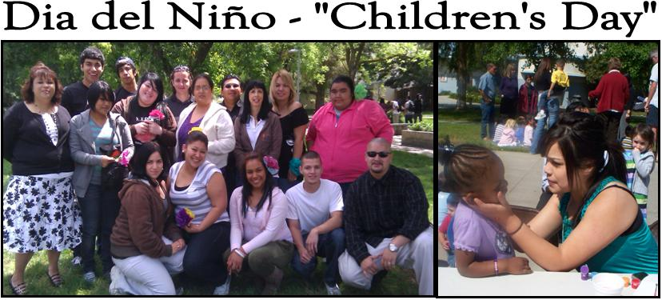
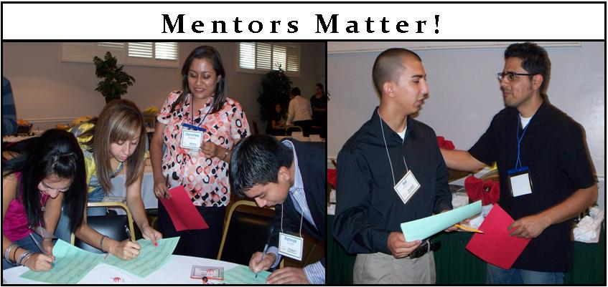
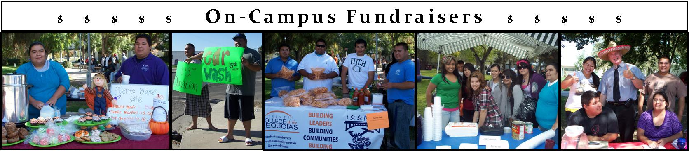

Puente Does Make A Difference!

