Slide 1
Guided Pathways
STUDENT SUCCESS TEAMS
Phase 1 and Phase 2
Community of Practice April 22, 2022

Slide 3
Student Success Teams for each Pathway will use:
a Pathway Website that organizes key supports for student success
Canvas sites for pathway communication and networking
Pathway specific data sets about students along their journey
Data sets disaggregated by demographics to reduce equity gaps
…helping our students will get a lot easier!

Slide 4
STUDENT SUCCESS TEAMS
PHASES BEING CONSIDERED FOR IMPLEMENTATION
PHASE 1 | PHASE 2 | PHASE 3 | PHASE 4
Phases will be gradual and driven by feedback and infrastructure. Goal is to create sustainable and proactive measures that makes supporting students easier and more streamlined.

Slide 5
PHASE 1
Student Success Team Members
Comprised of individuals from Academic Services, Student Services, Administrative Services, Student Mentors
Infrastructure: Pathway Website
Notes:
Phase 1 will also include a “Student Success Team” - a group of individuals for each of our Pathway that answers the question for students “Who Cares About Me?”
We see the makeup and work of Student Success Teams changing over time, but in Phase 1 here is what Student Success Teams will do.

Slide 6
PHASE 1
Please take our Phase 1 survey !
We want your feedback about Student Success Teams training and “soft-handshakes” to begin Phase 1!

Slide 7
STUDENT SUCCESS TEAMS PHASE 1
Infrastructure | Pathway Website and Gathering the Team
Student Success Team phase addresses: “What steps do I need to take next?” “Who cares about me” “How can I afford college?” and Enhances Belonging | Pathway Website is created for all Pathways that identifies Student Success Team Members and addresses key questions and barriers for students Pathway Counseling Faculty work with students within pathway to complete EdPlans with training in their pathway Discipline Faculty choose to be identified as a SST member and dedicate at least one Office Hour(s) for drop-in support Pathway student questions/needs with persistence project-like support. Peer Students and Student Assistants to communicate with peers as desired. Additional Members around campus are encouraged to identify as a SST member and contact information is published.

Slide 8
PHASE 2
Student Success Team Members
Comprised of individuals from Academic Services, Student Services, Administrative Services, Student Mentors
Infrastructure: Pathway Canvas Sites

Slide 9
STUDENT SUCCESS TEAMS PHASE 2
Infrastructure | Pathway Canvas Sites
Student Success Team phase addresses: “What steps do I need to take next?” “Who cares about me” “How can I afford college?” and Enhances Belonging | Pathway Canvas site is created for all Pathways: Addresses key questions and barriers Enables communication Create a sense of belonging and direction

Slide 10
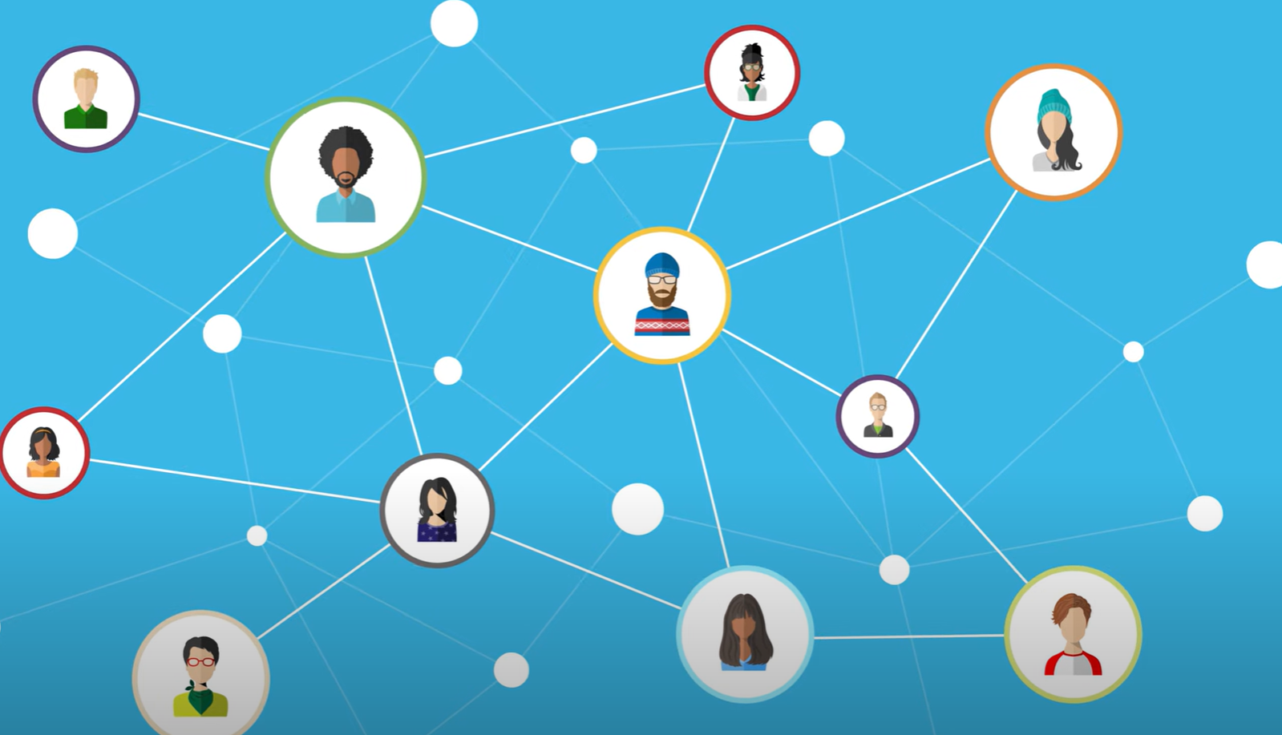
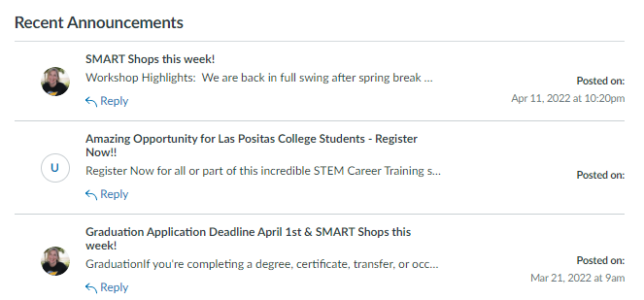
Pathway Canvas Sites
Focus on enhancing pathway communication and belonging.
Announcements can provide key academic and pathway information to their Canvas inbox!
Canvas sites can provide opportunities for students to interact, connect, network

Slide 11
Key Content on Canvas Templates
Student Success Team members, their contact information, office hours
Announcements
Program Maps for all degree/certificate programs
Career Information (Career Coach)
Semester-by-semester to-do list
Calendar

Slide 12
Breakout Group Activity
Part of the integration of Canvas in Pathways is to create norms. In groups, please discuss how we might utilize Canvas in a way that will not overwhelm students with information
Suggested discussion questions:
What belongs on the Canvas calendar (do we run the risk of creating too many items in a student’s calendar - Smart Shops, key deadlines, office hours, etc)?
What is the MOST vital information students should see on their Pathway Canvas page (front and center)?
Is a discussion board a useful place for students to interact with peers and/or professionals on campus?
How many announcements per week/month is too many?
15 minutes

Slide 13
Breakout Group Activity
Please discuss the key announcements that should be shared on a Pathway Canvas site.
Who should be posting announcements?
When (in the semester) should that announcement be made?
Pick a breakout room:
Zoom Group 1: “What steps do I need to take next?”
Zoom Group 2: “Who cares about me?”
Zoom Group 3: “How can I afford college?”
Zoom Group 4: Enhance Belonging
15 minutes
https://docs.google.com/document/d/1sZK5tF7ut5Cgl9n5BwxdvWHgHahJnTNUgRje25Ftd2k/edit?usp=sharing
Notes:
https://docs.google.com/document/d/1sZK5tF7ut5Cgl9n5BwxdvWHgHahJnTNUgRje25Ftd2k/edit?usp=sharing

Slide 14
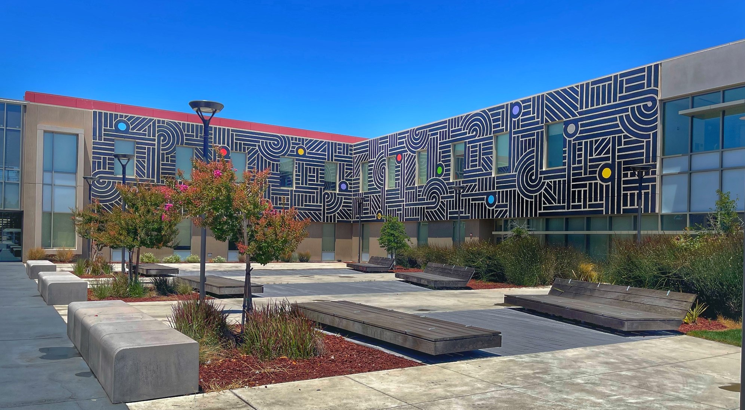
THE YEAR AHEAD – STUDENT SUCCESS TEAMS
IT IS AN “US” THING

