Slide 1

Guided Pathways
STUDENT SUCCESS TEAMS
PHASES BEING CONSIDERED FOR IMPLEMENTATION
Student Success Team CoP Meeting March 22, 2022

Slide 2
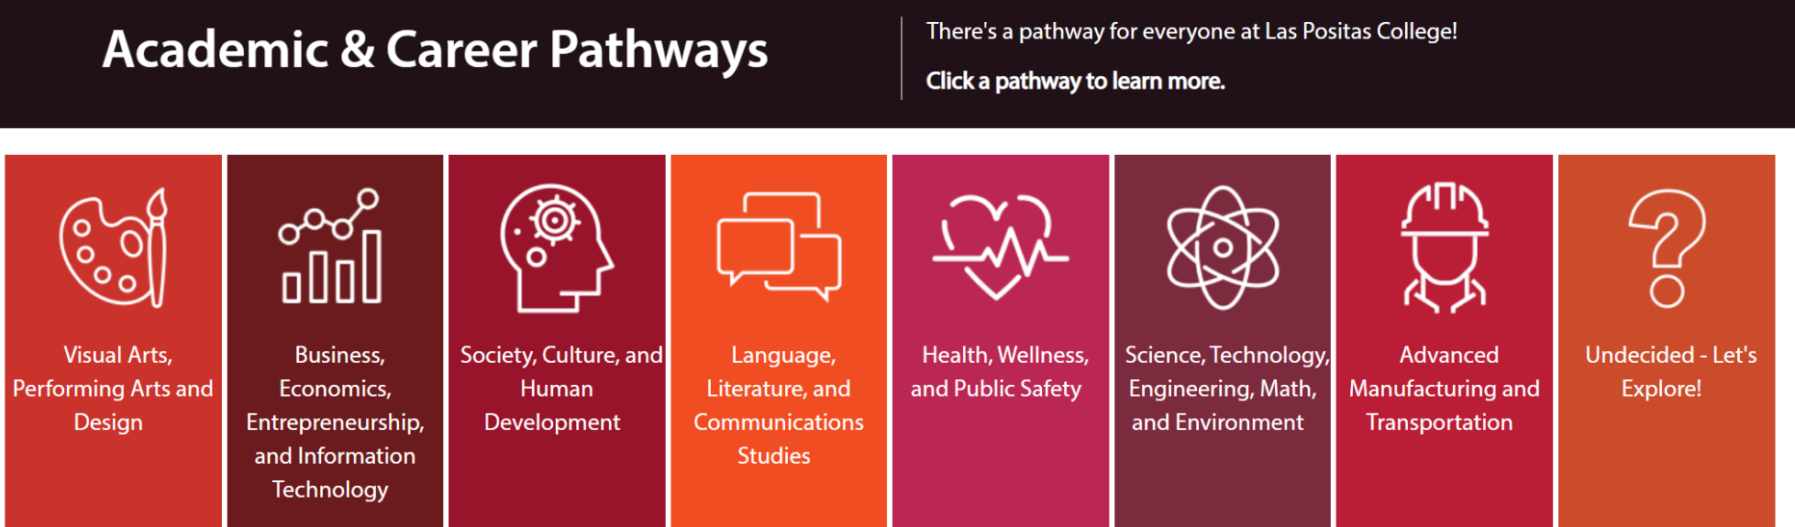
Imagine if all of our students are organized into one of our Academic and Career Pathways
and supported by a Student Success Team.

Slide 3
Imagine if Student Success Teams for each Pathway are given:
Websites that organizes key supports for student success
Canvas sites for pathway communication and networking
Pathway specific data sets about students along their journey
Data sets disaggregated by demographics to reduce equity gaps
…then helping our students will have just gotten a lot easier!

Slide 4
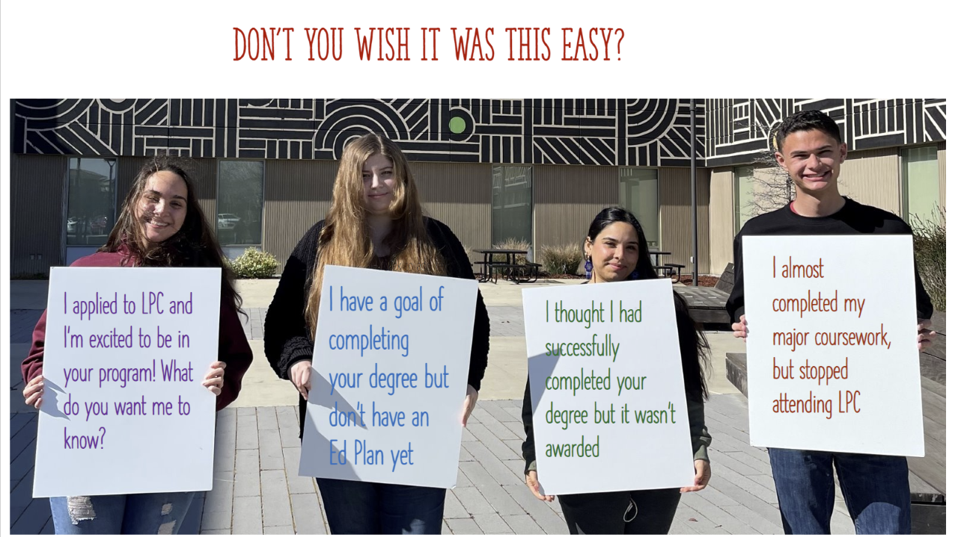
LPC Student Government Officers advocating for making our students’ invisible questions, needs, barriers, and unknowns visible for proactive support.

Slide 5
Student Success Teams:
Comprised of individuals from Academic Services, Student Services, Administrative Services, Student Mentors
Use data for timely student interventions
Provide equity-infused practices and holistic support along the student journey

Slide 6
STUDENT SUCCESS TEAMS
PHASES BEING CONSIDERED FOR IMPLEMENTATION
PHASE 1 | PHASE 2 | PHASE 3 | PHASE 4
Phases will be gradual and driven by infrastructure to support work strategically transforming into sustained, interactive and proactive work that makes supporting students easier and our work and time streamlined.

Slide 7
STUDENT SUCCESS TEAMS PHASE 1
Infrastructure | Pathway Website
Student Success Team phase addresses: “What steps do I need to take next?” “Who cares about me” “How can I afford college?” and Enhances Belonging | Pathway Website is created for all Pathways that addresses key questions and barriers for students.

Slide 8
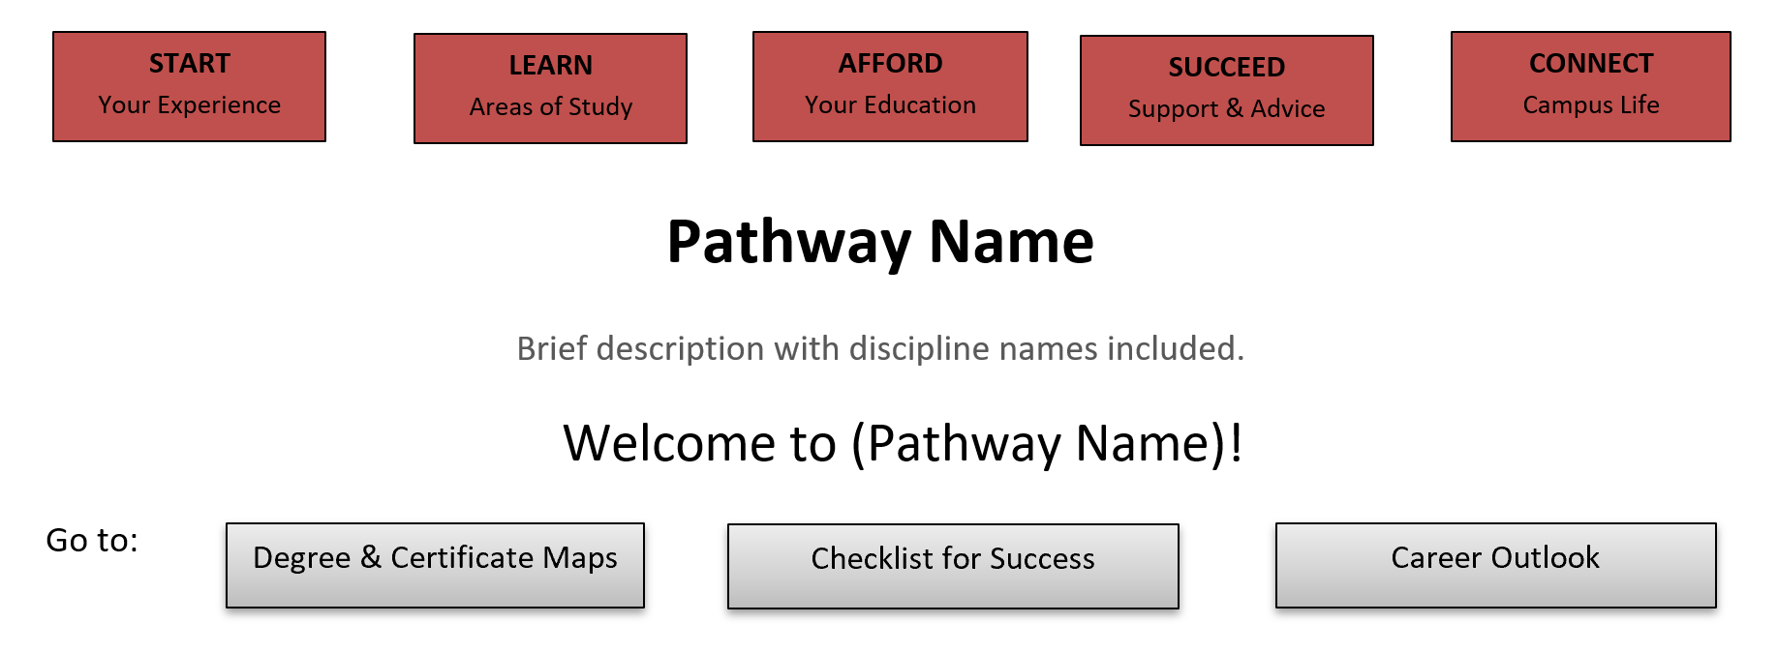
STUDENT SUCCESS TEAMS PHASE 1
First Look at Pathway Website

Slide 9

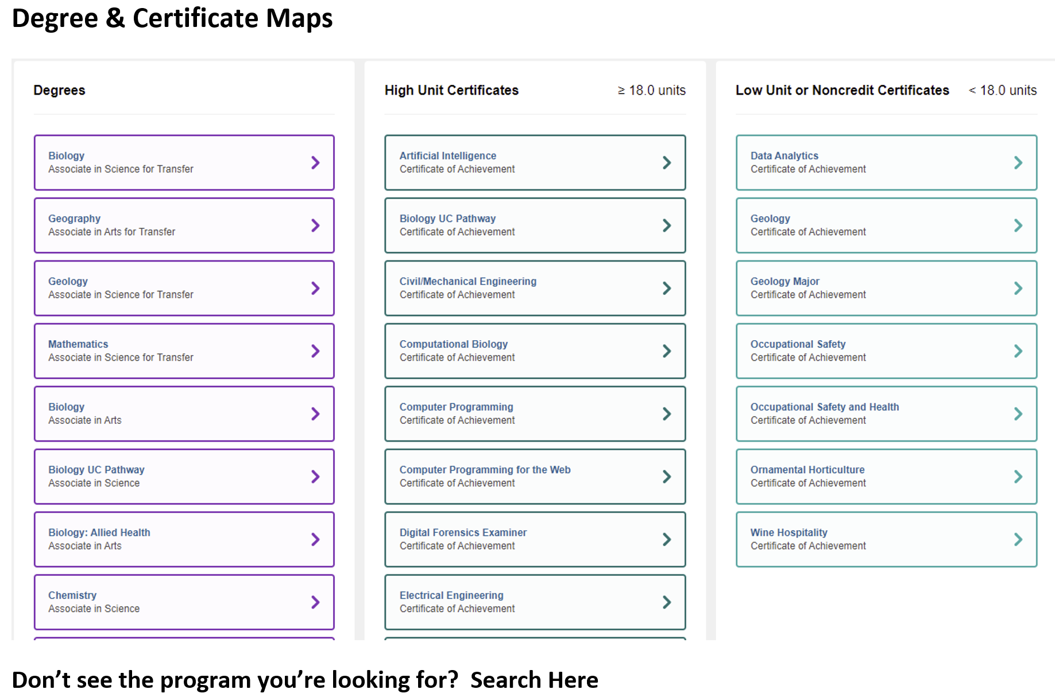

Slide 10

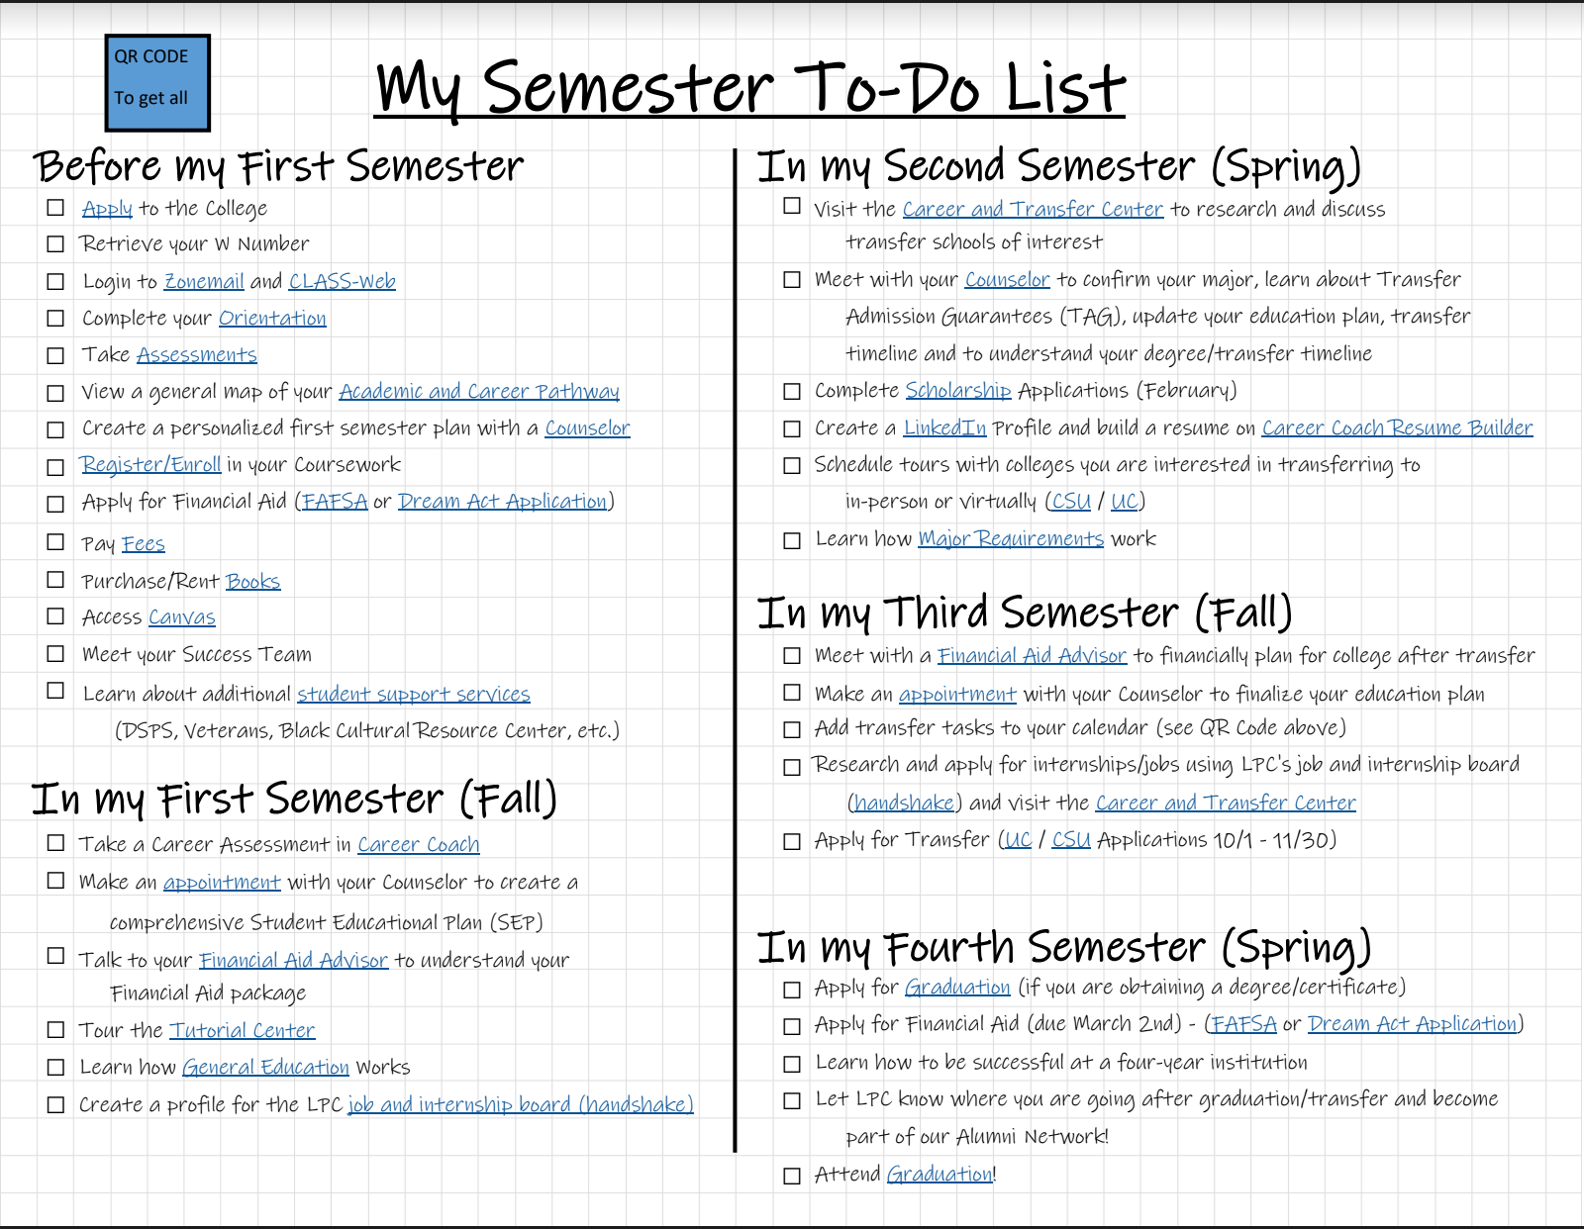

Slide 11

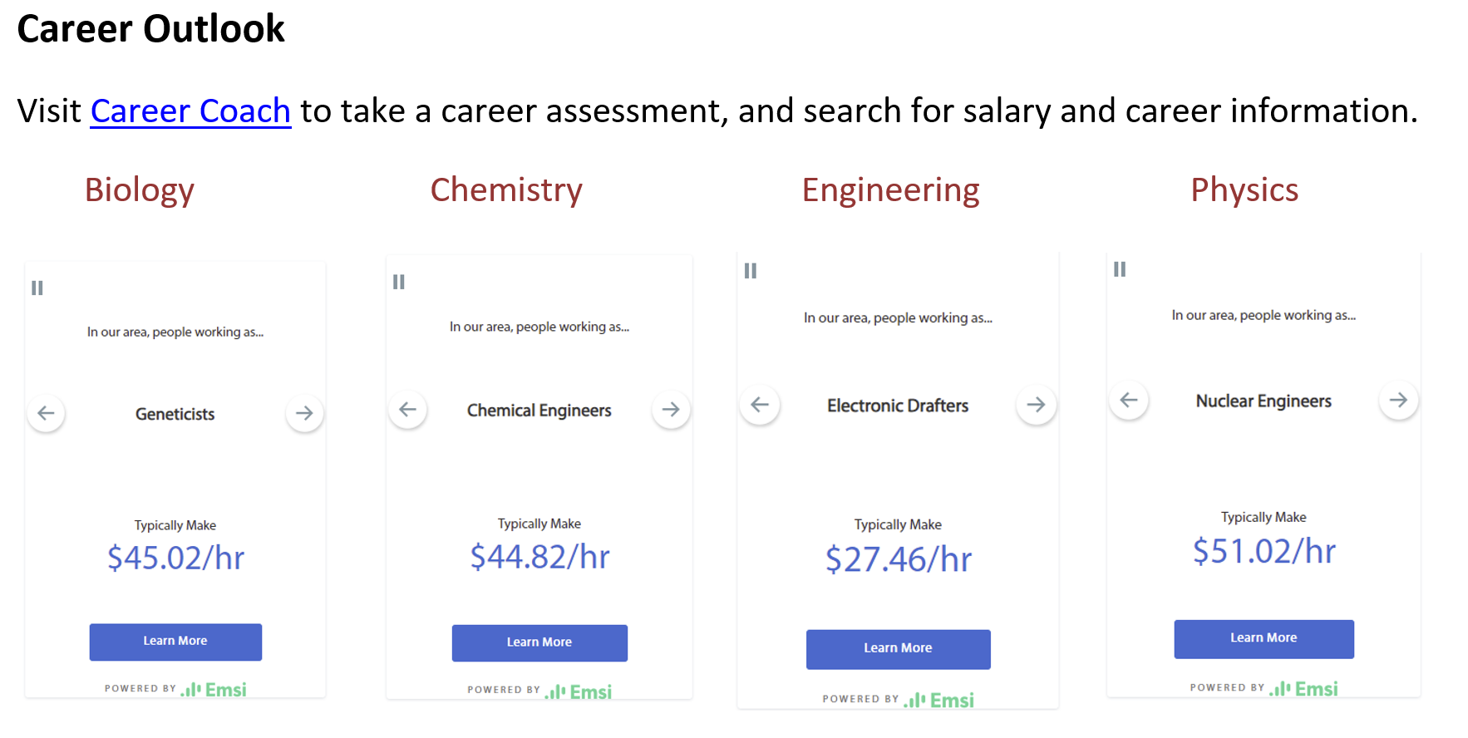

Slide 12
STUDENT SUCCESS TEAMS PHASE 1
First Look at Pathway Website
Prototype of our Pathway Website

Slide 13

Breakout Group Activity
Phase 1 Website & Milestone Supports
Pick a breakout room:
Zoom Group 1: Prototype of Pathway Websites
Zoom Group 2: “My Semester To-Do List”​
Suggested discussion questions:
  Does it address key questions and barriers for students?
  Suggestions for content? Layout?
  How do you envision helping students with this information?
Take notes in this Google Document!
10 minutes
Notes:
https://docs.google.com/document/d/1bx2bhwf-kXgvNTD2Cd-0Vre-CzbamxR6NmKfxpslSJk/edit?usp=sharing

Slide 14
PHASE 1
Student Success Team Members
Comprised of individuals from Academic Services, Student Services, Administrative Services, Student Mentors

Slide 15
STUDENT SUCCESS TEAMS PHASE 1
Infrastructure | Pathway Website
Student Success Team phase addresses: “What steps do I need to take next?” “Who cares about me” “How can I afford college?” and Enhances Belonging | Pathway Website is created for all Pathways addresses key questions and barriers for students and identifies Student Success Team Members. Pathway Counseling Faculty work with students within pathway to complete EdPlans with training in their pathway Discipline Faculty choose to be identified as a SST member and dedicate at least one Office Hour(s) for drop-in support Pathway student questions/needs with persistence project-like support. Peer Students and Student Assistants to communicate with peers as desired. Additional Members around campus are encouraged to identify as a SST member and contact information is published.

Slide 16
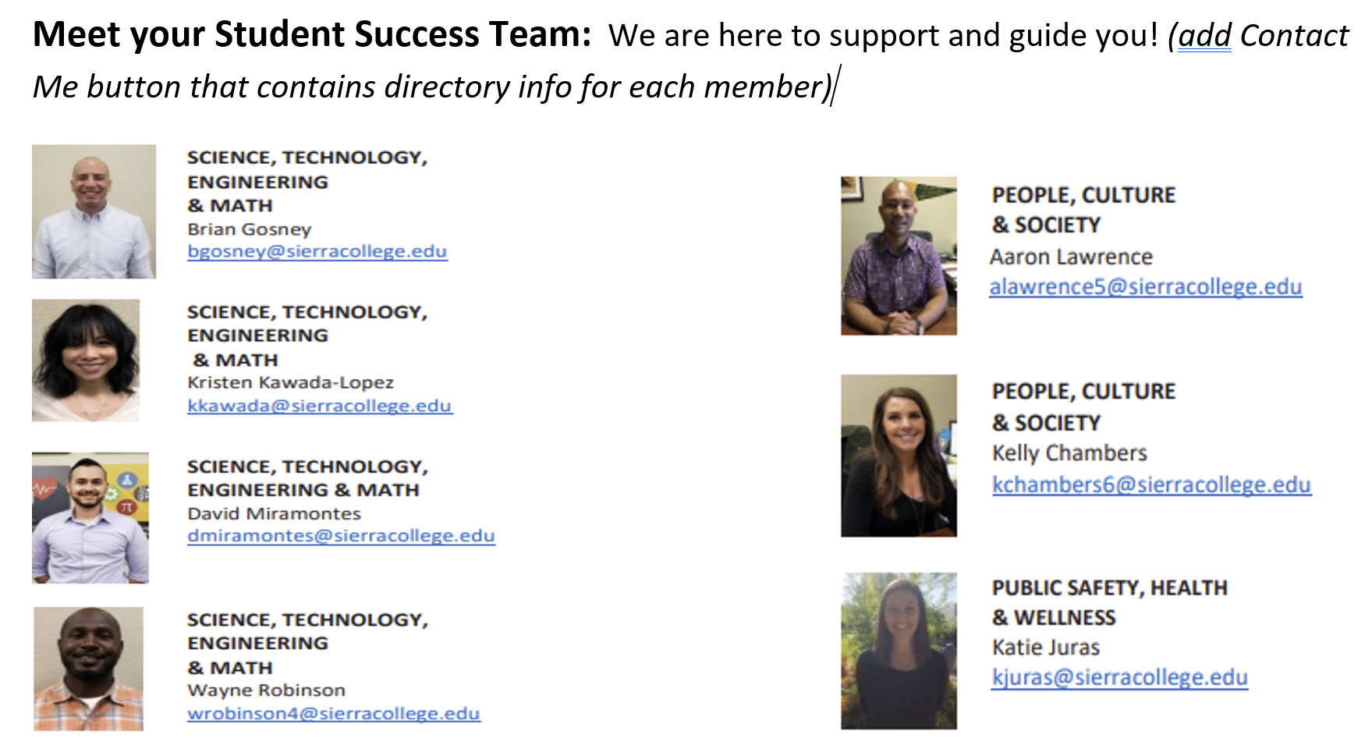
STUDENT SUCCESS TEAMS PHASE 1
Coming Soon!

Slide 17
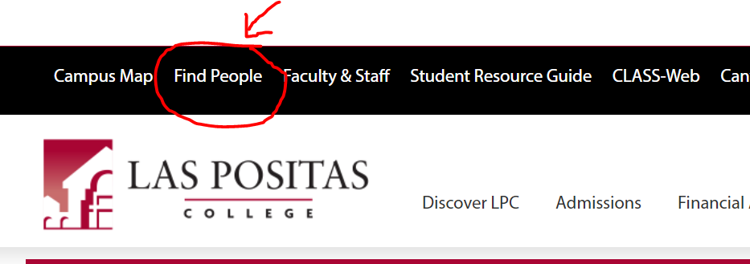
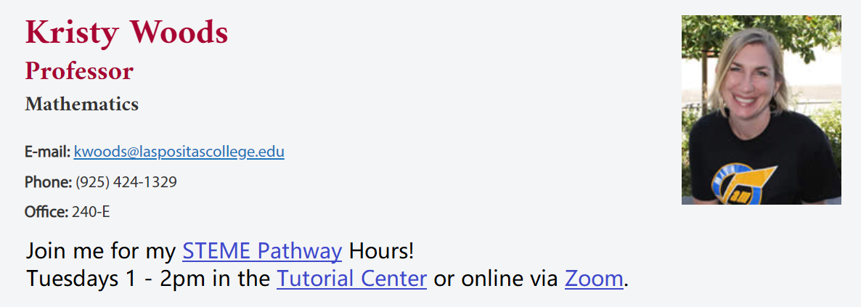
STUDENT SUCCESS TEAMS PHASE 1
Coming Soon!
Example of a Discipline Faculty Member choosing to be a Success Team Member

Slide 18
STUDENT SUCCESS TEAMS PHASE 1
Goal is to start Phase 1 Fall 2022
Infrastructure | Pathway Website
Student Success Team phase addresses: “What steps do I need to take next?” “Who cares about me” “How can I afford college?” and Enhances Belonging | Pathway Website is created for all Pathways that identifies Student Success Team Members and addresses key questions and barriers for students Pathway Counseling Faculty work with students within pathway to complete EdPlans with training in their pathway Discipline Faculty choose to be identified as a SST member and dedicate at least one Office Hour(s) for drop-in support Pathway student questions/needs with persistence project-like support. Peer Students and Student Assistants to communicate with peers as desired. Additional Members around campus are encouraged to identify as a SST member and contact information is published.

Slide 19
Breakout Group Activity
Starting Phase 1 Fall 2022
What could starting Phase 1 entail at LPC for our different SST members and ancillary support?
Pick a breakout room:
Zoom Group 1: Student Assistants/Peers to support Pathways
Zoom Group 2: Pathway Counseling Faculty Member
Zoom Group 3: Pathway SST Discipline Faculty Member
Zoom Group 4: Classified and Ancillary Supports
15 minutes

Slide 20
Breakout Group Activity
Starting Phase 1 Fall 2022
What could starting Phase 1 entail at LPC?
Suggested discussion questions:
  What conversations or survey questions should our campus have around Phase 1?
  How can we best identify and sustain our “soft-handshakes” around campus?
  What could your chosen member need to confidently choose to be a SST Member in their Pathway?
    What training or supports could be needed?
Take notes in this Google Document!
20 minutes
Notes:
https://docs.google.com/document/d/1ggz3-Frv1ztew3CRyWsqneScJxfgY8sm04ojLgCNVDM/edit?usp=sharing

Slide 21
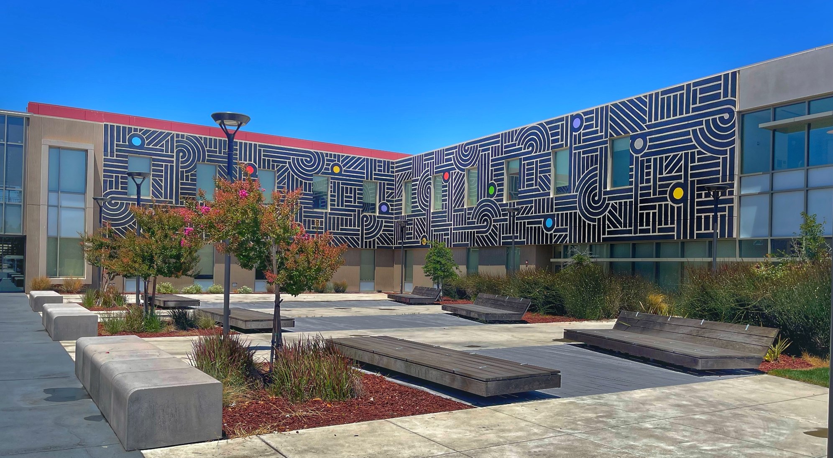
THE YEAR AHEAD – STUDENT SUCCESS TEAMS
IT IS AN “US” THING

