Slide 1



YOU CAN
SUCCEED
for students

Slide 2
MATERIALS NEEDED
FOR WORKSHOP
These materials are required for workshop:
Your Las Positas College transcript
The Probation Clearance form
An open and willing attitude to succeed

Slide 3
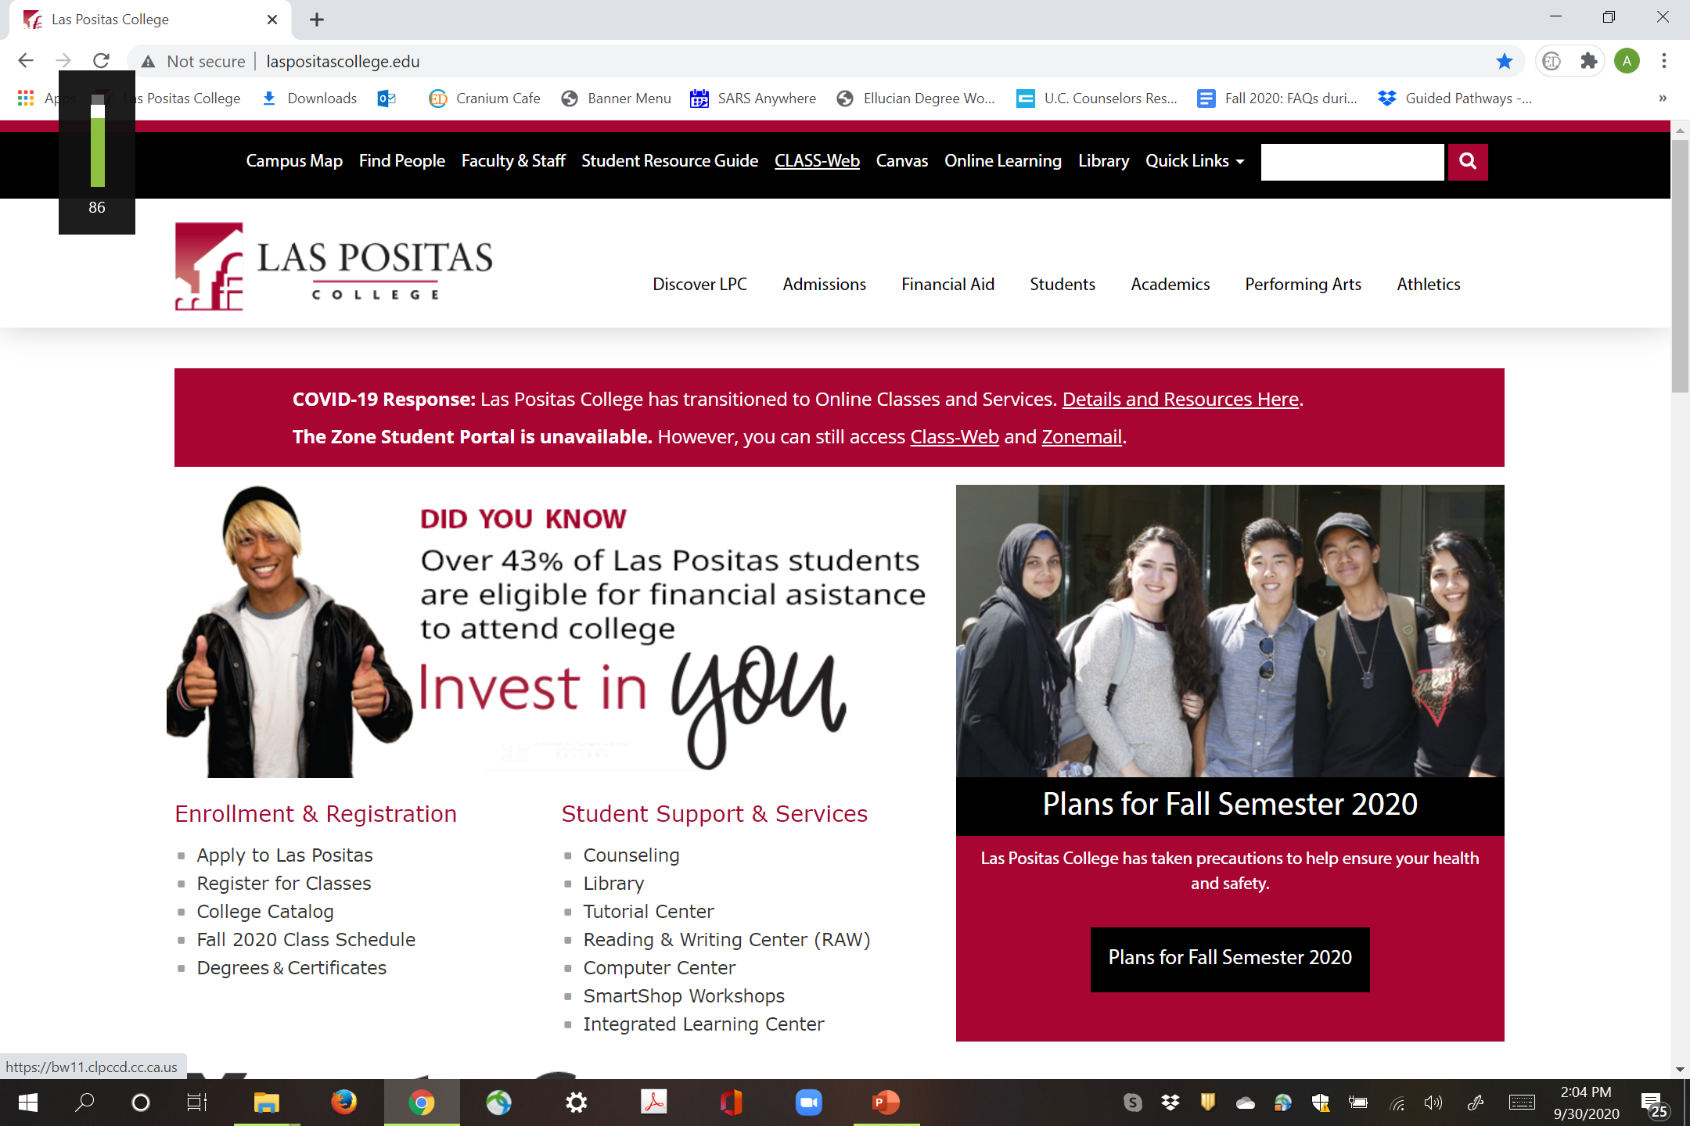
LAS POSITAS COLLEGE HOMEPAGE
WWW.LASPOSITASCOLLEGE.EDU
Notes:
You may access all the forms and resources discussed in this video by going to the LPC homepage at www.laspositascollege.edu.
To access your LPC transcript click on the CLASS Web link at the top of the homepage in the black bar.

Slide 4
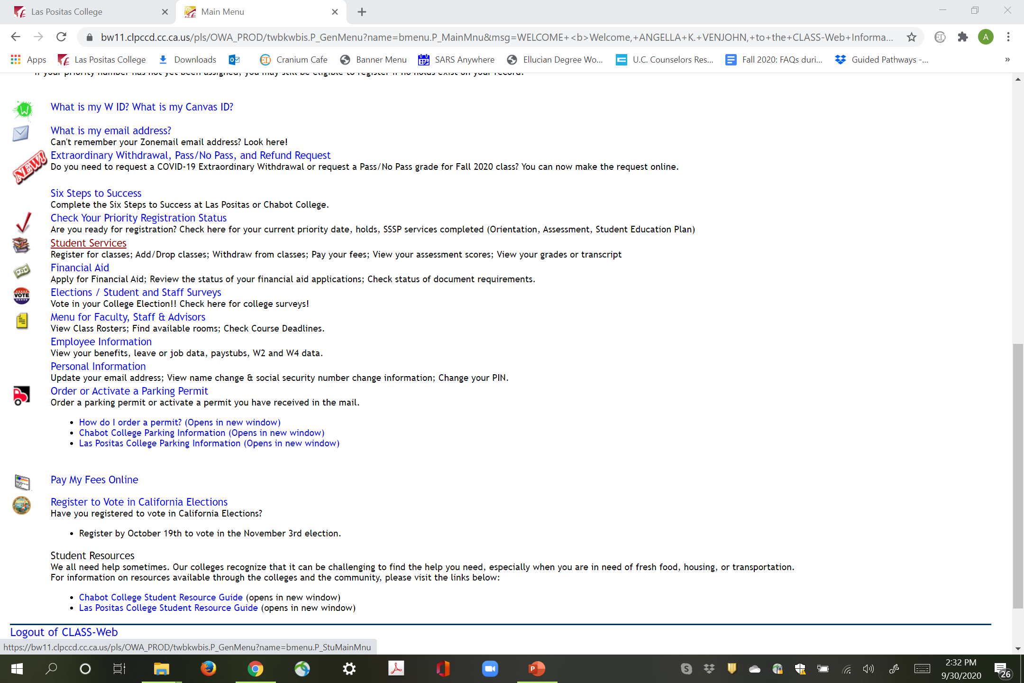
ACCESS YOUR
LPC TRANSCRIPT
To access your transcript:
https://bw11.clpccd.cc.ca.us/
From the LPC homepage
Log into CLASS Web with W#
Click on Student Services
Click on Unofficial Transcript

Slide 5
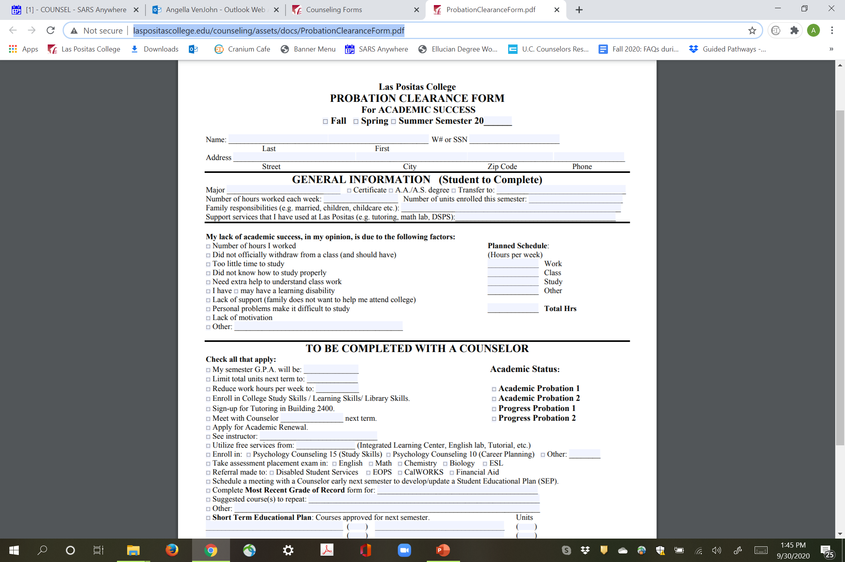
Academic / Progress Probation Clearance Form
To access the form:
Go to LPC Counseling homepage
Click on Counseling forms
Click Academic/Progress Probation Clearance
http://laspositascollege.edu/counseling/assets/docs/ProbationClearanceForm.pdf
Download petition to your computer & open it using Adobe Reader to fill it out before saving it on your computer.
Notes:
1. Download petition to your computer & open it using Adobe Reader to fill it out before saving it on your computer. If you fill it out on your web browser, no information is saved.
2. On the top of the petition, mark the current term that we are currently in (not the upcoming term).
3. Fill out your name and W # and the
4. General Information portion of the form.. Major, Degree, Number of hours worked, resources used
5. Also indicate what you think your lack of success was due to… And how many hours you work this term,

Slide 6

AGENDA
Today you will learn:
What probation means
Why it happens
The importance of
in “good standing”
How to get in
“good standing”
from Academic and
Progress Probation

Slide 7
WHY STUDENTS OFTEN DO NOT SUCCEED
Rarely intellect…
More likely:
  Work
  Family commitments
  Too many units
Personal problems
Lack of motivation
Need for better Study Skills
Choosing a major/goal/something you love
Share what you think is your reason….
Notes:
On the petition, answer the section “ what you think your lack of success was due to… Also complete the section Planned Schedule.
Work=How many hours you plan to work next term, Class =is the number of units you plan to enroll in next term. And study is # of hours you plan to study for these units.

Slide 8
WHAT PROBATION MEANS
Academic Probation
    Your cumulative Grade Point Average is below 2.0 or C average
Progress Probation
    50% or more of the cumulative units you have attempted were not successfully completed
      No Pass (NP)
      Withdraw (W)
      Incomplete (I)
Notes:
To find your academic standing. Look on your transcript after last term grades. It will state Academic or Progress Probation I or II. Check the corresponding box on the bottom portion of the Probation Clearance form under Academic Status. I means this is the 1st semester you are on probation. II means this is the 2nd semester you are on probation.

Slide 9
CONSEQUENCES OF PROBATION
  Loss of Financial Aid.
    Students on probation (academic or progress) for 2 consecutive terms may lose their financial aid. (California College Promise Grant Fee Waiver, LPC Promise Scholarship)
  Later Registration Date.
    Students on probation (academic or progress) for 2 consecutive terms lose their early registration date.

Slide 10
WHY “GOOD STANDING” IS IMPORTANT
You may be dismissed from college, after the 3rd semester of probation.
Readmitted students often have restrictions imposed upon them:
  Must petition to return to LPC
  Restricted in number of units allowed to register
  Not eligible for financial aid
  Can not graduate or transfer to a public university
  Can not play intercollegiate sports

Slide 11
HOW TO GET IN GOOD STANDING
Academic Probation
  Raise your cumulative GPA to above 2.0 (C average)
  Repeat D and F grades
    The more recent grade will be calculated into the GPA and the old grade will be excluded from GPA calculation.
    May only attempt a course 3 times (D, F, NC, NP & W’s are all attempts.)
  Withdraw from class if not passing with a C grade
  Petition for Academic Renewal (Revised Policy Spring ‘19)
  Exclude from GPA calculation all sub-standard grades (D’s, F’s) from LPC /Chabot only
      Two years must have elapsed since completion of LPC course work
      Student must have completed the following at an accredited college. (It doesn’t have to be @ LPC)
        12 units taken consecutively with a GPA of 2.5 or
        20 units consecutively with GPA of 2.0
      Maximum of 24 units may be renewed
      Does NOT alleviate substandard grades from LPC transcript
      May only be done once and can NOT be reversed
      Petition submitted to Admissions and Records

Slide 12

HOW TO GET IN GOOD STANDING
Progress Probation
  Change the equation of incompletes to completes
    Complete more than 50% of units with a letter grade
    Enroll in fewer units. Don’t over enroll.
    Drop classes by NGR (No grade of record)
    date. See class schedule for date.
  Protect your transcript
    Be proactive
    Check all grades at the end of each term!

Slide 13

ACCESS RESOURCES TO HELP YOU

Slide 14

TIME MANAGEMENT ADVICE
If you work
    40 hours a week – no more than 6 units
    30 hours a week – no more than 9 units
    20 hours a week – no more than 12 units
Schedule Study Time
    Use the 2:1 study ratio
    # units x 2 = study time per week
Learn to Study for College Success
  College Study Skills; Psychology-Counseling 15, 30
    Form Study Buddy Groups
    Use the library reserved rooms
  Manage your time wisely.

Slide 15

RESOURCES http://www.laspositascollege.edu/resourceguide/index.php
Need extra help to understand class work
    Instructor office hours
    Tutoring (rm. 2401) online tutoring- available 24/7
    Reading & Writing Center (RAW)(rm 2401) & online
    Integrated Learning Center (ILC), (rm 600)
    for Math and ESL help
    SMART Shop workshops: study skills, career exploration & transfer info, English math and science
    Concurrent Math Support Classes
    Library research class
    Psych-Counseling 10, 15, 30 (classes)
    Go to Student Resource Guide on the LPC homepage

Slide 16

NEED A LITTLE MORE HELP?
Maybe you have a learning challenge or another disability
  Go to the DSPS homepage (Disabled Students Programs and Services) office #1615
    More tutoring
    Extra time to test
    A quiet place to test
    Equipment for the hearing and
    vision impaired
    AND Priority registration!

Slide 17

PERHAPS IT’S MORE PERSONAL..
Lack of support
  Family
  Money
  Transportation
Personal Problems make it very difficult to be successful
  See a counselor.
  Visit Counseling homepage for hours & online access (bldg. 1600)
  Short term therapy in Health Center. Visit homepage for hours and online access information (bldg. 1700)
Lack of motivation
  Often a symptom of all the above
  Career and Educational Planning (Psychology-Counseling 10) might help.

Slide 18
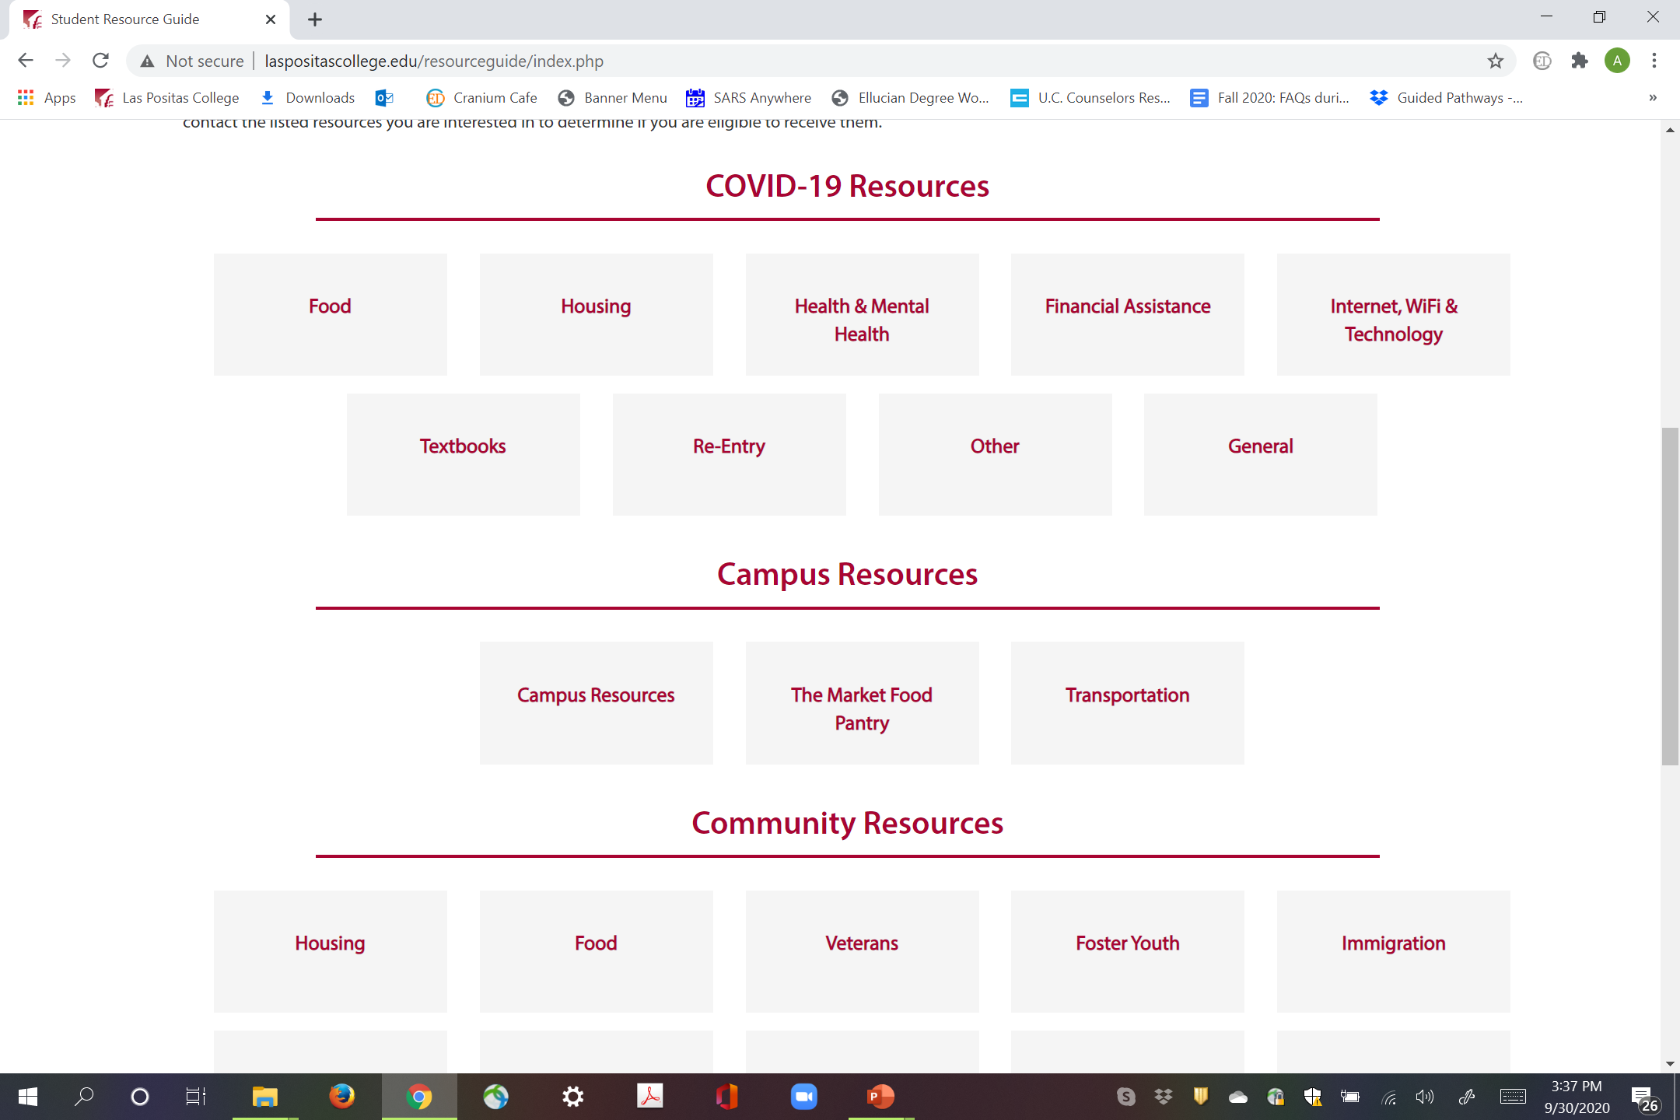
Additional Resources
Student Resource Guide on LPC Homepage http://www.laspositascollege.edu/resourceguide/index.php

Slide 19
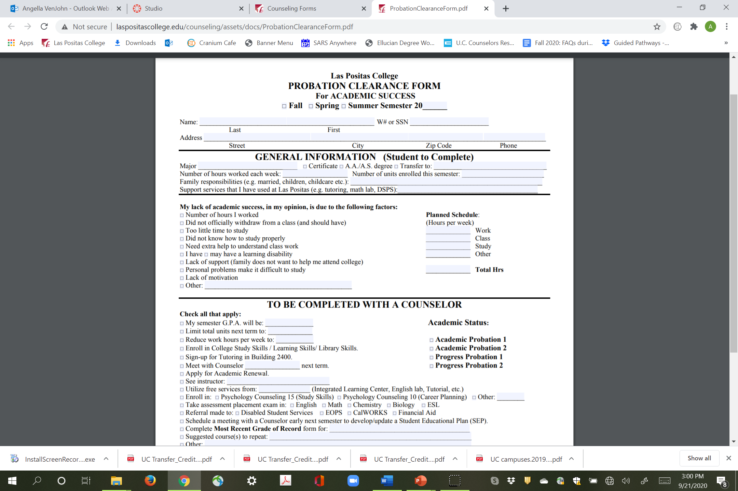
Academic /Progress Probation Form
Counseling homepage http://laspositascollege.edu/counseling/forms.php

Slide 20

Try not to come again!!!

