Slide 2
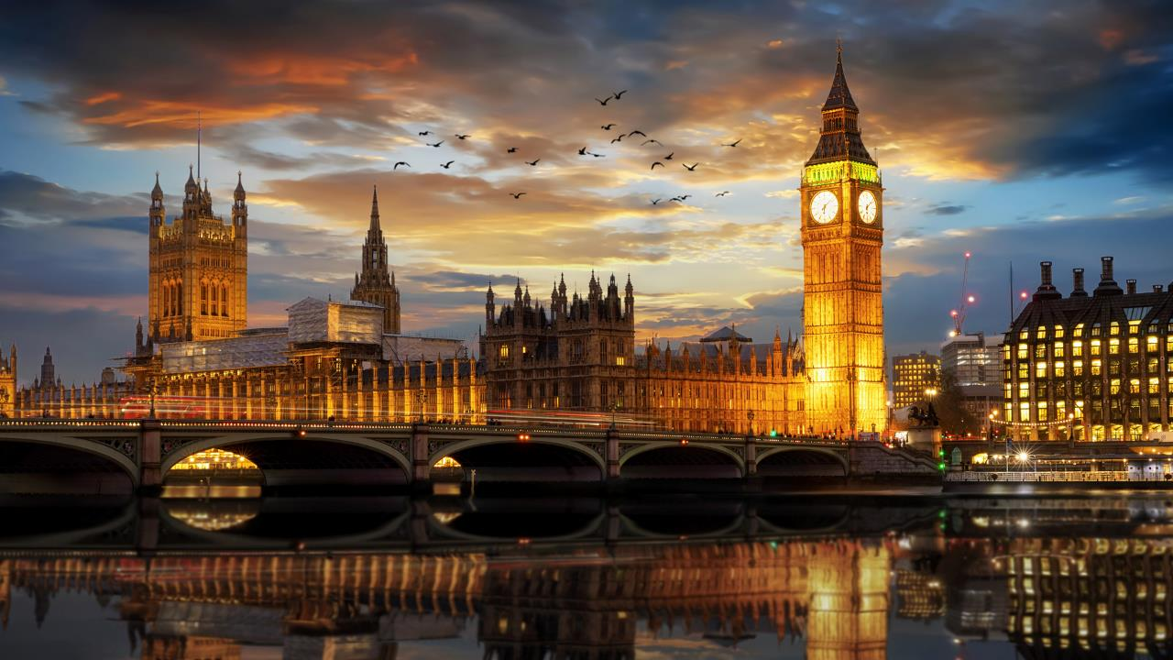
Dr. Eagan's Ireland, Wales & England
June 5, 2023 - June 14, 2023

Slide 3

About Dr. Eagan
Spent year abroad in Ireland in college
Delivered literary studies papers at conferences in Dublin, Belfast, London, and Zagreb
Took students on a trip to Ireland in June 2016
Spent 2016-2017 sabbatical working on globalizing the curriculum and teaching American Studies on a Fulbright scholar grant to the University of Zagreb, Croatia.
Took students on a trip to Italy and Croatia in June 2019
Pictured left in Korčula, Croatia (2017)

Slide 4
Benefits of Educational Travel
Expanded worldview
  Understanding and appreciation of different cultures
  Language and cultural immersion
Personal growth
  Increased confidence and competence
  Enhances the student’s lifelong learning journey
Life skills
  Demonstrates maturity and worldliness
  Strengthens job applications

Slide 5
Why Explorica?
Proven experience
  50 years in student travel
  More than 1 million travelers
  Tours to 75 countries on all 7 continents
Incredible Tour Directors
  Professionally trained
  Specialized in student travel
  Local experts bring the destination to life
  With group 24/7
Excellent value
  Fully inclusive
  Quality hotels, meals & activities
  Guaranteed best prices
Exceptional safety record
  Proven systems in place at all levels of operations
  Worldwide network of support
  Unmatched in industry

Slide 6
By your side, always
Proactive risk management
Expertly trained, multilingual Tour Directors
24/7 On-Call Support Team
50+ years of safe travel experiences
Worldwide support network
Local staff and partnerships
Comprehensive liability coverage
Trusted travel protection plans
Upgraded Cancel for Any Reason policy

Slide 7
Adaptations for Safety
HYGIENE
SAFETY BRIEFING
AT THE HOTEL
ADJUSTED ITINERARIES
ON THE MOTORCOACH
MEALS
We'll provide you with disposable masks to help you meet requirements for face coverings at sites we will visit or activities we do. We'll take breaks for frequent hand washing and provide hand sanitizer, too.
Our staff will brief you when you first arrive (or sometimes even before!) on new safety protocols, created in consultation with our Medical Director Dr. Neal Sikka.
Our hotel partners are deep cleaning, and modifying everything from check-in to the way you use the elevator. We're also offering affordable rooming upgrades for participants who request different room occupancy.
We're in-the-know with all the museums, performance venues, companies and other sites we visit. We’ll adjust your schedule to maximize your experiences and account for new rules for capacity management, social distancing, masks, and more.
Our bus partners have new cleaning protocols and are establishing new guidelines, like loading and unloading procedures, to help keep drivers and participants safe.
When we're selecting restaurants, we will use our local knowledge and strong relationships to choose spots following strict local guidelines and hygiene practices. We will work with restaurants to modify meal plans too, such as providing boxed lunches when possible.

Slide 8
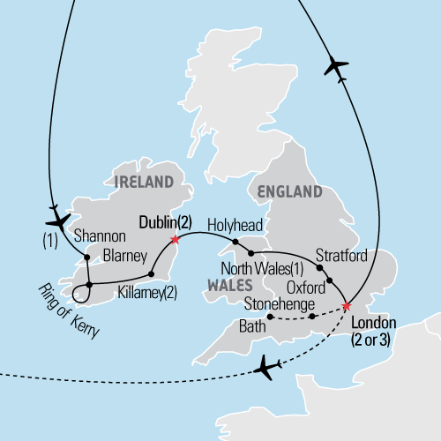
Where we’re going
Ireland, Wales & England
Date of trip: June 5, 2023 - June 14, 2023
Trip length: 10 days
Travel the Ring of Kerry, a scenic coastal route that offers breathtaking panoramic views of the Emerald Isle, visit the birthplace of true genius at William Shakespeare’s childhood home, stop by a local “chippie” for an authentic fish ‘n’ chips meal, and see the pillars of Stonehenge and a theatre performance in the West End.

Slide 9
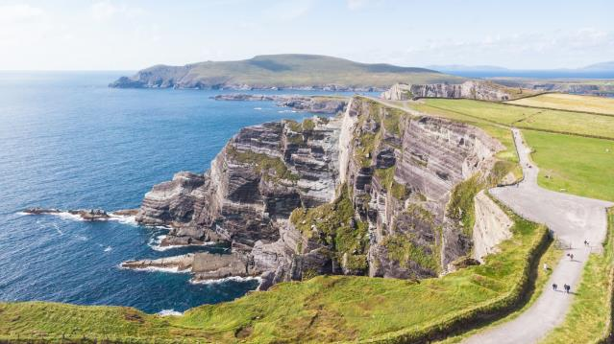

Tour Itinerary
DAY 1 | Start tour
  Flight to Ireland
DAY 2 | Hello Shannon
  Meet your tour director, Travel to Killarney and check into hotel
DAY 3 | Ring of Kerry
  Ring of Kerry excursion
  Sheep farm visit
DAY 4 | Killarney -- Dublin
  Travel to Dublin via Blarney Castle
  Blarney Castle visit
RING OF KERRY
BLARNEY CASTLE

Slide 10
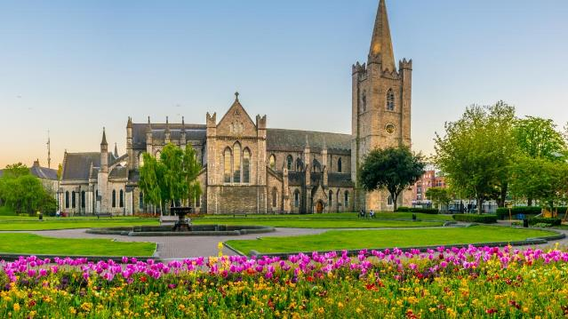
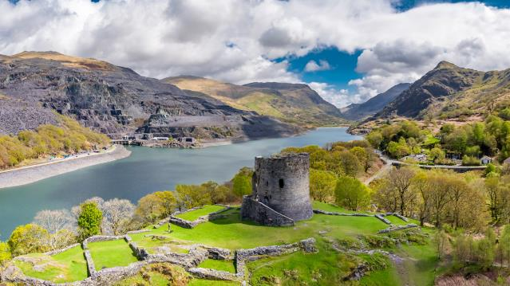
Tour Itinerary
DAY 5 | Dublin landmarks
  Dublin guided sightseeing tour
    Phoenix Park, St. Patrick’s Cathedral, Trinity College Book of Kells visit
  Dublin city walk
    O’Connell Street, Parnell Square, Henry Street
  Traditional public house dinner
  Optional Irish folklore evening $60
DAY 6 | Dublin--North Wales
  Ferry to Holyhead across Irish sea
  Travel to North Wales
  Llanfairpwllgwyngyll- gogerychwyrndrobw- llllantysilio- gogogoch
  Snowdonia National Park
ST. PATRICK’S CATHEDRAL
SNOWDONIA NATIONAL PARK

Slide 11

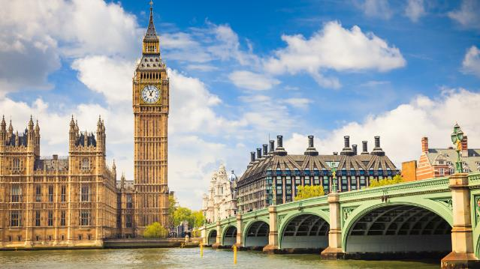
Tour Itinerary
DAY 7 | North Wales--London
  Travel to London via Stratford
  Anne Hathaway’s cottage & Shakespeare’s birthplace visit
DAY 8 | London landmarks
  London guided sightseeing tour
    Buckingham Palace, Big Ben, Houses of Parliament, Westminster Abbey, Tower Bridge, Hyde Park, St. Paul’s Cathedral
  Optional Windsor Castle guided excursion $80
  Classic fish & Chips dinner
DAY 9 | Start extension to London
  Stonehenge & Bath guided excursion
  West End theatre performance
DAY 10 | End tour
BUCKINGHAM PALACE
BIG BEN

Slide 12
What’s included
Round-trip airfare
Entrance fees to attractions per itinerary
All on-tour transportation
Guided sightseeing tours and city walks per itinerary
Accommodation in triple or quad rooms with private bathrooms
Full-time, professional Tour Director
Full breakfast daily
Online Tour DiaryTM, so you can follow our journey from home
Hearty, authentic dinner daily
24-hour emergency service

Slide 13
Insurance Also Included:
Travel Protection Plan PLUS
The “PLUS”:
$18/day
valuable extra protection
This plan covers the traveler for:
  A traveler’s injury, sickness, or death of a
  family member
  Theft of passport or visas
  Flight cancellations due to strike or bad weather
  Loss of luggage and personal effects
  Trip cancellation or trip interruption due to covered reasons such as a covered sickness, illness, or injury
  Trip cancellation or trip interruption due to terrorist acts, as defined
Explorica’s exclusive ”Cancel for Any Reason” protection:
  If you cancel your trip for any reason 30 days or more before the departure date, you will be reimbursed for 75% of the non-refundable cancellation fees, less the insurance premium

Slide 14
Your responsibilities
Acquiring a passport and visa (if applicable)
Travel to and from the airport, for departure and arrival back home
Tips for our tour director and bus driver
(unless included)
Spending money for optional excursions, free time activities, lunches, beverages/snacks, and souvenirs

Slide 15
Passports & visas
Passports
  The application process takes 4-6 weeks, so plan accordingly.
Visas
  Since requirements vary for each nationality, we recommend all travelers verify the individual requirements for their nationality with the local consulate for all the countries to be visited, or VisaCentral, Explorica’s partner for travel visas.

Slide 16
Easy ways to pay
Pay in full at enrollment
  Entire trip paid upon registration
  No remaining balance
  Payment rendered manually
Automatic monthly
payment plan
  $50 deposit paid upon registration
  Balance divided into equal monthly installments
  Payments charged automatically
Manual payment plan
  $99 deposit paid upon registration
  Balance divided into 4 installments
  Payments rendered manually

Slide 17
Easy ways to pay
Fundraising support
  Personal fundraising page on explorica.com
  Easily request and accept credit card donations from friends and family
Financial assistance
  Need-based support for qualifying families
  Confidential application
Trip cost:
  Students: $4,548.00
  Adults (ages 23 and over): $5,068.00
  $715.50 monthly payment
  (Price reflects savings of $210 scholarship until 10/13/2022. Use code Eagan2023)

Slide 18

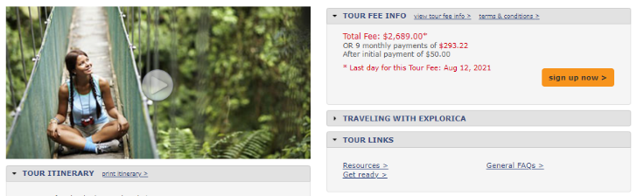




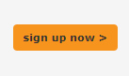

How to enroll
You can enroll through any of the following methods:
  Online at explorica.com/Eagan-1133
  By phone at 1-888-310-7121
  By mail when you complete the paper application and send it to:
    Explorica
    P.O. Box 9033
    Charlottesville, VA 22906-9033
Sample Tour Center

Slide 19

Thanks for joining us!
Questions? Please contact:
Program Leader: Catherine Eagan
Email: ceagan@laspositascollege.edu
Set up an Informational Meeting!
https://cccconfer.zoom.us/j/99187950462?pwd=dXFQRWVENFJ5a0hsdVUzT1JleFF2UT09

