Slide 1
College Day
Rebuilding Community & Re-establishing Connections
2022 - 2023

Slide 2

Welcome
President Foster
Enrollment Update
State of the College
President Foster
Director Samra
College Priorities
President Foster
Accreditation Update
VP Whalen
Budget Update
VP Raichbart
Caring Campus
Jean O’Neil Opipari
Academic Services Update
VP Whalen
Student Services Update
VP Wilson
Administrative Services Update
VP Raichbart
On the Horizon
President Foster

Slide 3
State of the College
Dr. Dyrell Foster
President

Slide 4
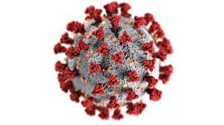


State of the College
Covid-19
Quest for Social Justice
Economic Upheaval

Slide 5

State of the College
Synonyms for Change:
    Adjust
    Innovate
    Modify
    Revise
    Transform
    Evolve
Source: Power Thesaurus

Slide 6
Changes in LPC Student Populations
Presented by Rajinder S. Samra
Director of Research, Planning, institutional Effectiveness
College Day
8.16.22

Slide 7
Las Positas College
Headcount of Students: Fall 1994 to Fall 2021

Slide 8
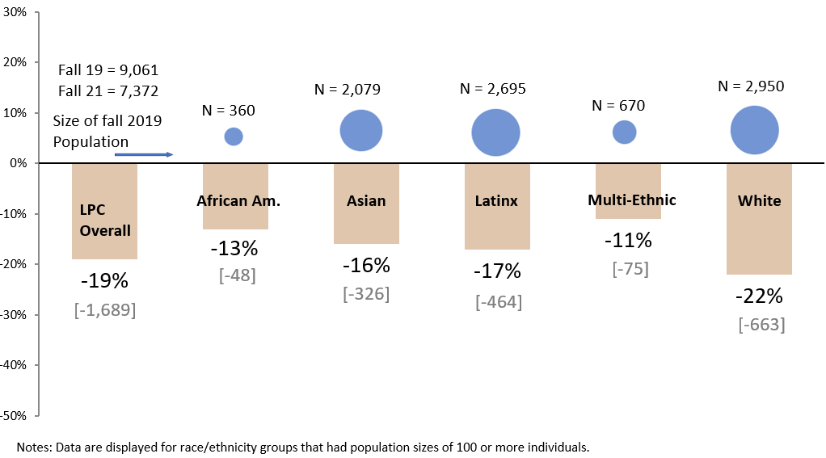
Las Positas College
Population Changes by Race/Ethnicity
Fall 2021 Compared to Fall 2019

Slide 9
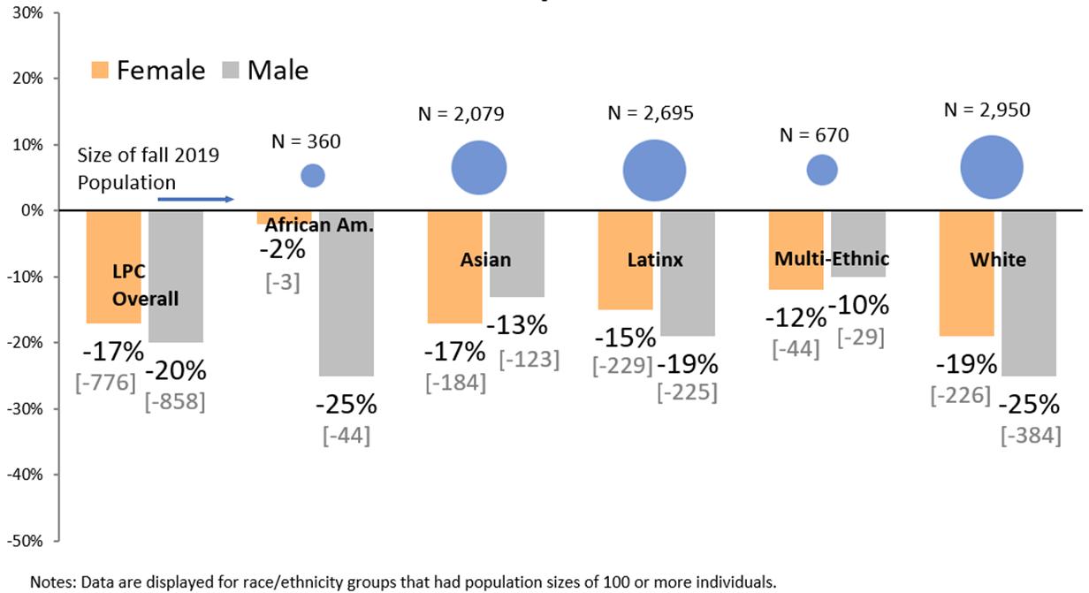
Las Positas College
Population Changes by Race/Ethnicity & Gender
Fall 2021 Compared to Fall 2019

Slide 10
Las Positas College
Population Changes by Race/Ethnicity
Fall 2021 Compared to Fall 2019

Slide 11
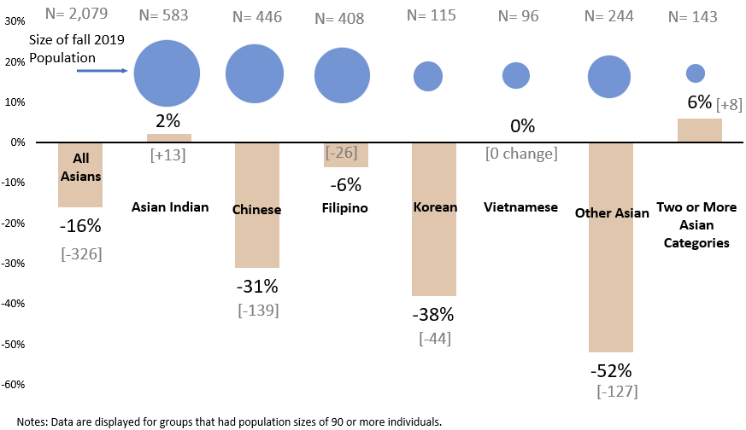
Las Positas College
Population Changes by Detailed Asian Categories
Fall 2021 Compared to Fall 2019

Slide 12


State of the College
We have always worked hard to:
RETAIN AND GRADUATE STUDENTS
GROW
ENROLLMENT

Slide 13
College Priorities
2022-23 Academic Year

Slide 14
College Priorities
Grow Enrollment
Outreach & Recruitment
Retention & Persistence

Slide 15

College Priorities
Every interaction is a moment of truth
Students evaluate the value proposition every day, every term.

Slide 16
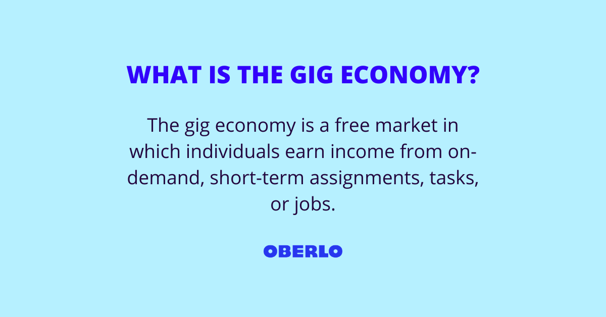

College Priorities
Every interaction is a moment of truth
Students evaluate our value proposition every day, every term.

Slide 17
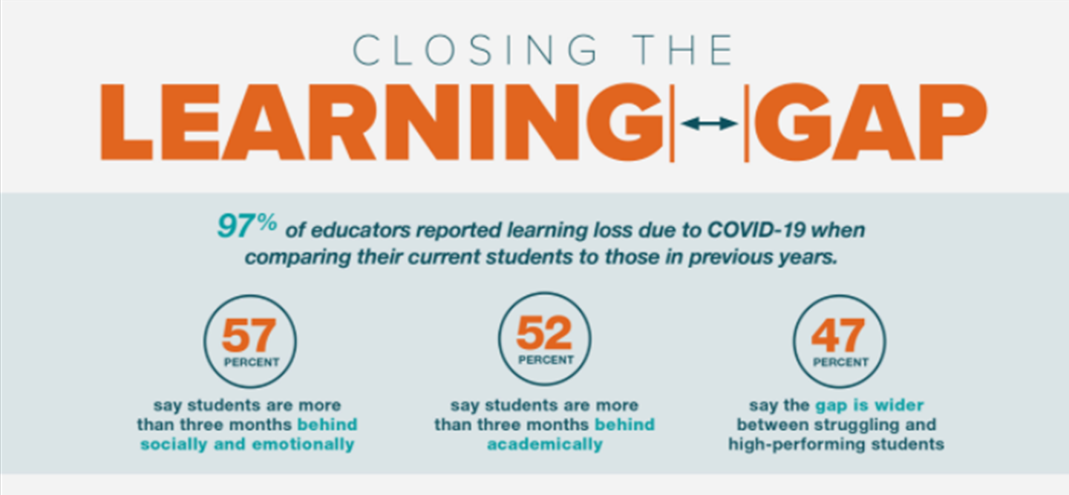
College Priorities
Every interaction is a moment of truth
Students evaluate our value proposition every day, every term.

Slide 18

College Priorities
What is our Value Proposition?
What is our commitment to our students?

Slide 19


Reasons Why LPC is the Best Choice
The #1 Community College in the Bay Area
The 3rd Best Community College in California
Among the highest transfer rates among all CA Community Colleges

Slide 20
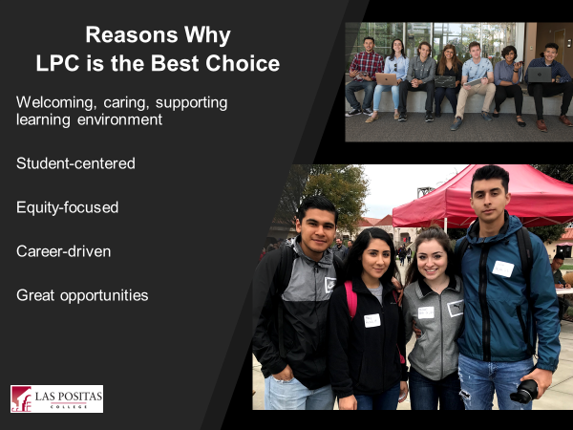

Slide 21
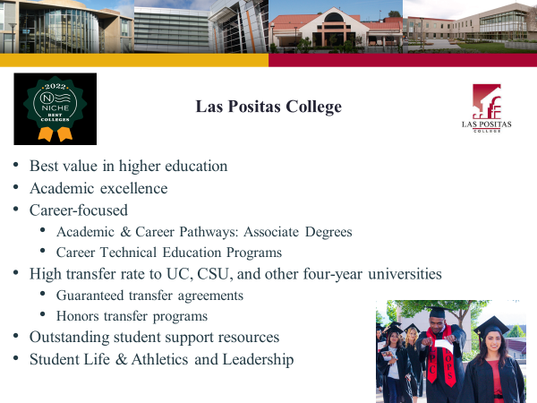

Slide 22
College Priorities
Prioritize Enrollment: Recruitment & Retention
    In-person events (sense of belonging)
    Persistence Project
    Every interaction is a moment of truth
Continue to advance Guided Pathways
    Implementation of Student Success Teams
Implement the Caring Campus Initiative

Slide 23
College Priorities
4. Identify & remove institutional barriers to student success
    Initial list of barriers and work collaboratively to find solutions
5. Begin conversations regarding institutional re-alignment
    Assess and align organizational structure with strategic goals
    Institutional effectiveness, stability and long-term institutional health

Slide 24

State of the College

Slide 25
College Priorities
Continue to enhance our campus culture to ensure that every student feels a sense of belonging and connectedness to Las Positas College
Professional Development

Slide 26
Accreditation Update
Dr. Kristina Whalen
Vice President of Academic Services

Slide 27
LPC’s ACCREDITATION TIMELINE
Kick off to ISER process; writing begins
District Standards Incorporated
ISER Submitted to ACCJC
Core Inquiry Report Rec’d
April 2020
January 2021
October 2021
February 2022
August 2020
March 2021
December 2021
March 2022
ACCJC Training
Writing continues
College Review of ISER
Comprehensive Review by Peer Team

Slide 28
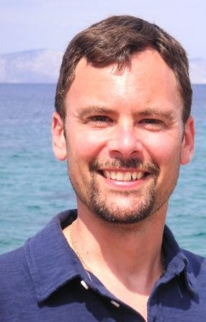
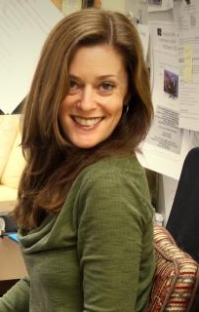
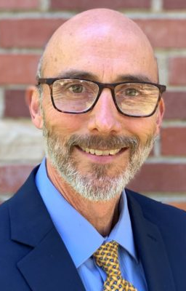
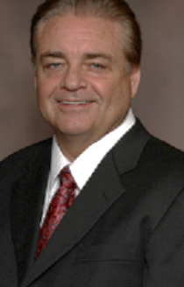
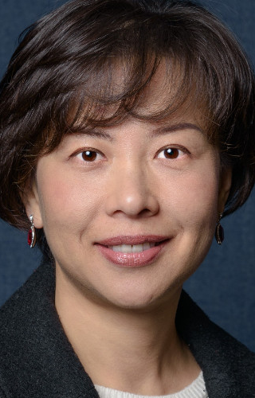





What’s Ahead
September 20 – Response to Core Inquiries submitted
October 10 – Focused site visit with:
Dr. Tim Karas,
Chair Superintendent/President
Mendocino College
Ms. Elissa Caruth,
English Professor, Department Chair
Academic Senate Vice President
Oxnard College
Dr. Kevin Bontenbal,
Vice President, ACCJC
Dr. Daniel Walden,
Vice Chair Superintendent/President
Victor Valley College
Dr. Lan Hao,
Director of Institutional Research, Planning, and Effectiveness
Citrus College

Slide 29
WHAT TO EXPECT
The visiting team will only focus on Core Inquiries
Dialogue with some of the following staff:
College President
Vice Presidents
Director of Institutional Research
Deans
Faculty and staff engaged in scheduling instruction and services
Counselor(s)
Evaluator(s)
Program Coordinator(s)
Discipline faculty
Articulation Officer
College Council members
Academic Senate President.
Associated Student President
Classified Senate President

Slide 30
Budget Update
Anette Raichbart
Vice President of Administrative Services

Slide 31
Las Positas College
FY 22-23 Budget (State & College)
August 16, 2022

Slide 32
California FY 2022-23 Budget
State Budget Overview
  Total expenditure budget greater than $300 billion, a 17% increase over last year
  General fund expenditure budget of $235 billion, a 20% increase over last year
  Reserves of $37.2 billion, with the Rainy Day Fund now at the constitutional maximum of 10% and the Public School System Stabilization Reserve making up $9.5 billion of the reserve total
Community Colleges
  $4 billion in Proposition 98 augmentations over prior year, the majority of which is provided as one-time funds

Slide 33
Hold Harmless
Revenue protection for districts through FY 2024-25
A district’s FY 2024-25 revenue level would become its new base, or floor, below which it could not drop.
Beginning in FY 2025-26, districts who do not generate funding through the SCFF greater than their FY 2024-25 revenue floor, would no longer be given cumulative COLAs
  COLA would essentially become one-time money in years in which it was given

Slide 34
Major Ongoing Items
COLA of 6.56%
  Nearly $8 million in additional ongoing revenue for the District
  COLA is also provided to various categorical programs
SCFF Metric increases
  $400 million dedicated to increasing the $ per FTES as well the $ per points in the supplemental and success components of the formula
  This has the desired effect of some districts moving out of hold harmless and onto the SCFF

Slide 35
Major One - Time Items
Physical Plant and Instructional Equipment funded at $840 million
  District should receive approximately $12.6 million and have until June 30, 2027 to expend or encumber
COVID-19 Block Grant funded at $650 million
  District should receive approximately $8.5 million to address issues related to the COVID-19 pandemic, including the mitigation of learning loss.
  Districts can use the funds for student support efforts, reengagement strategies, professional development opportunities, technology investments, and health and safety measures. Districts have 5 years to expend or encumber.

Slide 36
Major One - Time Items Cont.
$171.5 million for “local district efforts and initiatives”
  More information needed…could be competitive grants.
Retention and Enrollment strategies at $150 million
  District should receive approximately $2 million to address declining enrollment
Technology and Data Security funded at $75 million
  Districts should receive approximately $1 million to be used for modernization of the CCCApply system, security upgrades for education technology systems, costs for monitoring security risks, and efforts to improve the quality of online and distance education

Slide 37
Other One - Time Items
Health-care focused vocational pathways in Adult Education at $130 million (over 3 years)
Common Course Numbering at $105 million
Implement transfer reforms associated with AB 928 at $65 million
Implement equitable placement and completion practices at $64 million (competitive grants)
The list goes on…

Slide 38
Total Ongoing and One-Time Increases

Slide 39
Pension Increases
CalPERS goes from 22.91% to 25.37%, a 10.74% percentage increase
  Anticipate expenditures to increase by $900,000
CalSTRS goes from 16.92% to 19.10%, a 12.88% percentage increase
  Anticipate expenditures to increase by $1 million
Health Care rates at the District remained relatively stable year-over-year

Slide 40
Las Positas College Budget
95% of U/GF

Slide 41
Caring Campus
Jean O'Neal Opipari
Classified Senate President

Slide 42

Introducing Caring Campus College Day
Las Positas College
August 16, 2022
Caring Campus Ambassadors
© all material copyright IEBC, 2021

Slide 43
What is Caring Campus?
An intentional effort to make students feel welcome and a sense of connectedness to your college
Engages the underutilized classified professionals who are typically missing from student success efforts
Helps classified professionals connect with one another and with other employee groups to create a positive college environment
Creates behavior change that influences culture change across campus
Causes the college to reexamine policy barriers to student success

Slide 44


Caring Campus Process—A Quick Review
LPC classified professionals have identified and developed implementation, monitoring, and communication plans for traditional (face-to-face) and virtual student interactions.

Slide 45

Your College’s Caring Campus Classified Professional Leaders

Slide 46

Your College’s Caring Campus Classified Professional Leaders
Adria Anderson-Kelly | Amanda Ingold | Amy Rel | Angelica Cazarez | Aubrie Ross | Diana Navarro-Kleinschmidt
Frances DeNisco | Henry Smith | Hermina Sarkis-Kelly | Jean O’Neil-Opipari | Katelyn Cortez | Kiley Zieker
Lucianna Caselli | Marissa Ablaza | Miguel Alvarez | Mike Sugi | Ralitsa Ivanova-Olsson | Sarah Bettencourt-Anderson
Sherita Waters | Sharon Davidson | Shriya Shah | Stella Del Rosario | Terrance Thompson | Theresa Mailander

Slide 47
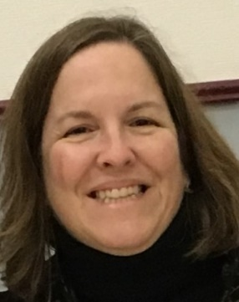

How We Got Here and Why
Jean O’Neil-Opipari
STEM Program Coordinator
STEM
What Caring Campus means for your college
The role of professional classified staff
What we hope Caring Campus will do

Slide 48
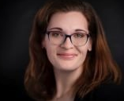
Behavioral Commitments
Aubrie Ross
Senior Administrative Assistant
Business, Social Science & Learning Resources Division (BSSL)
Traditional (face-to-face) Commitments
  Cross-Departmental Awareness
  Name Tags
  Warm Referrals
Virtual Commitments
  Cross-Departmental Awareness
  Give Your Information Up Front
  Warm Referrals

Slide 49
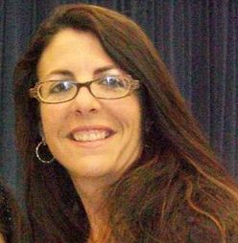
Implementation & Monitoring Plans
Frances DeNisco
Community Education
Admissions and Records
Staff
Photo
Here
Implementation Plan
What we will do
Timeline
Resources
Monitoring Plan
Not evaluation
Focusing on the positive
Rewards

Slide 50
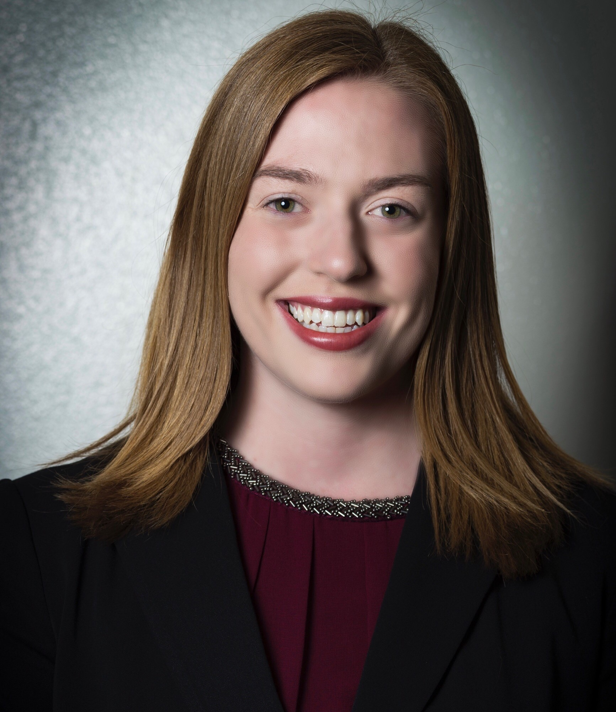
Communication Plans
Sarah Bettencourt-Anderson
Outreach Specialist
Student Services
Staff
Photo
Here
Leadership
Faculty
Students
Our professional staff colleagues

Slide 51

Celebrate!
Celebrate the accomplishments of the classified professionals who engaged
in this effort

Slide 52
Academic Services Update
Dr. Kristina Whalen
Vice President of Academic Services

Slide 53
Academic Services Update
State-wide Curriculum Changes
ZTC and LTC Momentum

Slide 54
Students Services Update
Dr. Jeanne Wilson
Vice President of Student Services

Slide 55
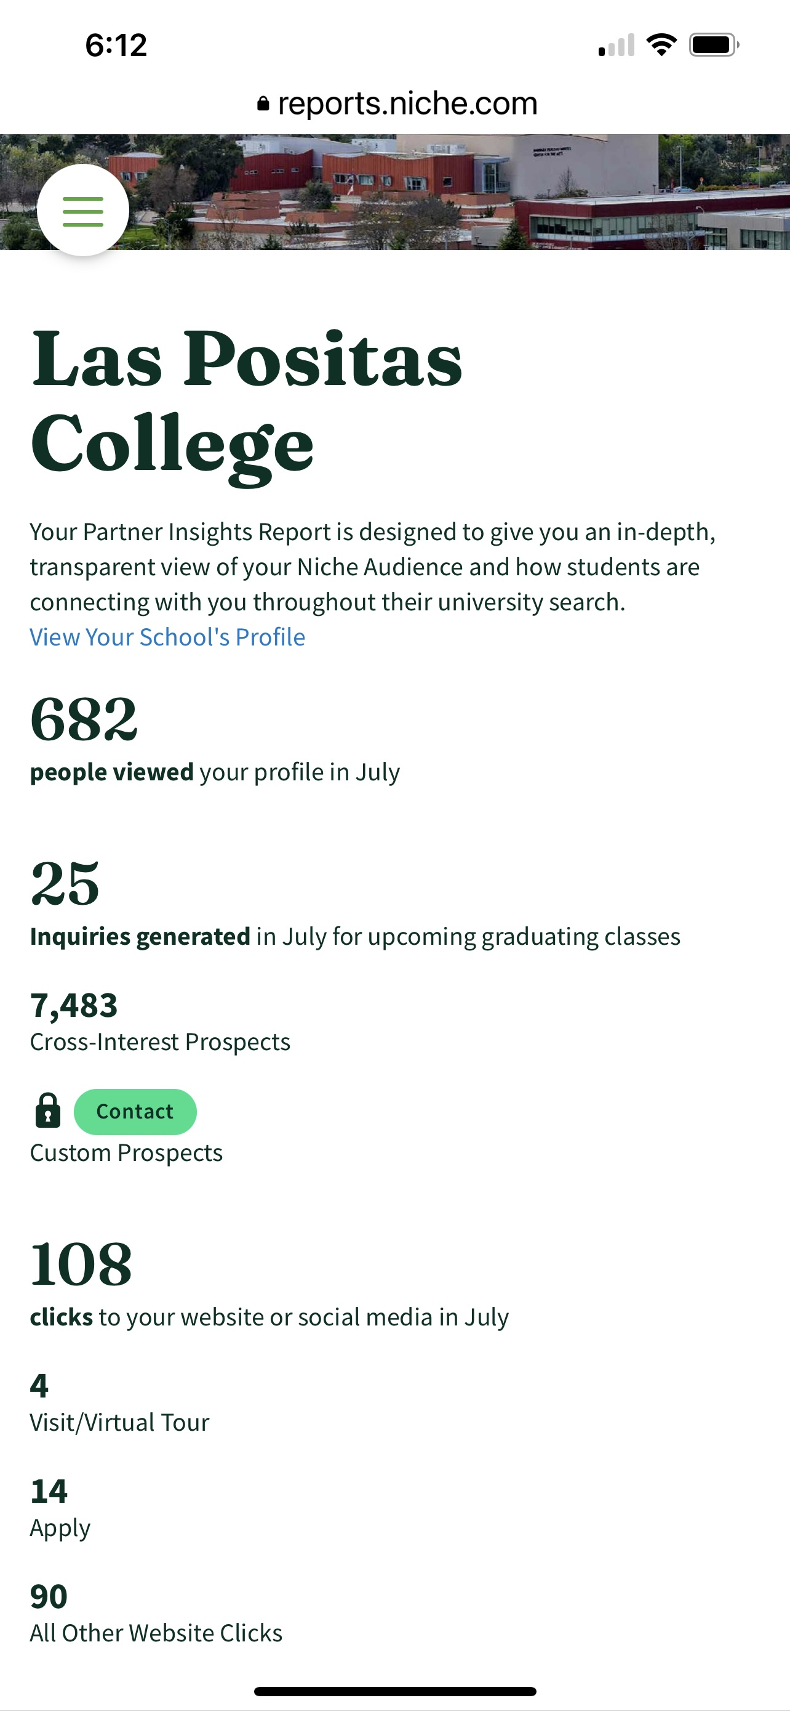

Marketing & Outreach
Reintroduce Ourselves
Telling Our Stories
Bumble Bee
Niche
Social Media LinkedIn/Instagram/Facebook

Slide 56

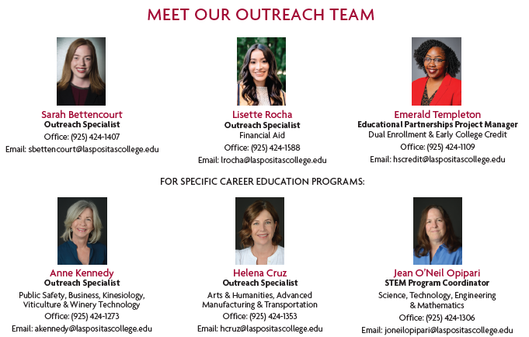
Concurrent/Dual Enrollment
Outstanding Outreach Team!

Slide 57
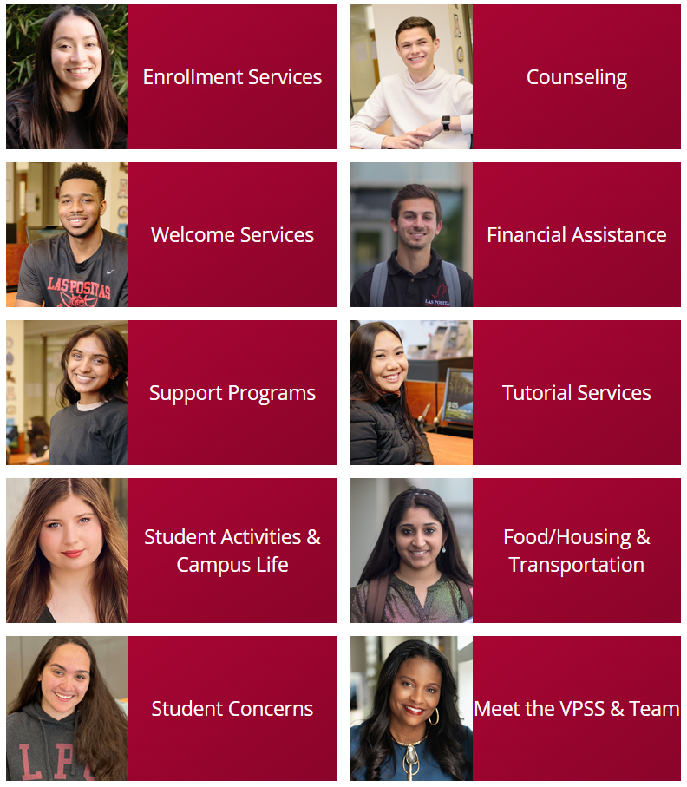
Access & Onboarding

Slide 58
Access & Onboarding
Onboarding Revisions
Application Inquiry project and review of major codes led to major changes. 150 Major Codes reduced to the 8 Pathways.
Kennedy & Co.
CCCAPPLY
District Onboarding Analysis Group
Fall 2022 Counselors Lead the Way!
Student’s 1st
Kudos to the Counseling Department for realigning the entire division by success teams.
Counselor Success Teams
Increase student success and completion through change in college practices and processes

Slide 59



Retention, Connectedness
& Belonging
  Intentional Focus
  Warm Welcoming Environment
  Basic Needs/Student Resource Coordinator
  New Mini Market
  Deans List Recognition
  Identified Staff Interpreters w Contact Info & Photo
CARING CAMPUS

Slide 60
Administrative Services Update
Anette Raichbart
Vice President of Administrative Services

Slide 61
Campus Updates
New tag less parking system. Your license plate is your parking permit.
Parking lot D and E will be re-striped in September and new signs around campus loop will be installed.
Campus Security system is being implemented with completion date of December 2022. Special Thank you! Sean Prather, Michael Sugi and the entire campus safety team!

Slide 62
Campus Updates
3D Map is now available on our web site. Please check it our by clicking on the link in the top left corner. Special Thank you! Thomas Rothman, Tim Druley, Michael Sugi, Stephen Gunderson, Dan Cearley
New trees planted in front of parking lot P and E. Special Thank you! To Walt Blevins and Ron Rinaldi and the Grounds Team!
COVID-19 masking signs are available around campus with a weekly update to take place each Friday morning to align with the county order.

Slide 63
On the Horizon…
Dr. Dyrell Foster
President

Slide 64
College Meetings
  College Meetings (Governance, Division, Department):
    In-person meetings are encouraged, however hybrid meetings are an option
    Most large gatherings will have a hybrid option:
      Town Meetings
      Flex Day (TBD)
      President’s Speaker Series will remain virtual this year

Slide 65
First Week of School
Free Food:
August 17, visit the Cafeteria (Building 1600) for Free Food from 8am-7pm
Information Tables:
August 17 & 18:
In front of Building 2000 (the Library) from 8am-7pm
In front of Building 1600 (facing Parking Lot C) from 8am-3pm
In between Building 800 & Building 1600 (near the cafeteria) from 8am-2pm

Slide 66

President’s Speaker Series
September 6, 2022, 3pm – 4pm
Ron Kaufman
Uplifting Service
New York Times Bestselling Author
Ranked #1 Customer Service Expert in the World
by Global Gurus in:
2018, 2019, 2020, 2021

Slide 67
The Remainder of the Day…
10:00am Guided Pathways:
Supporting Students in our Academic & Career Pathways
10:45am Keynote: Dr. Josie Ahlquist
Engaging the Digital Generation
12 noon Lunch
12:45pm Breakout Sessions
2:15pm Division Meetings
3:15pm Department/Discipline Meetings

Slide 68
THANK YOU!
Enjoy the Rest of the Day…

