Slide 1
New Associate Degree General Education Requirements

Slide 2
Key Changes

Slide 3
Key Changes
Residency can be determined at the District level

Slide 4
Key Changes
Residency can be determined at the District level
Requires the use of Credit for Prior Learning

Slide 5
Key Changes
Residency can be determined at the District level
Requires the use of Credit for Prior Learning
Removes Math, English, Ethnic Studies graduation requirements

Slide 6
Key Changes
Residency can be determined at the District level
Requires the use of Credit for Prior Learning
Removes Math, English, Ethnic Studies graduation requirements
Allows for a grade of ‘D’ in all GE areas

Slide 7
Key Changes
Residency can be determined at the District level
Requires the use of Credit for Prior Learning
Removes Math, English, Ethnic Studies graduation requirements
Allows for a grade of ‘D’ in all GE areas
Limits communication courses to Oral Communications

Slide 8
Key Changes
Residency can be determined at the District level
Requires the use of Credit for Prior Learning
Removes Math, English, Ethnic Studies graduation requirements
Allows for a grade of ‘D’ in all GE areas
Limits communication courses to Oral Communications
Students must take a Mathematics and Quantitative Reasoning course

Slide 9
Key Changes
Residency can be determined at the District level
Requires the use of Credit for Prior Learning
Removes Math, English, Ethnic Studies graduation requirements
Allows for a grade of ‘D’ in all GE areas
Limits communication courses to Oral Communications
Students must take a Mathematics and Quantitative Reasoning course
Explicitly allows for a transfer GE pattern to be used instead of local GE (we already do this)

Slide 10
Title 5 Associate Degree GE Fall 2025
Title 5 § 55061

Slide 11
Title 5 Associate Degree GE Fall 2025
Title 5 § 55061
Minimum of 21 units:

Slide 12
Title 5 Associate Degree GE Fall 2025
Title 5 § 55061
Minimum of 21 units:
English Composition (3 units)

Slide 13
Title 5 Associate Degree GE Fall 2025
Title 5 § 55061
Minimum of 21 units:
English Composition (3 units)
Oral Communication and Critical Thinking (3 units)

Slide 14
Title 5 Associate Degree GE Fall 2025
Title 5 § 55061
Minimum of 21 units:
English Composition (3 units)
Oral Communication and Critical Thinking (3 units)
Mathematical Concepts and Quantitative Reasoning (3 units)

Slide 15
Title 5 Associate Degree GE Fall 2025
Title 5 § 55061
Minimum of 21 units:
English Composition (3 units)
Oral Communication and Critical Thinking (3 units)
Mathematical Concepts and Quantitative Reasoning (3 units)
Arts and Humanities (3 units)

Slide 16
Title 5 Associate Degree GE Fall 2025
Title 5 § 55061
Minimum of 21 units:
English Composition (3 units)
Oral Communication and Critical Thinking (3 units)
Mathematical Concepts and Quantitative Reasoning (3 units)
Arts and Humanities (3 units)
Social and Behavioral Sciences (3 units)

Slide 17
Title 5 Associate Degree GE Fall 2025
Title 5 § 55061
Minimum of 21 units:
English Composition (3 units)
Oral Communication and Critical Thinking (3 units)
Mathematical Concepts and Quantitative Reasoning (3 units)
Arts and Humanities (3 units)
Social and Behavioral Sciences (3 units)
Natural Sciences (3 units)

Slide 18
Title 5 Associate Degree GE Fall 2025
Title 5 § 55061
Minimum of 21 units:
English Composition (3 units)
Oral Communication and Critical Thinking (3 units)
Mathematical Concepts and Quantitative Reasoning (3 units)
Arts and Humanities (3 units)
Social and Behavioral Sciences (3 units)
Natural Sciences (3 units)
Ethnic Studies (3 units)

Slide 19
Title 5 Associate Degree GE Fall 2025
Title 5 § 55061
Minimum of 21 units:
English Composition (3 units)
Oral Communication and Critical Thinking (3 units)
Mathematical Concepts and Quantitative Reasoning (3 units)
Arts and Humanities (3 units)
Social and Behavioral Sciences (3 units)
Natural Sciences (3 units)
Ethnic Studies (3 units)
Additional Areas and Units are allowed

Slide 20
LPC Associate of Science (AS) GE Fall 2024
19 units
Area I. Language and Rationality
IA - English Composition (3 units) (C or better or “P”)
IB - Communication and Analytical Thinking (3 units)
Area II: Natural Sciences (3 units)
Area III. Humanities (3 units)
Area IV. Social and Behavioral Sciences (3 units)
Area V. Kinesiology
VA - Kinesiology (1 unit)
Area VI. Ethnic Studies (3 units) (C or better or “P”)
Graduated Requirements – satisfactory completion of a course in:
MA. Mathematics Proficiency (C or better or “P”)

Slide 21
LPC Associate of Science (Cal-GETC)
19 21 units
Area I. Language and Rationality
IA - English Composition (3 units) (C or better or “P”)
IB - Communication and Analytical Thinking (3 units)
Area II: Natural Sciences (3 units)
Area III. Humanities (3 units)
Area IV. Social and Behavioral Sciences (3 units)
Area V. Kinesiology
VA - Kinesiology (1 unit)
Area VI. Ethnic Studies (3 units) (C or better or “P”)
Graduated Requirements – satisfactory completion of a course in:
MA. Mathematics Proficiency (C or better or “P”) (3 units)

Slide 22
LPC Associate of Arts (AA) GE Fall 2024
28 units
Area I. Language and Rationality
IA - English Composition (3 units) (C or better or “P”)
IB - Communication and Analytical Thinking (3 units)
IC - Writing and Critical Thinking (3 units)
Area II. Natural Sciences (3 units)
Area III. Humanities (3 units)
Area IV. Social and Behavioral Sciences (3 units)
Area V. Wellness
VA - Kinesiology (1 unit)
VB - Health (3 units)
Area VI. Ethnic Studies (3 units) (C or better or “P”)
Area VII. American Institutions (3 units)
Graduated Requirements – satisfactory completion of a course in:
MA. Mathematics Proficiency (C or better or “P”)

Slide 23
LPC Associate of Arts (Cal-GETC)
28 21 units
Area I. Language and Rationality
IA - English Composition (3 units) (C or better or “P”)
IB - Communication and Analytical Thinking (3 units)
IC - Writing and Critical Thinking (3 units)
Area II. Natural Sciences (3 units)
Area III. Humanities (3 units)
Area IV. Social and Behavioral Sciences (3 units)
Area V. Wellness
VA - Kinesiology (1 unit)
VB - Health (3 units)
Area VI. Ethnic Studies (3 units) (C or better or “P”)
Area VII. American Institutions (3 units)
Graduated Requirements – satisfactory completion of a course in:
MA. Mathematics Proficiency (C or better or “P”) (3 units)

Slide 24
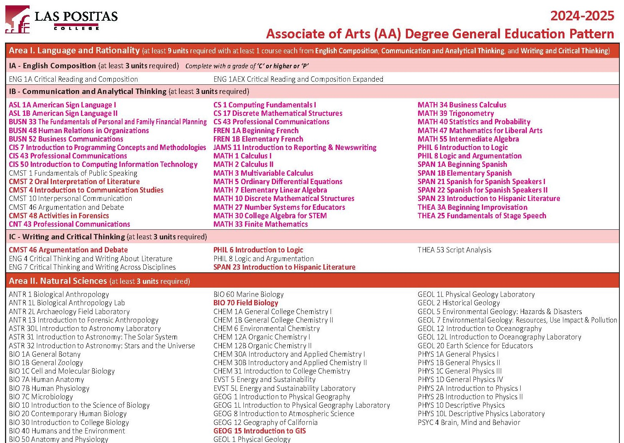

Slide 25
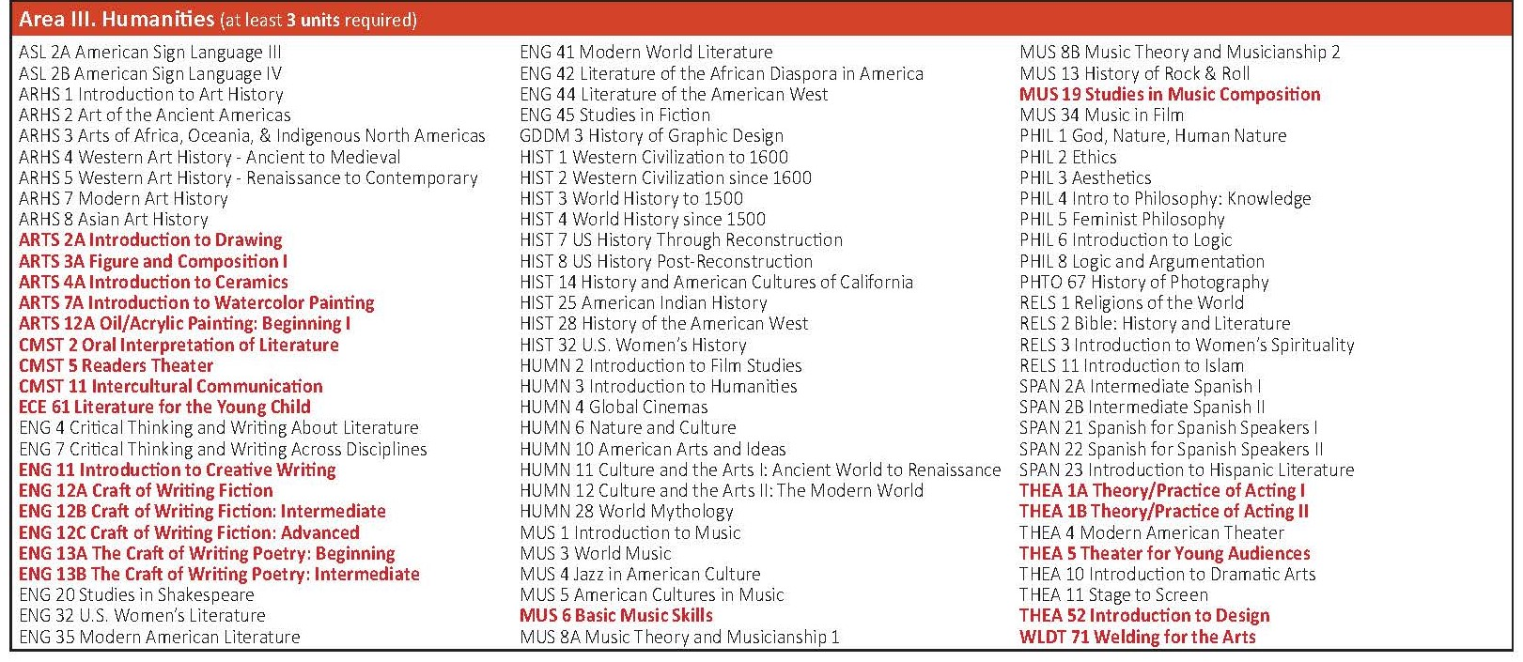

Slide 26
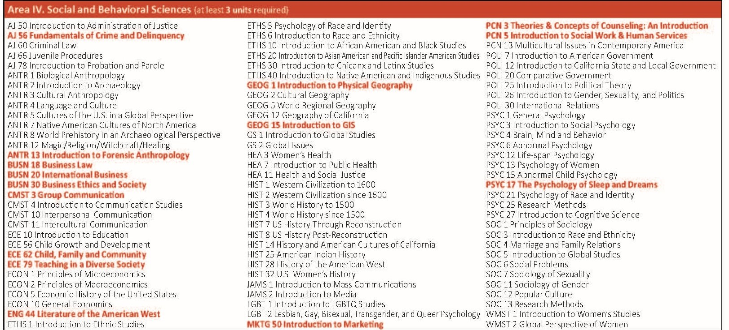

Slide 27
