Slide 1
"R.E.D." by The Halluci Nation (formerly A Tribe Called Red)
feat. Yasiin Bey, Narcy, & Black Bear
"Back in my room I put my earphones in. Put on A Tribe Called Red. They're a group of First Nations DJs and producers based out of Ottawa. They make electronic music with samples from powwow drum groups. It's the most modern, or most postmodern, form of Indigenous music I've heard that's both traditional and new-sounding" (77).
--Edwin Black, There There

Slide 2
There There a novel by Tommy Orange 2023 LPC Literary Arts Festival Keynote Speaker*
Welcome!
Spring 2023 campus read
*In conjunction with the President’s Speaker Series and with support from the LPC Foundation

Slide 3
LET’S DISCUSS!
FIRST IMPRESSIONS: What did you think of the book? What did you like? Dislike?
What stuck with you?
Any topics or themes that stood out?
Notice any personal connections? Connections to the world around us?

Slide 4
Focused discussion
The story shows how “a person’s identity does not form automatically – it must be cultivated. How has your family cultivated your identity? How have you cultivated it yourself?”
In the story, we see how “trauma is intergenerational--hardship is often passed down through families. What trauma has impacted your family? How have you had to deal with what happened to older generations?”
There There illustrates how “a physical place can both define and destroy an individual. How does [the Bay Area (or another place you’ve lived)] define you? How does it hold you back?”
Prompts taken from the
Free Library of Philadelphia’s
There There Curriculum

Slide 5
What are some takeaways regarding
LPC’s students and community?

Slide 6
So about that spider leg scene…
It really happened!

Slide 7
So about that spider leg scene…
It really happened!

Slide 8
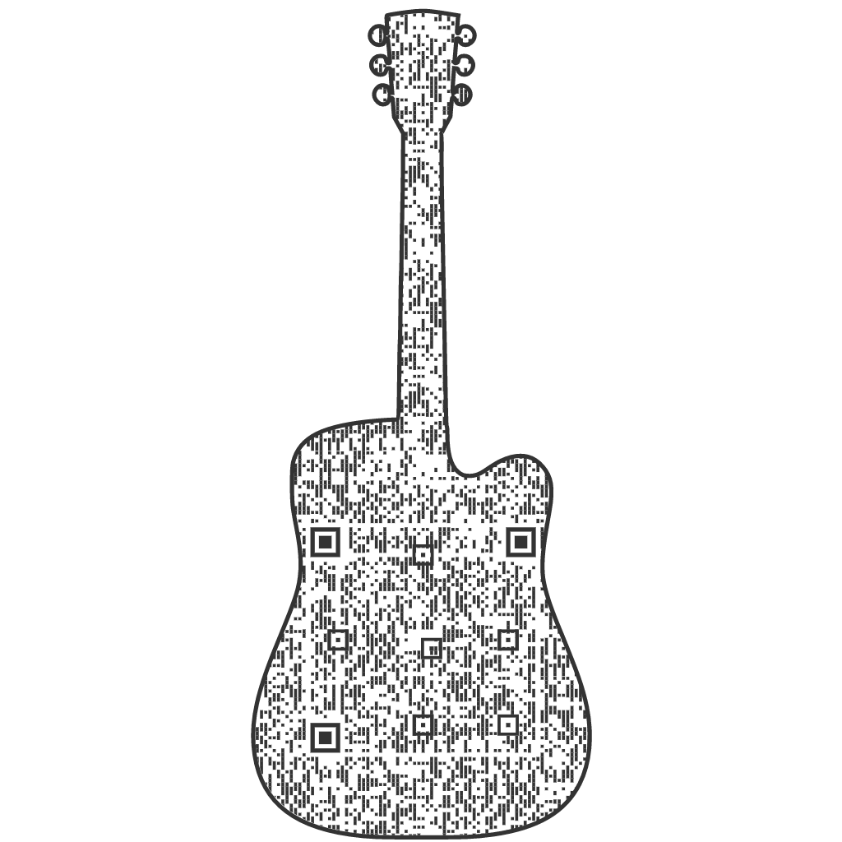
Tommy Orange’s There There Playlist (like, really)

Slide 9
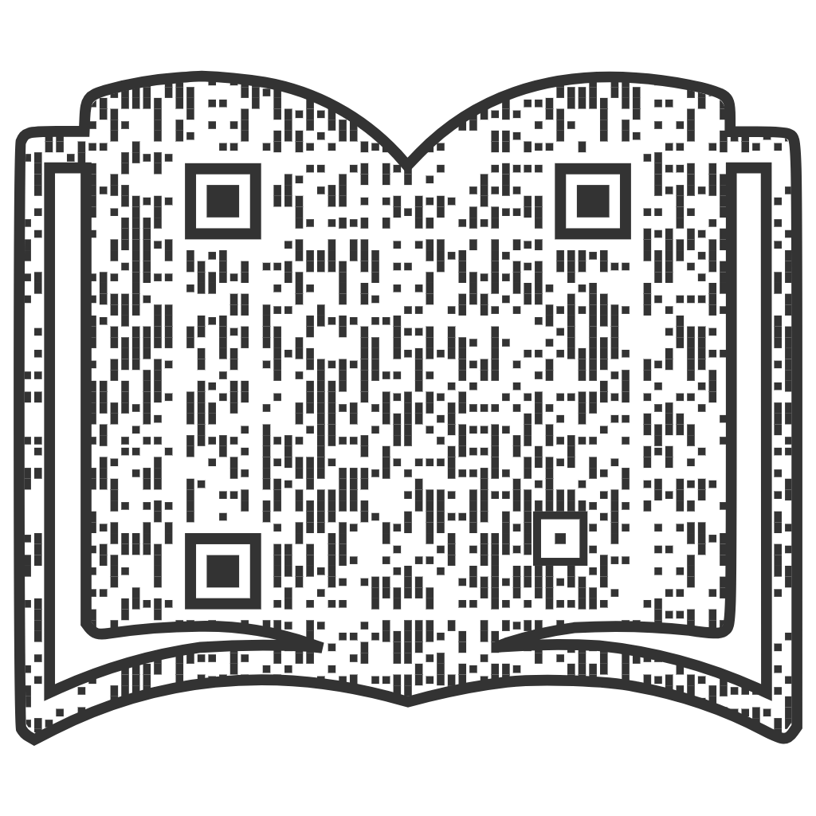
Teaching the book (now or in the future)? Here’s curriculum from the Free Library of Philadelphia. Includes book reviews, author interview, a Tommy Orange essay, reading questions, essay and assessment ideas, and links to audio and video interviews and websites about Oakland and its Urban Native American population.
Member of the English Department? This packet as well as other resources, including additional writing prompts, assignments about land acknowledgment, videos for context, and the Tommy Orange playlist, can be found in the department’s Canvas modules.

Slide 10
Thanks for joining us! Please take this survey if you have a minute.

