Slide 1
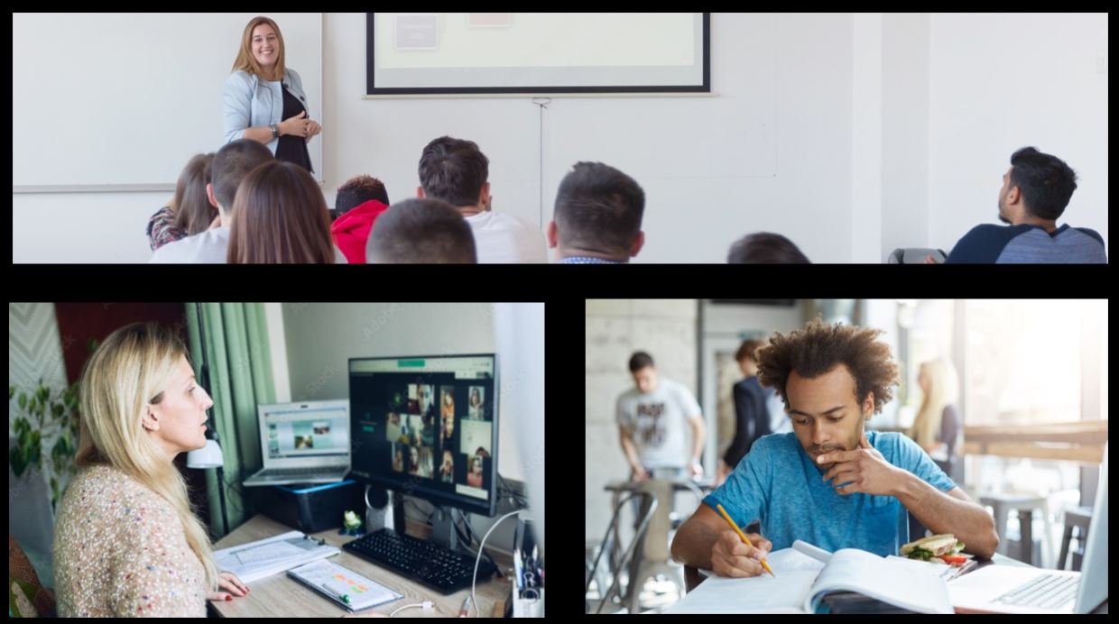
HyFlex @ LPC
Bill Komanetsky, CS/CNT/CIS
Flex Day, March 8, 2022

Slide 2
Agenda
My Faculty experience (so far)
Student Participation
Student Collaboration
Giving Exams
Technology Observations
Lecturing Habits

Slide 3
Key Points
There is no "Possibility" of increased workload. There Will be an increased workload
You must setup the class earlier than a normal F2F class (this gets easier as your experience builds)
You need to get acquainted, intimately, with the Tech
You must remember that there are students on line.
It's easy to get caught up with the students who are in the class and you forget about the on-line students

Slide 4
Student Participation

Slide 5
Students Participating
Before we went Face-to-Face, I did a poll:
45% of students said they would be on-line all of the time
8% of students said they would be on-line 25% of the time
13% of students said they would be on-line 50% of the time
18% of students said they would be on-line 75% of the time
15% of students said they would always be in class
These number vary by +/- 10%

Slide 6
Students Participating
The participation poll numbers are close to reality.
Anywhere from 10 - 20% of the student population actually comes to face to face
The face to face numbers drop drastically on Exam days

Slide 7
Student Collaboration

Slide 8
Student Collaboration
About 20% of students in class complain there is no way to collaborate with students who are remote
Students, for the most part, are hesitant to get too close to other students in the classroom, making collaboration difficult

Slide 9
Student Collaboration
I allowed students in class to log into Zoom (no audio or video) to collaborate with on-line students
In-class students place IC or In-Class at the end of their names in Zoom
I setup the Zoom Breakout rooms and with a little effort, made sure remote and local students are distributed
I would visit the breakout rooms, to see how students were doing
I allowed all students to share their screens, not Web Cam’s

Slide 10
Student Collaboration
I allowed students in class to log into Zoom (no audio or video) to collaborate with on-line students
I let students know to use chat and to leave the room and come back to the main room if they have a question they wish to pose verbally
In-Class students can ask questions from on-line students in their group - kind of like “translators”
Students thought this was difficult, but better than nothing

Slide 11
Giving Exams

Slide 12
Giving Exams
To keep things fair, all exams are given on-line
During my first exam, 90% of the students were were joining face to face didn't on exam day
There is obviously something advantageous to taking an exam at home
Two exams need to be created
One for on-line students: Proctorio enabled
One for face-to-face students: No Proctorio
Works OK if missed exams are not automatically given a 0% grade

Slide 13
Technology Observations

Slide 14
Technology Observations
Connecting a second computer or device to the Zoom meeting is very advantageous
Using Pronto can be a problem. Only one fifth of my students have installed Pronto and I cannot force them to do so
These students will not see messages sent to Pronto students
Discussion boards (Canvas) have worked better. Everyone can see those
Pronto creates a 24x7 instructor contact mechanism (I need some sleep)

Slide 15
Technology Observations
Using the OWL app (iPhone or Android) and setting the cameras to enhanced presenter mode is really important
Gives the students a more 'live' view of the instructor as they more around the class
White Board use is spotty
Glare from windows makes seeing the white board difficult on-line. Closing the blinds or turning off the classroom lights just makes this worse
I have actually pointed my laptop camera at the whiteboard making it MUCH clearer for students

Slide 16
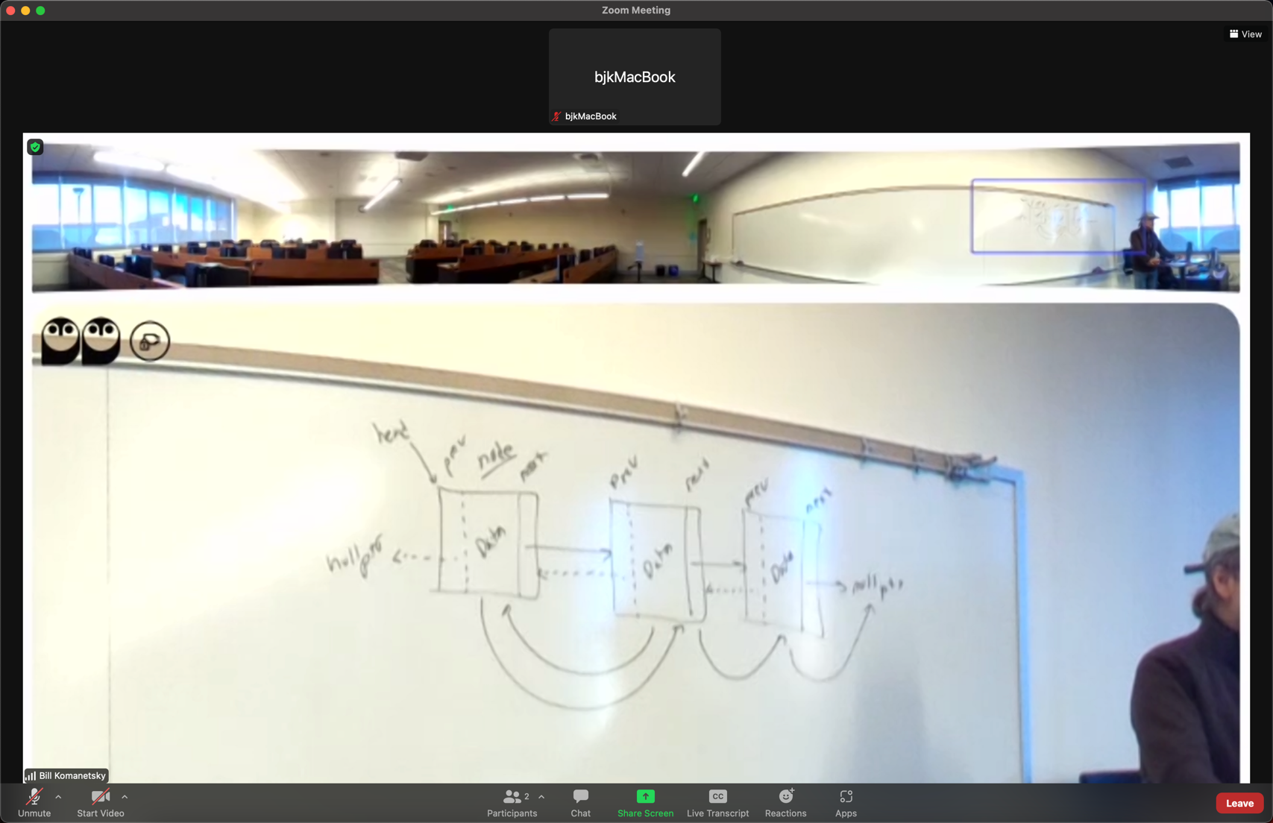
Technology Observations
White Board Example - Owl Camera
Yes, the blinds are down 100%
Blinds Down - Manual Zoom
Blinds Down - Auto Zoom

Slide 17
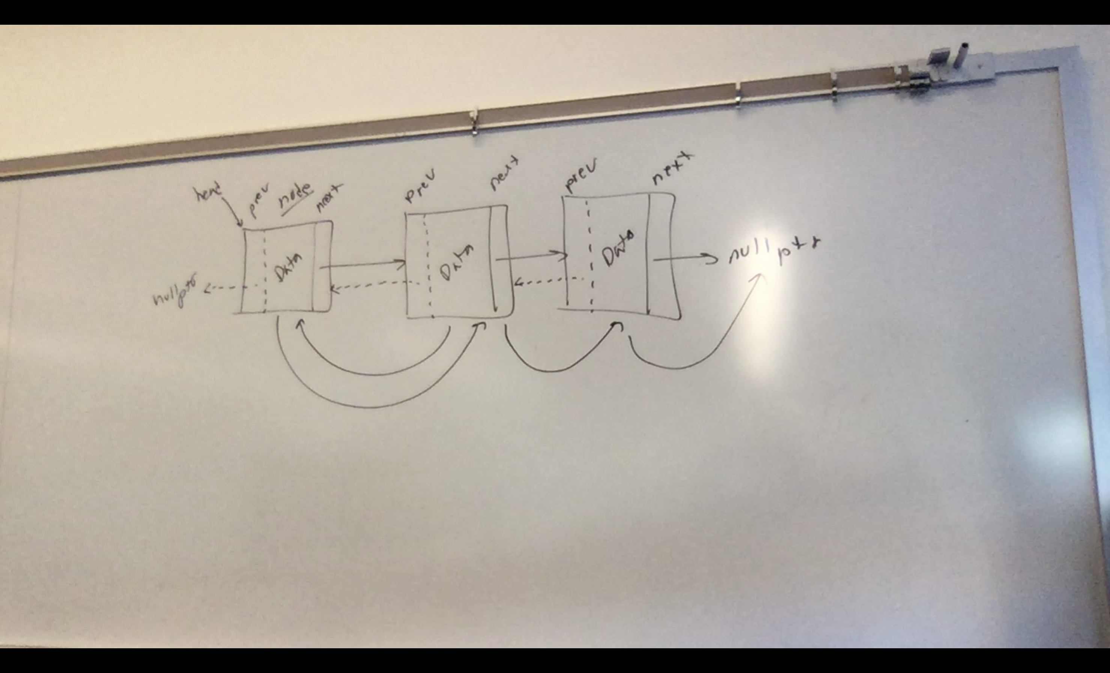
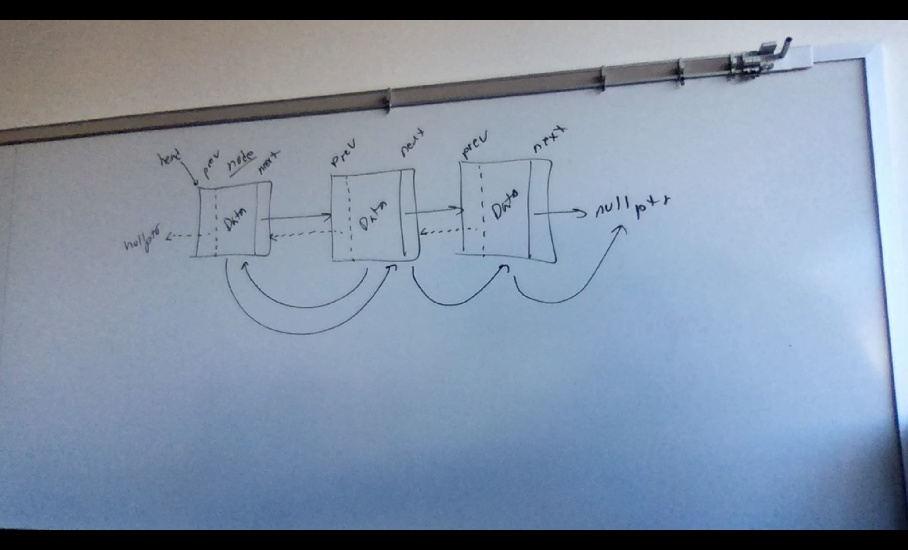
Technology Observations
White Board Example - Laptop Camera
Blinds Up
Blinds Down 75%

Slide 18
Technology Observations
Using the Zoom or another white-board app
Students in class have complained that they cannot see me as I am sitting down to use these apps
Using the drawing app on a tablet as I stand works much better - impossible with a standard laptop

Slide 19
Technology Observations
All of these technology issues will be resolved in the ‘Real’ technology coming in the Fall (2022)

Slide 20
Lecturing Notes

Slide 21
Lecturing
It's very easy to forget your on-line students. Appointing an on-line student to remind you is of great help - also promotes questions from on-line
You definitely need to speak more loudly so on-line students can hear. If you are wearing a mask, even more so
more?

Slide 22
What do Students Say?

Slide 23
What’s good about HyFlex?
Ability to attend class
I was able to go to the doctor without feeling guilty
No Traffic
Sleeping an extra 1/2 hour
A choice to commute or not
Sometimes my family is using my car

Slide 24
What’s worst about HyFlex?
Bad Camera focus at times
Reading the white board
Difficult asking questions without stepping on someone else asking a question
Difficult to see if others have questions
Nothing

Slide 25
HyFlex Experiences
All Done.....

