Slide 1
Transfer-Related Data and Through the Gate Study
Presenter: Rajinder S. Samra
Director of Research, Planning, and Institutional Effectiveness
OCTOBER 14, 2021
Institutional Planning and Effectiveness Meeting
Notes:
- There’s a lot of data that I could have covered.
- It takes a village to address transfer.
High leveraged.

Slide 2
Agenda
LPC Mission Statement
Educational Goals of Students
Through the Gate Study
Overall Study Results
Data on New First-Time College Students
Transfer Achievers
Student Transfer Capacity-Building Framework

Slide 3
LPC Mission Statement
Las Positas College provides an inclusive, learning-centered, equity-focused environment that offers educational opportunities and support for completion of students’ transfer, degree, and career-technical goals while promoting lifelong learning.

Slide 4
Educational Goals

Slide 5
Educational Goal of Students
Fall 2020
N = 8,339

Slide 6
N = 1,112
N = 990
N = 796
N = 486
N = 350
N = 4,605

Slide 7
Through the Gate Study
Notes:
The RP Group provided the results of the study.
However, we provided all of the record level data to them, including. David played a key role in this.
Over 2 million records.
94,883 students
Took out students with bachelor degrees
Improvement on the statewide study: (statewide did not consider grades of ‘P’), identify the correct English and math course

Slide 8
Brief Study Methodology
District-Wide Study Facilitated by The RP Group
Students enrolled between Summer 2014 to Spring 2020
94,883 Students (possibility of enrolling at least six years)
Earned at least 12 transferable units
23,943 students (9,502 at LPC)
Students Divided into Five Groups
Transfer Achievers
Students at the Gate
Students Near the Gate
Momentum Students
Transfer Explorers
Notes:
RP Group – Grant money; at a time when we were working on our EMP… a lot going on.
Over 2 million records (info on each class students took, transfer info)
They crunched the data.
The RP Group provided the results of the study.
However, we provided all of the record level data to them, including. David played a key role in this.
Over 2 million records.
94,883 students
Took out students with bachelor degrees
Improvement on the statewide study: (statewide did not consider grades of ‘P’), identify the correct English and math course

Slide 9
Source: The RP Group
Notes:
It takes a village to address transfer.
High liveraged?

Slide 10
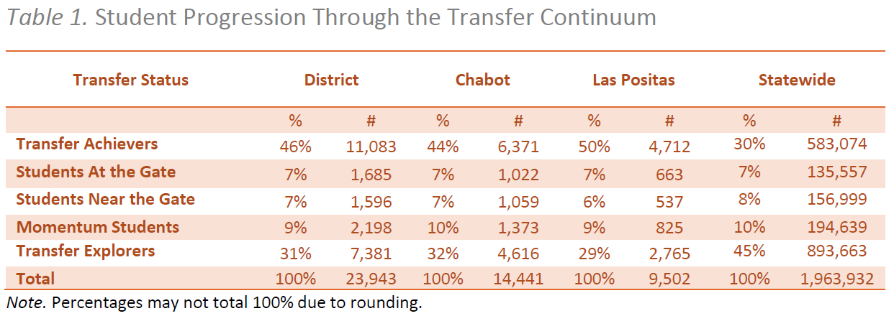
Source: The RP Group

Slide 11
Subset of Through the Gate Data
New first-time college students at LPC who went on to transfer
4,712 students to 3,160 students
Produced statistics
Years to Transfer
Cumulative Transferable Units Earned
Transfer Universities

Slide 12
Switch to Excel

Slide 13
Student Transfer Capacity-Building Framework

Slide 14
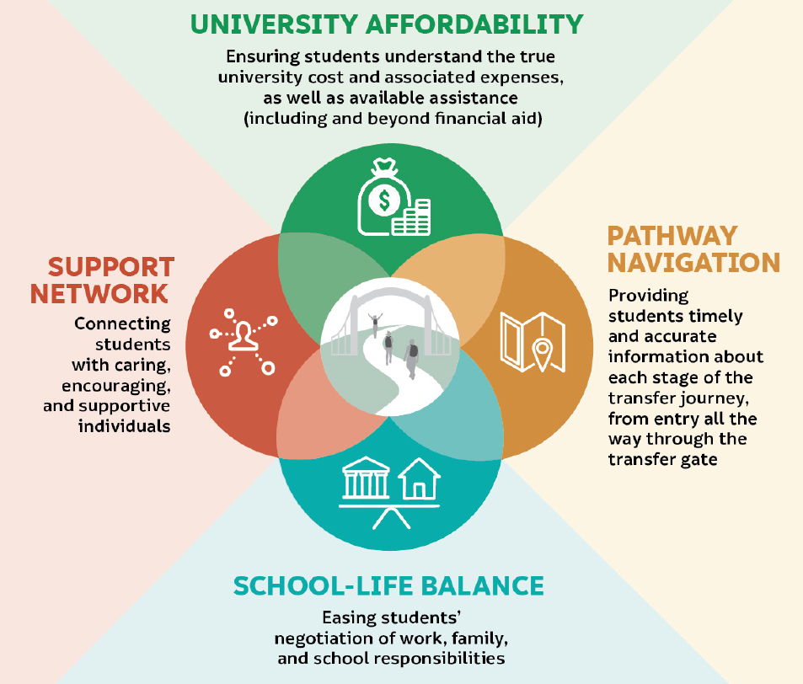
Student Transfer Capacity-Building Framework
Source: The RP Group
Notes:
In spring 2021, the RP Group surveyed nearly 8,000 “high-leverage” students attending California Community Colleges (CCC) — those who were close to transfer but had not yet made it to university — exploring the near-term impact of the COVID-19 pandemic on their transfer experience
Participants: 7,894 students who had completed at least 45 transferable units as of fall 2020.

Slide 15
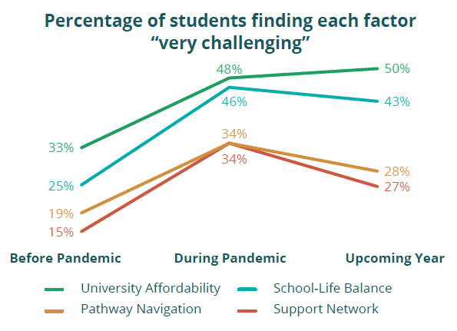
Student Transfer Capacity-Building Framework.
Source: The RP Group

